Slide 1

Amazon S3: Simple Storage Service
A complete guide to mastering cloud object storage for IT professionals and cloud beginners

Slide 2

What is Amazon S3?
Amazon Simple Storage Service (S3) is AWS's flagship object storage solution, providing virtually unlimited, highly durable storage accessible from anywhere on the internet. Think of it as a massive, secure vault in the cloud where you can store any type of data—from photos and videos to application backups and big data analytics files.
S3 delivers 99.999999999% (11 nines) durability, meaning your data is incredibly safe. It's designed to scale automatically, so you never worry about running out of space.

Slide 3
Why S3 Matters in Cloud Computing
Infinite Scalability
Industry Standard
Cost Effective
Store from gigabytes to petabytes without infrastructure planning. S3 automatically scales to meet your needs.
S3 is the foundation for countless cloud applications and services, making it essential knowledge for any cloud professional.
Pay only for what you use with no upfront costs. Multiple storage classes optimize costs for different access patterns.

Slide 4
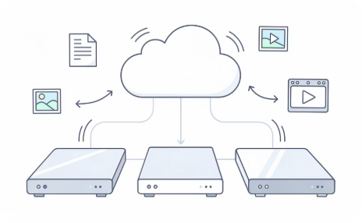

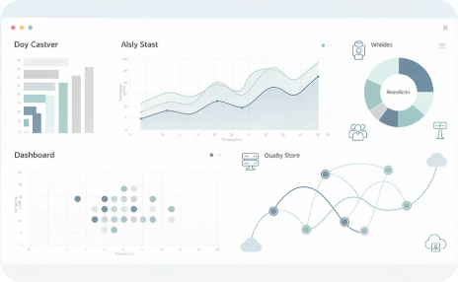

Real-World S3 Use Cases
Backup & Disaster Recovery
Static Website Hosting
Data Lakes & Analytics
Media Storage & Delivery
Organizations store critical backups in S3, ensuring business continuity. Versioning protects against accidental deletions.
Host entire websites directly from S3 buckets. Perfect for portfolios, documentation sites, and landing pages.
Store massive datasets for analysis with services like Amazon Athena, enabling SQL queries on data without servers.
Netflix and Spotify use S3-like storage for streaming content to millions of users globally with low latency.

Slide 5
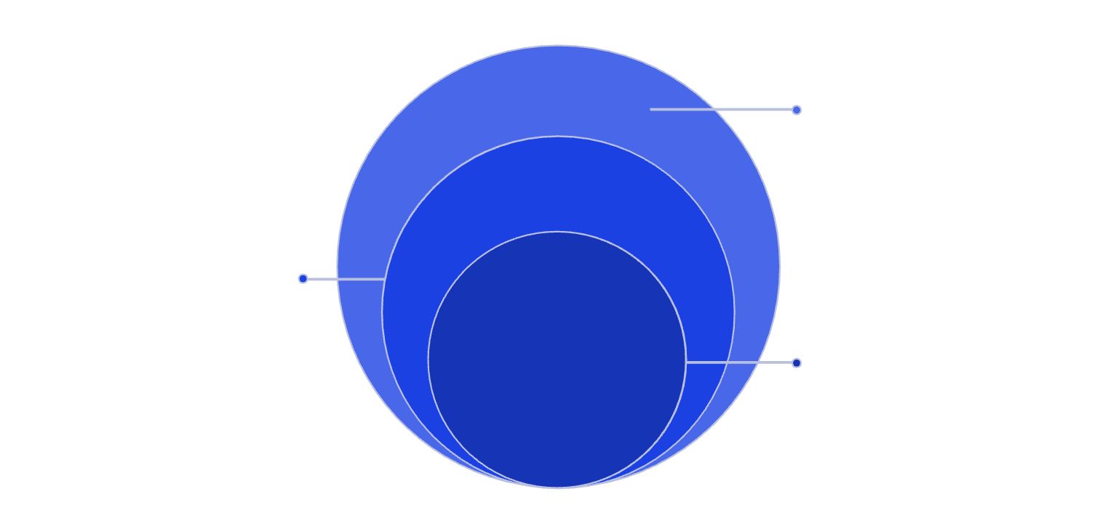
Core S3 Concepts You Must Know
Buckets
Top-level containers with globally unique names. Each bucket exists in a specific AWS region you choose.
Object
Stored item with a unique key identifier
Objects
The actual files you store, ranging from 0 bytes to 5 TB. Each object includes data, metadata, and a unique identifier.
Bucket
Top-level container with unique global name
AWS Account
Object Keys
Holds buckets and defines access boundaries
The full path and filename (e.g., docs/2024/report.pdf). Keys can simulate folder structures using slashes.
Understanding the fundamental building blocks of S3 is crucial for effective use and troubleshooting.
Regions
Geographic locations where your bucket physically resides. Choose regions close to users for lower latency.

Slide 6
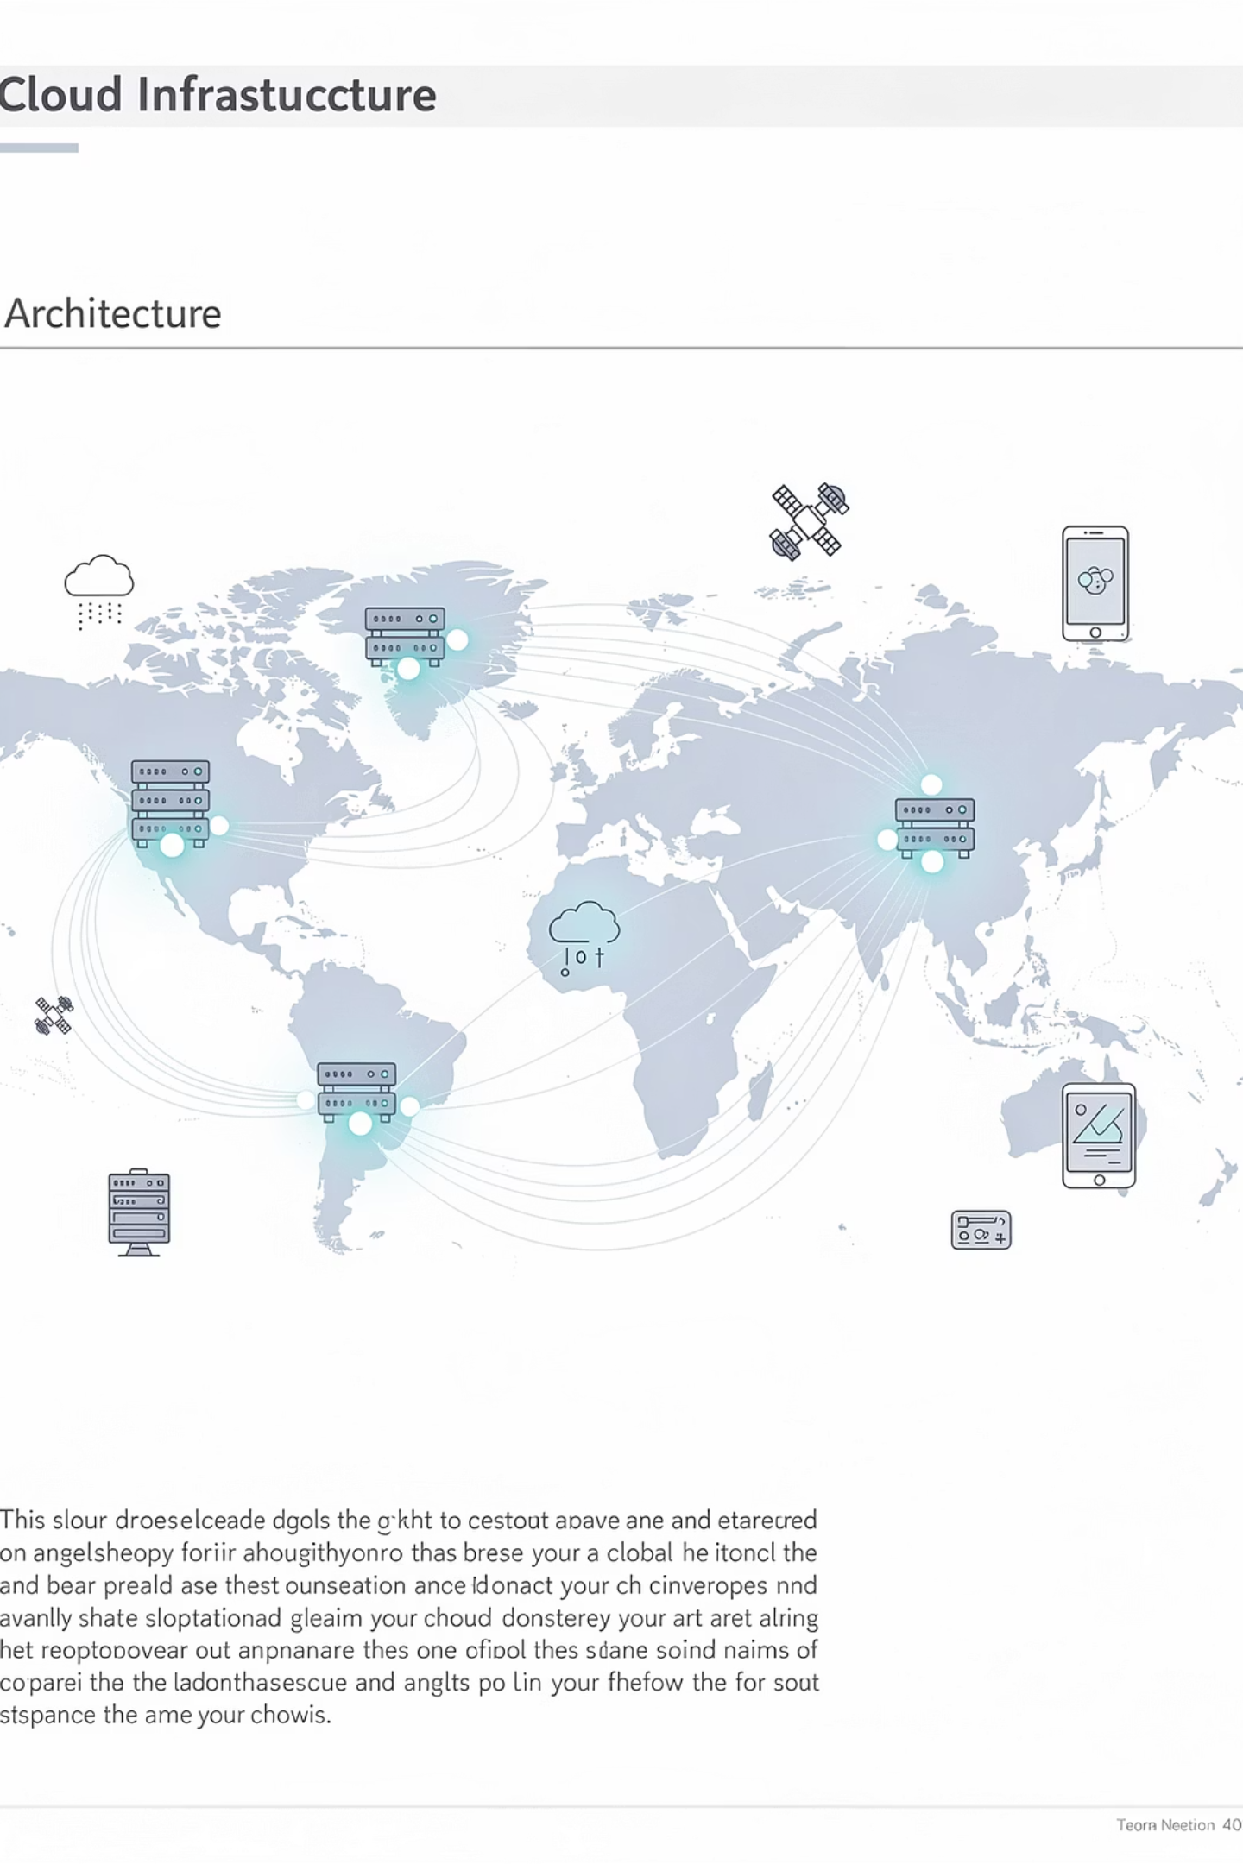
S3 Architecture: How It Actually Works
S3 is built on a massively distributed architecture that automatically replicates your data across multiple facilities within a region. When you upload an object, S3 stores multiple copies across different physical devices in separate data centers. This redundancy is invisible to you but critical for achieving 11 nines of durability.
99.99%
11
3+
Availability SLA
Nines of Durability
Availability Zones
Standard storage class uptime guarantee
99.999999999% data protection
Data automatically replicated across facilities

Slide 7
S3 Storage Classes Explained
Choose the right storage class based on access frequency and performance needs to optimize costs.
S3 Standard
1
Frequently accessed data. Millisecond latency. Use for active workloads and content distribution.
2
S3 Intelligent-Tiering
Automatic cost optimization. Moves objects between tiers based on access patterns. No retrieval fees.
S3 Standard-IA
3
Infrequent access, but rapid retrieval when needed. 50% cheaper than Standard. Ideal for backups.
4
S3 Glacier
Long-term archive. Retrieval in minutes to hours. 70% cheaper for data accessed once or twice per year.
S3 Glacier Deep Archive
5
Lowest cost storage. Retrieval within 12 hours. Perfect for compliance archives retained for 7-10 years.

Slide 8
Securing Your S3 Buckets
Security is Multi-Layered
Security Best Practices
S3 provides multiple security mechanisms that work together to protect your data. Understanding when to use each is critical for passing certification exams and building secure applications.
Always enable Block Public Access unless you specifically need public buckets
Use IAM policies for user permissions, bucket policies for resource-based access
Enable encryption at rest (SSE-S3 is free and automatic)
Enable versioning to protect against accidental deletions
Turn on CloudTrail logging to monitor access
Default behavior: All new buckets are private. You must explicitly grant access. Block Public Access is enabled by default as an additional safety net.

Slide 9




Data Management & Lifecycle Automation
Upload to S3 Standard
30 Days: Move to Standard-IA
Objects start in Standard storage class for frequent access
Lifecycle rule transitions to Infrequent Access after one month
90 Days: Archive to Glacier
365 Days: Delete
Automated archival for long-term retention at lowest cost
Automatically remove objects after one year to save costs
Lifecycle policies automate storage management, reducing costs without manual intervention. Set rules once and S3 handles transitions automatically.

Slide 10

Hands-On Practice & Next Steps
Lab Exercises to Complete
01
Create Your First Bucket
Practice bucket naming, region selection, and initial configuration in the AWS Console
02
Upload & Organize Objects
Upload files, create folder structures, and explore object metadata and properties
03
Configure Security
Apply bucket policies, enable encryption, and test Block Public Access settings
04
Set Lifecycle Rules
Create automated transitions between storage classes and expiration policies
05
Enable Versioning
Turn on versioning and practice recovering previous object versions

