Slide 1


CMR ENGINEERING COLLEGE
(UGC AUTONOMOUS)
(Accredited by NBA,Approved by AICTE NEW DELHI, Affiliated to JNTU, Hyderabad)
Kandlakoya, Medchal Road, Hyderabad-501 401.
Department of Computer Science & Engineering
A Mini Project
On
WINE QUALITY PREDICTION USING
MANCHINE LEARNINIG
Presented By
Vikas Seervi
M.Deepika
M.Sai Teja
T.Venkatesh
Internal Guide:-
Mr. U.Mahender, Assistant Professor,
Dept. of CSE.
: (218R1A05C8)
: (218R1A0595)
: (218R1A0596)
: (218R1A05C5)
A.Y 2024-2025

Slide 2
Abstract
This project leverages machine learning to predict wine quality based on chemical properties. Using a dataset of wine samples, we evaluate several algorithms, including Decision Trees, and Random Forests. After preprocessing the data, we assess model performance using metrics like accuracy and mean squared error. Our results show that Random Forests provide the highest prediction accuracy, demonstrating the potential of machine learning to offer objective and reliable wine quality assessments.

Slide 3
Table of Content
Abstract
Introduction about Project
Literature survey
Existing System
Proposed System (Project Scope, Objectives, Modules)
Software Requirement Specification
Hardware Requirements
System Architecture
System Design
Output Screen
Conclusion
Future Enhancement
References/Bibliography

Slide 4
Introduction
Wine, derived from fermented grape and fruit juices, features a moderate alcohol content. Quality evaluation centers on taste and vintage, yet this process is labor-intensive, costly, and inefficient. Key parameters such as acidity levels, sugar content, sulfur dioxide, density, pH balance, sulphates, and alcohol define the composition and quality of wine.
Machine learning techniques are applied to predict wine quality by analyzing chemical properties from a dataset. Algorithms such as Decision Trees and Random Forests are evaluated, and their performance is assessed using metrics like accuracy. The findings reveal that Random Forests demonstrate the highest prediction accuracy

Slide 5
Literature Survey
S NO | Paper Title | Journal / conference | Year Published | Abstract | Methodologies/Technologies | Conclusion
1 | Red Wine Quality Prediction | Conference | 2023 | It deals with the quality prediction of the red wine using its various attribute | Navie Bayes, Support vector machine, Random forest.. | The training dataset contains about 70% of the data from the original data set, thus result demonstrate the support vector as the best algorithm
2 | Enhancing red wine quality prediction through Machine Learning approaches with Hyperparameters optimization technique | Conference | 2023 | Predicting red wine quality is challenging due to the complex winemaking process and numerous influencing factors. | Support Vector Classifier, Decision Tree, Random Forest, Gradient Boosting, Logistic Regression | In conclusion, enhancing red wine quality prediction using machine learning has significant applications in the wine industry. This study found Gradient Boosting to be highly accurate among various algorithms tested.

Slide 6
3 | A prediction Model for Quality of Through Explainable Artifical Intelligence | Conference | 2022 | In the complexity and low efficiency of the wine quality prediction process, It compares the accuracy of 7 different AI classification and Objective quality of wine, and find out accurate sensitivity and used to analyse the good classification performance. | Navie Bayes, Logistic regression, Random forest, Decision tree. | This paper uses the random forest algorithm and the ‘Boruta’ package to select important features from the ‘Chronic Kidney Disease’ dataset. It evaluates the algorithm's performance in classification and regression. The study suggests its applicability for datasets with many variables.
4 | Application of Random Forest Algorithm on Feature Subset Selection and Classification and Regression | Conference | 2017 | Feature subset selection is crucial for data sets with many variables, as it improves prediction performance and understanding of the data | Random forest, Regression. | This paper applies the random forest algorithm to the ‘Chronic Kidney Disease’ data from the UCI repository, using the ‘Boruta’ package for feature subset selection. It demonstrates the algorithm's effectiveness in classification and regression .
5 | A Machine learning and its applications | Conference | 2017 | Given the abundance of data, it is crucial to analyze it to extract useful information and develop algorithms. This can be done through data mining and machine learning, which designs algorithms based on data trends and historical relationships. | Random forest , regression | We have discussed the role of machine learning in different fields such as image deconvolution, students retention, detection of oil spills, land cover changes, and some of the other applications.

Slide 7
Existing System
Traditional wine quality assessment relies on human tasters, whose evaluations can be subjective and inconsistent. While chemical analysis provides objective measures of attributes like acidity and alcohol content, it still requires expert interpretation.
Current computational methods are limited and do not fully leverage advanced machine learning algorithms, highlighting the need for more accurate and efficient predictive models

Slide 8
Proposed System
The proposed system leverages machine learning to predict wine quality using chemical properties, offering a more objective and scalable approach. Data is collected, preprocessed, and split into training and testing sets. Key chemical attributes are selected, and models like Linear Regression, Decision Trees, Random Forests, and Support Vector Machines are evaluated.
Model performance is optimized with metrics like MSE, R², accuracy, and F1-score. The best model is deployed for practical use, allowing winemakers to input chemical properties for objective quality predictions, seamlessly integrating with existing processes for real-time assessments.

Slide 9
Modules
Data Collection and Preprocessing:
Gathering a comprehensive dataset and Handling missing values.
Model Development:
Model development involves selecting machine learning algorithms suitable for predicting wine quality based on dataset characteristics, followed by training these models on a split dataset and validating their performance.
Deployment and Integration:
Integrating the trained model into a production environment where it can make predictions based on new data inputs.

Slide 10
Software Requirements
Programming Technology | PYTHON
Web Technologies | HTML, JavaScript,CSS
IDE | Visual Studio Code,PyCharm
Operating System | Windows 8/10/11

Slide 11
Hardware Requirements
Processor | Dual Core/I3/I5/I7/ Ryzen 7
RAM | 8GB
Hard Disk | 256 GB SSD or above

Slide 12
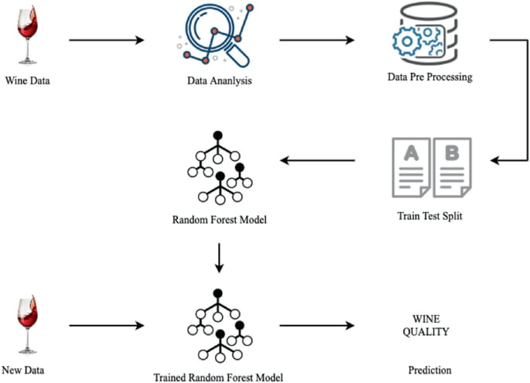
System Architecture

Slide 13
SYSTEM DESIGN

Slide 14
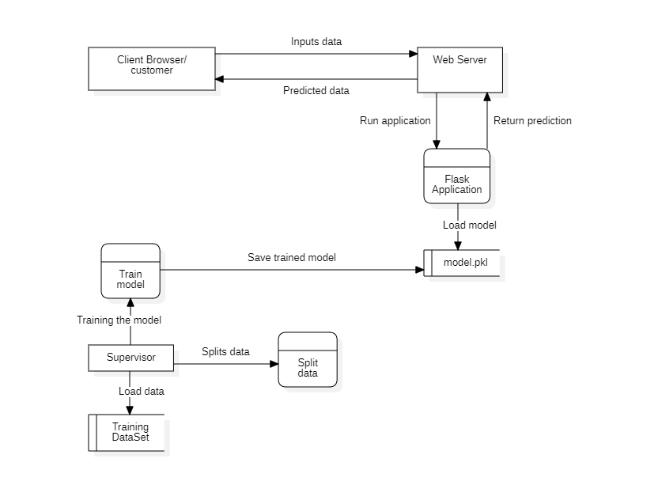
Data Flow Diagram

Slide 15
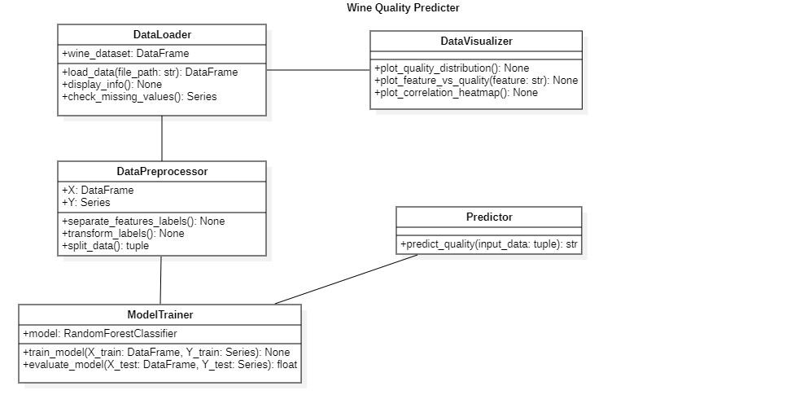
Class Diagram

Slide 16
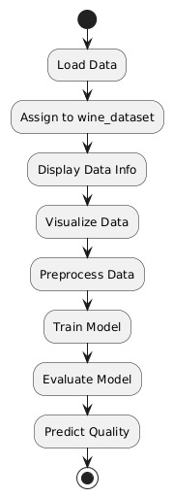
Activity Diagram

Slide 17
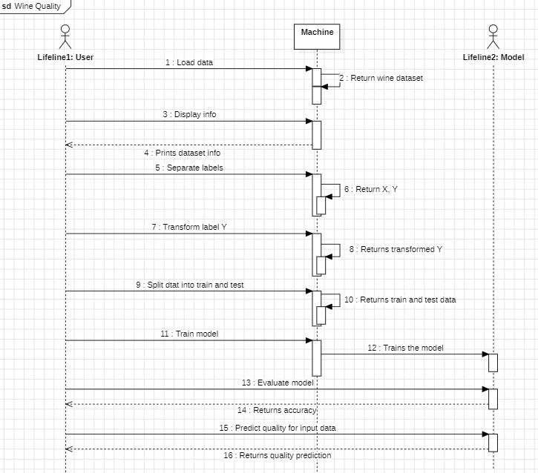
Sequence Diagram

Slide 18
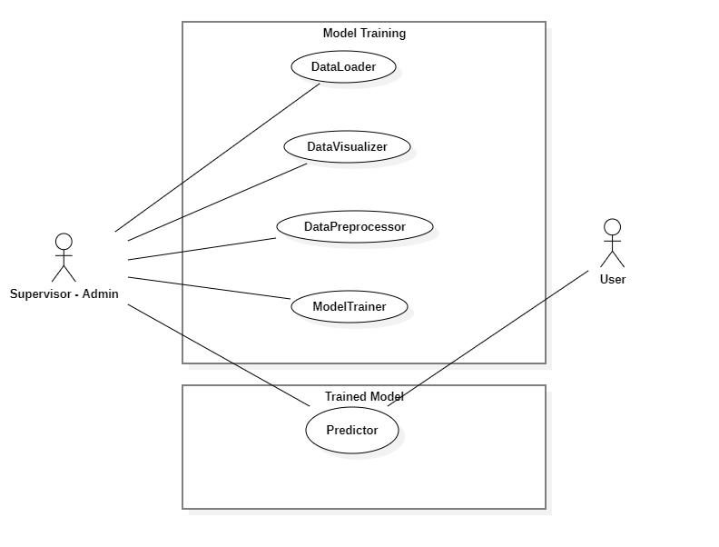
Use Case Diagram

Slide 19
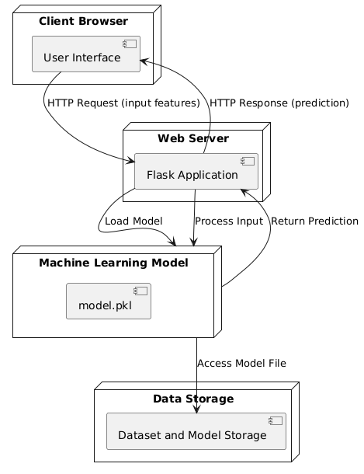
Deployment Diagram

Slide 20
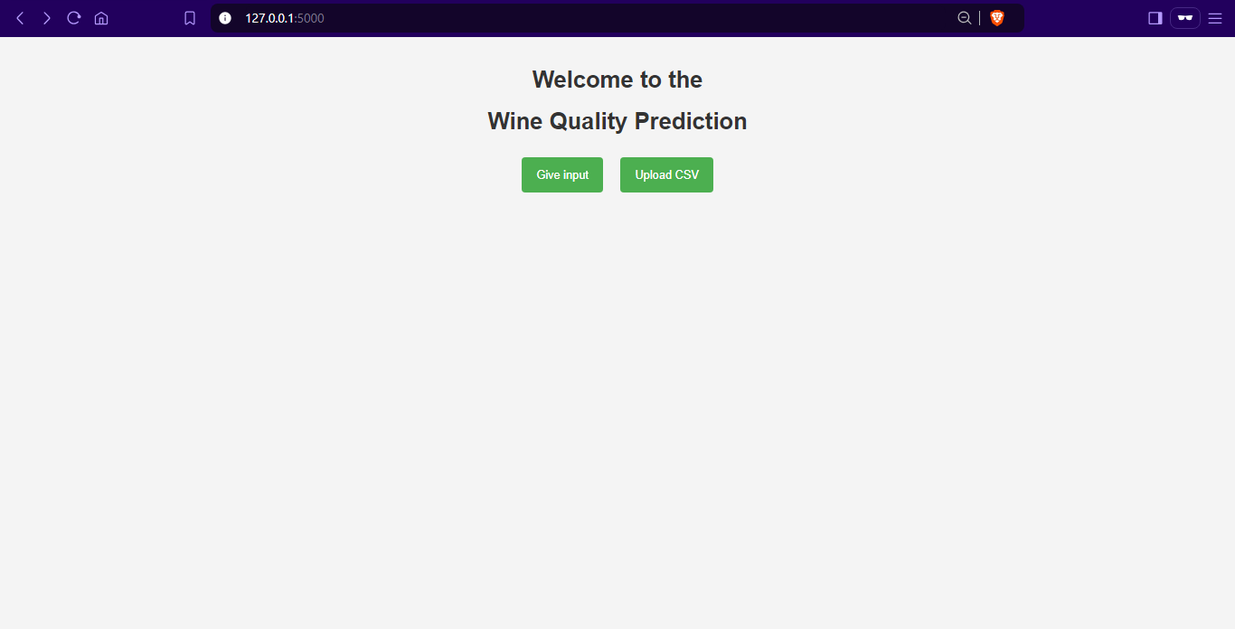
Output Screen

Slide 21
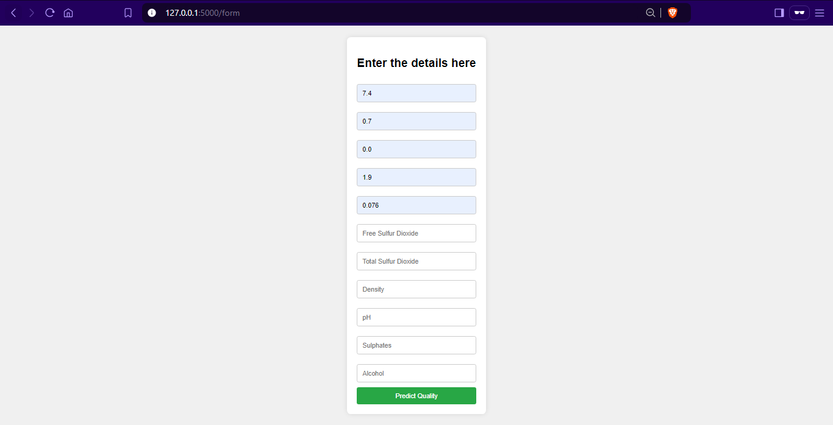

Slide 22
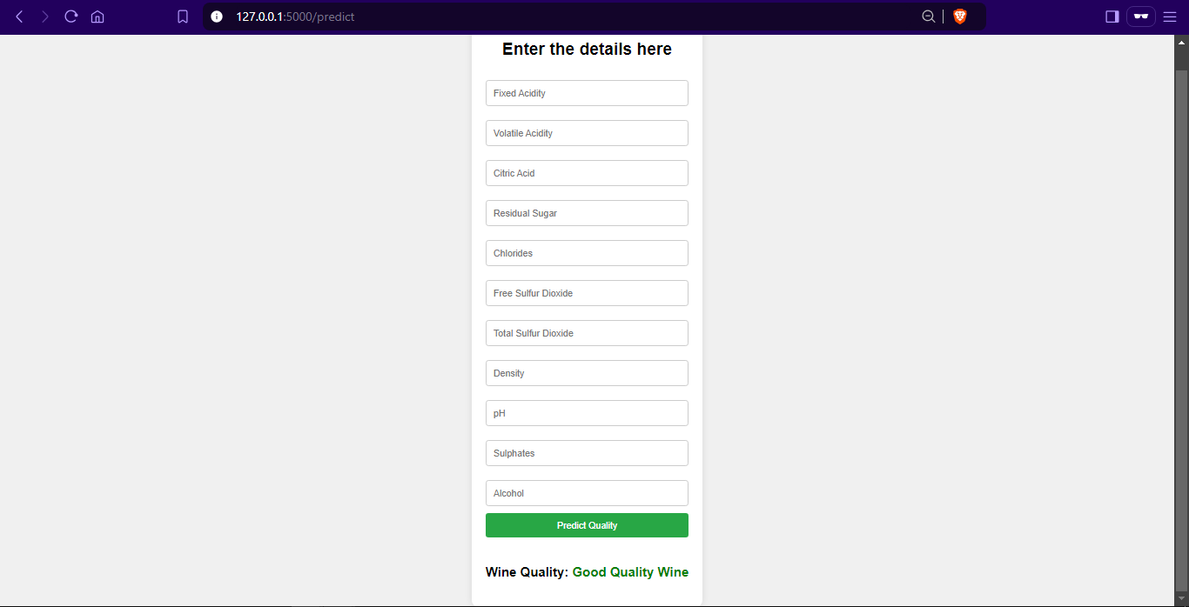

Slide 23
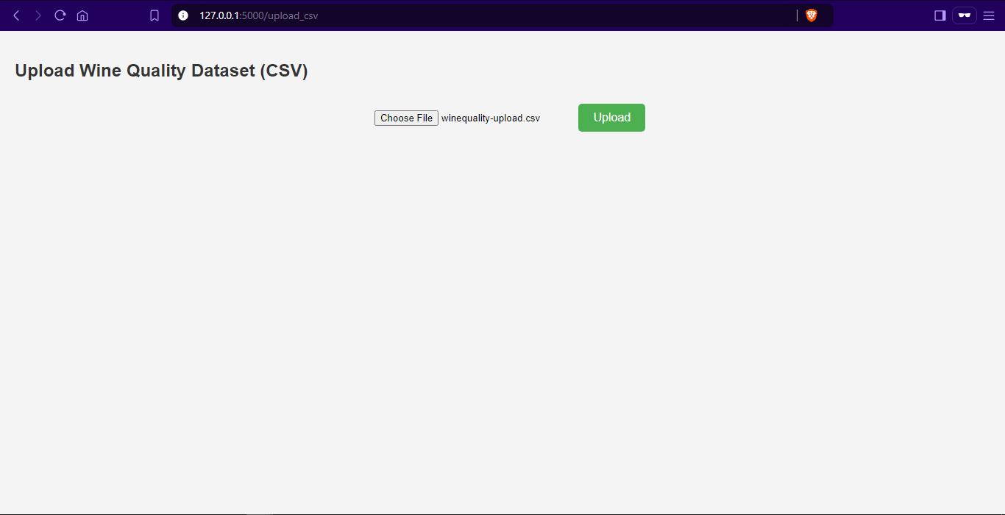

Slide 24
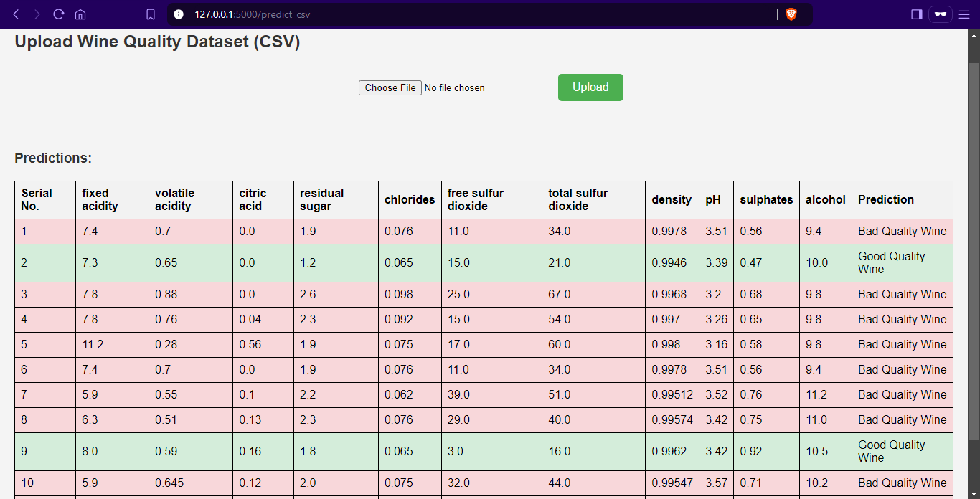

Slide 25
Conclusion
In conclusion, our study demonstrates that machine learning can effectively predict wine quality based on physicochemical properties, with the Random Forest model showing the highest accuracy. Key features influencing quality include alcohol content, volatile acidity, and sulphates. These insights can guide winemakers in optimizing production processes and help consumers make informed purchasing decisions.

Slide 26
Future Enhancement
Leveraging larger and more diverse datasets, encompassing global wine varieties, vintages, and winemaking methods, could significantly improve the model’s accuracy and generalizability.
Integrating AI-driven insights to analyze how each feature impacts wine quality predictions would enhance the model's interpretability, providing users with a clearer understanding of why a particular quality score was given.
Additionally, incorporating visualizations of feature importance could further enrich the user experience, allowing users to visually explore the factors influencing wine quality and deepening their engagement with the predictions.

Slide 27
Reference/Bibliography
A Machine Learning Based Approach for Wine Quality Prediction: https://ieeexplore.ieee.org/document/9908870
Enhancing red wine quality prediction through Machine Learning approaches with Hyperparameters optimization technique: https://ieeexplore.ieee.org/document/10157719
Machine learning and its applications: A review: https://ieeexplore.ieee.org/document/8070809
Application of Random Forest Algorithm on Feature Subset Selection and Classification and Regression: https://ieeexplore.ieee.org/document/8074494
A Prediction Model for Quality of Red Wine through Explainable Artificial Intelligence: https://ieeexplore.ieee.org/document/9916008
A Machine Learning Based Approach for Wine Quality Prediction : https://ieeexplore.ieee.org/document/9908870

Slide 28


