Slide 1

Online Bus Booking System
Prepared By,
Vikas Landge - 140099
Paurnima Salve - 140096
Shubham Kadam -140094

Slide 2
Introduction
The Online Bus Ticket Reservation System is a web-based application that allows visitors check bus ticket availability, book bus ticket and pay for the ticket. This Online Bus Reservation System provides bus transportation system, a facility to reserve seats, cancellation of seats and different types of enquiry which need an instant and quick reservation. This system can be used by the users in performing online reservation via internet for their all business and personal purposes.
Online Bus Ticket Booking System provides service to the large number of audience who intended to travel from one city to another.

Slide 3
Objectives
Online bus ticket booking system is web based system, accessible any time and from the internet.
Customer can check bus provider’s popularity and prices to select comfortable bus to begin journey.
To make sure that bus or ticket is free and available on the date selected for particular route.
Offers will be applicable for new user.

Slide 4
Software Requirements
Languages | C#, Asp .NET MVC
Web Technologies | HTML, CSS, JavaScript, JQuery, Ajax, Bootstrap, Web-Services
Operating System | Windows 7
Database | SQL Server Management Studio
Browser | Google Chrome
IDE | Visual Studio 2017

Slide 5
Database Design

Slide 6
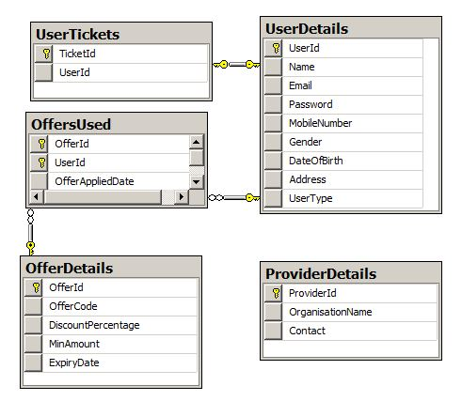
Application-Side Database

Slide 7
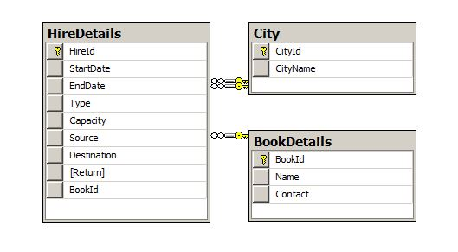
Bus-Hire Database

Slide 8
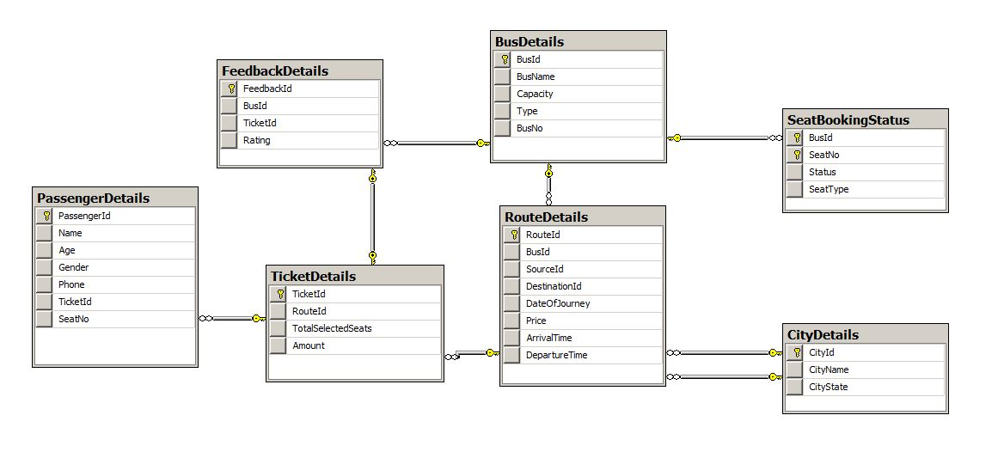
Web-Service Database

Slide 9
Web-Service Working
A web service is any piece of software that makes itself available over the internet and uses a standardized XML messaging system.
All web services works using the following components −
SOAP (Simple Object Access Protocol)
UDDI (Universal Description, Discovery and Integration)
WSDL (Web Services Description Language)
A web service takes the help of −
XML to tag the data
SOAP to transfer a message
WSDL to describe the availability of service.

Slide 10
Web-Service Working
We are providing the web services for bus providers.
Bus provider have to create there own web service with all the details like Bus details, Route details, City details, etc.
We had created procedures to perform core operations on application.
Consuming web service to application with the help of XML, SOAP, WSDL, etc.
Use that different web services of different bus providers with system to perform operations throughout the application.

Slide 11
UML DIAGRAMS

Slide 12
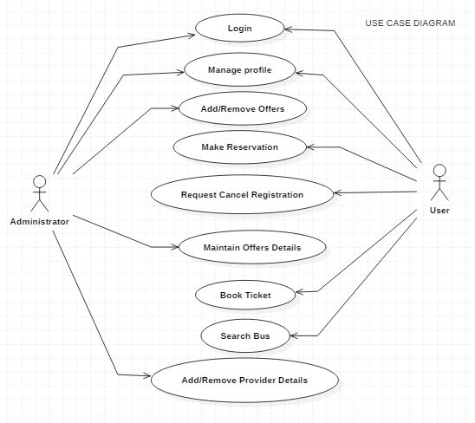
Use-Case Diagram

Slide 13
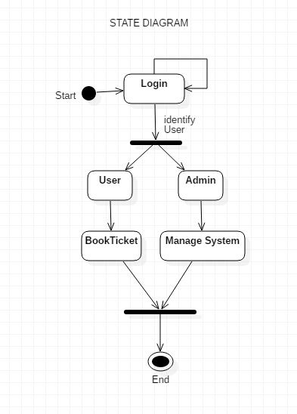
StateChart Diagram

Slide 14
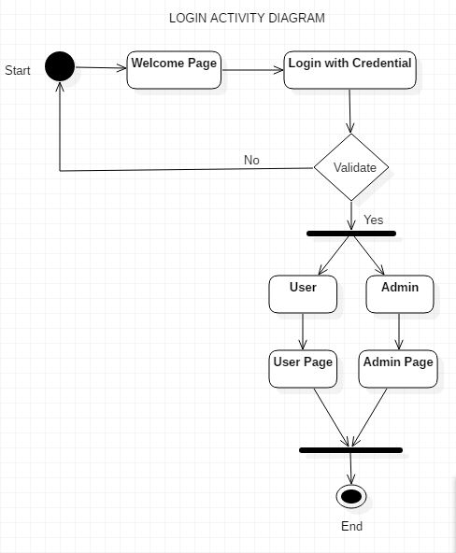
Login-Activity Diagram

Slide 15
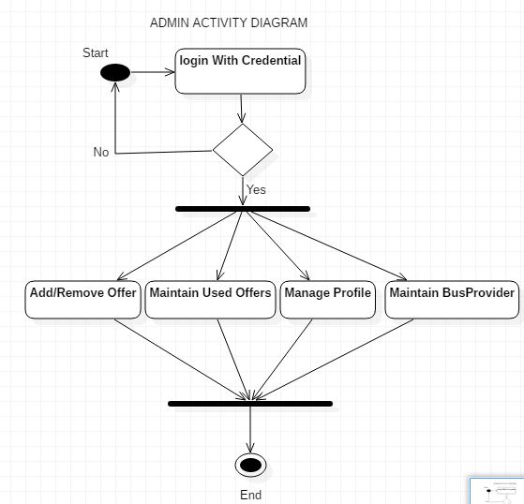
Administrator-Activity Diagram

Slide 16
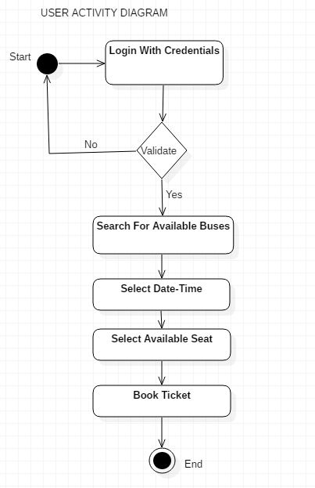
User-Activity Diagram

Slide 17
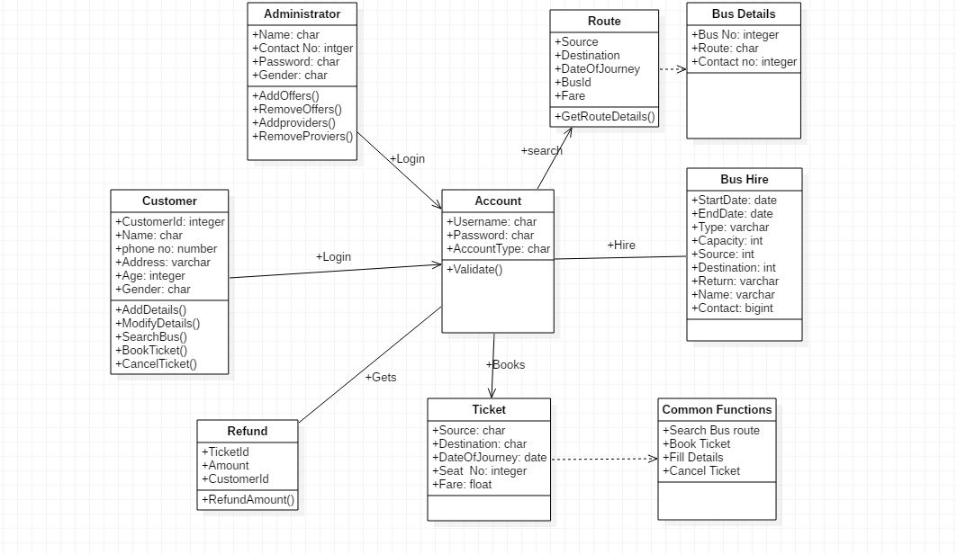
Class Diagram

Slide 18
Project Screenshots

Slide 19
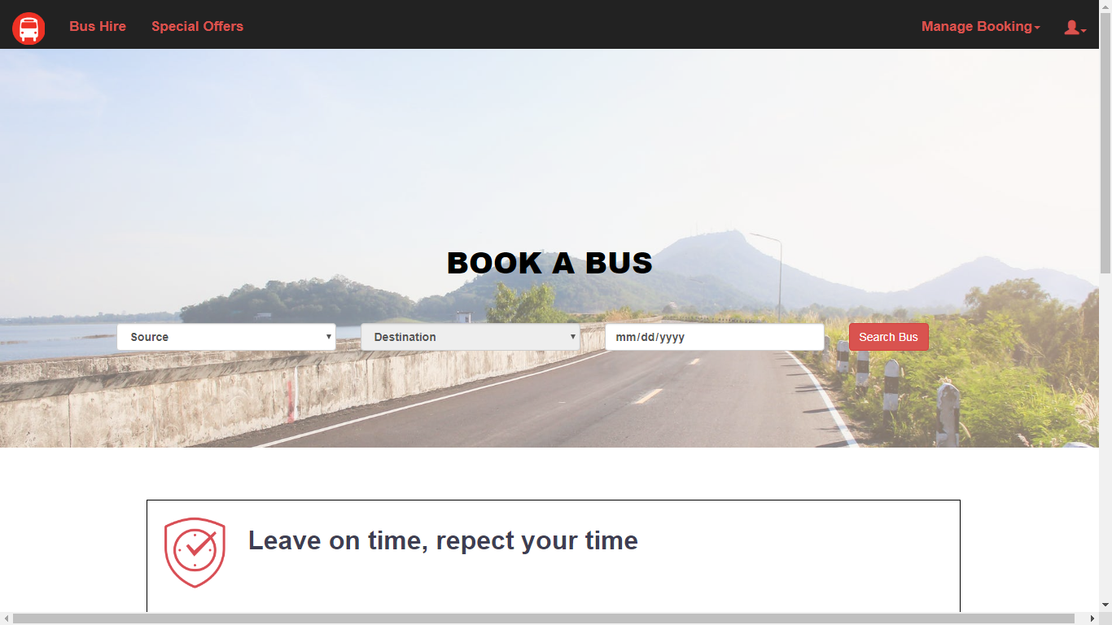
Homepage

Slide 20
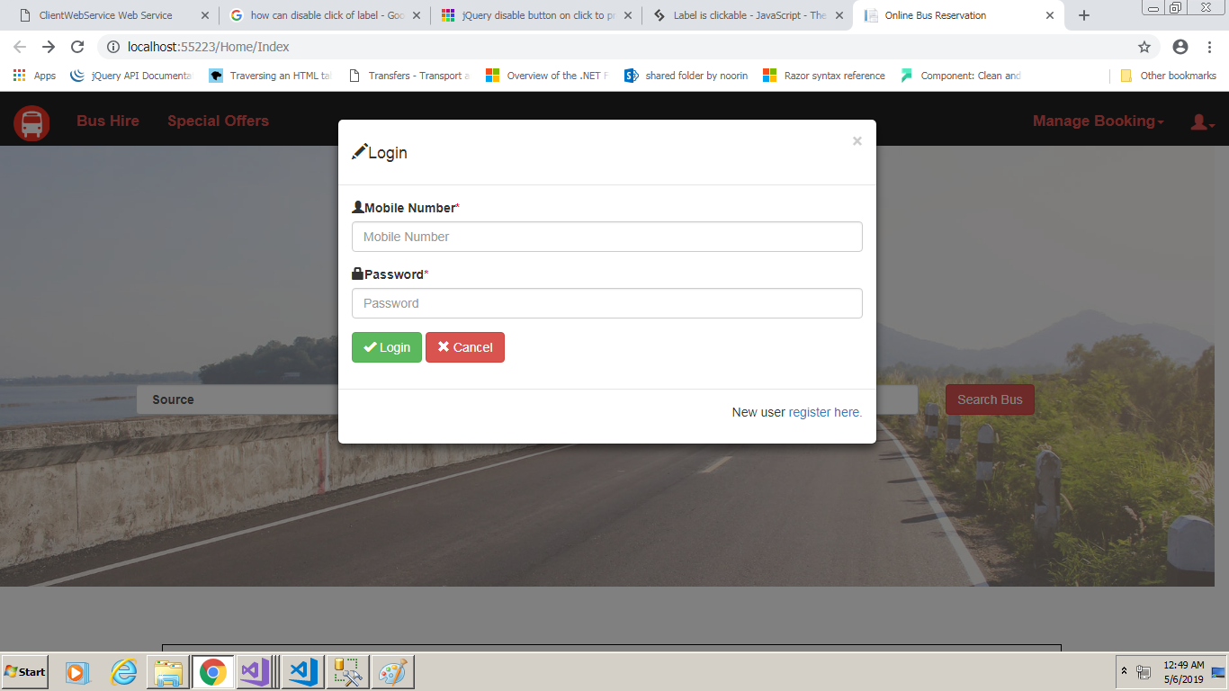
Login Page

Slide 21
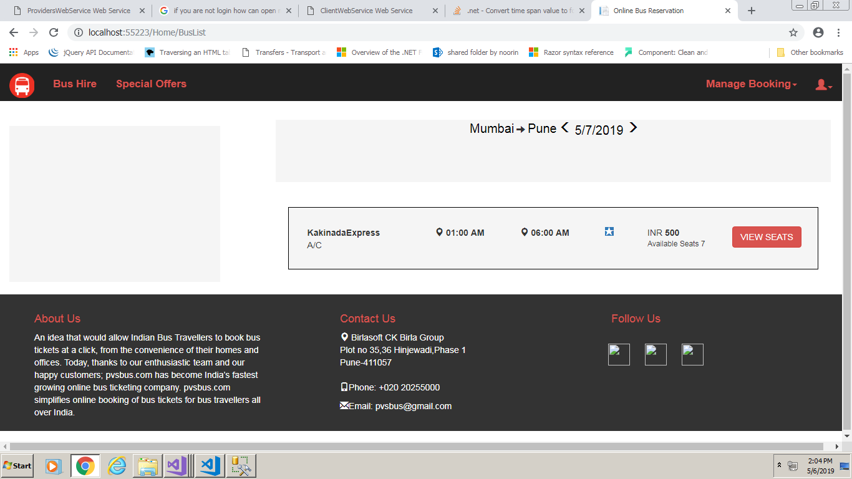
Search Bus

Slide 22
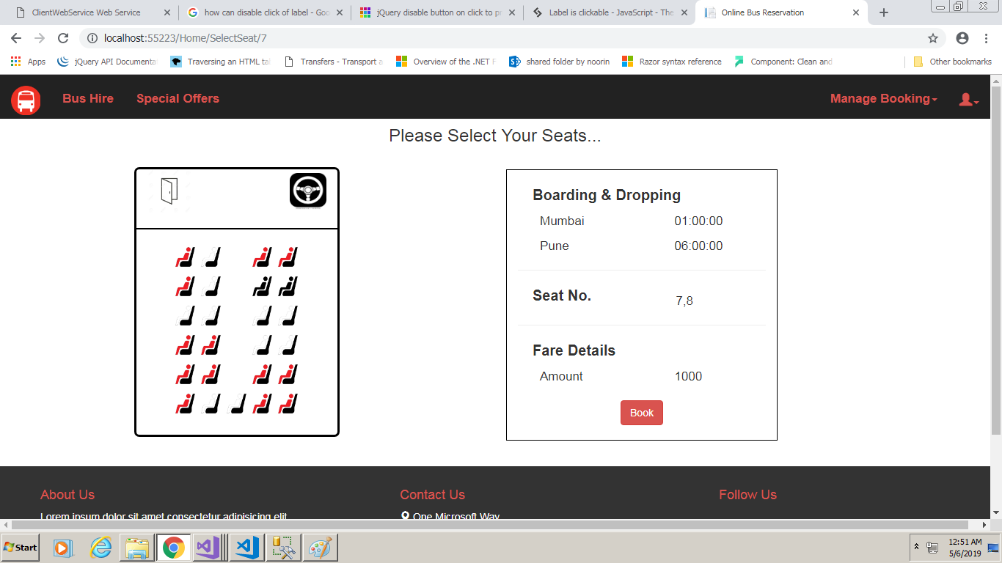
Seats Booking

Slide 23
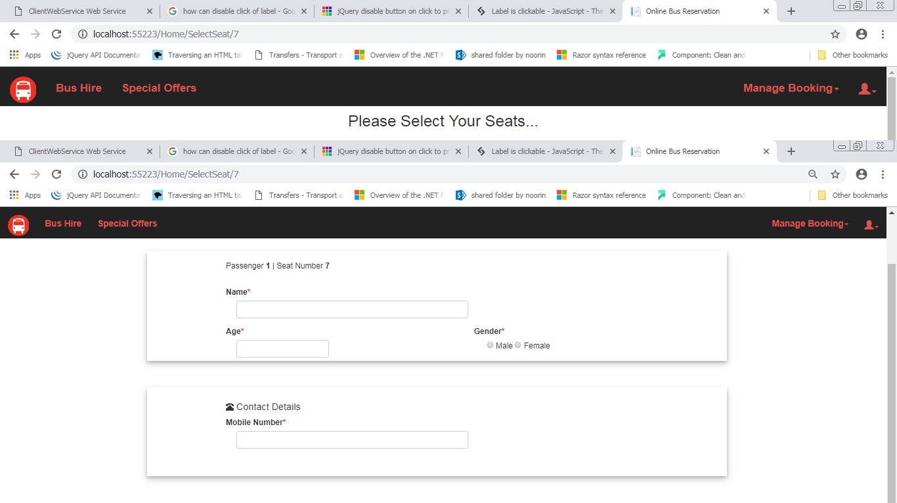
Passengers depend on number of seats

Slide 24
Any Questions…?

Slide 25
Thank You…!!!

