Slide 1
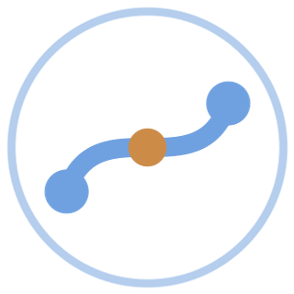
AURA
ASSET UNIFIED REASONING AGENT · PROBLEM 08
The Unified Asset &
Operations Brain
AI that connects the knowledge scattered across your plant — and surfaces what no single team can see.
Working prototype · Knowledge graph · Cited RAG · Agentic compliance
Presented by Vikas Yadav · Team Viktory
Notes:
Open with the product name and the one-line promise: AURA connects the knowledge scattered across a plant and surfaces what no single team can see. Mention this is a working prototype, not a mockup.

Slide 2
THE PROBLEM
Knowledge is everywhere. Insight is nowhere.
35%
18–22%
25%
of an engineer's working hours lost searching for, clarifying, or recreating documents that already exist.
of unplanned downtime in Indian heavy industry traced to knowledge fragmentation.
of India's experienced engineers retire within a decade — taking undocumented know-how with them.
McKinsey global survey, 2024
BIS Research
NASSCOM–EY study
A single plant runs across 7–12 disconnected systems. The knowledge exists. The connections don't.
AURA
02
Notes:
Land each number with a pause. The point at the bottom is the thesis: this is a connection problem, not a storage problem.

Slide 3



WHY IT MATTERS
Not a filing problem. A safety, quality & efficiency problem.
Safety
Quality & Compliance
Efficiency
Maintenance and operating decisions get made without complete equipment history or failure context — until something leaks, trips, or burns.
Required investigations and evidence sit scattered across systems. Gaps surface during an audit, not before.
The same failures repeat, the same questions get re-answered, and unplanned downtime compounds over time.
It compounds over time — and whoever solves it first gains a structural advantage in how they operate, maintain, and improve their assets.
AURA
03
Notes:
Three consequences. Keep it tight — these set up why the example on the next slide matters.

Slide 4
A REAL EXAMPLE
One pump. Three failures. Five systems. Zero connections.
MAR 2024
JUL 2024
NOV 2024
DEC 2024
Seal fails
Seal fails again
Seal fails — 7.1 mm/s
Fire near-miss
CMMS
Vibration
OEM Manual
Email
Compliance
3 work orders — each closed as an isolated repair
2× signature — textbook misalignment
misalignment = #1 cause of repeat failure
two engineers diagnosed it — no work order raised
required root-cause analysis never done
Every clue existed — in a different system. No single person ever connected them. That is the knowledge cliff, and it is expensive.
AURA
04
Notes:
This is the heart of the pitch. Walk the timeline, then the scattered clues, then the punchline. This is the exact scenario the live demo solves.

Slide 5

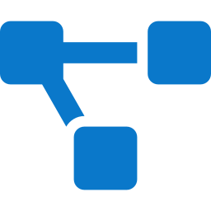


THE SOLUTION
Meet AURA — unified reasoning across every asset.
AURA ingests every document type, connects them into one self-updating knowledge graph, and answers any question with cited, confidence-scored intelligence — on any device.
Ingest anything
Connect everything
Answer with citations
Act with agents
PDFs, P&IDs, scanned forms, spreadsheets, email — structured and unstructured.
A knowledge graph linking assets, failures, procedures, regulations and people.
A RAG copilot that cites its sources and shows its confidence on every reply.
Purpose-built agents for root-cause, compliance gaps and lessons learned.
AURA
05
Notes:
Four capabilities, left to right = the pipeline. This previews the architecture and the demo.

Slide 6
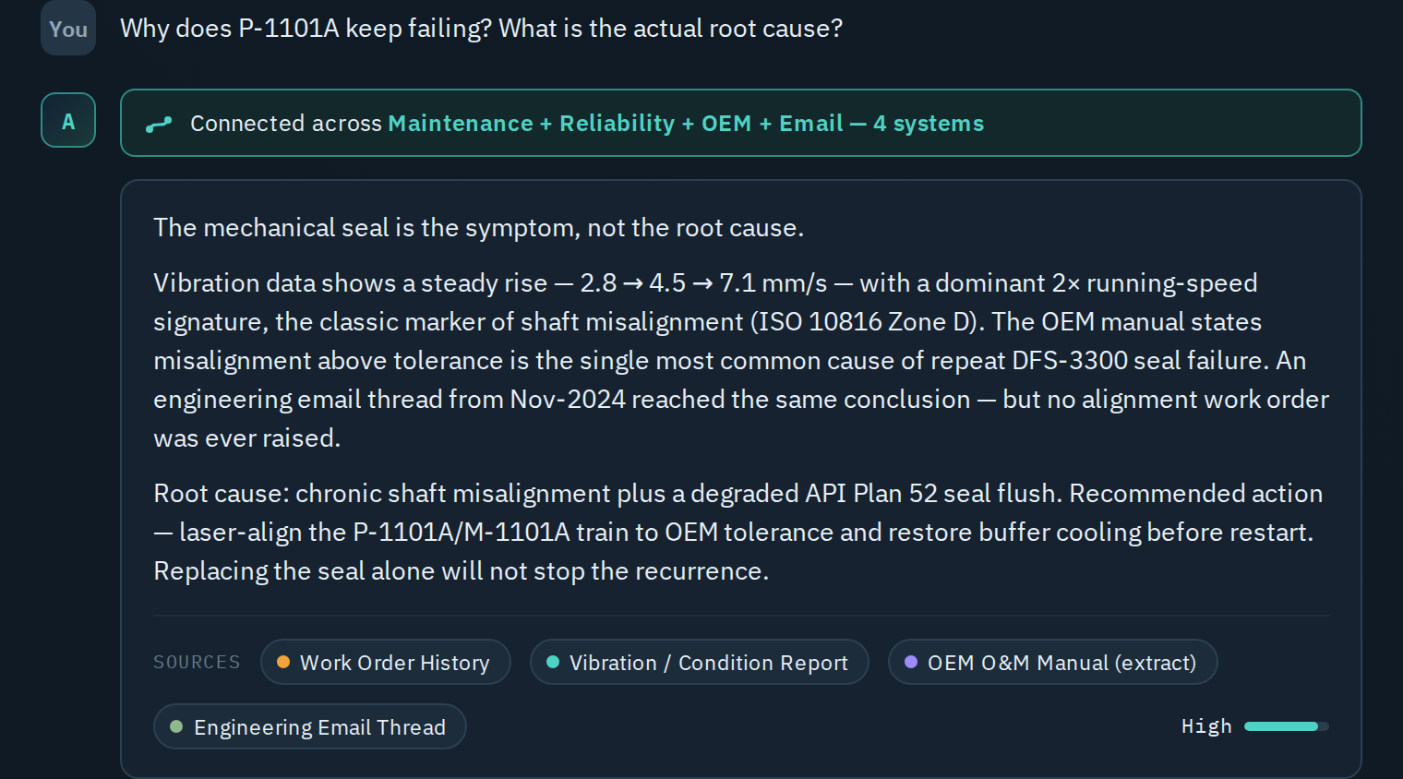
LIVE DEMO
Ask why it keeps failing. Get the answer in 3 seconds.
Connects 4 systems
maintenance, reliability, OEM and email — automatically
Names the real root cause
misalignment, not the seal it kept replacing
Cites every claim
each source is one tap from the answer
Shows its confidence
trustworthy, not a black box
AURA
06
Notes:
THE money moment. Switch the prototype to Demo mode before recording so it is instant. Click the Q2 chip, then read the connected-across banner aloud. Linger here.

Slide 7
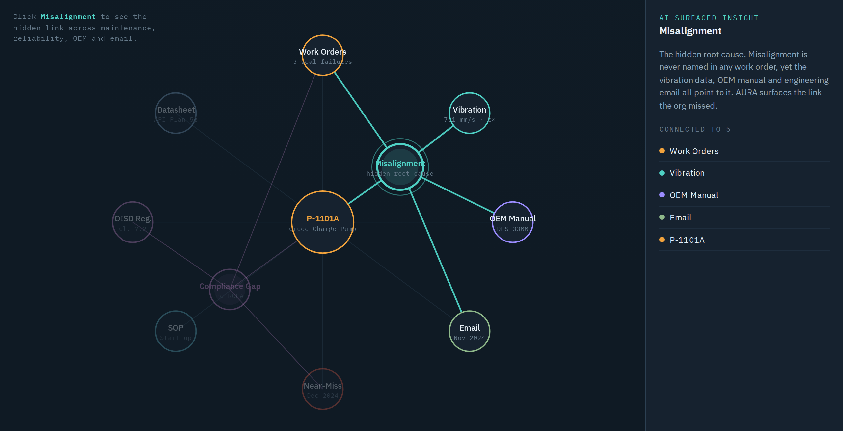
THE KNOWLEDGE GRAPH
The link the organisation missed — made visible.
AURA
07
Select the hidden root cause and watch it light up the four systems that each held one piece of the puzzle.
Notes:
Click the Misalignment node live. This is your most memorable visual — let it breathe.

Slide 8
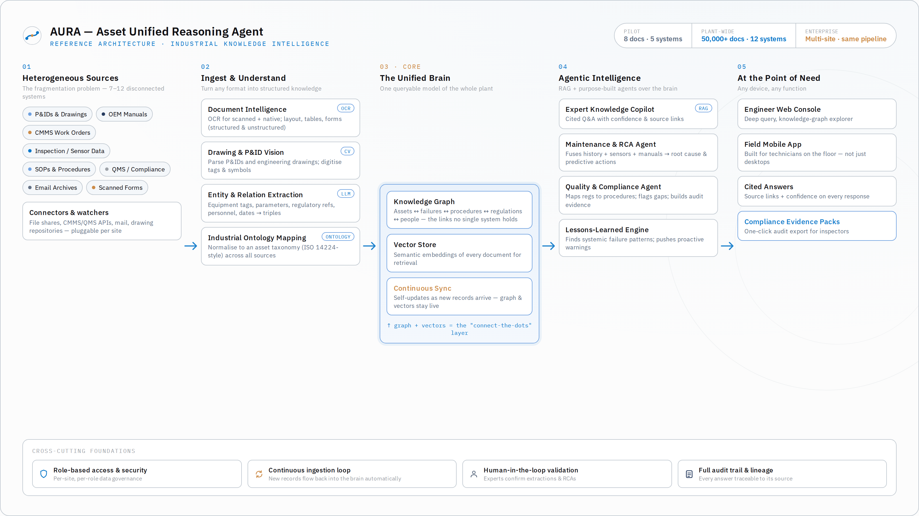
HOW IT WORKS
One pipeline. Five layers. Any scale.
AURA
08
Notes:
Walk left to right: sources, ingest and understand, the brain, agents, the people. Point to the scalability ribbon top-right.

Slide 9



TECHNICAL EXCELLENCE
Real engineering, not slideware.
RAG over a heterogeneous corpus
Knowledge graph + industrial ontology
Computer vision + OCR
Retrieval-augmented answers across every document type.
Entities and relationships normalised to an asset taxonomy.
P&ID parsing, drawing digitisation, structured + unstructured.
Agentic AI
Cited & confidence-scored
Self-updating
Root-cause, compliance and lessons-learned agents.
Every answer is traceable to its originating source.
New records flow back into the graph automatically.
The prototype is live: it answers any question grounded in the document set — switchable to a fully offline demo mode.
AURA
09
Notes:
Reassure judges this is real. Mention live-AI mode answers novel questions; demo mode guarantees the recording.

Slide 10
BUSINESS IMPACT
Hours, not weeks. Incidents prevented. Audits passed.
3 → 1
three repeat failures collapse into one root-cause fix
Time to root-cause a repeat failure (analyst hours, illustrative)
1
fire near-miss made preventable with a proactive alert
1-click
audit evidence pack vs. days of manual assembly
AURA
10
Notes:
Translate the demo into money and risk. The numbers are illustrative but grounded in the example. Adjust figures to your judges' context if you can.

Slide 11
SCALABILITY
The same pipeline, from pilot to enterprise.
PILOT
PLANT-WIDE
ENTERPRISE
8 docs · 5 systems
→
50,000+ docs · 12 systems
→
Multi-site · multi-plant
One critical asset, proven end-to-end.
Every asset across a full site.
One brain across the organisation.
Add a connector, not a rebuild. The ingestion → graph → RAG → agent pipeline is identical at every scale.
AURA
11
Notes:
Pre-empt the 'does it scale' question. Same pipeline, more connectors. Point back to the architecture slide.

Slide 12
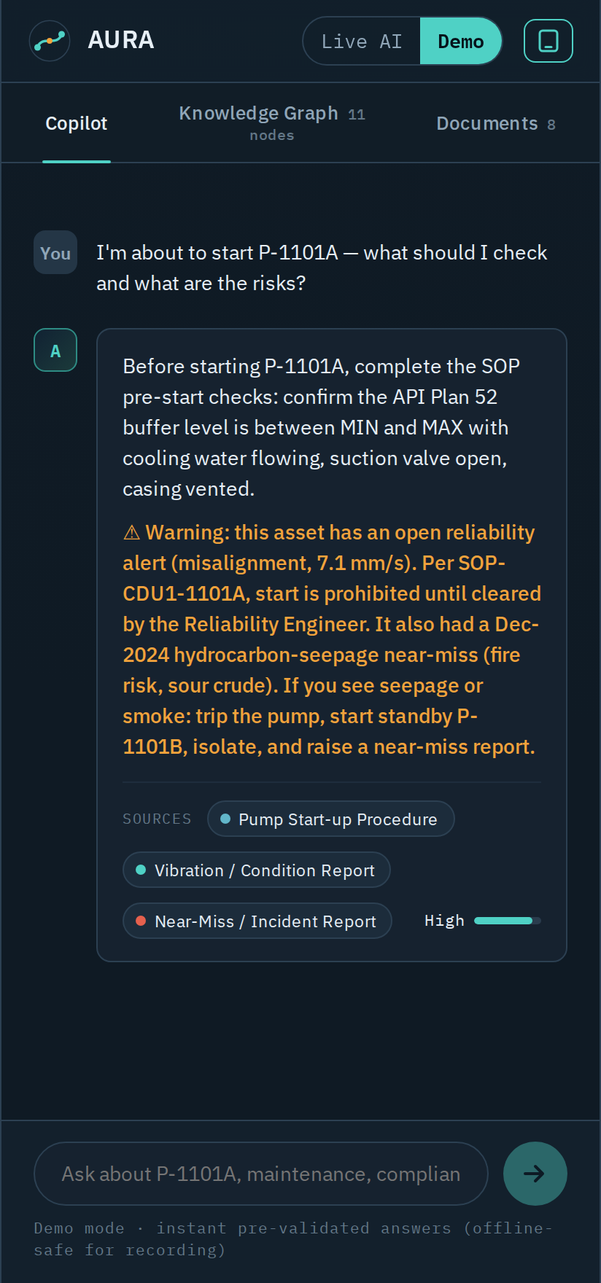


WHY AURA
Not a better search box. A brain that connects the dots.
Cross-system intelligence
Surfaces patterns no single team or tool can see.
Trustworthy by design
Citations, confidence scores and a full audit trail.
Field-first
Built for technicians on the floor — not just desktops.
Agentic compliance
Auto-detects gaps and assembles audit evidence.
AURA
In the field, on a phone
12
Notes:
Tie each differentiator to a judging criterion: cross-system = innovation; trustworthy = technical; field-first = UX; agentic compliance = business impact.

Slide 13
AURA
Unified reasoning across every asset.
Industrial Knowledge Intelligence · Problem 08
Vikas Yadav · Team Viktory · 6393214420
Notes:
Close on the tagline. Offer to run the live demo or answer questions.

