Slide 1
Paid video/chat procedure
Alumni
Set preference
Video or chat
Set price / hour
Receive Notice
Send Message to arrange date and time
Session
Hit complete button
Receive payment
Request session button shown
Future/current student
Press button
Request sent
Message to arrange datetime
Book datetime
Pay
Session
Hit complete
button
Alumate
Receive payment
Receive notice
Pay

Slide 2
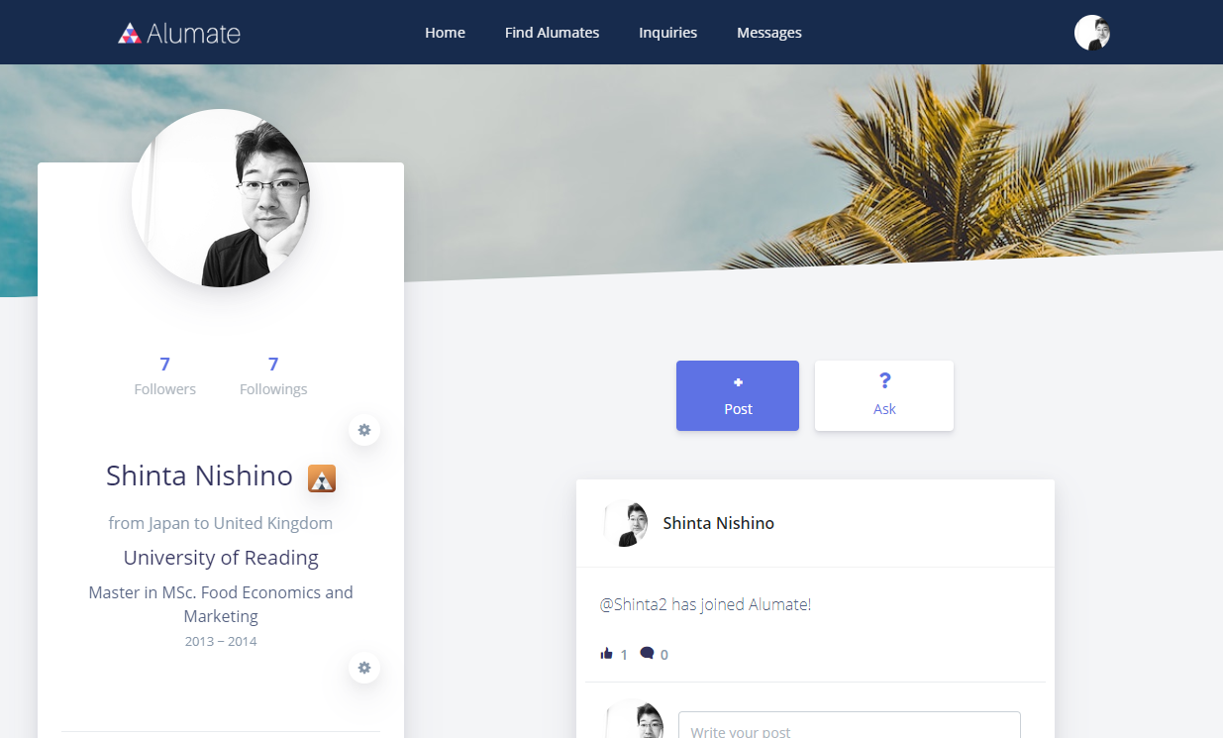
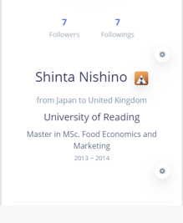
Account page (host)
Set online meeting preference

Slide 3
Account page (host)
Online meeting preference
Unit time (minutes)
30 mins
Price (JPY)
Set online meeting preference
500
Preferred day and time
UK time zone
Mon to Fri 19:00 ~ 20:00
Sat and Sun 10:00 ~20:00
Japan time zone
Mon to Fri 3:00 ~ 4:00
Sat and Sun 18:00 ~ 4:00
Time
Time
Create
Cancel

Slide 4


Host account page (seen by client)
Create profile tab in the center
Show profile as default
In profile tab, display university and below info.
Meeting preference
¥500 / 30 mins
UK time zone
Mon to Fri 19:00 ~ 20:00
Sat and Sun 10:00 ~20:00
Japan time zone
Mon to Fri 3:00 ~ 4:00
Sat and Sun 18:00 ~ 4:00

Slide 5
Host account page (seen by client)
Online meeting preference
Unit time (minutes)
30 mins
Price (JPY)
Meeting preference
500
¥500 / 30 mins
UK time zone
Mon to Fri 19:00 ~ 20:00
Sat and Sun 10:00 ~20:00
Japan time zone
Mon to Fri 3:00 ~ 4:00
Sat and Sun 18:00 ~ 4:00
Preferred day and time
UK time zone
Mon to Fri 19:00 ~ 20:00
Sat and Sun 10:00 ~20:00
Japan time zone
Mon to Fri 3:00 ~ 4:00
Sat and Sun 18:00 ~ 4:00
Time
Time
Save
Cancel
Delete

Slide 6

Host account page (seen by client)
Request online meeting
¥500 / 30 mins
Preferred day and time
UK time zone
Mon to Fri 19:00 ~ 20:00
Sat and Sun 10:00 ~20:00
Japan time zone
Mon to Fri 3:00 ~ 4:00
Sat and Sun 18:00 ~ 4:00

Slide 7
Paid video/chat procedure
Alumni
Set preference
Video or chat
Set price / hour
Receive Notice
Send Message to arrange date and time
Session
Hit complete button
Receive payment
Request session button shown
Future/current student
Press button
Request sent
Message to arrange datetime
Book datetime
Pay
Session
Hit complete
button
Alumate
Receive payment
Receive notice
Pay

Slide 8
Host account page (seen by client)
Request online meeting
¥500 / 30 mins
Preferred day and time
UK time zone
Mon to Fri 19:00 ~ 20:00
Sat and Sun 10:00 ~20:00
Japan time zone
Mon to Fri 3:00 ~ 4:00
Sat and Sun 18:00 ~ 4:00

Slide 9
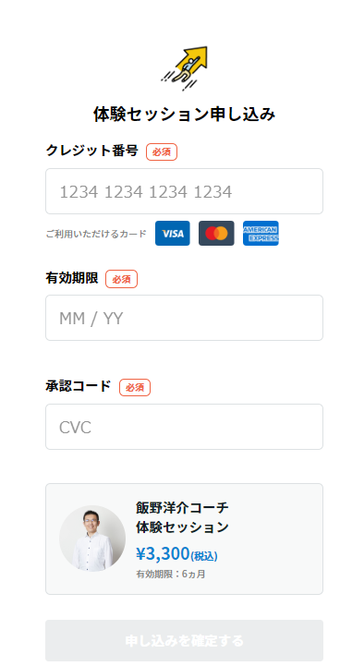
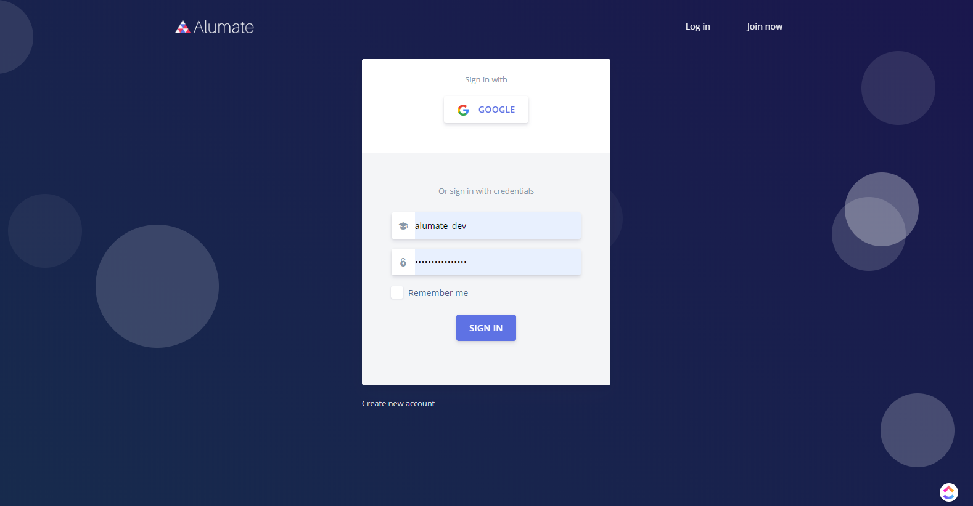

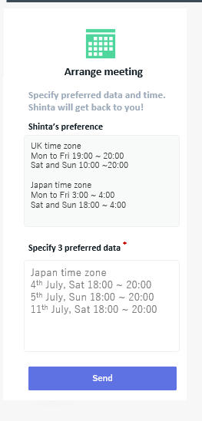

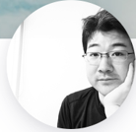
Arrange meeting (client)
Arrange meeting
Your order is complete.
Specify preferred data and time.
Shinta will get back to you!
Shinta’s preference
UK time zone
Mon to Fri 19:00 ~ 20:00
Sat and Sun 10:00 ~20:00
Japan time zone
Mon to Fri 3:00 ~ 4:00
Sat and Sun 18:00 ~ 4:00
*
Expiration date
Quantity
2
× 30 mins
Specify 3 preferred data
*
Security code
Japan time zone
4th July, Sat 18:00 ~ 20:00
5th July, Sun 18:00 ~ 20:00
11th July, Sat 18:00 ~ 20:00
Online talk with Shinta
30 mins
Order
\500
Send

Slide 10
Arrange meeting sent (client)
Your preference has been sent.
Shinta will get back to you soon!
Please check your message.
Go to message

Slide 11
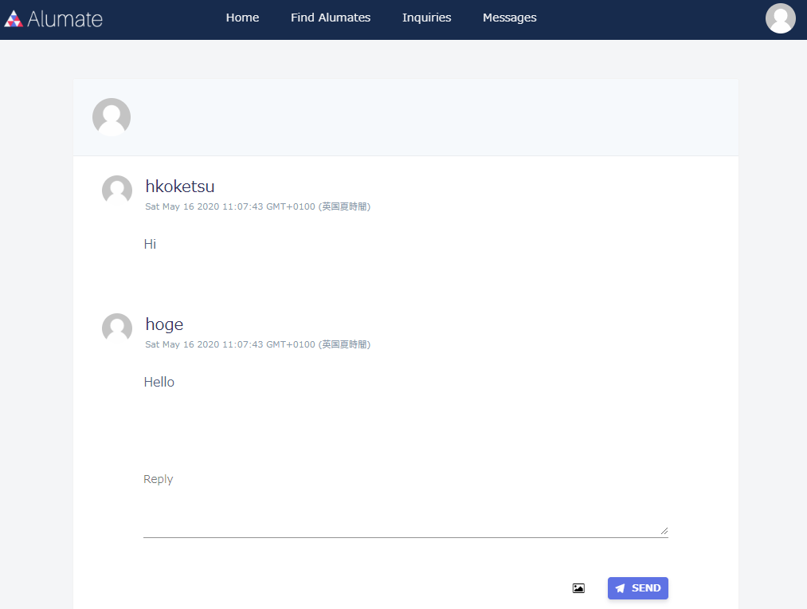
Message (client)
Shinta
Automatic message
User 1
Meeting request
Preferred date
Japan time zone
4th July, Sat 18:00 ~ 20:00
5th July, Sun 18:00 ~ 20:00
11th July, Sat 18:00 ~ 20:00
Online meeting request from Client to Shinta
Quantity 60mins
Preferred date
Japan time zone
4th July, Sat 18:00 ~ 20:00
5th July, Sun 18:00 ~ 20:00
11th July, Sat 18:00 ~ 20:00

Slide 12

Arrange a meeting (host)
Client
Automatic message
Online meeting request from Client to Shinta
Quantity 60mins
Preferred date
Japan time zone
4th July, Sat 18:00 ~ 20:00
5th July, Sun 18:00 ~ 20:00
11th July, Sat 18:00 ~ 20:00
Shinta, please reply and arrange the meeting!
Once agree the date, create a meeting, by clicking the button below.
Create a meeting
Shinta
Shinta
Thank you for your request!
How about this time?
Japan time zone
4th July, Sat 18:00 ~ 18*30
Client
Sure. That’s good for me.

Slide 13
Create a meeting (host)
Client
Automatic message
Create a meeting
Online meeting request from Client to Shinta
Preferred date
Japan time zone
4th July, Sat 18:00 ~ 20:00
5th July, Sun 18:00 ~ 20:00
11th July, Sat 18:00 ~ 20:00
Shinta, please reply and arrange the meeting!
Once agree the date, create a meeting, by clicking the button below.
Date
Time
Create
Cancel
Create a meeting
Shinta
Shinta
Thank you for your request!
How about this time?
Japan time zone
4th July, Sat 18:00 ~ 18*30
Client
Sure. That’s good for me.

Slide 14
Created a meetin (host)
Client
Automatic message
Online meeting request from Client to Shinta
Quantity 60mins
Preferred date
Japan time zone
4th July, Sat 18:00 ~ 20:00
5th July, Sun 18:00 ~ 20:00
11th July, Sat 18:00 ~ 20:00
Shinta, please reply and arrange the meeting!
Once agree the date, create a meeting, by clicking the button below.
Meeting has been created
Shinta
Shinta
Thank you for your request!
How about this time?
Japan time zone
4th July, Sat 18:00 ~ 18*30
Client
Sure. That’s good for me.
Shinta
Our meeting has been created as follows.
Date and time: 4th July, Sat 18:00 ~ 18*30

Slide 15
Book a meeting (client)
Client
Automatic message
Meeting has been created!
Please pay to book a meeting
Automatic message
Book a meeting
Online meeting request from Client to Shinta
Quantity 60 mins
Preferred date
Japan time zone
4th July, Sat 18:00 ~ 20:00
5th July, Sun 18:00 ~ 20:00
11th July, Sat 18:00 ~ 20:00
Shinta, please reply and arrange the meeting!
Once agree the date, create a meeting, by clicking the button below.
Meeting has been created
Shinta
Shinta
Thank you for your request!
How about this time?
Japan time zone
4th July, Sat 18:00 ~ 18*30
Client
Sure. That’s good for me.
Shinta
Our meeting has been arranged as follows.
Date and time: 4th July, Sat 18:00 ~ 19:00

Slide 16

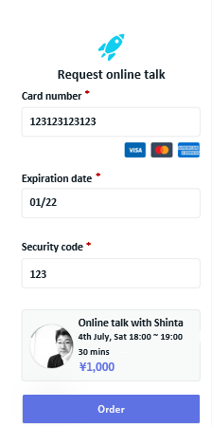
Payment (client)
Request online talk
Request online talk
*
*
Card number
Card number
123123123123
*
*
Expiration date
Expiration date
01/22
*
*
Security code
Security code
123
Online talk with Shinta
Online talk with Shinta
4th July, Sat 18:00 ~ 19:00
4th July, Sat 18:00 ~ 19:00
\1,000
60 mins
60 mins
\1,000
\1,000
Order
Order
Order

Slide 17
Created a zoom meeting (host)
Client
Automatic message
Meeting has been booked by Client!
Create a zoom meeting by clicking the button on the top right.
If not having a zoom account, please create zoom account and click the button.
Automatic message
Online meeting request from Client to Shinta
Quantity 60mins
Preferred date
Japan time zone
4th July, Sat 18:00 ~ 20:00
5th July, Sun 18:00 ~ 20:00
11th July, Sat 18:00 ~ 20:00
Shinta, please reply and arrange the meeting!
Once agree the date, create a meeting, by clicking the button below.
Create a zoom meeting
Meeting has been created
Shinta
Shinta
Thank you for your request!
How about this time?
Japan time zone
4th July, Sat 18:00 ~ 18*30
Client
Sure. That’s good for me.
Shinta
Our meeting has been arranged as follows.
Date and time: 4th July, Sat 18:00 ~ 19:0

Slide 18
Created a zoom meeting (host)
Client
Automatic message
Meeting has been booked by Client!
Create a zoom meeting by clicking the button on the top right.
If not having a zoom account, please create zoom account and click the button.
Automatic message
Create a zoom meeting
Create Zoom meeting
Online meeting request from Client to Shinta
Quantity 60mins
Preferred date
Japan time zone
4th July, Sat 18:00 ~ 20:00
5th July, Sun 18:00 ~ 20:00
11th July, Sat 18:00 ~ 20:00
Shinta, please reply and arrange the meeting!
Once agree the date, create a meeting, by clicking the button below.
4th July 2020
18:00 – 19:00
Meeting has been created
Create
Cancel
Shinta
Shinta
Thank you for your request!
How about this time?
Japan time zone
4th July, Sat 18:00 ~ 18*30
Client
Use Host’s Zoom account and API
Sure. That’s good for me.
Shinta
Our meeting has been arranged as follows.
Date and time: 4th July, Sat 18:00 ~ 19:0

Slide 19
Created a zoom meeting (host)
Client
Automatic message
Meeting has been booked by Client!
Create a zoom meeting by clicking the button on the top right.
If not having a zoom account, please create zoom account and click the button.
Automatic message
Online meeting request from Client to Shinta
Quantity 60mins
Preferred date
Japan time zone
4th July, Sat 18:00 ~ 20:00
5th July, Sun 18:00 ~ 20:00
11th July, Sat 18:00 ~ 20:00
Shinta, please reply and arrange the meeting!
Once agree the date, create a meeting, by clicking the button below.
Zoom meeting has been created
Automatic message
Your zoon meeting has been created!
Date and time: 4th July, Sat 18:00 ~ 19:00
Please visit the link at the meeting time
https//xxxx.xxxxxx.xxxxxxx
Once meeting has been completed, click the button below.
Meeting has been created
Meeting completed
Shinta
Shinta
Thank you for your request!
How about this time?
Japan time zone
4th July, Sat 18:00 ~ 18*30
User’s zoom account API
Can it be generated automatically after payment from client?
Client
Sure. That’s good for me.
Shinta
Our meeting has been arranged as follows.
Date and time: 4th July, Sat 18:00 ~ 19:00

Slide 20
Created a zoom meeting (client)
Client
Automatic message
Meeting has been created!
Please pay to book a meeting
Automatic message
Meeting has been booked
Online meeting request from Client to Shinta
Quantity 60 mins
Preferred date
Japan time zone
4th July, Sat 18:00 ~ 20:00
5th July, Sun 18:00 ~ 20:00
11th July, Sat 18:00 ~ 20:00
Shinta, please reply and arrange the meeting!
Once agree the date, create a meeting, by clicking the button below.
Automatic message
Your zoon meeting has been created.
Date and time: 4th July, Sat 18:00 ~ 19*30
Please visit the link at the meeting time
https//xxxx.xxxxxx.xxxxxxx
Meeting has been created
Shinta
Shinta
Thank you for your request!
How about this time?
Japan time zone
4th July, Sat 18:00 ~ 18*30
Client
Sure. That’s good for me.
Shinta
Our meeting has been arranged as follows.
Date and time: 4th July, Sat 18:00 ~ 19:00

Slide 21
Completed a meeting (host)
Client
Automatic message
Meeting has been booked by Client!
Create a zoom meeting by clicking the button on the top right.
If not having a zoom account, please create zoom account and click the button.
Automatic message
Online meeting request from Client to Shinta
Quantity 60mins
Preferred date
Japan time zone
4th July, Sat 18:00 ~ 20:00
5th July, Sun 18:00 ~ 20:00
11th July, Sat 18:00 ~ 20:00
Shinta, please reply and arrange the meeting!
Once agree the date, create a meeting, by clicking the button below.
Zoom meeting has been created
Automatic message
Your zoon meeting has been created!
Date and time: 4th July, Sat 18:00 ~ 18*30
Please visit the link at the meeting time
https//xxxx.xxxxxx.xxxxxxx
Once meeting has been completed, click the button below.
Meeting has been created
Meeting has been completed
Shinta
Shinta
Thank you for your request!
How about this time?
Japan time zone
4th July, Sat 18:00 ~ 18*30
Client
Sure. That’s good for me.
Shinta
Our meeting has been arranged as follows.
Date and time: 4th July, Sat 18:00 ~ 18*30

Slide 22
Completed a meeting (client)
Client
Automatic message
Meeting has been created!
Please pay to book a meeting
Automatic message
Meeting has been booked
Online meeting request from Client to Shinta
Quantity 60 mins
Preferred date
Japan time zone
4th July, Sat 18:00 ~ 20:00
5th July, Sun 18:00 ~ 20:00
11th July, Sat 18:00 ~ 20:00
Shinta, please reply and arrange the meeting!
Once agree the date, create a meeting, by clicking the button below.
Automatic message
Your zoon meeting has been created.
Date and time: 4th July, Sat 18:00 ~ 18*30
Please visit the link at the meeting time
https//xxxx.xxxxxx.xxxxxxx
Meeting has been created
Automatic message
Shinta
Has the meeting completed?
Shinta informed us the meeting has been completed.
Please confirm the completion of the meeting
Shinta
Thank you for your request!
How about this time?
Japan time zone
4th July, Sat 18:00 ~ 18*30
Yes, Meeting has been completed
No, meeting has not been completed
Client
Sure. That’s good for me.
Shinta
Our meeting has been arranged as follows.
Date and time: 4th July, Sat 18:00 ~ 19:00

Slide 23
Confirmed completion (client)
Client
Automatic message
Meeting has been created!
Please pay to book a meeting
Automatic message
Meeting has been booked
Online meeting request from Client to Shinta
Quantity 60 mins
Preferred date
Japan time zone
4th July, Sat 18:00 ~ 20:00
5th July, Sun 18:00 ~ 20:00
11th July, Sat 18:00 ~ 20:00
Shinta, please reply and arrange the meeting!
Once agree the date, create a meeting, by clicking the button below.
Automatic message
Your zoon meeting has been created.
Date and time: 4th July, Sat 18:00 ~ 18*30
Please visit the link at the meeting time
https//xxxx.xxxxxx.xxxxxxx
Meeting has been created
Automatic message
Shinta
Has the meeting completed?
Shinta informed us the meeting has been completed.
Please confirm the completion of the meeting
Shinta
Thank you for your request!
How about this time?
Japan time zone
4th July, Sat 18:00 ~ 18*30
Confirmation has been sent
Client
Sure. That’s good for me.
Shinta
Our meeting has been arranged as follows.
Date and time: 4th July, Sat 18:00 ~ 19:00

Slide 24
Confirmed completion (host)
Client
Automatic message
Meeting has been booked by Client!
Create a zoom meeting by clicking the button on the top right.
If not having a zoom account, please create zoom account and click the button.
Automatic message
Online meeting request from Client to Shinta
Quantity 60mins
Preferred date
Japan time zone
4th July, Sat 18:00 ~ 20:00
5th July, Sun 18:00 ~ 20:00
11th July, Sat 18:00 ~ 20:00
Shinta, please reply and arrange the meeting!
Once agree the date, create a meeting, by clicking the button below.
Zoom meeting has been created
Automatic message
Your zoon meeting has been created!
Date and time: 4th July, Sat 18:00 ~ 18*30
Please visit the link at the meeting time
https//xxxx.xxxxxx.xxxxxxx
Once meeting has been completed, click the button below.
Meeting has been created
Meeting has been completed
Shinta
Shinta
Thank you for your request!
How about this time?
Japan time zone
4th July, Sat 18:00 ~ 18*30
Automatic message
Client confirmed the competition!
We will transfer the payment to your account!
Client
Sure. That’s good for me.
Shinta
Our meeting has been arranged as follows.
Date and time: 4th July, Sat 18:00 ~ 18*30

Slide 25
Not confirmed completion (host)
Client
Automatic message
Meeting has been booked by Client!
Create a zoom meeting by clicking the button on the top right.
If not having a zoom account, please create zoom account and click the button.
Automatic message
Online meeting request from Client to Shinta
Quantity 60mins
Preferred date
Japan time zone
4th July, Sat 18:00 ~ 20:00
5th July, Sun 18:00 ~ 20:00
11th July, Sat 18:00 ~ 20:00
Shinta, please reply and arrange the meeting!
Once agree the date, create a meeting, by clicking the button below.
Zoom meeting has been created
Automatic message
Your zoon meeting has been created!
Date and time: 4th July, Sat 18:00 ~ 18*30
Please visit the link at the meeting time
https//xxxx.xxxxxx.xxxxxxx
Once meeting has been completed, click the button below.
Meeting has been created
Meeting has been completed
Shinta
Shinta
Thank you for your request!
How about this time?
Japan time zone
4th July, Sat 18:00 ~ 18*30
Automatic message
Oops! Client did not confirm the completion of the meeting.
Is it correct?
Yes, I will arrange another meeting
No, meeting has been completed.
I would like to report to Alumate staff.
Client
Sure. That’s good for me.
Shinta
Our meeting has been arranged as follows.
Date and time: 4th July, Sat 18:00 ~ 18*30

Slide 26
Not confirmed completion (host)
Client
Automatic message
Meeting has been booked by Client!
Create a zoom meeting by clicking the button on the top right.
If not having a zoom account, please create zoom account and click the button.
Automatic message
Online meeting request from Client to Shinta
Quantity 60mins
Preferred date
Japan time zone
4th July, Sat 18:00 ~ 20:00
5th July, Sun 18:00 ~ 20:00
11th July, Sat 18:00 ~ 20:00
Shinta, please reply and arrange the meeting!
Once agree the date, create a meeting, by clicking the button below.
Zoom meeting has been created
Automatic message
Your zoon meeting has been created!
Date and time: 4th July, Sat 18:00 ~ 18*30
Please visit the link at the meeting time
https//xxxx.xxxxxx.xxxxxxx
Once meeting has been completed, click the button below.
Meeting has been created
Meeting has been completed
Shinta
Shinta
Thank you for your request!
How about this time?
Japan time zone
4th July, Sat 18:00 ~ 18*30
Automatic message
Oops! Client did not confirm the completion of the meeting.
Is it correct?
Yes, I will arrange another meeting
Client
Sure. That’s good for me.
Automatic message
Create a zoom meeting by clicking the button on the top right.
If not having a zoom account, please create zoom account and click the button.
Shinta
Our meeting has been arranged as follows.
Date and time: 4th July, Sat 18:00 ~ 18*30
Create a zoom meeting

Slide 27
Report to Alumate staff (host)
Automatic message
Meeting has been completed!
We sent completion confirmation request to Client.
Once Client confirms, we transfer the payment to your account
Contact form
Automatic message
We love to hear from you.
Get you back as son as possible!
Oops! Client did not confirm the completion of the meeting.
Is it correct?
Yes, I will arrange another meeting
No, meeting has been completed.
I would like to report to Alumate staff.
Send
Cancel

