Slide 1
Definitions

Slide 2
Template - Hierarchy
Template Hierarchy
A template can be one of three types:
Standalone (Default)
Master
Addendum
A master template can have multiple addendums
When creating a “new doc”, template hierarchy must be checked to determine what additional metadata needs to be captured for the “Addendum” templates.
The Addendum templates should have option of “Must fill” or “Optional fill” which will determine whether metadata for addendums must be entered or is optional.
Addendum template could be having multiple masters.
Common metadata between master and addendum could be auto-inherited from master to avoid duplication. For example, Party Name could be entered in Mastered and in the addendum, it may be marked as “inherited” from Master.
Template version is incremented if someone using an existing template, makes changes to structure and then saves with prompt “Overwrite existing template”. This will invalidate v1.0 and create v2.0. The v1.0 template will be marked Inactive.
Template can be deleted which means it will not show up actively in any reporting.
All deletes are soft deletes. i.e. not visible but marked as such in tables.
Template Model
Template id: ____ One unique number
Template type: Standalone (default), Master, Addendum
Template version: __
Created by: __ on __
Last edited by: __ on __
Status: Active, Inactive or Deleted
Kit IDs:
Template associations: _ , _ , _ , list of kit idss to which this template is associated
When training a template, we must capture the type of template and any template associations. Show drop down list of other templates available for association.
When training template, each clause capture iteration will ask for three items (instead of the current clicks which only allows to capture the label)
Clause type: Title
Clause label: Confidentiality Agreement
Clause text: None

Slide 3
Examples of KITs
Kit 10003 -Sales
s
P
c
s
s
s
s
s
Kit 10001 -HR
Kit 10001 - Marketing
P
P
P
P
s
P
P
s
c
c
c
c
c
P
c
c
d
d
d
c
d
d
d

Slide 4
Template Associations
Template Associations
Any template can be associated with another template to form a group. The common key to associate these templates is called a “KIT id”.
Templates could have multiple associations hence the “KIT id” is a list.
For example:
KIT ID Number: 10001
KIT ID Description: HR kit
KIT ID Owner : ___ created by
KIT associations: tempidHR1, tempidHR2, tempidNDA3, tempidHR3
KIT ID Number: 10002
KIT ID Description: Sales kit
KIT ID Owner : ___ created by
KIT associations: tempidSALES1, tempidSALES2, tempidNDA3, tempidSALES3
Note, in above example, one template is common between both KITs.
KIT id Model:
Kit ID Number: _____ Unique number
Kit ID Description: ____ text description
Kit ID Owner : ___ created by
KIT associations: __, __, __, list of templates associated with this kit

Slide 5
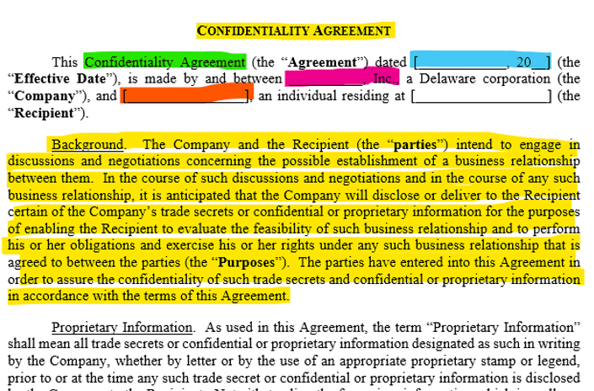
Clause Library
Clause Model:
Clause unique Sysid: system generated number
Clause Label
Clause type: Title, preamble, Primary clause, Sub clause
Clause text
Clause origin: Templateid
Clause create date:
Clause Create action: Training, New Document – edit
Clause Creator name:
Clause Parent: Clause id if this clause was created using copy of another clause
Every template that is uploaded will add it’s content to the “Clause” library in a certain format.
The template should be seen as a structure of paras, with clauses
Clause type
Clause label
Clause text
When training template, each clause capture iteration will ask for three items (instead of the current clicks which only allows to capture the label)
Clause type: Title
Clause label: Confidentiality Agreement
Clause text: None
For example
Clause type: Title
Clause label: Confidentiality Agreement
Clause text: None
Clause type: Preamble;
Clause label: None
Clause text: This Confidentiality Agreement ….. Until “Recipient”)
Clause type: Regular;
Clause label: Background
Clause text: This Confidentiality Agreement ….. Until “Recipient”)
Clause type: Regular;
Clause label: Proprietary Information
Clause text: As used in this Agreement …. Until the end of the paragraph or start of next clause.

Slide 6
Creating New Doc - Workflow
Start doc from existing template
(A)
Prompt for existing template
OR
Browse from list
If template found, prompt for metadata
Accept metadata input, validate
If all metadata is valid, build document and display
Edit scenario 2
Display option to save document
OR
EDIT
EDIT ‘metadata’ (GO TO A)
OR
‘clause text’ – (GOTO C)
(C2)
If edit Clause
ALLOW for edit within clause text
Track changes in clause text and save to clause library
Edit scenario 1
(C)
If adding or change clause name C1
(C1)
If adding or change clause name – change in structure, save as a new template type
If change in structure, prompt for saving as new template
(C)
If adding or change clause text (C2)

Slide 7
Examples of changes in template
Original
Scenario 1
Structure remains same, clause text changed
Scenario 2
Structure changes, clause text also changed; one clause added; one clause removed
Title
First para (Preamble)
Background
Proprietary information
Terms and Conditions
Miscelleneous
Title
First para (Preamble)
Background
Proprietary information – some edits in this clause
Terms and Conditions
Miscellaneous
Title
First para (Preamble)
Background
Proprietary information – some edits in this clause
++ Confidentiality info
Terms and Conditions
-- Miscellaneous

Slide 8
Database models
Every item in the system has a unique sysid
Applies to templates, clauses, documents, metadata
Allow for items to be traced back. Ex. Document stored should have enough info on sys id of template used, which in turn has a list of clause ids used.
Conversely, every clause stored in the system should be traceable to where the clause appears in templates and where it was used in documents.

Slide 9
Reporting related ideas
Document search
Should allow entry for document name
Search for document names matching with wildcard
Documents listing should be shown with up to 15 on each page, start with ‘documents created’, followed by ‘documents uploaded’ sections. Latest timestamps should be shown first.
Template search
Should allow entry for template name
Search for template names matching with wildcard
Templates listing should be shown with up to 15 on each page, start with standalone templates, followed by Parent templates. Separate section follows with child templates linked to parent templates.

Slide 10
Adaptor basics – PDF adapter
PDF READ (PDFMINER) Adapter provides txt copy
The code picks up txt file and look for structure match
Template id identified
Doc is now uploadable, so go ahead and provide doc id
Save pdf copy as is to files folder with the doc id reference
Save txt copy with the same docid refenence
Metadata is known from template
Scan txt file to get metadata values
Save metadata values to metadata tables with doc id reference
Structured Pdf to be uploaded
Pdf txt copy saved
Pdf SAVED
OCR Adapter provides txt copy
The code picks up txt file and look for structure match
Template id identified
Doc is now uploadable, so go ahead and provide doc id
Save pdf copy as is to files folder with the doc id reference
Save txt copy with the same docid refenence
Metadata is known from template
Scan txt file to get metadata values
Save metadata values to metadata tables with doc id reference
Image Pdf to be uploaded
Pdf txt copy saved
Pdf SAVED

Slide 11
New Rel 2 slides -UI

Slide 12
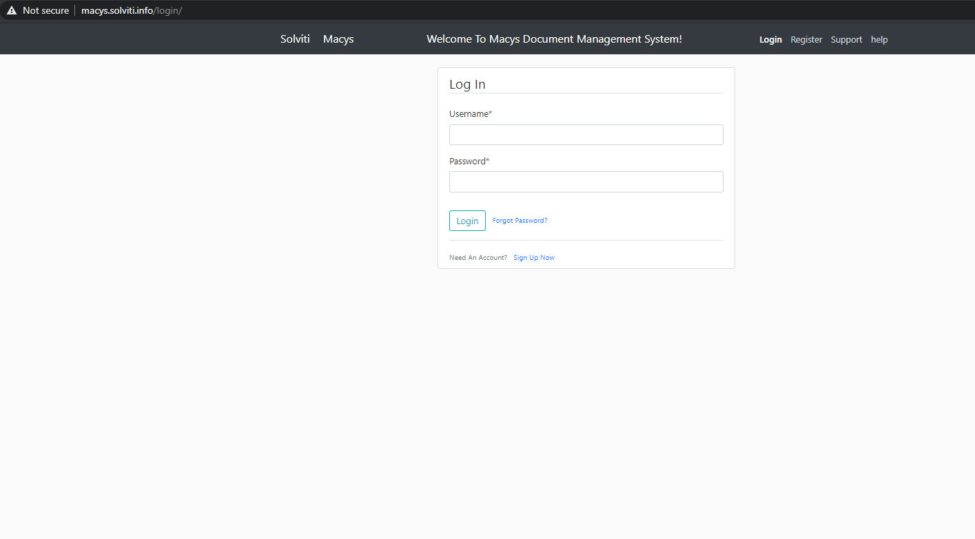


Need to move to HTTPS://
Move Solviti logo to left corner
Move Macys logo to right corner
Ensure Sign up is validating “allowed domain” i.e. @macys.com for tenant macys.Solviti.info.
This bar below must be seen for customers who have not logged in yet. Right now we can see it only after login.

Slide 13
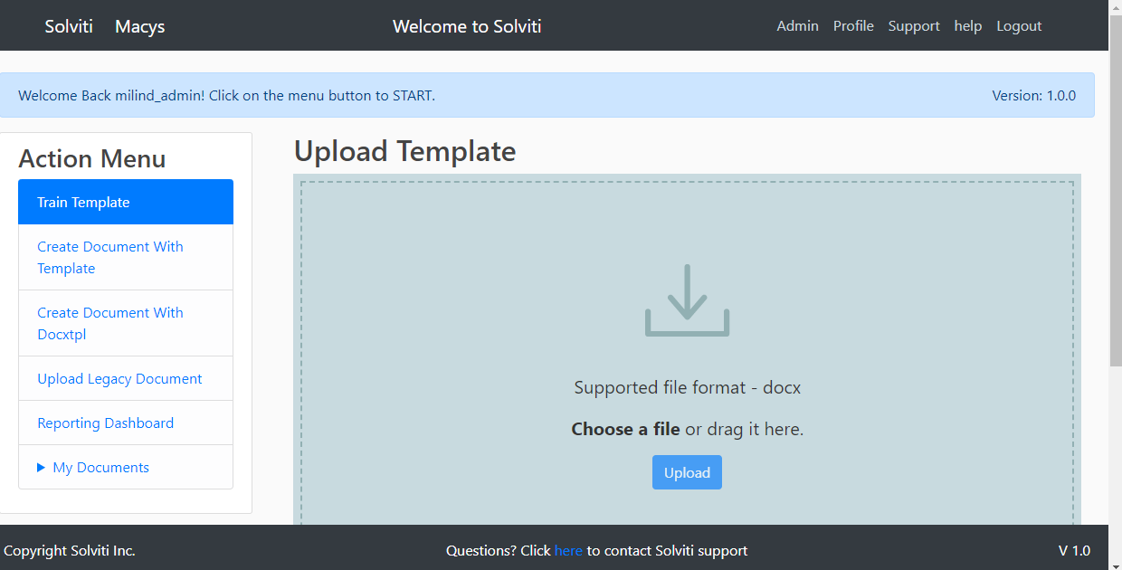




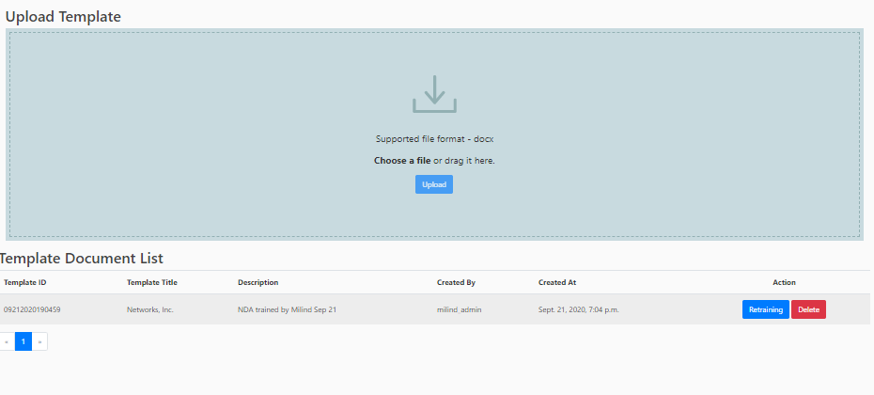
Menu bar on top; Train template will be grayed if user is not admin

Slide 14
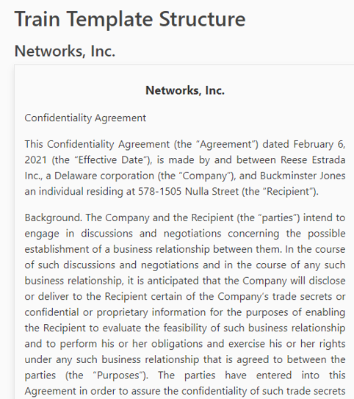
Template training
Menu bar on top; Train template uses entire screen
Template attributes:
Description: (entered by user)
Template type: (drop down)
Status: Active, Inactive or Deleted
Parent template: (display drop down of available parent templates only if template type selected above is child)
Kit IDs: (user can see drop down of kit ids with option of creating new kit id)
------------------------------
Filename found: (from upload)
Template version: (assigned by system)
Template id: (assigned by system)
Created by: __ on __
Last edited by: __ on __
… add any other attributes we need to display

Slide 15


Template training
Menu bar on top; Train template uses entire screen
Training para 2
Clause Label
Clause type: Title
Preamble
Primary clause
Sub clause
Clause text
Clause text
Do you have additional text to be added to this clause? (Y/N)
If “N” is selected, the Green/Red buttons show up so trainer can accept clause.

Slide 16
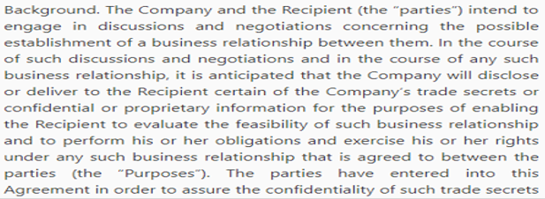
Template training
If answer is Yes, open up new “Additional Clause text” box and allow clicks to capture the text
Clause Label
Clause type: Title
Preamble
Primary clause
Sub clause
Additional
Clause text
Clause text
Clause text
Do you have additional text to be added to this clause? (Y/N)
Accept
Reselect

Slide 17
Template training
If “Accept” is clicked for the ‘Additional Clause text’ box
Iterate on asking the same question again to add more text until ‘N’ is pressed
Clause Label
Clause type: Title
Preamble
Primary clause
Sub clause
Clause text
Clause text
Do you have additional text to be added to this clause? (Y/N)
If “N” is selected, the Green/Red buttons show up so trainer can accept clause.

Slide 18
Template training
If “Accept” is clicked for the ‘Additional Clause text’ box
Iterate on asking the same question again to add more text until ‘N’ is pressed
Clause Label
Clause type: Title
Preamble
Primary clause
Sub clause
Clause successfully added.
Clause id:
Clause type:
Clause label :
Clause text:
Click “OK” to continue
Clause text
Clause text
OK
If “N” is selected, the Green/Red buttons show up so trainer can accept clause.

Slide 19
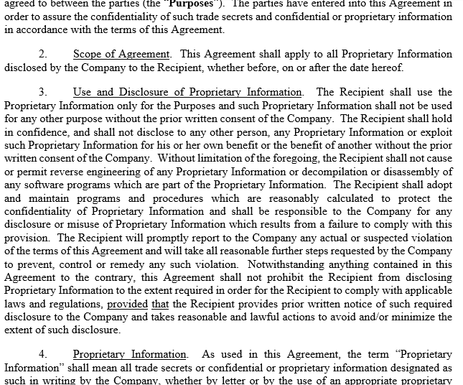
Template training
Now training para after the previous processed para
Now Training para 4
Clause Label
If “N” is selected, the Green/Red buttons show up so trainer can accept clause.
Clause type: Title
Preamble
Primary clause
Sub clause
Clause text
Clause text
Do you have additional text to be added to this clause? (Y/N)

Slide 20
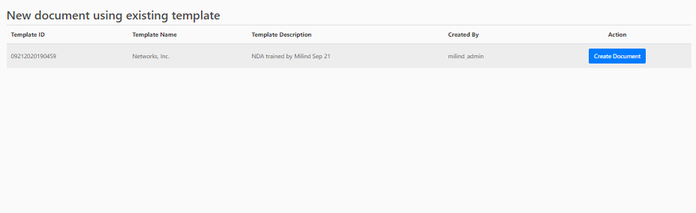
Create document
Menu bar on top; navigate to next menu by click on the button. If unfinished on previous task, provide pop up box and ask for save, cancel and navigate option

Slide 21
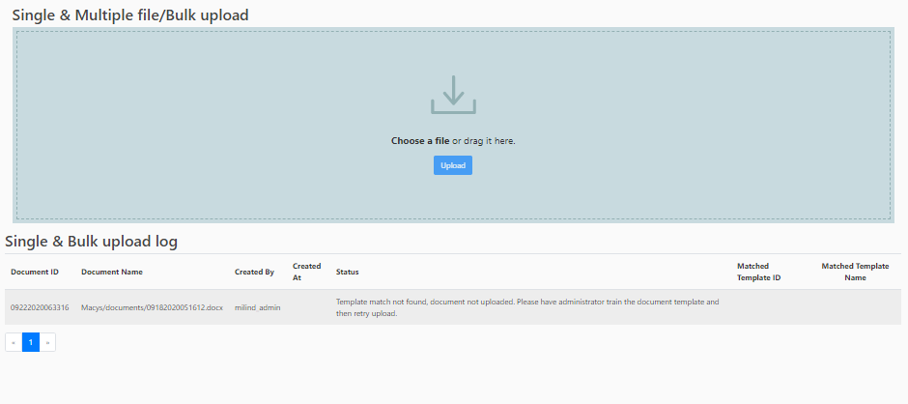
Menu bar on top; navigate to next menu by click on the button.
Welcome bar should disappear on first click

Slide 22

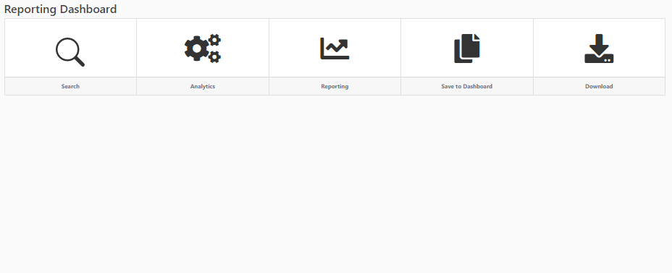
Menu bar on top; navigate to next menu by click on the button.

Slide 23
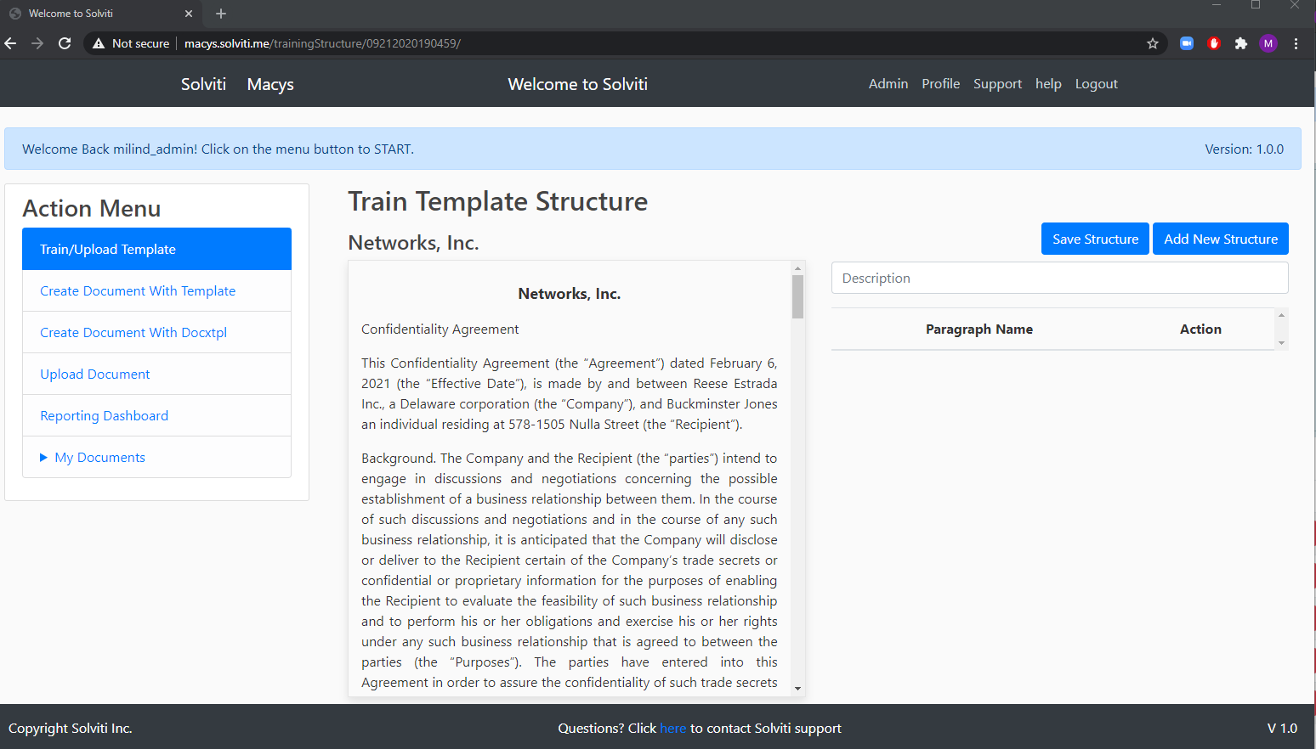
Template training
Display pop up box to flag if any existing template of the same attributes has been found. Use existing text.
If no duplicate found, go to next page.
Template attributes:
Description: (entered by user)
Template type: (drop down)
Status: Active, Inactive or Deleted
Parent template: (display drop down of available parent templates only if template type selected above is child)
Kit IDs: (user can see drop down of kit ids with option of creating new kit id)
------------------------------
Filename found: (from upload)
Template version: (assigned by system)
Template id: (assigned by system)
Created by: __ on __
Last edited by: __ on __
… add any other attributes we need to display
Check slide and delete

Slide 24
Display pop up box to grab the key items we need from user – template type, description, status, parent/child relationship and kit ids
Template attributes:
Description: (entered by user)
Template type: (drop down)
Status: Active, Inactive or Deleted
Parent template: (display drop down of available parent templates only if template type selected above is child)
Kit IDs: (user can see drop down of kit ids with option of creating new kit id)
------------------------------
Filename found: (from upload)
Template version: (assigned by system)
Template id: (assigned by system)
Created by: __ on __
Last edited by: __ on __
… add any other attributes we need to display
Check slide and delete

Slide 25

Train template will now show boxes for the captured Clause label (non editable), clause type, clause text.
Clause Label
Clause type: Title
Preamble
Primary clause
Sub clause
Clause text
Check slide and delete

Slide 26
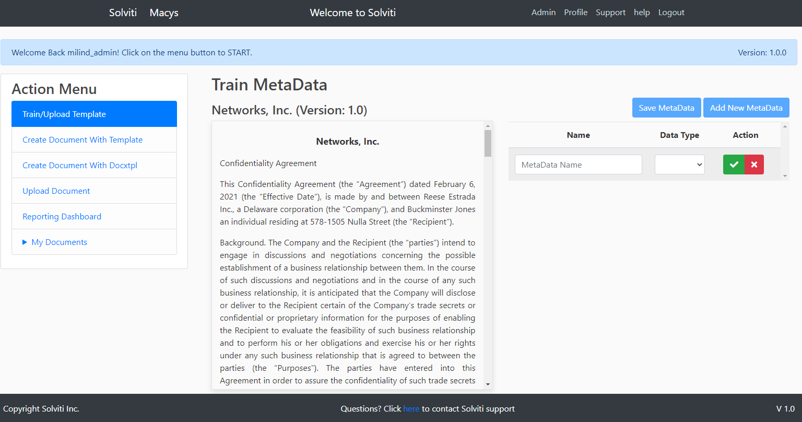
Selected Text: __________
Matched name if found in the metadata list should be displayed along with current description, may be a pop up box. Customer/onboarding team can override to create new.
Else use Selected text string as new meta data name
Matched Metadata name: __________
Choose metadata from existing dropdown list
Metadata Description (will be displayed in Metadata entry field when creating new doc):
__________________________________________
Metadata type: Integer
String
date
Time

Slide 27
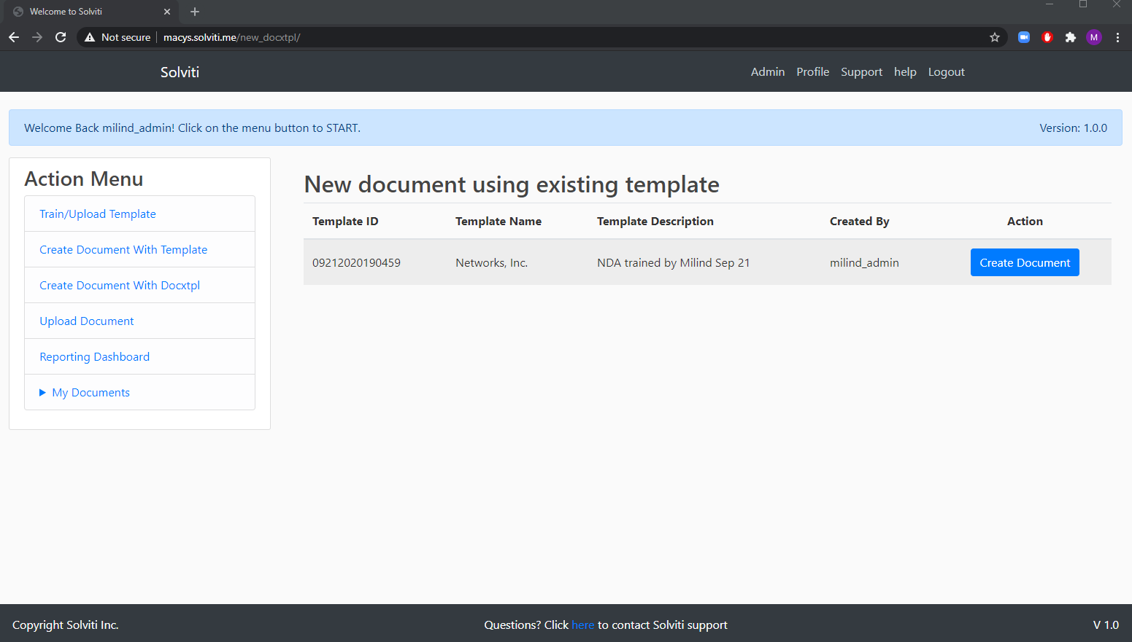
Create New Document – Choose template

Slide 28
Prior slides – need review before deleting

Slide 29
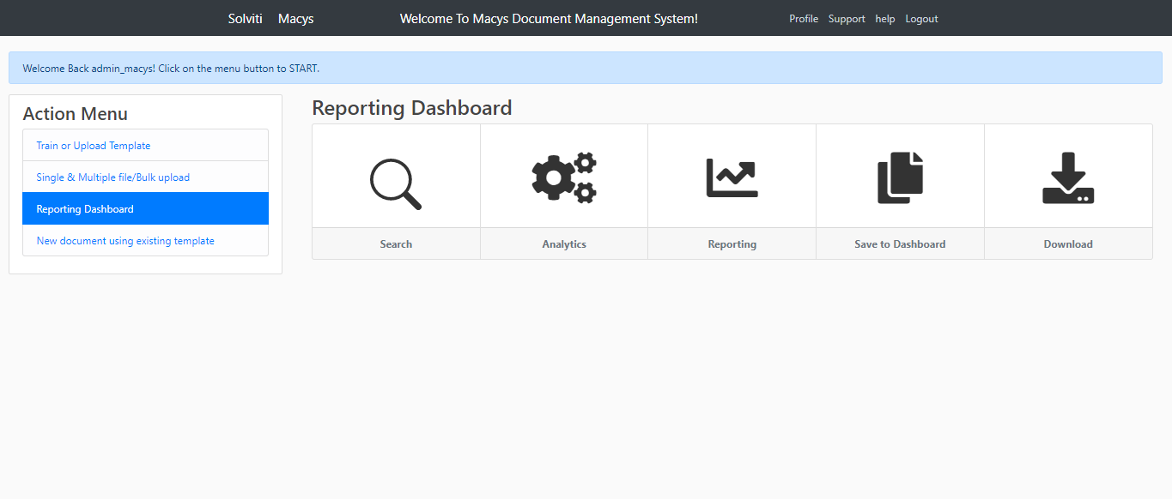

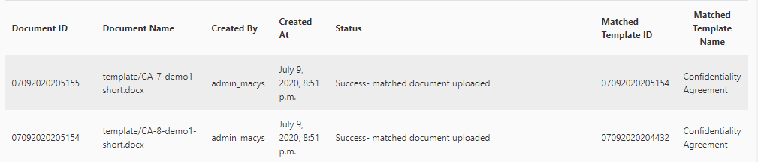
Simple search: When we click the search box, the options of search “Filename OR Template OR Metadata .
Search results filtered by what they enter in the box: Logic could be * ”search string” *.* or you can suggest whatever works best
SEARCH FUNCTIONALITY
Clicking View will show file in viewing mode (almost like a preview window popping up). That window can then have another button for download.
So overall workflow is :
User clicks Search
User selects Filename or Template or Metadata from search bar
User enters Filename or template name or metadata to search
Search results show up
If they want to preview to check if that’s the correct document, they will use VIEW button,
If correct document, within the preview window, there will be a download button.
: FILENAME SEARCH
Filename
Demo1-short.docx
Template
Metadata
Download
Delete
View
Download
Delete
View

Slide 30
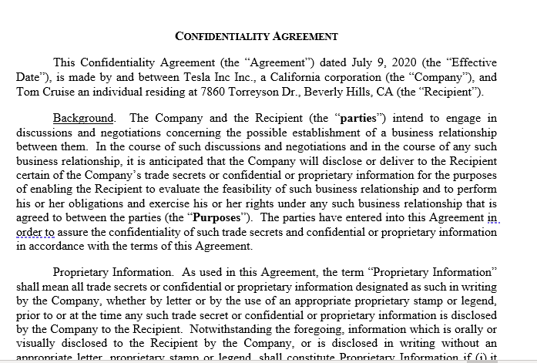
VIEW FUNCTIONALITY AFTER SEARCH
Clicking View will show file in viewing mode (almost like a preview window popping up). That window can then have another button for download.
So overall workflow is :
User clicks Search
User selects Filename or Template or Metadata from search bar
User enters Filename or template name or metadata to search
Search results show up
If they want to preview to check if that’s the correct document, they will use VIEW button,
If correct document, within the preview window, there will be a download button.
Filename
Demo1-short.docx
Template
Metadata
View
Showing: CA-1-demo1.short.docx
Close Preview Window
Download
Delete

Slide 31
Simple search: When we click the search box, the options of search “Filename OR Template OR Metadata .
Search results filtered by what they enter in the box: Logic could be * ”search string” *.* or you can suggest whatever works best
METADATA SEARCH FUNCTIONALITY
Clicking METADATA search should allow for two fields that need input.
The Metadata variable and
The Metadata value
Also the third item should be the Boolean operator.
The displayed output shows the clause/provision where the metadata value appears, along with document name and id where it appears.
Give option to VIEW the document similar to the PREVIEW mode in the basic document search funciton.
: METADATA SEARCH
METADATA SEARCH
Metadata
Partyname
Equals,
search value field
Metadata field “Party One” == “Tom Cruise” found in the following provisions and related documents
Preamble para
Provision label
Download
Delete
View
Preamble para
Download
Delete
View

