Slide 1
Spring
Vikas tadge

Slide 2
What we are going to learn…
foundational Spring
Getting started
Deploying web applications
Working with data
Securing spring

Slide 3
What we are going to learn…
Integrated Spring
Creating rest services
Consuming rest services
Send message asynchronously
Integrating spring

Slide 4
Getting started
Introduced in October 2002
Stable release 5.2.2
Light weight alternative to J2EE
Offered simpler approach for EJB
Initially heavy weight in terms of configuration (xml based)
Annotations introduced in spring 2.5
Spring boot reduced configurations and adding start up dependency

Slide 5
Spring application container
At its core, Spring offers a container, often referred to as the Spring application context, that creates and manages application components. These components, or beans, are wired together inside the Spring application context to make a complete application, much like bricks, mortar, timber, nails, plumbing, and wiring are bound together to make a house.

Slide 6
Dependency injection
The act of wiring beans together is based on a pattern known as dependency injection (DI). Rather than have components create and maintain the lifecycle of other beans that they depend on, a dependency-injected application relies on a separate entity (the container) to create and maintain all components and inject those into the beans that need them. This is done typically through constructor arguments or property accessor methods.

Slide 7
Creating spring application
Download spring application from start.spring.io
Lombok
Thymleaf
web
Examining project structure
pom.xml
Bootstrap java class
Application.properties
Static
Templates
Test application

Slide 8
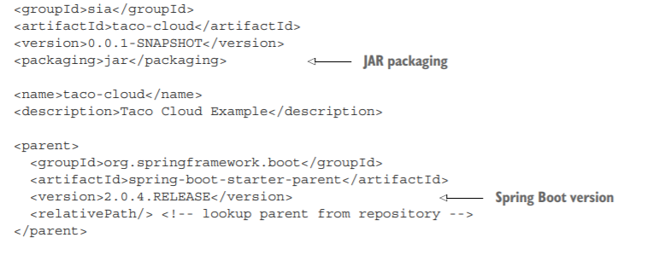
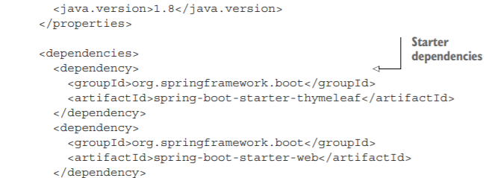
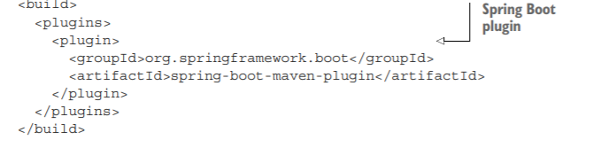
pom.xml

Slide 9
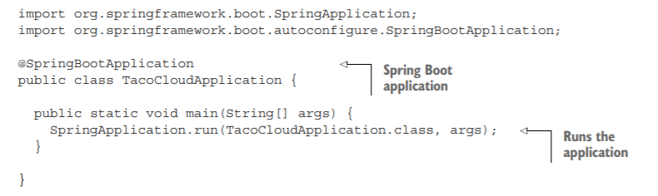
Bootstrap java class

Slide 10
@SpringBootApplication
@SpringBootConfiguration : Designates this class as a configuration class. Although there’s not much configuration in the class yet, you can add Javabased Spring Framework configuration to this class if you need to. This annotation is, in fact, a specialized form of the @Configuration annotation.
@EnableAutoConfiguration : Enables Spring Boot automatic configuration. We’ll talk more about autoconfiguration later. For now, know that this annotation tells Spring Boot to automatically configure any components that it thinks you’ll need.
@ComponentScan : Enables component scanning. This lets you declare other classes with annotations like @Component, @Controller, @Service, and others, to have Spring automatically discover them and register them as components in the Spring application context.

Slide 11
@SpringBootApplication
The main() method calls a static run() method on the SpringApplication class, which performs the actual bootstrapping of the application, creating the Spring application context.
The two parameters passed to the run() method are a configuration class and the command-line arguments. Although it’s not necessary that the configuration class passed to run() be the same as the bootstrap class, this is the most convenient and typical choice.

Slide 12
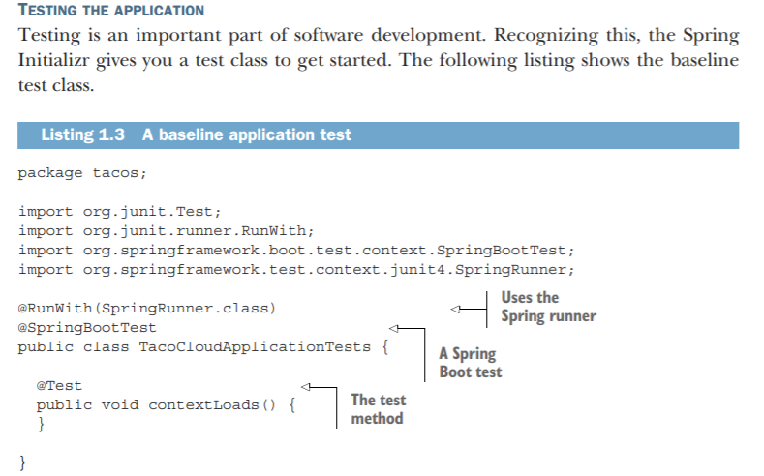
Testing application
the class annotated with @RunWith(SpringRunner.class).
@RunWith is a JUnit annotation, providing a test runner that guides JUnit in running a test. Think Listing 1.3 A baseline application test Uses the Spring runner A Spring Boot test The test method Writing a Spring application 17 of it as applying a plugin to JUnit to provide custom testing behavior.
In this case, JUnit is given SpringRunner, a Spring-provided test runner that provides for the creation of a Spring application context that the test will run against.

Slide 13
Writing spring application
A controller class that handles requests for the homepage
A view template that defines what the homepage looks like
Test class

Slide 14
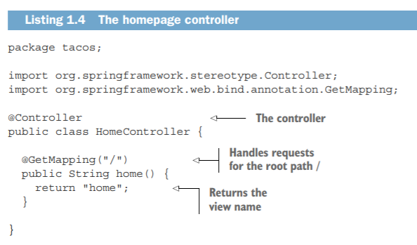
Controller class

Slide 15
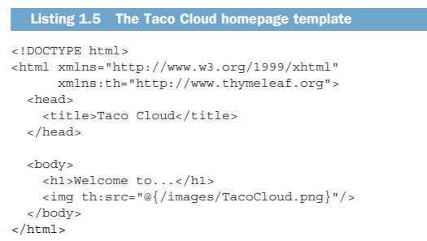
View

Slide 16
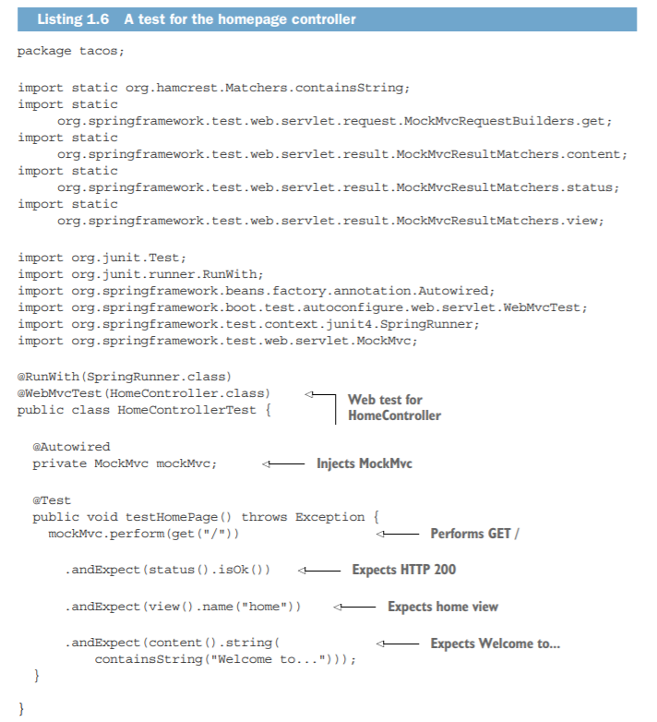
Testing

Slide 17
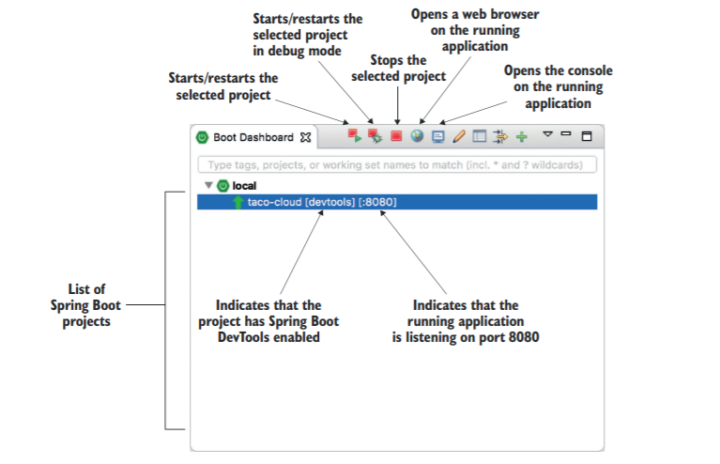
Building and running application

Slide 18
Spring Devtools
As its name suggests, DevTools provides Spring developers with some handy development-time tools. Among those are -
Automatic application restart when code changes
Automatic browser refresh when browser-destined resources (such as templates, JavaScript, stylesheets, and so on) change.
Automatic disable of template caches.
Built in H2 Console if the H2 database is in use.

Slide 19
Spring Landscape
Core spring framework
Spring boot
Spring data
Spring security
Spring integration
Spring batch
Spring cloud

Slide 20
Summary
Spring aims to make developer challenges easy, like creating web applications, working with databases, securing applications, and microservices.
Spring Boot builds on top of Spring to make Spring even easier with simplified dependency management, automatic configuration, and runtime insights.
Spring applications can be initialized using the Spring Initializr, which is web based and supported natively in most Java development environments.
The components, commonly referred to as beans, in a Spring application context can be declared explicitly with Java or XML, discovered by component scanning, or automatically configured with Spring Boot autoconfiguration

Slide 21
Developing web application
Present data in browser
Processing data in browser
Validating input
Choosing a template library

Slide 22
Order Taco Online
Order taco online
Select ingredient so customer can customize their order
Display list of ingredients from database

Slide 23
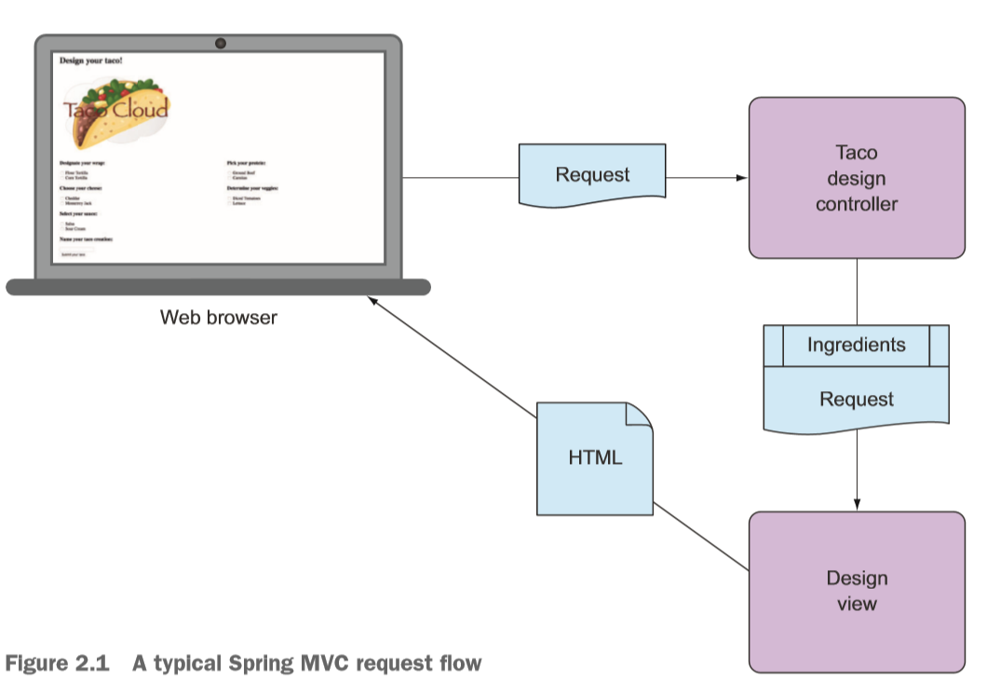
Order Taco Online

Slide 24
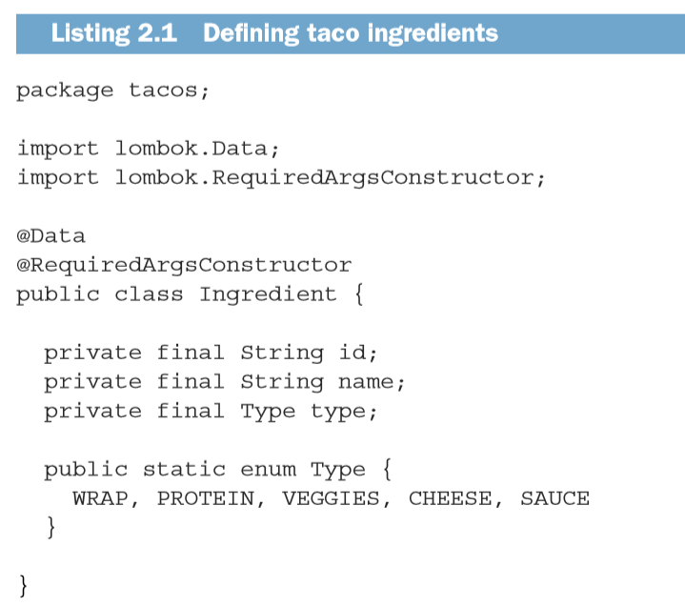
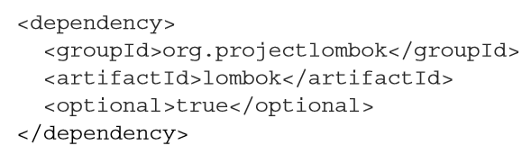
Define Domain

Slide 25
Creating controller
Handle HTTP GET requests where the request path is /design
Build a list of ingredients
Hand the request and the ingredient data off to a view template to be rendered as HTML and sent to the requesting web browser

Slide 26
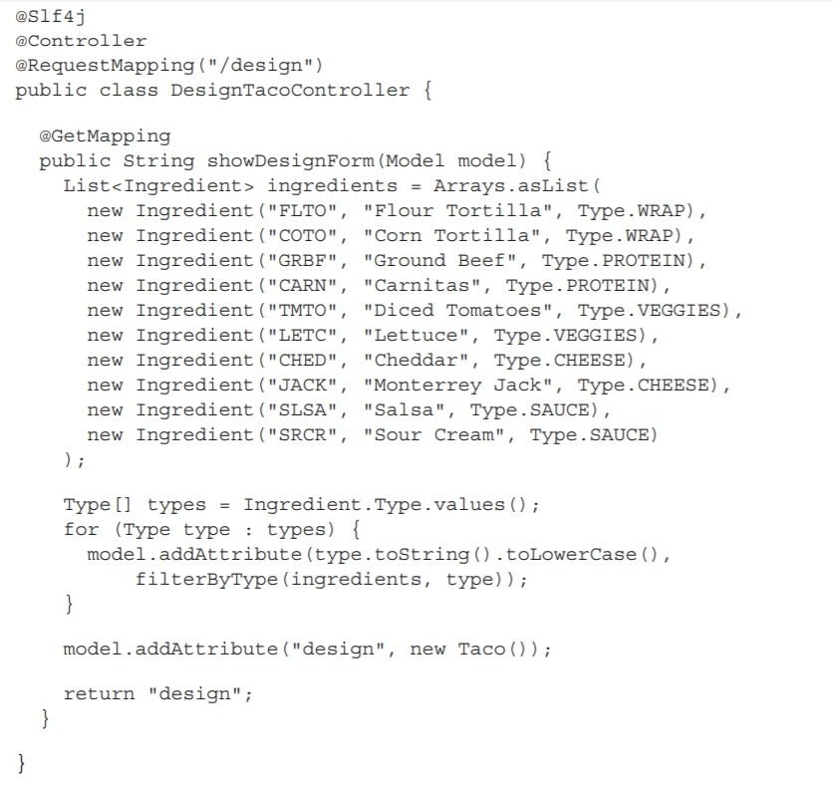
Creating controller

Slide 27
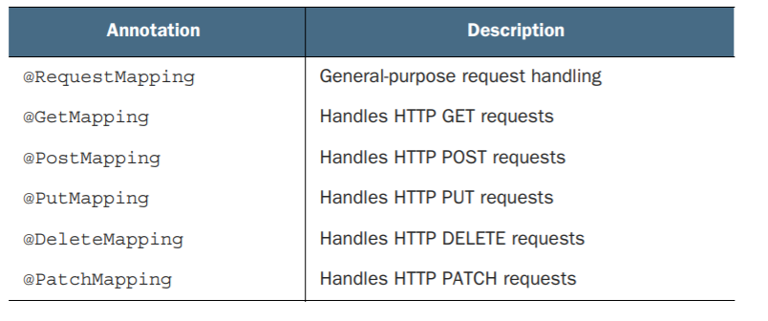
HTTP Mappings

Slide 28
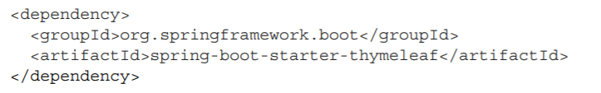
Designing views

Slide 29
Designing views

Slide 30
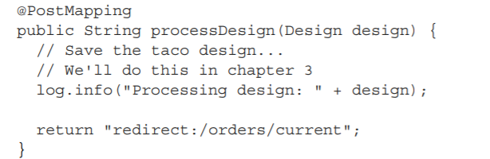
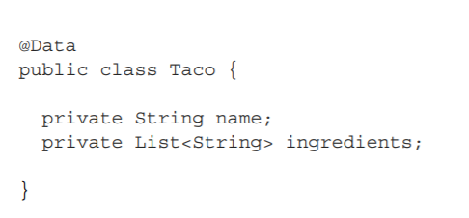
Form processing
As applied to the processDesign() method, @PostMapping coordinates with the classlevel @RequestMapping to indicate that processDesign() should handle POST requests for /design. This is precisely what you need to process a taco artist’s submitted creations
Taco is a straightforward Java domain object with a couple of properties. Like Ingredient, the Taco class is annotated with @Data to automatically generate essential JavaBean methods for you at runtime

Slide 31
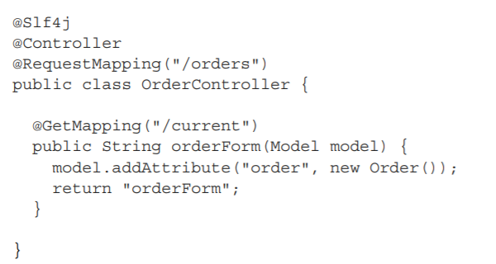
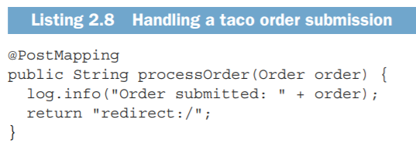
Creating controller for order

Slide 32
Order views

Slide 33
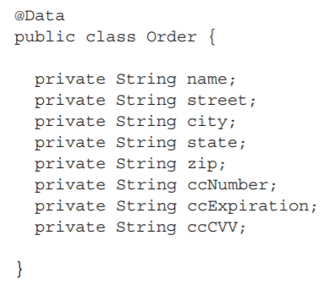
Domain object for order

Slide 34
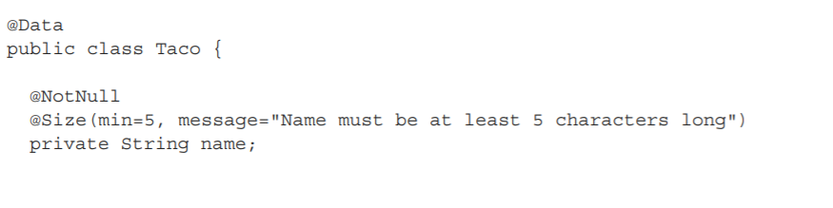
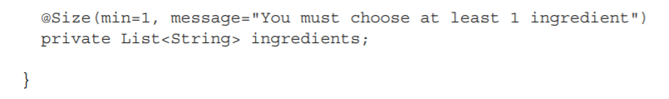
Domain class with validations

Slide 35
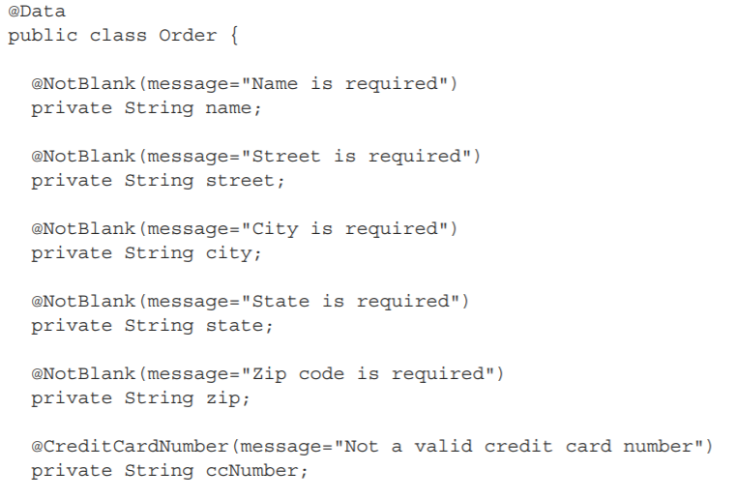
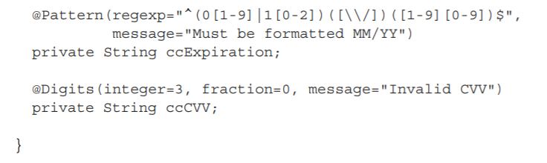
Domain class with validations

Slide 36
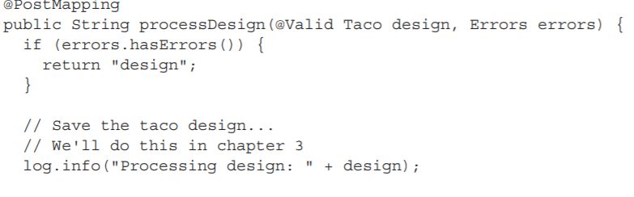

Validating domain Taco in controller
The @Valid annotation tells Spring MVC to perform validation on the submitted Taco object after it’s bound to the submitted form data and before the processDesign() method is called

Slide 37
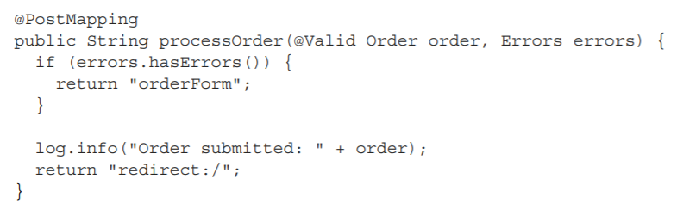
Validating domain Order in controller

Slide 38
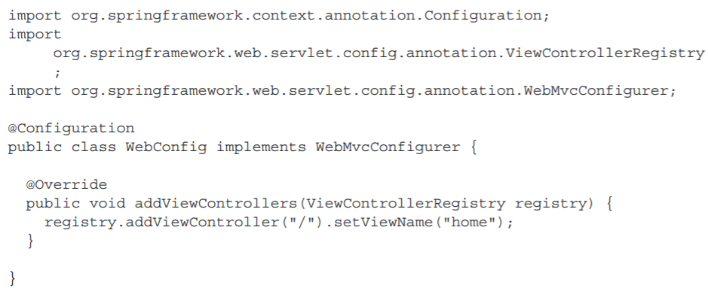
View controller
The most significant thing to notice about @WebConfig is that it implements the WebMvcConfigurer interface. WebMvcConfigurer defines several methods for configuring Spring MVC. Even though it’s an interface, it provides default implementations of all the methods, so you only need to override the methods you need. In this case, you override addViewControllers().

Slide 39
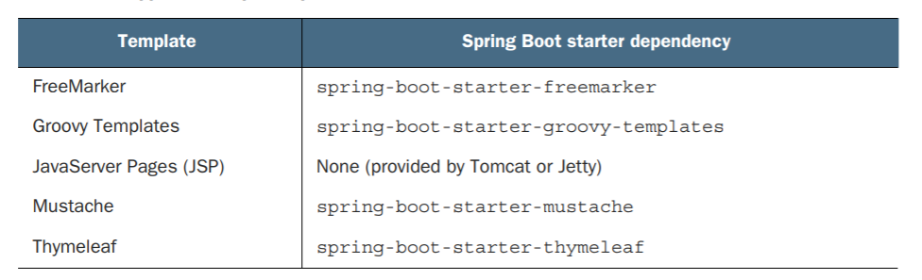
Supporting template

Slide 40
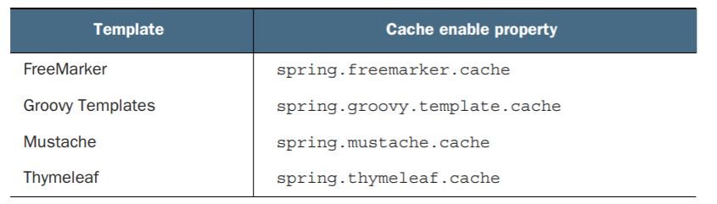
Template caching
By default, templates are only parsed once, when they’re first used, and the results of that parse are cached for subsequent use.
This is a great feature for production, as it prevents redundant template parsing on each request and thus improves performance.
That feature is not so awesome at development time, however. Let’s say you fire up your application and hit the taco design page and decide to make a few changes to it. When you refresh your web browser, you’ll still be shown the original version. The only way you can see your changes is to restart the application, which is quite inconvenient.

Slide 41
Summary
Spring offers a powerful web framework called Spring MVC that can be used to develop the web frontend for a Spring application.
Spring MVC is annotation-based, enabling the declaration of request-handling methods with annotations such as @RequestMapping, @GetMapping, and @PostMapping.
Most request-handling methods conclude by returning the logical name of a view, such as a Thymeleaf template, to which the request (along with any model data) is forwarded.
Spring MVC supports validation through the Java Bean Validation API and implementations of the Validation API such as Hibernate Validator.
View controllers can be used to handle HTTP GET requests for which no model data or processing is required.
In addition to Thymeleaf, Spring supports a variety of view options, including FreeMarker, Groovy Templates, and Mustache

