Slide 1
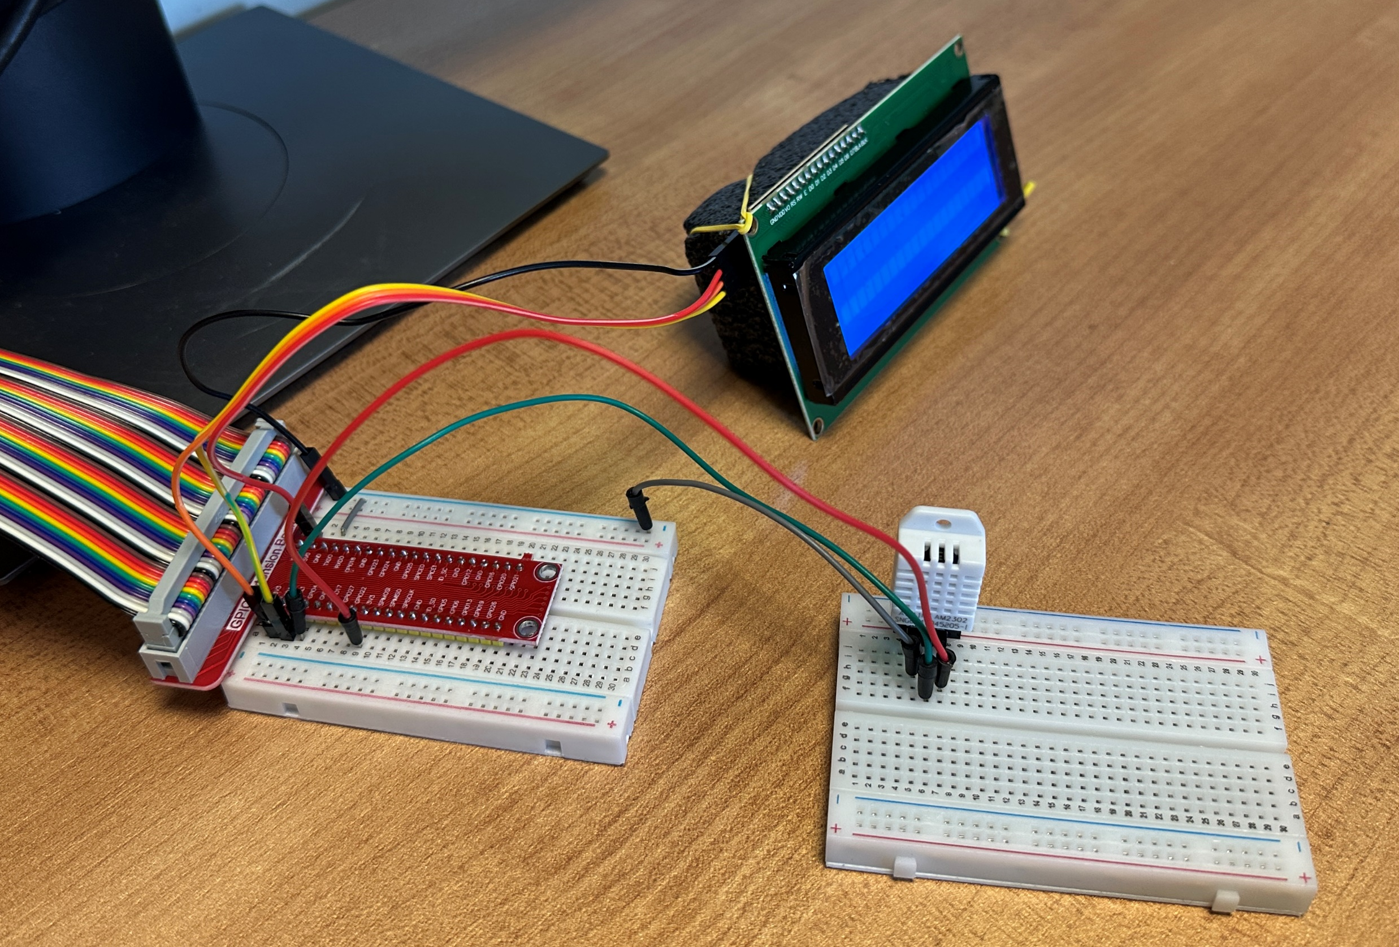
Pin: 2
(VCC 5V)
Pin: 6
(Ground)
Pin: 3
(GPIO 2)
Pin: 5
(GPIO 3)
Pin: 17
(VCC 3.3V)
Pin: 7
(GPIO 4)

