Slide 1
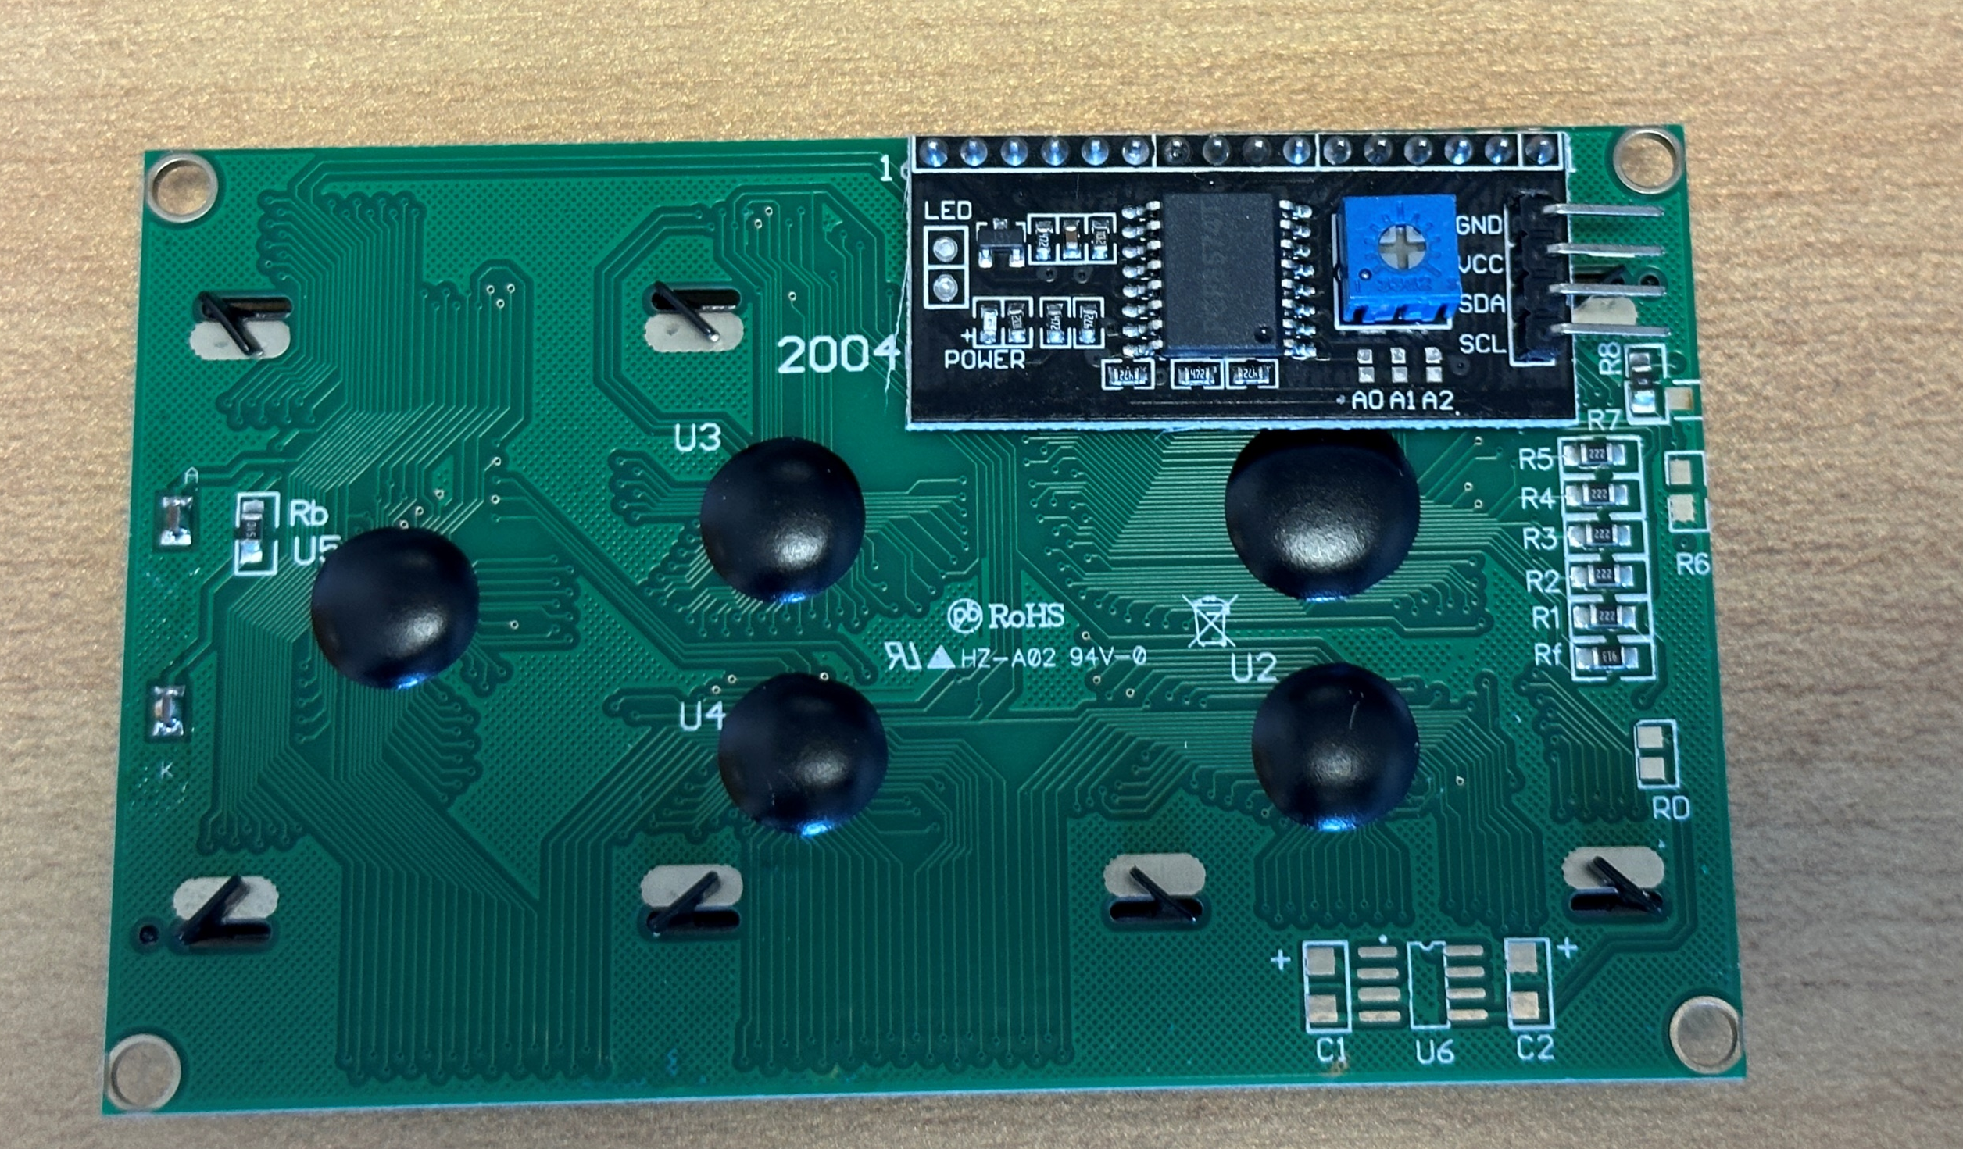
Pin: 6
(Ground)
Pin: 2
(VCC 5V)
GND
VCC
SDA
SCL
Pin: 3
(GPIO 2)
Pin: 5
(GPIO 3)

