Slide 1

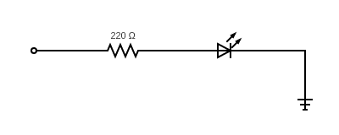
Pin: 6
GROUND
Pin: 11
GPIO 17
LED
Pin: 13
GPIO 27
LED

