Slide 1
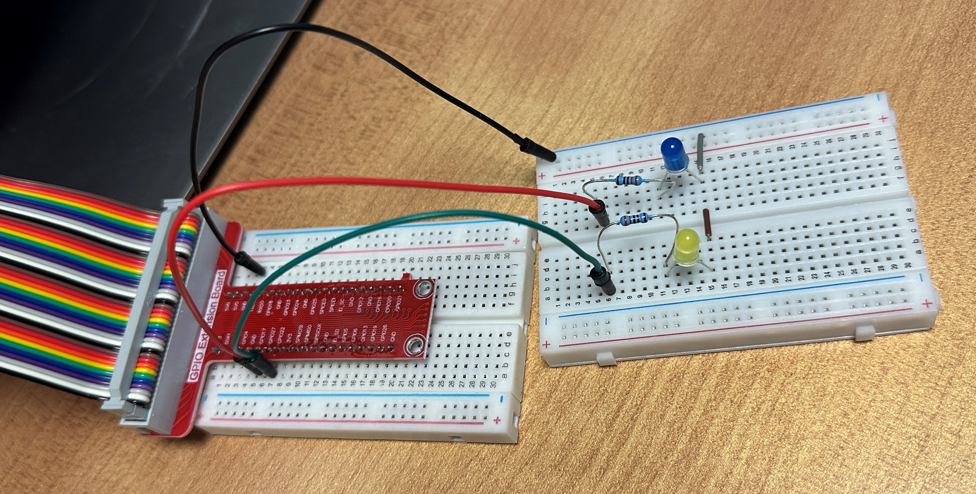
Pin: 6
(Ground)
Pin: 11
(GPIO 17)
Pin: 13
(GPIO 27)

