Slide 1

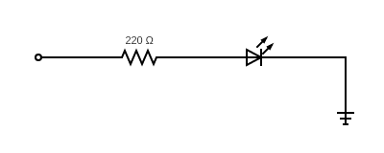
Pin: 6
GROUND
Pin: 11
GPIO 17
Pin: 16
GPIO 23
LED
LED
Pin: 13
GPIO 27
Pin: 15
GPIO 22
LED
LED

