Slide 1
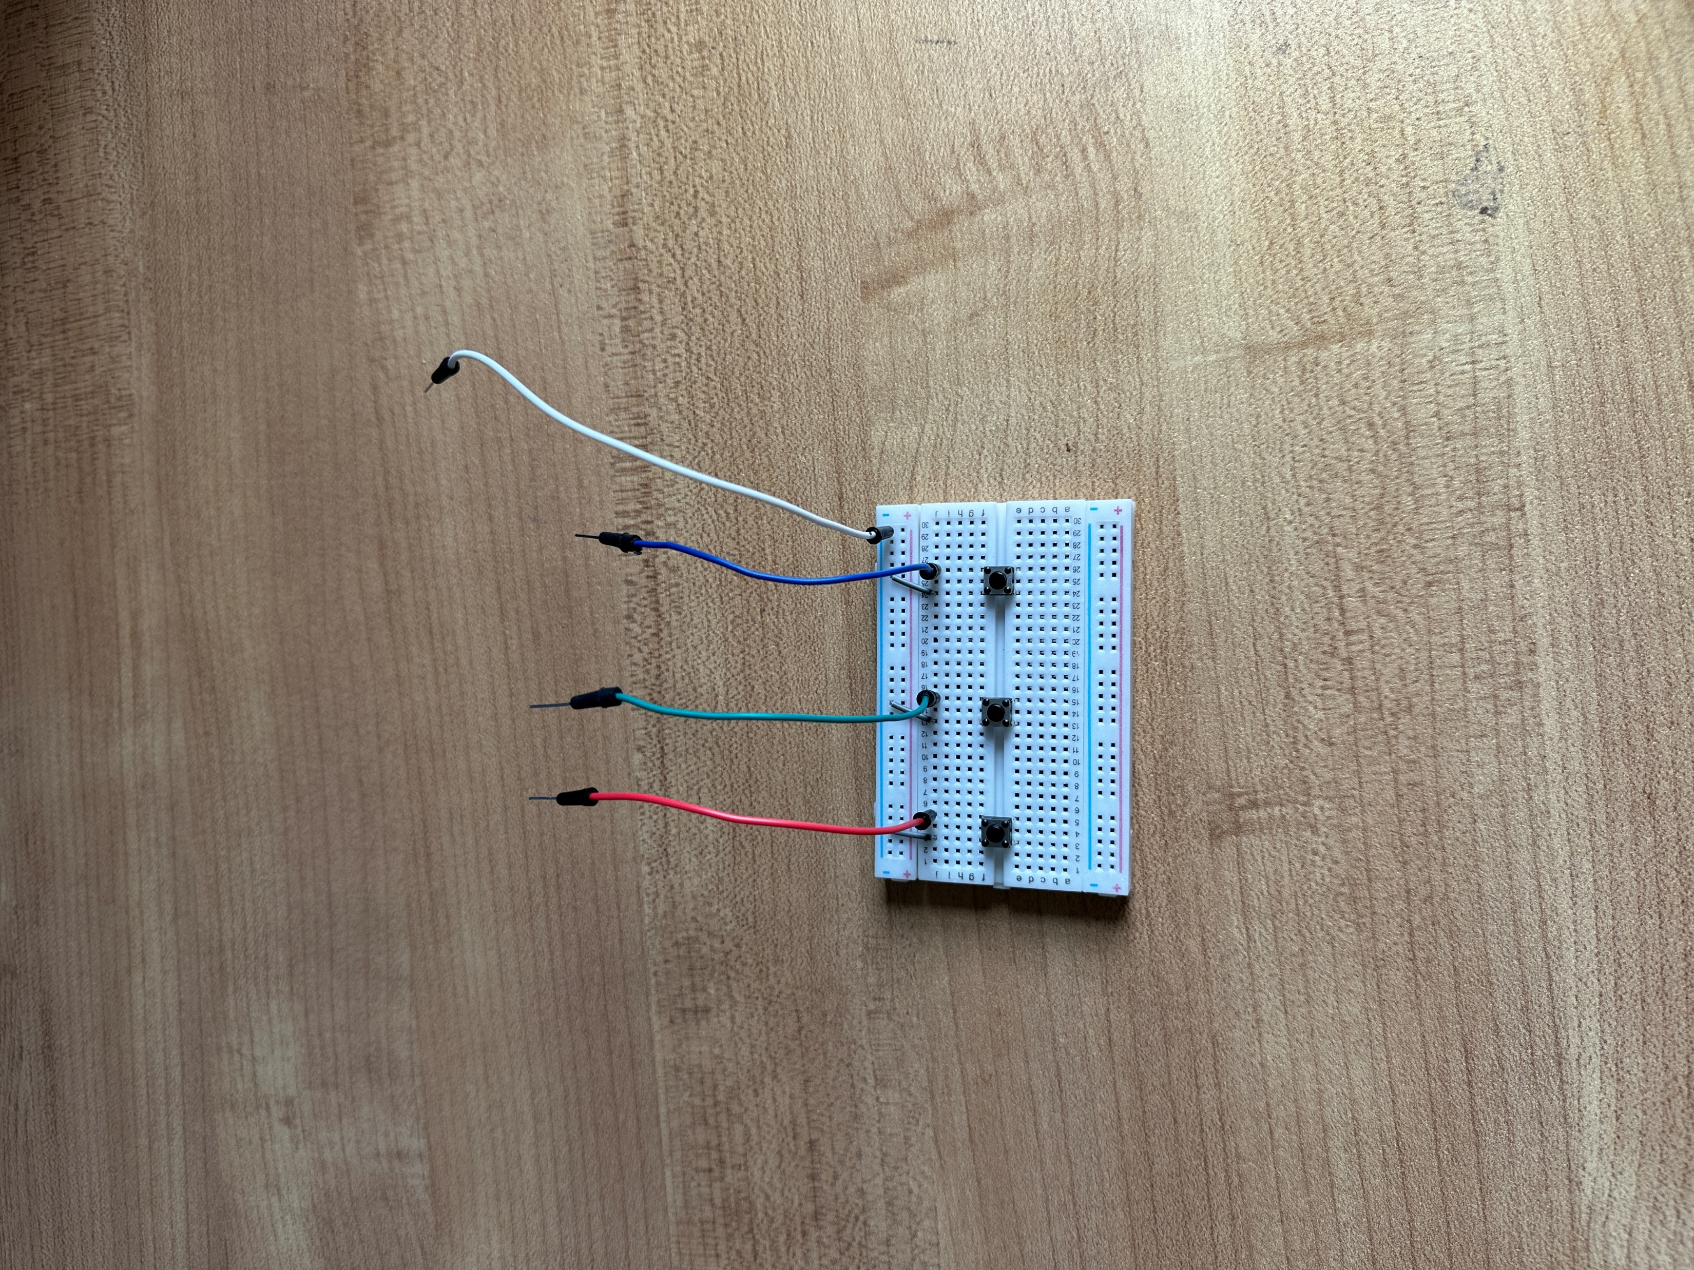
Pin: 37
GPIO 26
(Rock)
Pin: 38
GPIO 20
(Paper)
Pin: 40
GPIO 21
(Scissors)
Pin: 6
GROUND

