Slide 1
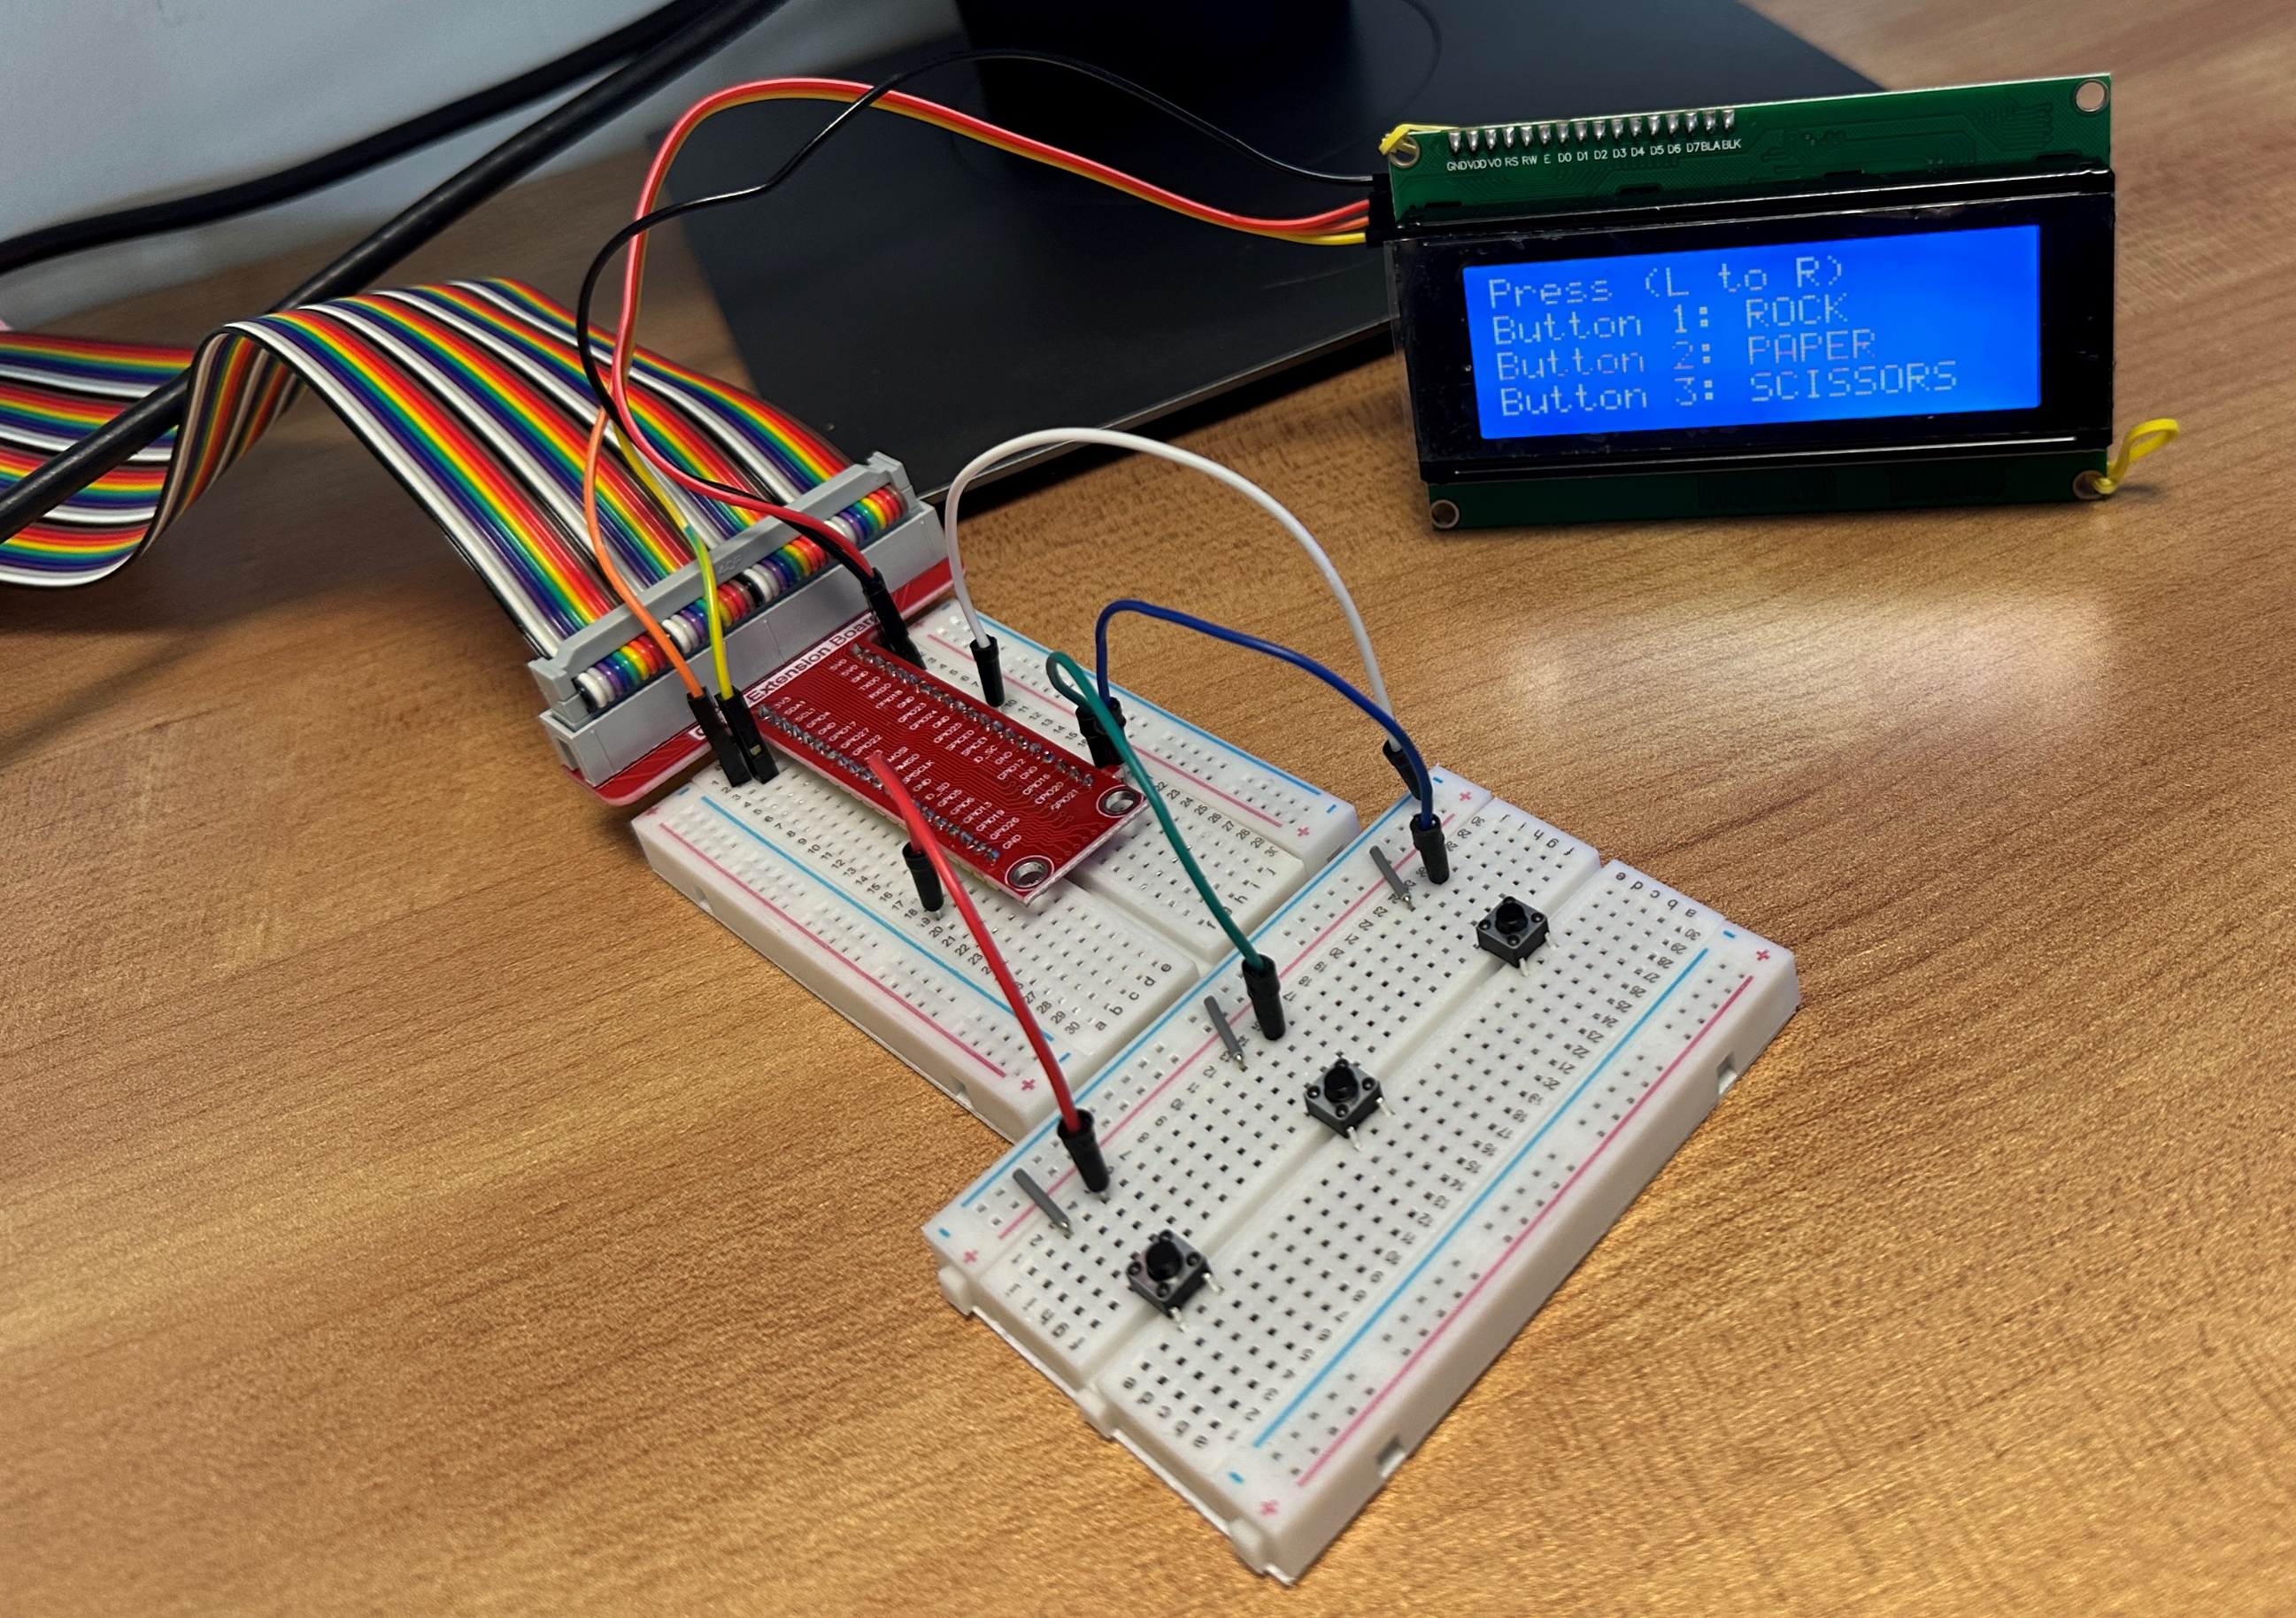
Pin: 6
(Ground)
Pin: 2
(VCC 5V)
Pin: 3
(GPIO 2)
Pin: 5
(GPIO 3)
Pin: 37
GPIO 26
(Rock)
Pin: 38
GPIO 20
(Paper)
Pin: 40
GPIO 21
(Scissors)

