Slide 1
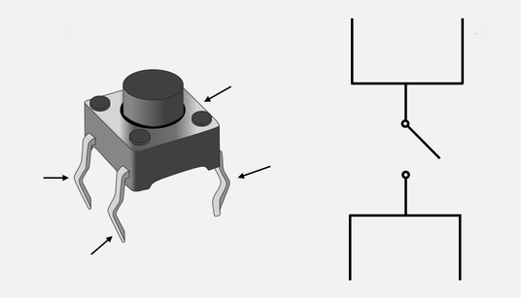
A
B
C
D
A
longer
B
C
D

