Slide 1
CSI 300 Database management Systems
Database basics
-Vikas Thammanna Gowda

Slide 2
Data
Weather forecasting
Analyzing financial investments
Tracking global trends
Data is numeric, textual, visual, or audio information that describes real-world systems.
Data can vary in several important ways
Scope
Format
Access
Small business
&
Amazon
Satellite images
&
Student’s information
Private
&
Government
Historically, data was mostly analog, encoded as continuous variations on various physical media.
Ex: Audio was recorded as vibrations impressed on vinyl disks.
Images were recorded as chemicals on celluloid tapes.
Today, data is mostly digital, encoded as zeros and ones on electronic and magnetic media.

Slide 3
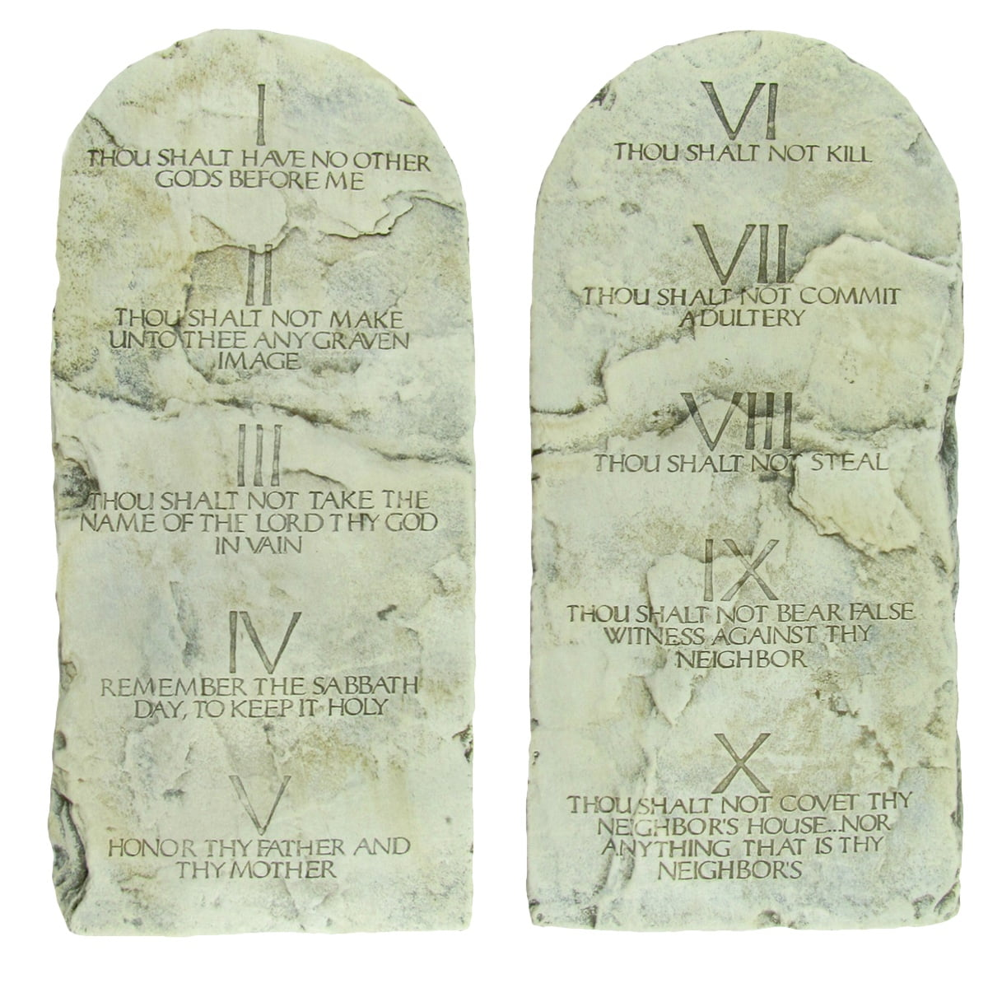

databases
A database is a collection of data in a structured format.
A database system (/DBMS) is a software that reads and writes data in a database.
Secure
Consistent
Available at all times
A query is a request to retrieve or change data in a database.
A query language is a specialized programming language, designed specifically for database systems.
This Photo by Unknown Author is licensed under CC BY
This Photo by Unknown Author is licensed under CC BY

Slide 4

databases
A transaction is a group of queries that must be either completed or rejected as a whole.
Transactions ensure data consistency by following the ACID properties
Atomicity: All operations succeed or none are applied.
Consistency: Transactions leave the database in a valid state.
Isolation: Transactions do not interfere with each other.
Durability: Changes persist even after a system failure.
** The above requirements are supported in sophisticated transaction management subsystems of most database systems.
This Photo by Unknown Author is licensed under CC BY
Notes:
* Ensure transactions are processed completely or not at all. A computer or application might fail while processing a transaction. When failing to process a transaction, the database system must reverse partial results and restore the database to the values prior to the transaction.
* Prevent conflicts between concurrent transactions. When multiple transactions access the same data at the same time, a conflict may occur.
Ex: Sam selects a seat on a flight. Maria purchases the same seat in a separate transaction before Sam completes his transaction. When Sam clicks the 'purchase' button, his seat is suddenly unavailable.
* Ensure transaction results are never lost. Once a transaction completes, transaction results must always be saved on storage media, regardless of application or computer failures.

Slide 5
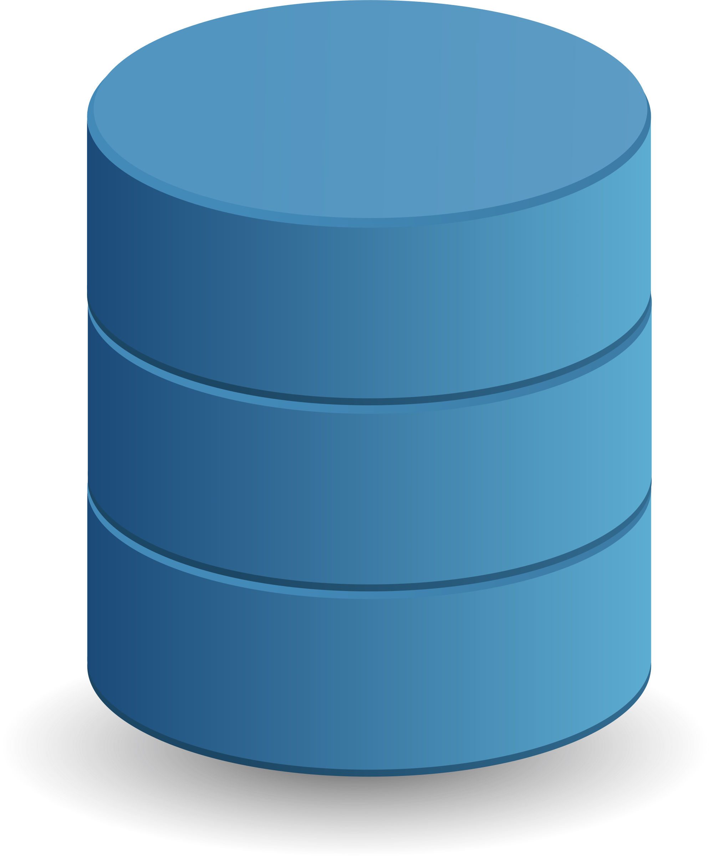

Databases systems
A database application is software that helps business users interact with database systems.
User data
Metadata
Indices
Overhead data
Application metadata
Database
Database
Application
Database
Management
System
Client/User
Components of a Database System
Database Contents
Data about the structure of a database are called metadata.
Ex: names of tables,
names of columns and the tables to which they belong,
properties of tables and columns
Notes:
* A database has user data and metadata, as just described. A database also has indexes and other structures that exist to
improve database performance, and we will discuss such structures in later chapters.
* Overhead data is data used for purposes such as addressing, congestion management, error control, priority indication,
and routing calls, blocks, frames, packets, and cells containing payload.
* Finally, some databases contain application metadata; these are data that describe application elements,
such as forms and reports. For example, Microsoft Access carries application metadata as part of its databases.

Slide 6
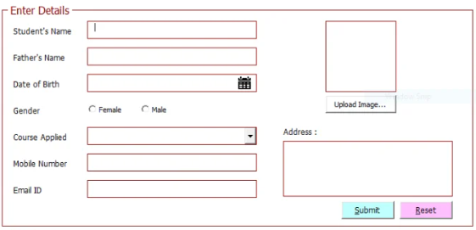
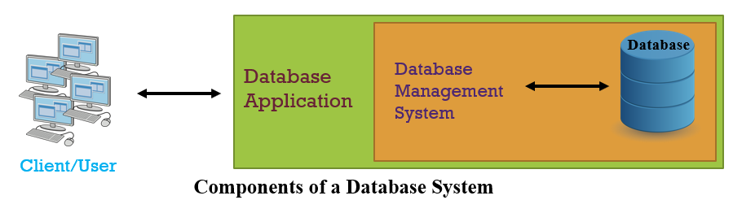
Databases systems
Functions of Database Application Programs
• Create and process forms
• Process user queries
• Create and process reports
• Execute application logic
• Control application
Functions of Database Administration
• Control concurrency
• Provide security
• Perform backup and recovery
A DBMS controls concurrency by ensuring that one user’s work does not inappropriately interfere with another user’s work.
Notes:
* A form in a database is a user interface that allows users to enter, edit, and display data in a database.
* A DBMS controls concurrency by ensuring that one user’s work does not inappropriately interfere with another user’s work.

Slide 7
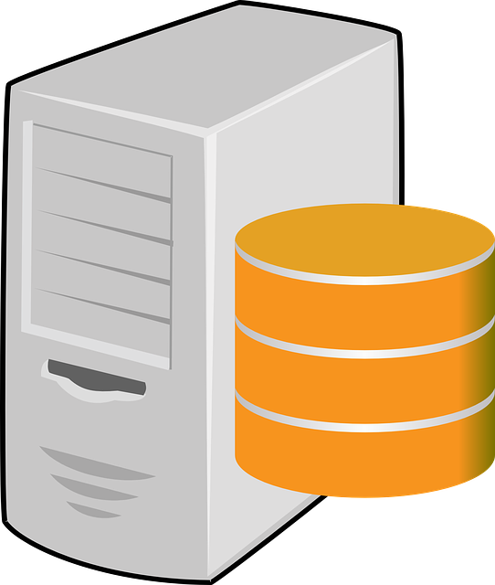
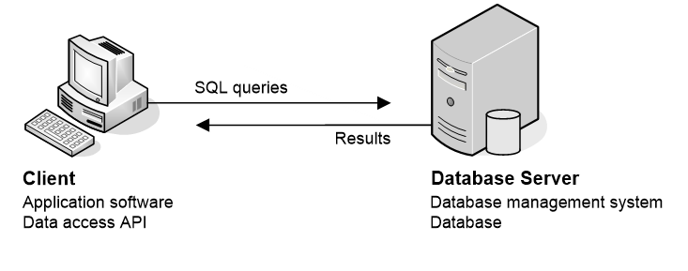

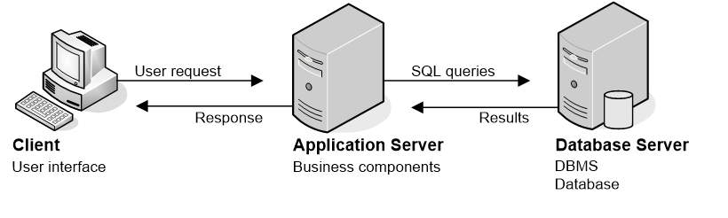

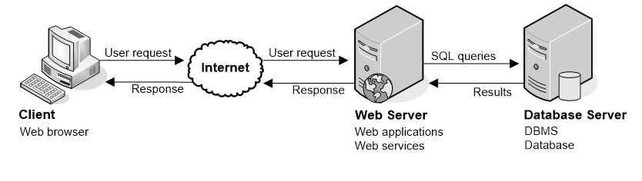
Databases systems
Database
Server
Interface
WAN
LAN
Network system
Client/User
Client/User
Client/User
Web-based system
Client-Server system
This Photo by Unknown Author is licensed under CC BY

Slide 8
Databases systems
Key Considerations
Scalability
Performance
Maintainability
Choose the appropriate architecture based on the expected number of users and data size.
Use load balancers, caching layers, and optimized database queries to improve response times.
Opt for modular designs to facilitate future updates and debugging.
Security
Cost
Implement secure communication (e.g., HTTPS, firewalls) and authentication mechanisms.
Evaluate infrastructure costs, including hardware, cloud services, and maintenance.

