Slide 1
NORMALIZATION
CSI 300 DATABASE MANAGEMENT SYSTEMS
-Vikas Thammanna Gowda

Slide 2
NORMALIZATION
NORMALIZATION is a database design technique that organizes tables in a manner that reduces redundancy and dependency of data.
Normalization divides larger tables into smaller tables and links them using relationships.
The main goal of Database Normalization is to restructure the logical data model of a database to:
Eliminate redundancy.
Organize data efficiently.
Reduce the potential for data anomalies.
Insert
Delete
Update

Slide 3
HISTORY/OVERVIEW
Database Normalization was first proposed by Edgar F. Codd.
Codd defined the first three Normal Forms, which we’ll look into, of the 7 known Normal Forms.
In order to normalize we must know what the requirements are for each of the three Normal Forms that we’ll go over.
1NF
2NF
One of the key requirements to remember is that Normal Forms are progressive.
In order to have 3rd NF we must have 2nd NF.
In order to have 2nd NF we must have 1st NF.
3NF
…..

Slide 4
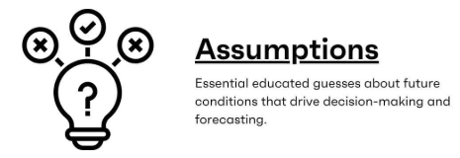
DISCLAIMER
Design
Implement
Test
Whatever we study in the upcoming slides will make complete sense because the examples are simple. However, in reality, it is complex.
We aim to follow the rules of database normalization and implement the design accordingly.
It is only during the testing phase that we encounter issues in design or implementation, prompting us to go back and fix them while ensuring that we adhere to normalization rules.

Slide 5

1NF REQUIREMENTS
The requirements to satisfy the 1st NF:
Each table has a primary key.
The values in each column of a table are atomic (No multi-value attributes allowed).
StudentID | AdvID | AdvName | AdvRoom | ClassID
123 | 123A | James | 555 | 102-8, 104-9
124 | 123B | Smith | 467 | 209-0, 102-8
There are no repeating groups: two columns do not store similar information in the same table.
StudentID | AdvID | AdvName | AdvRoom | ClassID1 | ClassID2
123 | 123A | James | 555 | 102-8 | 104-9
124 | 123B | Smith | 467 | 209-0 | 102-8
This Photo by Unknown Author is licensed under CC BY-SA

Slide 6
1NF EXAMPLE
Un-normalized Students table:
StudentID | AdvID | AdvName | AdvRoom | ClassID1 | ClassID2
123 | 123A | James | 555 | 102-8 | 104-9
124 | 123B | Smith | 467 | 209-0 | 102-8
Normalized (1NF) Students table:
Potential primary key: (StudentID, ClassID)
StudentID | AdvID | AdvName | AdvRoom | ClassID
123 | 123A | James | 555 | 102-8
123 | 123A | James | 555 | 104-9
124 | 123B | Smith | 467 | 209-0
124 | 123B | Smith | 467 | 102-8

Slide 7
2NF REQUIREMENTS
The requirements to satisfy the 2nd NF:
All requirements for 1st NF must be met.
Redundant data across multiple rows of a table must be moved to a separate table.
No partial dependency: All non-key attributes must depend on the entire primary key, not just part of it.
Normalized (1NF) Students table:
StudentID | AdvID | AdvName | AdvRoom | ClassID
123 | 123A | James | 555 | 102-8
123 | 123A | James | 555 | 104-9
124 | 123B | Smith | 467 | 209-0
124 | 123B | Smith | 467 | 102-8
This Photo by Unknown Author is licensed under CC BY-SA

Slide 8
2NF EXAMPLE
Normalized (1NF) Students table:
StudentClasses table
StudentID | AdvID | AdvName | AdvRoom | ClassID
123 | 123A | James | 555 | 102-8
123 | 123A | James | 555 | 104-9
124 | 123B | Smith | 467 | 209-0
124 | 123B | Smith | 467 | 102-8
StudentID | ClassID
123 | 102-8
123 | 104-9
124 | 209-0
124 | 102-8
Students table
StudentID | AdvID | AdvName | AdvRoom
123 | 123A | James | 555
124 | 123B | Smith | 467
The primary key is
(StudentID, ClassID).
There are no other attributes in this table, so no partial dependencies.
many-to-many between Student and Class
The primary key here is StudentID.
All attributes (AdvID, AdvName, AdvRoom) depend on Student\# only.

Slide 9
3NF REQUIREMENTS
The requirements to satisfy the 3rd NF:
All requirements for 2nd NF must be met.
Eliminate fields that do not depend on the primary key.
That is, any field that is dependent not only on the primary key but also on another field must be moved to another table.
Students table
StudentID | AdvID | AdvName | AdvRoom
123 | 123A | James | 555
124 | 123B | Smith | 467
This Photo by Unknown Author is licensed under CC BY-SA

Slide 10
3NF EXAMPLE
Students table
StudentClasses table
StudentID | AdvID | AdvName | AdvRoom
123 | 123A | James | 555
124 | 123B | Smith | 467
StudentID | ClassID
123 | 102-8
123 | 104-9
124 | 209-0
124 | 102-8
Students table
Advisor table
StudentID | AdvID
123 | 123A
124 | 123B
AdvID | AdvName | AdvRoom
123A | James | 555
123B | Smith | 467
many-to-many between Student and Class

Slide 11
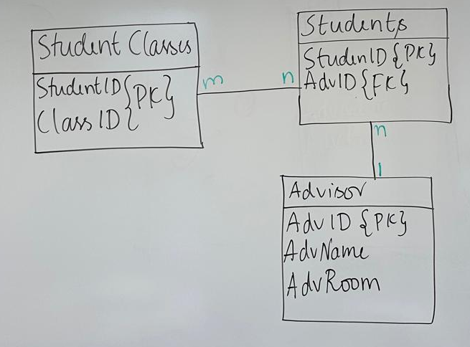
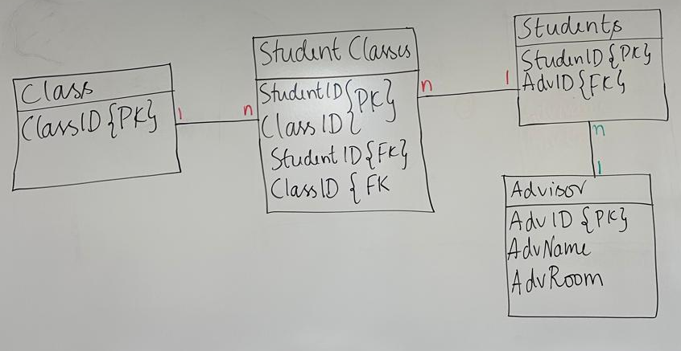
UML

Slide 12
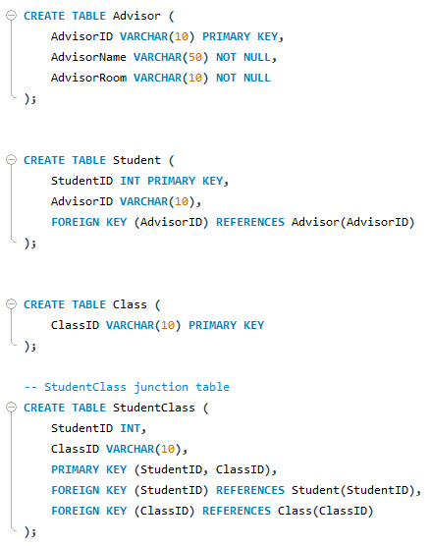
TABLES
n
1
n
n
1
1
Create table and insert values statements are on canvas and on agenda page.

