Slide 1
CSI 300 Database management Systems
Relationships in DBMS
-Vikas Thammanna Gowda

Slide 2

Relationships
In a Database Management System (DBMS), relationships define how data in different tables are related to each other.
These relationships ensure data consistency and integrity.
The three main types of relationships are:
One to One (1:1)
One to Many (1:M)
Many to Many (M:N)
This Photo by Unknown Author is licensed under CC BY-SA

Slide 3
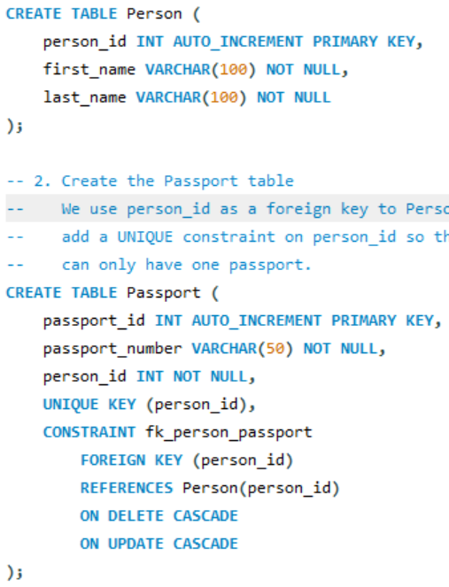
One-to-One (1:1) Relationship
Definition: One record in Table A is associated with at most one record in Table B, and one record in Table B is associated with at most one record in Table A.
Real-World Example: A person and their passport. Each person can have zero or one passport, and each passport can belong to exactly one person.

Slide 4
One-to-One (1:1) Relationship
UNIQUE KEY (person_id)
This ensures that no two rows in the Passport table can reference the same person_id.
In other words, if a person has an entry in Passport, you cannot add another row with the same person_id.
This enforces the one-to-one relationship: one Person can have at most one Passport in this table.
FOREIGN KEY (person_id) REFERENCES Person(person_id)
This sets up a referential link between the Passport table and the Person table, saying: “The person_id in Passport must match an existing person_id in Person.”
It ensures data integrity by preventing any person_id in Passport that doesn’t exist in Person
ON DELETE CASCADE
If a Person row is deleted from the Person table, the matching row in Passport is automatically deleted.
ON UPDATE CASCADE
If the primary key (person_id) in Person is updated (which is rare but possible), all matching person_id values in Passport are automatically updated to stay in sync.

Slide 5
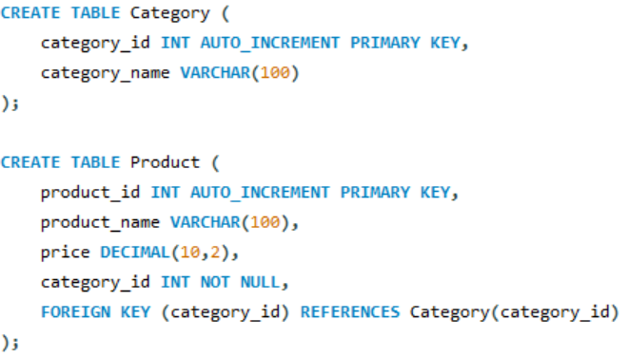
One-to-many (1:m) Relationship
Definition: A row in Table A can be associated with many rows in Table B, but a row in Table B can be associated with only one row in Table A.
Real-World Example: A category can have many products; each product belongs to exactly one category.

Slide 6
Many-to-many (M:n) Relationship
Definition: One record in Table A can be related to many records in Table B, and one record in Table B can be related to many records in Table A.
Real-World Example: Students and courses. A student can enroll in multiple courses, and each course can have multiple students.
To represent a many-to-many relationship,
we create a junction table that connects both tables.
Why a Junction Table?
You cannot represent many-to-many directly by adding a single foreign key column to one of the two tables—this would force a one-to-many or many-to-one.
Instead, you create a third table (often called a junction table, linking table, or join table) that holds references (foreign keys) to both of the original tables.

Slide 7
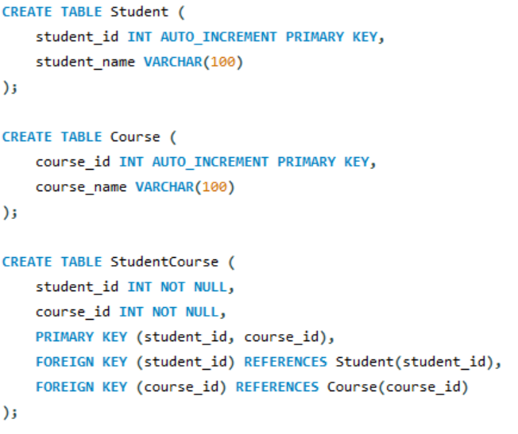
Many-to-many (M:n) Relationship
To represent a many-to-many relationship,
we create a junction table that connects both tables.
PRIMARY KEY(student_id, course_id) is usually the only natural way to identify each row uniquely, so it becomes both a candidate key and the primary key.

