Slide 1
CSI 300 Database management Systems
Relational Database
-Vikas Thammanna Gowda

Slide 2
Relation
It is a formal representation of a relation in mathematics, particularly set theory, but adapted to database structures.
A relation in an RDBMS is a two-dimensional structure (table) that organizes data into rows and columns.
Component | Explanation
Attributes (Columns/Field) | Represent the properties of the data. Each column has a unique name (attribute name) and a defined data type (e.g., integer, string, date).
Tuples (Rows/Record) | Represent individual data entries. Each entry is a single, unique instance of data within the table.
Domain | The set of all possible values that an attribute can hold. For example, a column "Age" might have a domain of integers between 0 and 120.
Schema | The structure of the relation, including its name, attributes, and their data types. Example schema: Student(ID: INT, Name: VARCHAR, Age: INT).
Degree | The number of attributes (columns) in the relation. Example: A table with 3 columns has a degree of 3.
Cardinality | The number of tuples (rows) in the relation. Example: A table with 5 rows has a cardinality of 5.

Slide 3
Relation
Example
Characteristics
Rows contain data about an entity.
Columns contain data about attributes of the entity.
Cells of the table hold a single value.
All entries in a column are of the same kind.
Each column has a unique name.
The order of the columns is unimportant.
The order of the rows is unimportant.
No two rows may hold identical sets of data values.
Each value in a tuple is atomic, meaning it is indivisible
(no nested tables or repeating groups).
ID | Name | Age
101 | Zoro | 21
102 | Bob | 22
103 | Charlie | 20
Attributes: ID, Name, Age
Tuples: Each row
(e.g., 101, Alice, 20)
Degree: 3
Cardinality: 3

Slide 4
Relational databases
A database model is a conceptual framework for database systems, with three parts:
Data structures that prescribe how data is organized.
Operations that manipulate data structures.
Rules that govern valid data.
Functions
• Create database
• Create tables
• Create supporting structures (e.g., indices)
• Read database data
• Modify (insert, update, or delete) database data
• Maintain database structures
• Enforce rules

Slide 5
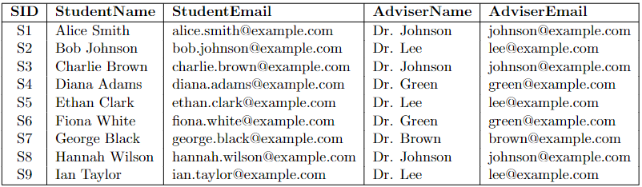
Advantages of Relational databases
Redundancy?
If I delete row 7?
If I update adviser’s email in row 9?
If I add a new adviser?

Slide 6
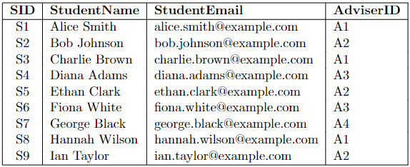
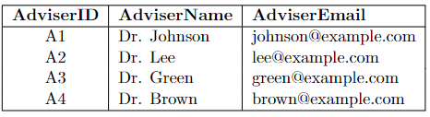
Advantages of Relational databases
Student table
Adviser table
Redundancy?
If I delete row 7 from Student table?
If I update adviser’s email?
If I add a new adviser?

Slide 7
Keys
Key Type | Definition | Characteristics | Importance
Primary Key | A unique identifier for each record in a table. | Ensures that no two rows have the same primary key value. Cannot contain NULL values. Each table can have only one primary key. | Essential for uniquely identifying records, facilitating efficient data retrieval, and serving as a reference point for establishing relationships with other tables.
Foreign Key | An attribute or set of attributes in one table that references the primary key of another table. | Establishes a link between two tables. Enforces referential integrity by ensuring that a value in the foreign key column corresponds to a valid primary key value in the referenced table | Foreign keys are vital for maintaining data consistency across related tables and enforcing relationships between different entities in the database.
Candidate Key | A minimal set of attributes that can uniquely identify a record in a table. | There can be multiple candidate keys in a table. One of the candidate keys is chosen as the primary key. | Candidate keys provide alternative options for unique identification of records and are considered when selecting the most appropriate primary key.
* Refer sql notes for more on keys

Slide 8
Keys
Primary Key: AdviserID
Candidate Keys: AdviserID and AdviserEmail
Primary Key: SID
Candidate Keys: SID and StudentEmail
Foreign Key: AdviserID

