Slide 1
SQL Joins
CSI 300 Database management Systems
-Vikas Thammanna Gowda

Slide 2
SQL
Select <List of Columns and expressions (usually involving columns)>
From <List of Tables & Join Operators>
Where <List of Row conditions joined together by And, Or, Not>
Group By <list of grouping columns>
Having <list of group conditions connected by And, Or, Not >
Order By <list of sorting specifications>

Slide 3
Conceptual Evaluation
From Tables: Cross product and join operations
1
4
3
5
2
Compute
aggregates and
reduce each
group to 1 row
Restriction on where conditions
Group By?
Sort on Group BY columns
Restriction
on HAVING
conditions
Yes
No
6
Sort
columns in
ORDER BY
Order
By?
Yes
No
Project columns in SELECT
7

Slide 4
Types of Joins
Inner Join
Natural Join
Left (Outer) Join
Right (Outer) Join
)Full) Outer Join
Left (Outer) Join Excluding Inner Join
Right (Outer) Join Excluding Inner Join
(Full) Outer Join Excluding Inner Join
Cross Join

Slide 5
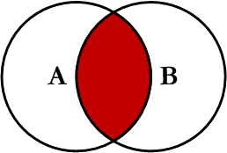
Inner Join
Inner join produces only the set of records
that match in both Table A and Table B
Most commonly used, best understood join.
INNER JOIN Syntax
SELECT column_name(s) FROM table1 INNER JOIN table2 ON table1.column_name = table2.column_name;
Note:
Inner Joins do not have to use equality to join the fields
Can use <, >, <>

Slide 6
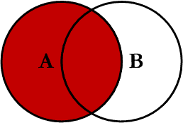
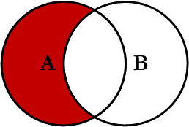
Left Join
Left outer join produces a complete set of records from Table A, with the matching records (where available) in Table B.
If there is no match, the right side will contain null.
Left inclusive Join
This query will return all of the records in Table A that do not match any records in Table B.
Left exclusive Join

Slide 7
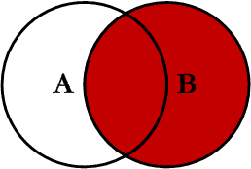
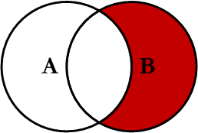
right Join
Right outer join produces a complete set of records from Table B, with the matching records (where available) in Table A.
If there is no match, the left side will contain null.
Right inclusive Join
This query will return all of the records in Table B that do not match any records in Table A.
right exclusive Join

Slide 8
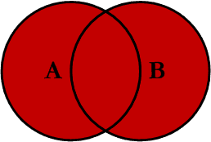
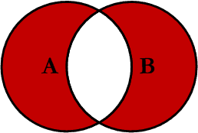
Outer Join
Full outer join produces the set of all records in Table A and Table B, with matching records from both sides where available.
If there is no match, the missing side will contain null.
Full outer inclusive Join
This query will return all of the records in Table A and Table B that do not have a matching record in the other table.
Full outer exclusive Join

Slide 9
Example
CREATE TABLE Publisher (
PublisherID INT AUTO_INCREMENT PRIMARY KEY,
PublisherName VARCHAR(255),
PublisherAddress VARCHAR(255),
PublisherPhone VARCHAR(20));
CREATE TABLE Author (
AuthorID INT AUTO_INCREMENT PRIMARY KEY,
AuthorName VARCHAR(255),
AuthorEmail VARCHAR(255));
CREATE TABLE Book (
BookID INT PRIMARY KEY,
Title VARCHAR(255),
ISBN VARCHAR(20),
PublicationYear INT,
Genre VARCHAR(100),
AuthorID INT, PublisherID INT,
FOREIGN KEY (AuthorID) REFERENCES Author(AuthorID),
FOREIGN KEY (PublisherID) REFERENCES Publisher(PublisherID));

Slide 10
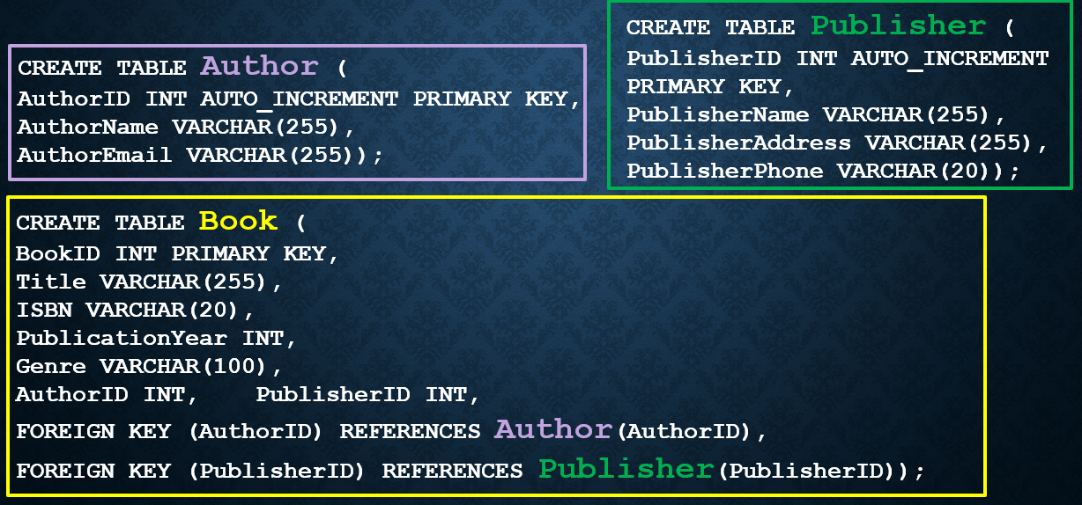
Example
Retrieve Author names and their corresponding book count in descending order
SELECT a.AuthorName, COUNT(b.AuthorID) AS BookCount
FROM book b
JOIN author a ON b.AuthorID = a.AuthorID
GROUP BY b.AuthorID
ORDER BY BookCount DESC;

