Slide 1
CSI 300 Database management Systems
How does JOINs work?
-Vikas Thammanna Gowda

Slide 2


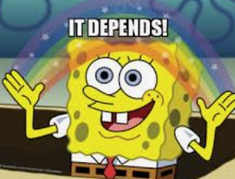
JOIN
You will JOIN on Central Table
Which table goes in front of
FROM and JOIN?
Does not matter for Inner Join
Matters for
Right/Left Join

Slide 3
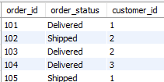

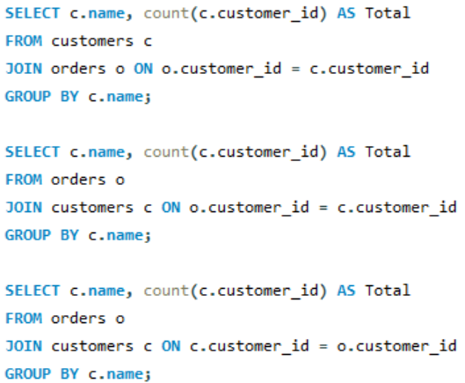
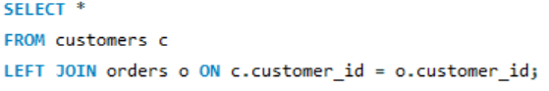
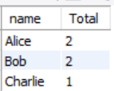
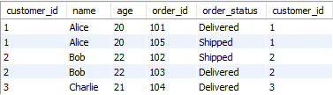
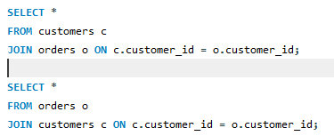

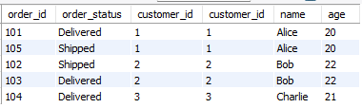

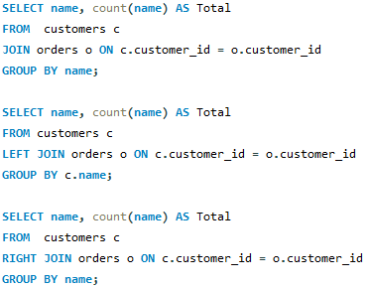


orders
customers
Get total orders placed by each customer
Left Join
Right Join
Will be sorted on customer_id
Get total orders placed by each customer

Slide 4
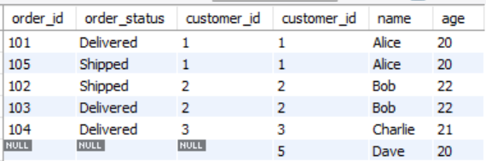
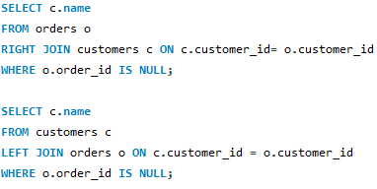

orders
customers
Get total orders placed by each customer
Left Join
Right Join
Will be sorted on customer_id
Get customer/s who haven’t placed an order

Slide 5
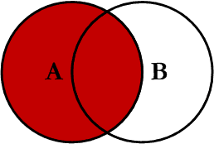
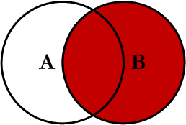
JOIN
Left Join
Right Join

