Slide 1
Full stack development
Amruta2024std

Slide 2
Contents
Web Application Architecture
Front end technologies
Back end technologies
Database
Tools required

Slide 3
Client- server Architecture
Server
Client
Request
Response

Slide 4
Web Application Architecture
Well Known web application like Facebook, Instagram and Amazon etc.
How they works
From User point of view:
User may use them from mobile as well as from laptop.
For using from mobile user need to install that application
For using from laptop user need web browser to use these applications

Slide 5
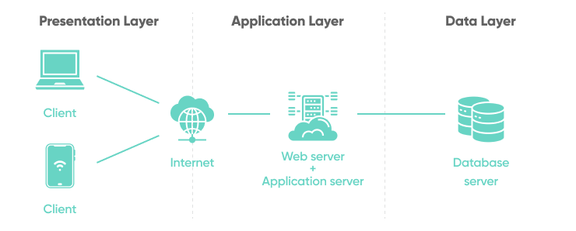
Web application General architecture

Slide 6
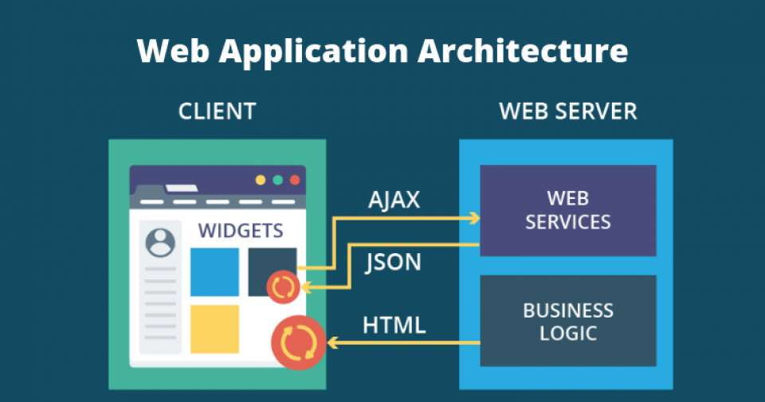
Working of Web application

Slide 7
Client Application/ UI / Front end
Technologies used:
HTML
CSS
Java Script
AngularJS
ReactJS
Flutter
React Native
Bootstrap

Slide 8
Backend Technologies
Python : flask, Django
Java Script : Node js and Expess
Java: Spring boot
PHP: larawell
9975045310

Slide 9
HTML
HTML (HyperText Markup Language) is the standard frontend language to create web pages.
Currently we are using HTML5
It is used to create the structure of a website.
It offers basic tools for adding forms, buttons, containers, and other elements.
It uses predefined tags that tell the browser how to display content.
The browser uses HTML to manipulate texts, images, and other website elements and display them in the required format.
It is platform-independent and easy to learn and use.

Slide 10
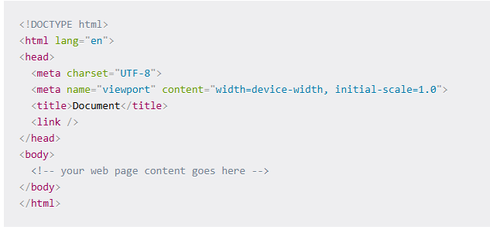
Structure of HTML page

Slide 11
Tags and Elements
Headings: The heading tags from <h1> to <h6>are used to define headings or subheadings within a document.
<h1> your text goes here </h1>
.
.
<h6> your text goes here </h6>
Paragraph:The paragraph tag (<p> your text goes here </p>) is used to separate blocks of text into distinct paragraphs. It is a block-level element that represents a unit of text or a block of content, and it is commonly used to structure and separate text on a webpage.

Slide 12
CSS( Cascading Style Sheets)
CSS describes how HTML elements are to be displayed on screen, paper, or in other media
CSS saves a lot of work. It can control the layout of multiple web pages all at once
External stylesheets are stored in CSS files

Slide 13
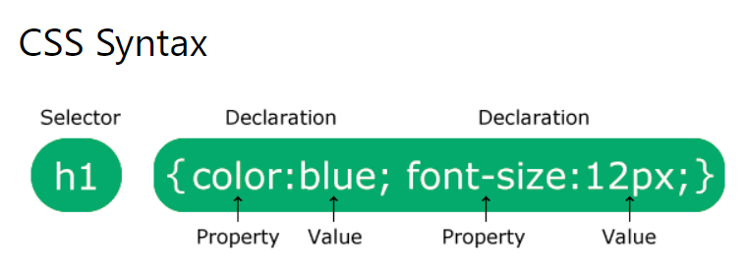
CSS Syntax
A CSS rule consists of a selector and a declaration block.
The selector points to the HTML element you want to style.
The declaration block contains one or more declarations separated by semicolons.
Each declaration includes a CSS property name and a value, separated by a colon.
Multiple CSS declarations are separated with semicolons, and declaration blocks are surrounded by curly braces.

Slide 14
Ways of adding styles
Inline approach: we can apply this by using style attribute
Internal approach: we can apply this by using <style> tag in head section of your html page.
External Approach: we will write style in separate file with extension .css. We have link that in head section of html page with help link tage.

Slide 15
Requests
Get: when client need data from sever we will use this get method
Post: when client want to send data to the server then we have to use this post method
112.34.03.567 -→ amazon.in(domain name)
Update
Delete

Slide 16
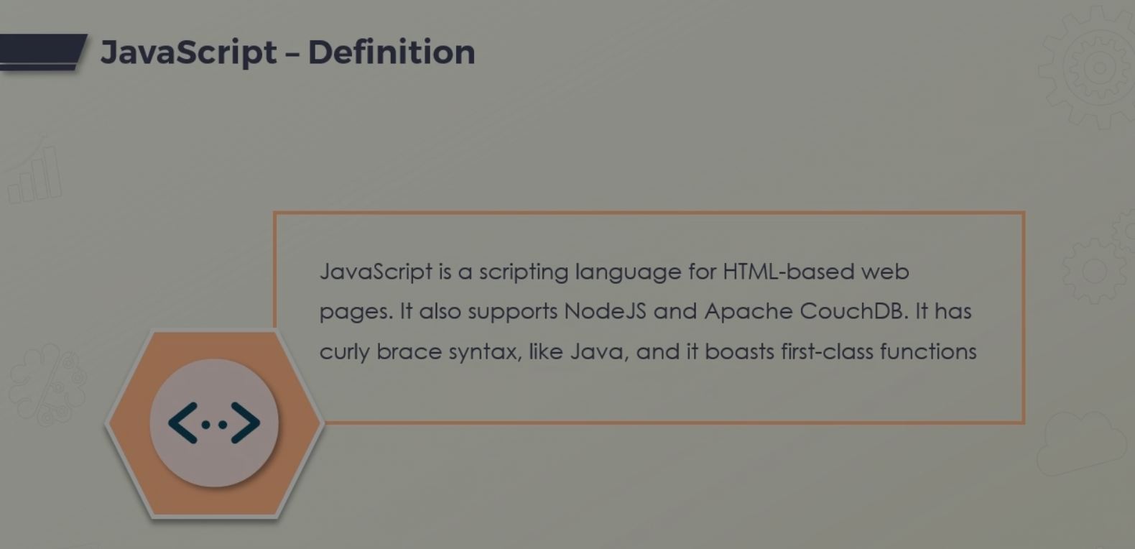
Java Script

Slide 17
Importance of JavaScript
JS run in the browser and can make ordinary, dull HTML pages come alive in dynamic way.
JS gives developer control over DOM.
JS we can use in server side programming with Node JS.
Several Brower APIs available via JS, like authentication, storage and geolocation

Slide 18
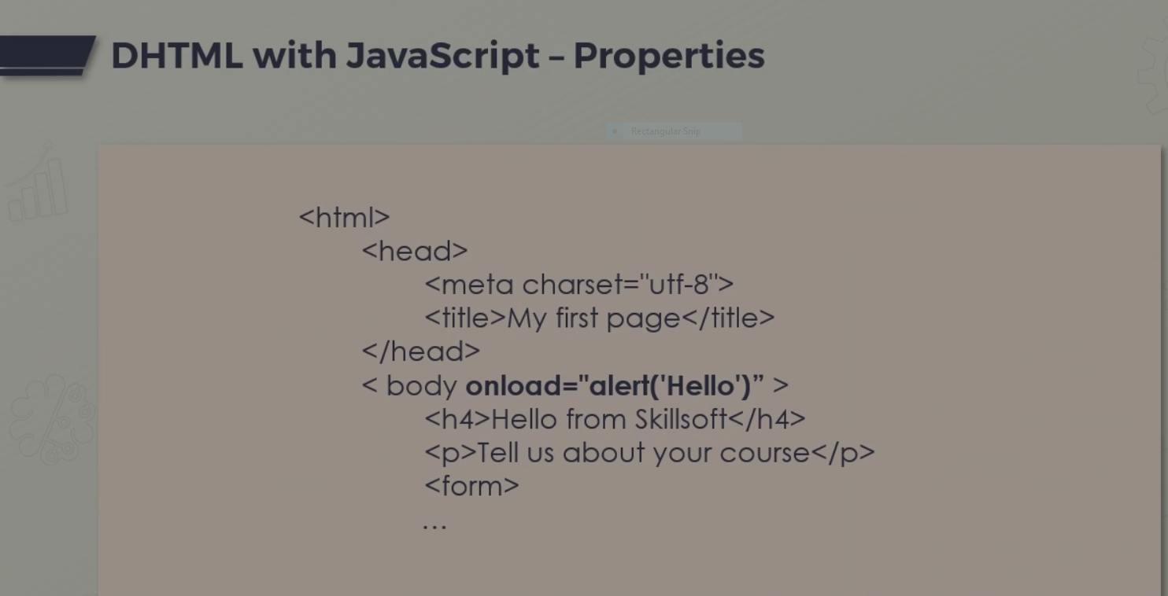

Slide 19
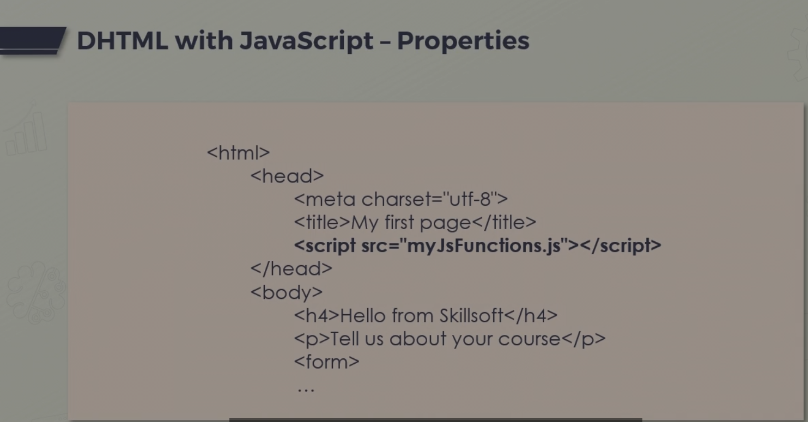

Slide 20
JavaScript is a programming Language
Variables
functions(first class citizens)
Sequence, decisions and iterations

Slide 21
Variables in JavaScript
Used to store values
Native data types are numeric, string and objects
The constant variables : will not changed as the program runs
Literals are just that-either numbers, strings or characters used as they are and not assigned.

Slide 22
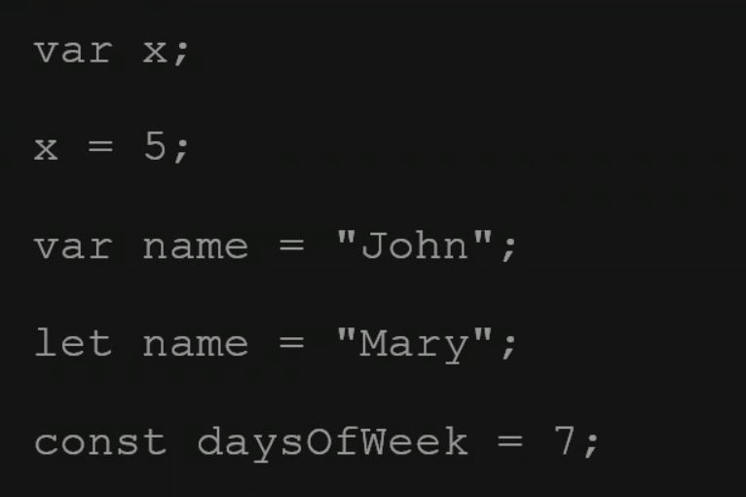
Variables in JS
Difference between var and let: in scope.
Var are globally scoped and let are within curly brackets.

Slide 23
Functions in JavaScript
A JS function is a block of code used to perform a task
Functions are first-class objects/citizens
A JS function is defined starting with the function keyword, then ()
The code in side the function will run when some other part of the code calls it.

Slide 24
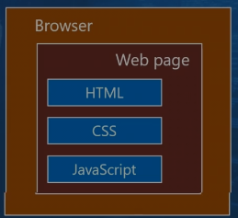
The Document object Model(DOM)

Slide 25
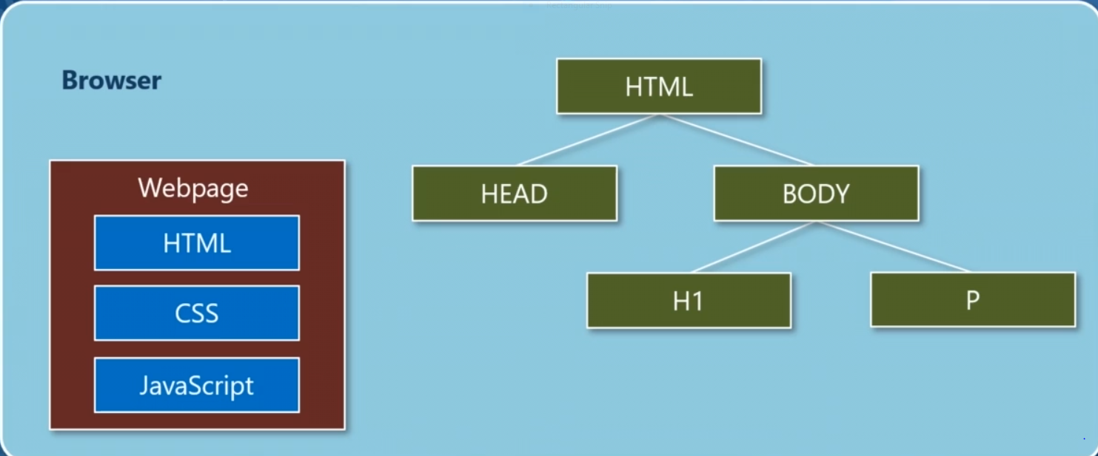
DOM: java script has ability to manipulate DOM element.

Slide 26
JavaScript arrays and functions
Array are variables containing a sequence of values.
The contents of array can be heterogeneous.
Their length are dynamic (elements can be added and removed)
Shallow and deep copies

Slide 27
Functions in JavaScript
It is block of statements to perform specific task
Functions are considered as first class members or citizens
A higher order functions : operates on other functions- either by taking them arguments or by returning them.
Their use in JavaScript is very common.

Slide 28
Objects in JavaScript
An object is a set of key-value pairs, where the values can also be function.
Each key-value pair is called a property of the object.
They are similar to maps, dictionaries and associative arrays
The value can be functions or even other objects
Object can inherit from and be created out of other objects.
Object are dynamic in nature

Slide 29
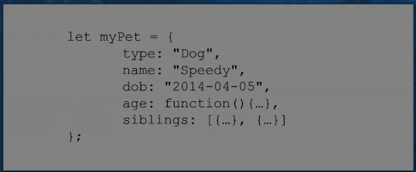
Example of object in JavaScript

Slide 30
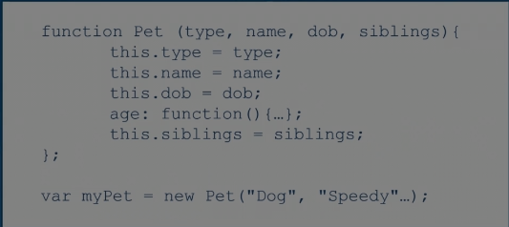
Object Constructors
A blueprint for a JavaScript object can be defined using a function constructor(similar to classes)
New instance can be created from these blueprints using the new keyword

Slide 31
Classes in JavaScript
It is possible to declare classes in JavaScript, but they are merely syntactic sugar over function constructors.
Inheritance can be implemented using the extends keyword
Under the hood, prototype-based inheritance is used(more on that later).

Slide 32
JavaScript Quirks
Strange special values. Undefined and null values, Nan and infinity(acceptable)
String and numeric operations:
Implicit conversion of numbers to strings for some operations
Addition and comparisons of numbers with strings may produce unexpected results
Strange equality operators:
== is equality operator and check for equal values(and perform conversion if needed)
=== is strict equality operator- it checks for equal values and types
Truthy and falsey:
Anything that JS can convert to Boolean true is considered truthy.
Non-zero numbers, non-empty strings, array etc. are truthy
Anything the JS can convert to a Boolean false is falsey.

Slide 33
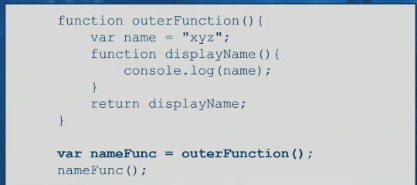
closures
It is a package of a function along with its enclosed environment.

Slide 34
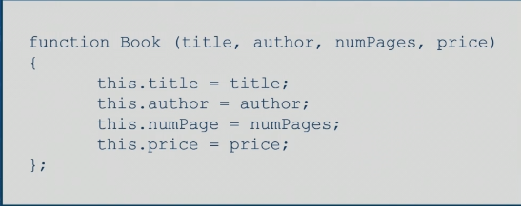
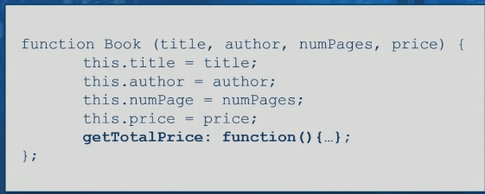
Prototypes and inheritance in JavaScript
Object constructor

Slide 35
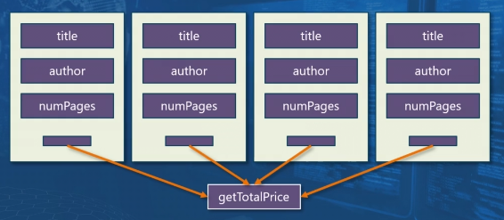
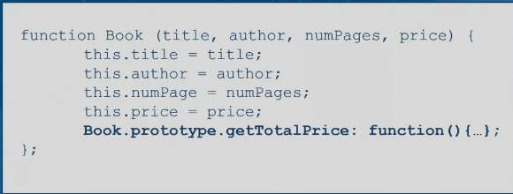

Slide 36
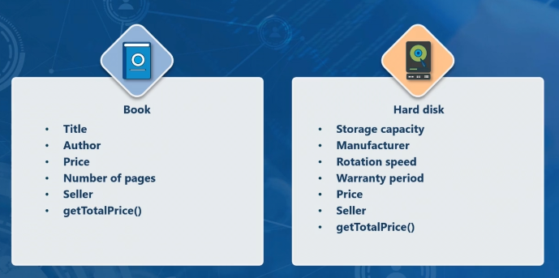
Variety of products

Slide 37
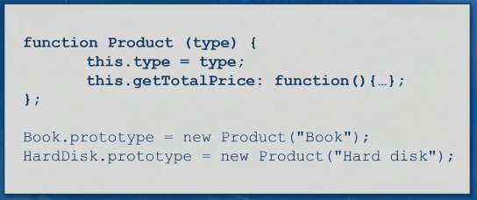
Common functions for all products
The getTotalPrice function should apply to hard disk as well as Books.
We can use a prototype to enable this.
The prototype in tis case can be an object.

