Slide 1
AI ENABLED CARD ORGANIZER
Group –6
Daniyal Ahmed - 301152472
Kanishka Dhir - 301220757
Utkarsh Kaushik - 301209079
Soham Rajput - 301180583
Vikas Bhargav Trivedi - 301217554

Slide 2

Research
Business card scanning apps use Optical Character Recognition (OCR) technology to extract contact information and organize it on mobile devices
Hub.cards, CamCards, and Covve scan are examples of business card scanning apps
SanSan scan to Salesforce can create leads automatically in Salesforce
Abby is an OCR software that can convert scanned documents, PDFs, and images into editable formats
HubSpot is an all-in-one marketing, sales, and service platform that uses advanced technology to automate processes
These apps offer different pricing models, making them accessible to businesses and individuals of all sizes.

Slide 3
ML/DL Algorithms
Support Vector Machines (SVM) has been used for business card recognition tasks.
Convolutional Neural Networks (CNNs) has been used for reading business cards by detecting text regions and extracting text from them.
Recurrent Neural Networks (RNNs) has been used for recognizing text on business cards by predicting the next character until the entire text is recognized.
Deep Learning-based Optical Character Recognition (OCR) is a DL-based approach that uses a combination of CNNs and RNNs to recognize text on business cards, which has been used to accurately recognize text on business cards, even when the text is distorted or appears in different fonts.
DL-based approaches, such as CNNs and RNNs, have shown the most promising results in recent years for reading business cards.

Slide 4
Technology Stack
Python: Used for the backend development of the application
JavaScript: Used for the frontend development of the application
AWS S3 and DynamoDB: Highly scalable object storage service and fully managed NoSQL database used to store and manage the leads contact datastore of the application.
Serverless Framework: AWS Chalice used to develop and deploy the backend of the application, supporting Python and integrating with AWS services such as AWS Lambda, API Gateway, and DynamoDB.
AI Services: AWS Recognition, AWS Translate and AWS Comprehend used to translate and extract information from images, for extracting contact information from images and text.

Slide 5

Functional Requirements
User Registration and Authentication: The application should allow users to create accounts and log in
Lead Data Management: The application should allow users to create, read, update, and delete lead data.
Contact Information Extraction: The application should be able to extract contact information such as name, email, phone number, address, etc., from images and text
Data Storage: The application should store the lead data securely in AWS S3 and DynamoDB.
API Access: The application should provide a RESTful API to allow other applications to access the lead data and functionalities of the application.
Translating the Information: The application should be translating the information on card if it is not in English language. The translated text should be displayed, and the user should be allowed to edit the information.

Slide 6
Architecture
A RESTful API Architecture is used to provide a web-based interface for accessing the application's data and functionalities, with its scalable, reliable, and easy-to-maintain architectural style.

Slide 7
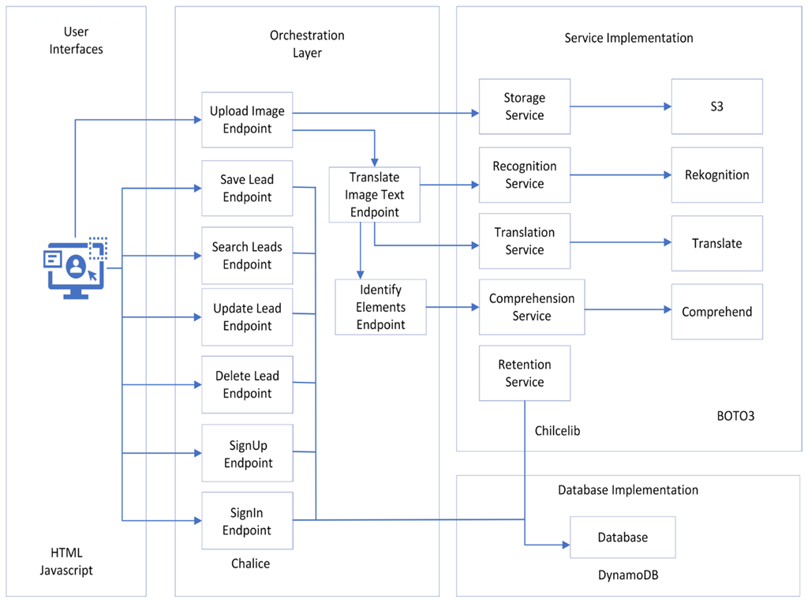
Architecture Diagram

Slide 8
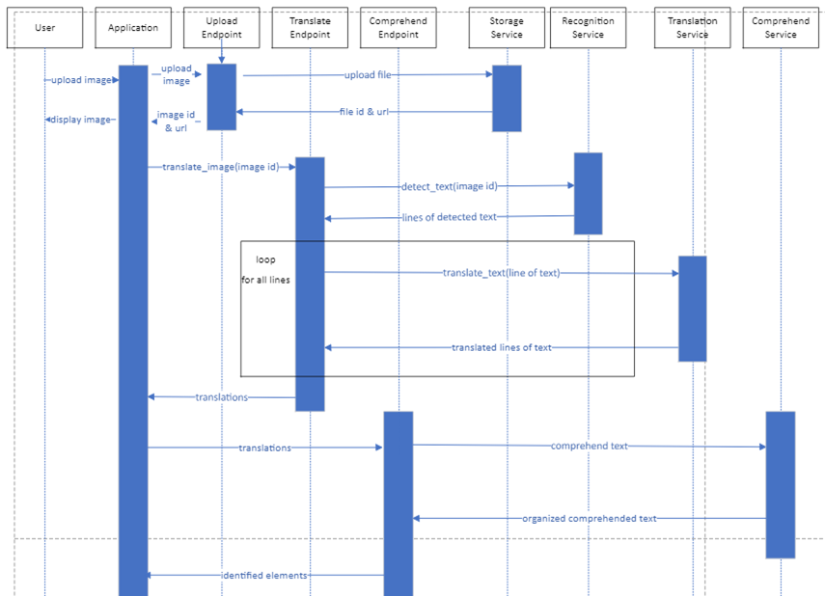
AWS Services Communications Diagram

Slide 9
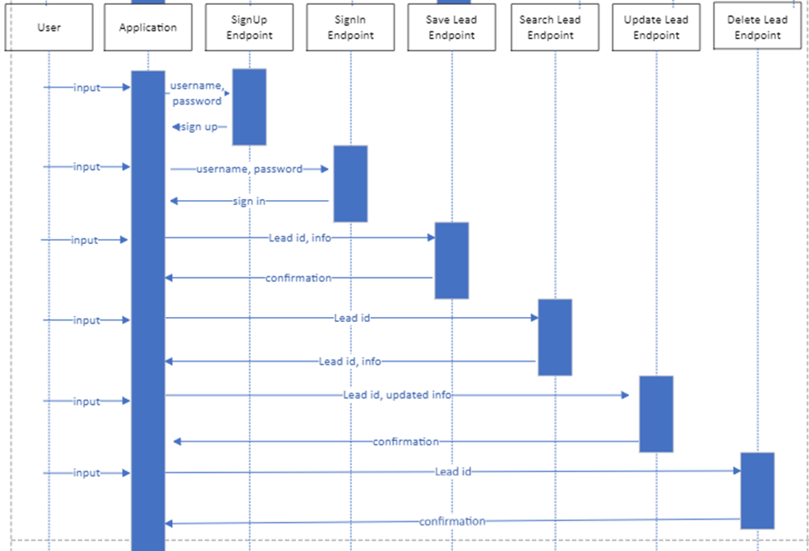
DynamoDB User Communications Diagram

Slide 10
Endpoints
/images - upload image
/translate-text – translate image text
/detect-text – detect and translate image text
/save - submit and save new lead, update lead
/signin - sign user in
/signup - sign user up
/search - search leads and return lists of leads
/delete - delete lead

Slide 11
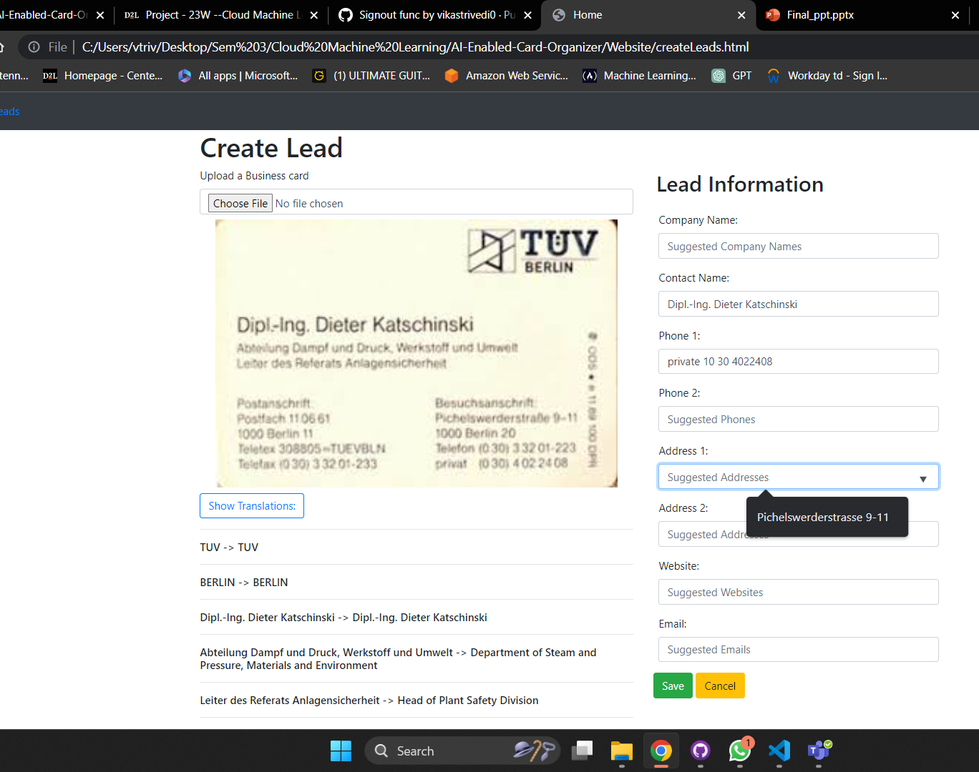
Translating and Detecting Text

Slide 12
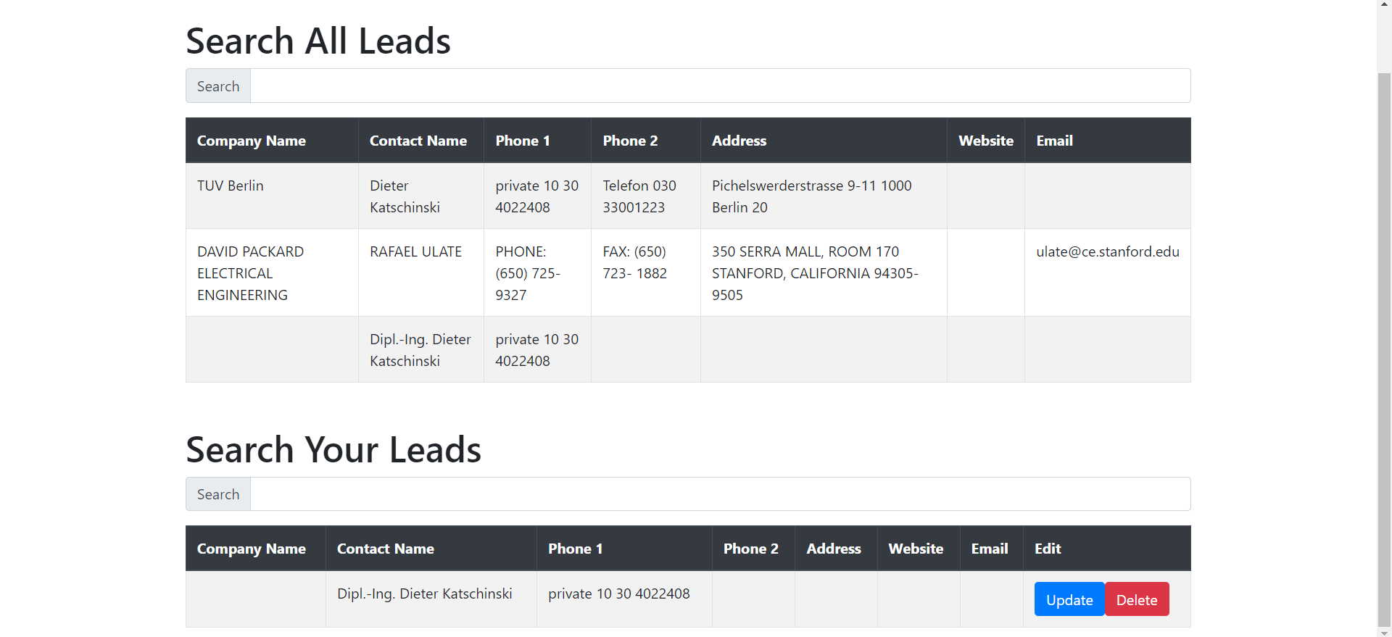
Searching the Leads

Slide 13
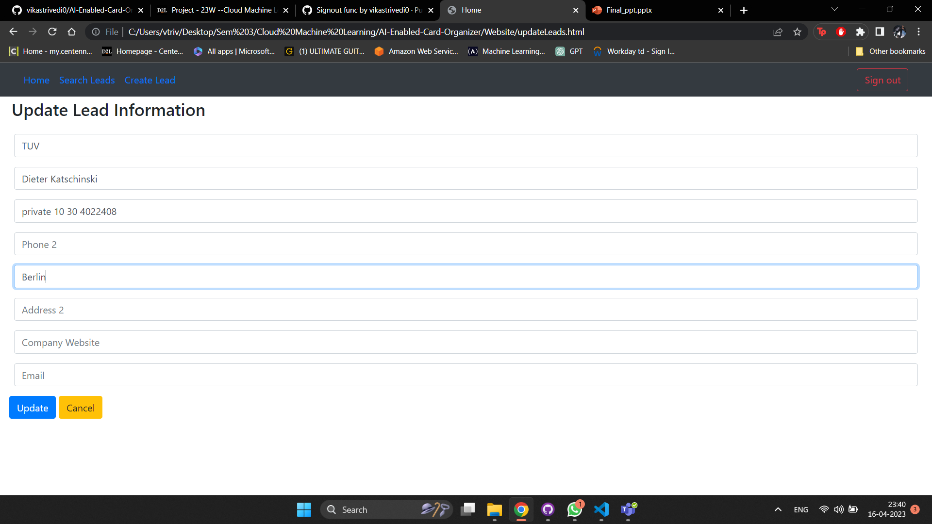
Updating the Leads

Slide 14
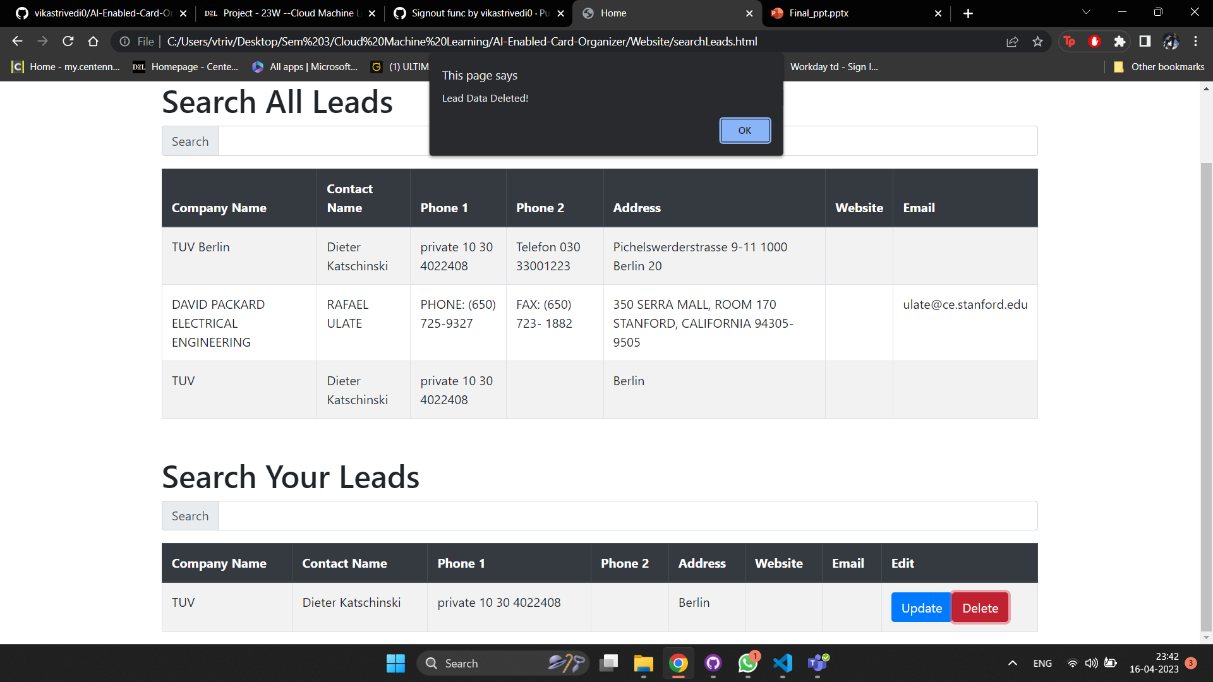
Deleting the Leads

Slide 15
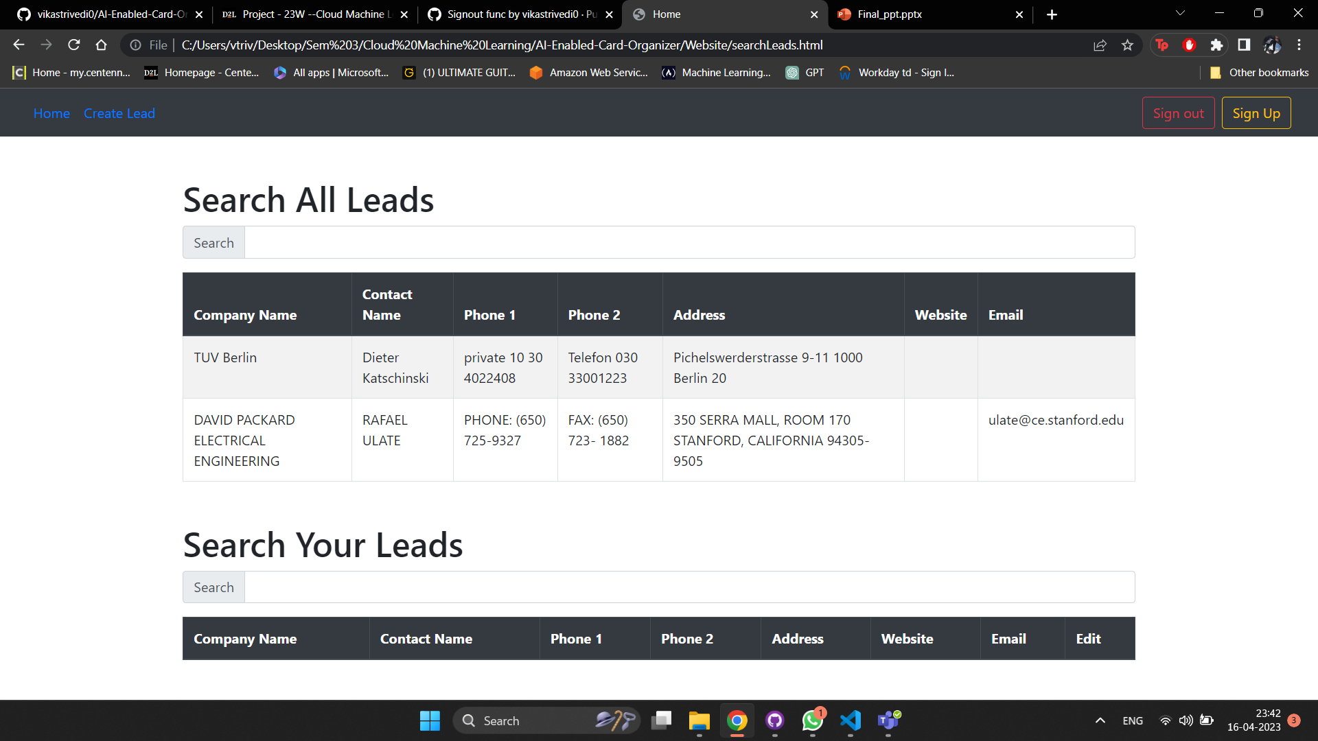
Read the Leads if User is not signed In

Slide 16
Working Demonstration

