Slide 1

Natural Language Processing Project Group 6
Kanishka Dhir (301220757)
Rushin Barvadia (301227529)
Vikas Trivedi (301217554)

Slide 2
Contents:
Data Exploration
Data Pre-Processing
Mode Training
Model Testing

Slide 3
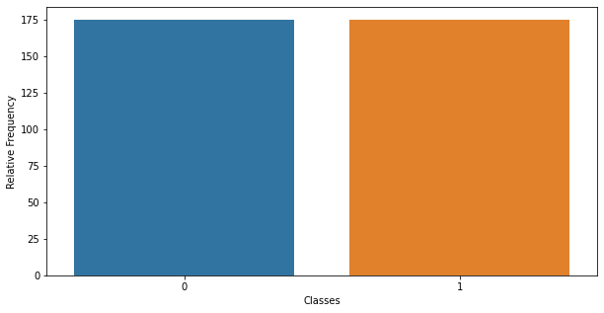
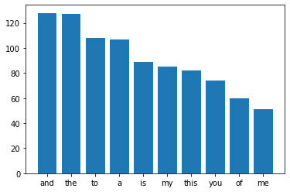
Data Exploration
Relative Frequency of Classes
Stop Words frequency in data

Slide 4
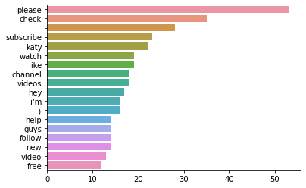
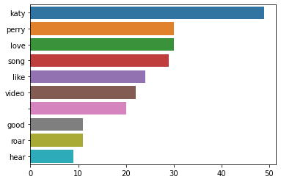
Data Exploration
Commonly Appearing Spam comment words
Commonly Appearing Ham comment words

Slide 5
Data Pre-processing
Convert all the data to Lower case
Remove the English stop words
Replace all punctuations with spaces
Shuffle the dataset
Convert the data to vectors using CountVectorizer
Down scale the data using TF-IDF algorithm

Slide 6
Model Training
Training and Test split: 75:25
Algorithms: Gaussian Naïve Bias & Multinomial Naïve Bias
Cross Validation Scores
Gaussian Naïve Bias:
[0.79245283, 0.94339623, 0.90384615, 0.88461538, 0.86538462]
Mean score: 0.8779390420899855
Multinomial Naïve Bias:
[0.9245283, 0.94339623, 0.90384615, 0.92307692, 0.94230769]
Mean score: 0.9274310595065313

Slide 7
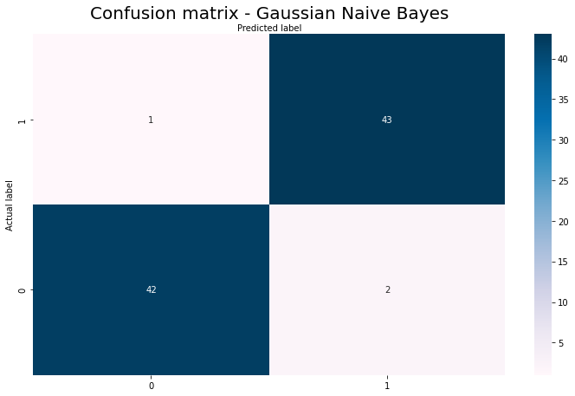
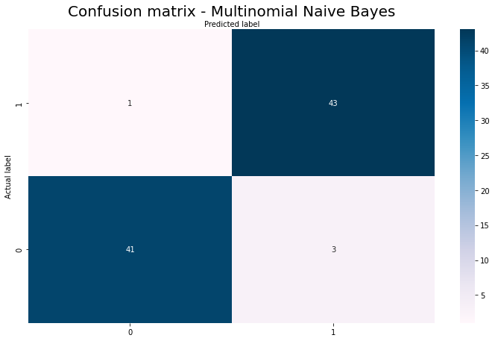
Model Testing
Gausian Naïve Bias Classifier Accuracy on test data: 96.59
Multinomial Naïve Bias Classifier Accuracy on test data: 96.59

Slide 8
Model Testing
Dummy Comments Generated:
"Visit my channel for more videos&*^*(*",
"Like,comment share and subscribe to my channel.",
"http i love this ong",
"I LOVE YOOU!!!!",
"Katy is underrated",
#"I am a big fan of you and your music!!"
“Never heard a song as shitty as this one”
Model Predictions:
[ Spam, Spam, Ham, Ham, Ham, Ham ]

