Slide 1


APP STORE READY | DELAWARE C-CORP | PRE-SEED
AuraGuide
A Lifeline for Family Caregivers.
Voice-first AI assistant that reduces caregiver burden, prevents medical errors, and protects caregiver wellbeing.
"63 Million Invisible Workers. $1 Trillion in Unpaid Labor. Zero Purpose-Built Tools."
CONFIDENTIAL | APRIL 2026 | VIKTRON HEALTH

Slide 2

THE CRISIS
The Invisible Backbone of American Healthcare
Family caregivers are the backbone of American healthcare — yet they remain completely invisible to the technology industry.
63M
$1T
Unpaid Family Caregivers
Annual Economic Value
In the US today — a 19% increase since 2020.
Unpaid caregiving in 2024 exceeds total US Medicaid spending of $932B.
27 hrs
$10,200
Per Week Average
Out-of-Pocket Per Year
40%+ provide high-intensity care. Only 22% receive any formal training.
1 in 4 take on debt. 1 in 5 cannot afford food.
The US caregiver population is projected to grow as 10,000 baby boomers turn 65 every single day. By 2030, all 73 million boomers will be 65+. No dominant platform has emerged to serve this demand surge.
Sources: AARP/NAC Caregiving in the US 2025 | AARP Valuing the Invaluable 2026 | US Census Bureau

Slide 3
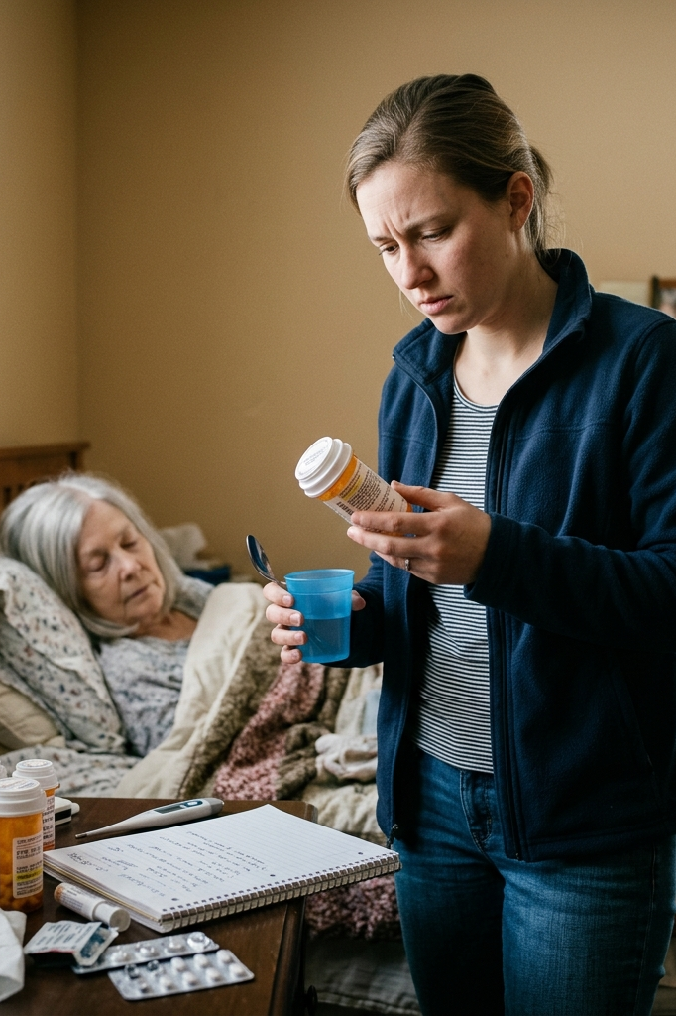


THE PROBLEM
The Caregiver Collapse Cycle
Caregiving is a 24/7 medical, logistical, and emotional operation — performed by untrained individuals under extreme and sustained stress.
Physical Blockade
1
The hands-full reality. Caregivers cannot type during active care. Critical data goes unlogged. 90% of medication errors reported to Poison Control Centers occur at home. Error rates hit 14–23%.
The Knowledge Gap
2
Information overload. Managing 5+ medications, contraindications, and shifting baselines from memory. 78% manage complex medical tasks with zero clinical background. Only 22% receive training.
Critical Errors
3
Cascade failure. Medication errors cost the US healthcare system $300 billion annually. 1 in 131 non-hospital deaths are tied to these errors.
Caregiver Burnout
4
87% report significant stress. 78% experience burnout. 36% experience clinical depression. ER utilization rises 73% when caregivers burn out.
"Mobile screens are fundamentally incompatible with active caregiving. The solution must be voice-first — and medically intelligent."
Sources: NCBI/StatPearls | AARP/NAC 2025 | AMCP | A Place for Mom 2026 | ianacare 2024 | Alzheimer's Association 2024

Slide 4



OUR INNOVATION
AuraGuide: The Zero-Friction Medical Intelligence Partner
An AI assistant that does not just log data — it understands clinical context, fills the medical knowledge gap, and becomes the intelligence layer caregivers were never given. Speak naturally while hands are on the patient. AuraGuide listens, interprets clinical context, and responds with the right information at exactly the right moment.
Voice-First Medical Intelligence
Real-Time Crisis Intelligence
Tracks schedules, checks real-time drug interactions, confirms dosages, proactively flags dangerous combinations. Holds full clinical context so caregivers stop memorizing.
Recognizes symptom patterns against clinical protocols. Locates nearest urgent care with wait times. Auto-generates medication and vitals summary for ER visits. All by voice.
Passive Wellbeing Monitoring
40+ Language Support
Voice-tone analysis detects early burnout. Triggers guided breathing and respite care resources. Protecting the caregiver IS protecting the patient.
Operates fully in the caregiver's native language including clinical vocabulary. Eliminates dangerous translation friction in multilingual households.
AuraGuide is not a scheduling app with voice features added on. It is a medical intelligence layer — built on clinical protocols, drug interaction databases, and caregiver-specific workflow patterns.

Slide 5
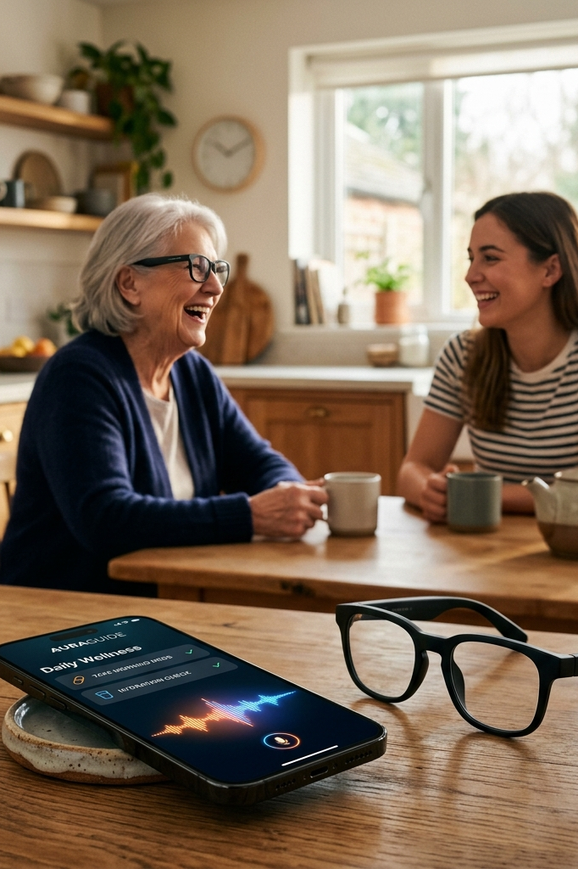
HOW IT WORKS
The Operating System for Home Care
Conversations That Save Time and Lives
Medication Management
Urgent Care
Caregiver: "AuraGuide, what medication is next?"AuraGuide: "Robert's Metformin 500mg is due at 2:00 PM. He took his morning Lisinopril at 8:15 AM. Metformin should be taken with food. Flagging: his Lisinopril dose is due for review at Thursday's appointment."
Caregiver: "He has a fever of 101 and seems confused."AuraGuide: "Sudden confusion with fever can indicate a UTI or early sepsis. I've located 3 urgent care clinics nearby; the closest has a 12-minute wait. Shall I prepare his complete medication list and symptom timeline?"
Vitals Tracking
Caregiver Wellbeing
Caregiver: "Log blood pressure 140 over 90 for Robert."AuraGuide: "Logged. That reading is elevated — Robert's 30-day baseline is 122/80. I've flagged this for Thursday's 3 PM appointment. If it reaches 160/100, I'll alert you immediately."
Caregiver: "I haven't slept properly in days and I feel like I'm losing it."AuraGuide: "Sleep deprivation significantly increases caregiver error risk. You matter too. Would you like a 5-minute guided breathing session right now? I can also search for nearby respite care."

Slide 6
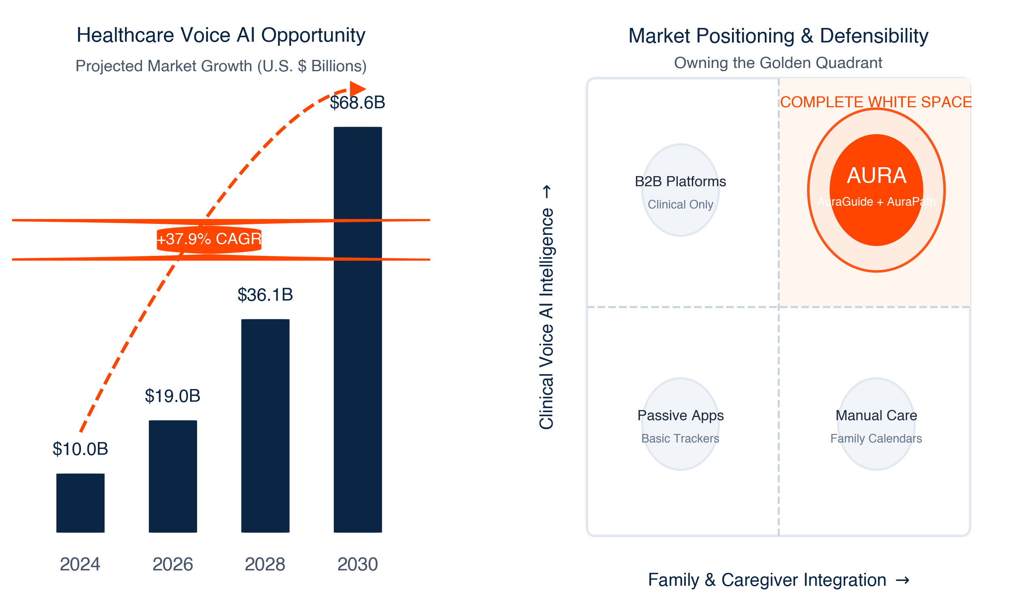
GOAL
A $72B Market at a Structural Inflection Point. No Dominant Player. Perfect Timing.
5 Converging Forces — Why Now:
Demographic Avalanche
1
10,000 boomers turn 65 daily. By 2030, all 73M will be 65+. Projected shortfall of 1.5M professional caregivers by 2030.
$1 Trillion Policy Priority
2
Unpaid caregiving exceeded Medicaid in 2024. Corporate caregiver benefits are a top Fortune 500 HR priority for 2025–2026.
Voice AI Mainstream
3
On-device LLMs and 98%+ accuracy in noisy homes make clinical-grade voice AI viable now. Healthcare voice AI CAGR: 37.87%.
4
Post-COVID Acuity Shift
35%+ increase in home-based care since 2020. Medically complex patients now under untrained family supervision.
5
Complete White Space
Existing apps are passive. Clinical platforms ignore families. No app combines voice + clinical AI + wellbeing.
Sources: Allied Market Research 2023 | US Census Bureau | PHI National | AARP 2026 | Nova One Advisor 2024 | CMS/CDC 2024

Slide 7

MARKET POSITION
Built for Caregivers, Not Just Patients.
AuraGuide is the only platform purpose-built for the caregiver's workflow — combining clinical AI, voice-first design, wellbeing monitoring, and a hardware integration path no competitor can replicate.
Capability
AuraGuide
Generic Voice (Siri/Alexa)
Care Scheduling Apps
Clinical Platforms (Epic)
Senior Care Apps
Voice-First Design
✓
✓
✗
✗
✗
Clinical Medical AI Intelligence
✓
✗
✗
✗
✗
Caregiver Wellbeing Monitoring
✓
✗
✗
✗
✗
Medication Interaction Checking
✓
✗
✗
✓
✗
40+ Language Support
✓
✓
✗
✗
✗
Hardware Integration Path
✓
✗
✗
✗
✗
Purpose-Built for Caregiver Workflow
✓
✗
✗
✗
✗
Consumer-Accessible Pricing
✓
✓
✓
✗
✗
"AuraGuide is the only platform that combines voice-first design, clinical AI intelligence, and caregiver wellbeing monitoring at a consumer price point."

Slide 8
BUSINESS MODEL
Software-First, Recurring Revenue Engine
AuraGuide runs on a freemium SaaS model with three tiers and a clear enterprise path.
🆓 Free — Freemium Onramp
⭐ Premium — $14.99/month
🏥 Enterprise — Per-Seat Licensing
Basic care logging, medication reminders, emergency contacts. No credit card required. Designed as onboarding funnel for premium conversion.
Full voice AI with clinical intelligence, smart care plans, medication interaction checking, wellbeing monitoring, multi-language support, family sharing.
Home health agencies and hospital discharge programs. Admin dashboard, HIPAA-ready, bulk licensing, clinical outcome analytics.
Target: 50 accounts × 20 seats × $25/seat/month = $25,000 MRR by Year 3.
Benchmarked: Calm ($14.99), Noom ($17), Papa ($20–35). AuraGuide delivers direct clinical safety value at the same consumer price.
15%
$539
Freemium Conversion
3-Year LTV
vs. industry benchmark of 8–12%; caregiver urgency drives higher conversion
Per premium subscriber ($14.99 × 36 months)
<6mo
~85%
CAC Payback
Gross Margin
Caregiver Facebook communities, hospital discharge desks, senior centers
Scalable software infrastructure

Slide 9
Traction & Team
Building toward Series A with proven technical execution and a clear 18-month roadmap.
Current Traction
18-Month Roadmap
✓ Working voice AI app with end-to-end clinical pipeline
Q2 2026 — Launch
1
App Store release iOS & Android. 15–20 person structured beta. Partnership MOUs with 2 local care centers. Clinical accuracy validation loop.
✓ App Store submission preparation in progress
2
Q3–Q4 2026 — Grow
✓ Viktron Health Delaware C-Corp incorporated
Premium tier activation. 100+ monthly active users. Voice AI clinical refinement. First enterprise inbound conversations.
Q1 2027 — Scale
3
✓ 15–20 structured beta recruits identified through care centers
First enterprise pilot with home health agency. Multi-language expansion (Spanish, Mandarin, Hindi). Series A preparation begins.
4
Q2–Q3 2027 — Expand
✓ Patent pending: cognitive augmentation system for memory-impaired patient care (USPTO)
Active B2B revenue. 1,000+ active users. HIPAA certification complete. Series A close target $3–5M.
✓ AuraPath smart glasses hardware prototype complete (MLX face recognition functional)
Planned Hires With This Round:
The Team — Vikash V | Founder & CEO
Clinical Care Advisor (RN/MD) — Validates clinical protocols
UX / Voice Design Lead — Healthcare voice interfaces
Community Manager — Primary GTM engine
Regulatory Counsel — HIPAA compliance & FDA pathway
10+ years as AI Architect: LLM orchestration, RAG pipelines, multi-agent systems at enterprise scale
Patent inventor: cognitive augmentation system for memory-impaired patients (USPTO pending)
Built AuraPath prototype and AuraGuide app entirely solo — technical execution already proven
Enterprise AI delivery across GCP, Azure, and AWS for Fortune 500 clients

Slide 10



THE ASK
$500,000 Pre-Seed
Post-Money SAFE | $3M–$5M Valuation Cap | 20% Discount | Minimum viable raise: $400K
Product & Engineering·40%
·40%
·
Go-to-Market & Beta·30%
·30%
·
Team & Operations·30%
·30%
·
40% — Product & Engineering ($200K)
30% — Go-to-Market & Beta ($150K)
30% — Team & Operations ($150K)
Voice AI clinical accuracy refinement, premium feature development, multi-language medical vocabulary, App Store infrastructure.
Caregiver community outreach, hospital discharge desk partnerships, care center pilots, beta program operations.
Key hires (UX lead, clinical advisor, community manager), legal, infrastructure, compliance groundwork.
$500K = 12–15 month runway | $400K minimum: App Store launch + structured beta + initial premium revenue | $500K full raise: PMF + 100+ active users + first enterprise conversations + Series A readiness
"AuraGuide exists for one reason: no family caregiver should navigate this alone."
— Vikash Vardhanapu | Founder & CEO | Patent Pending

