Slide 1
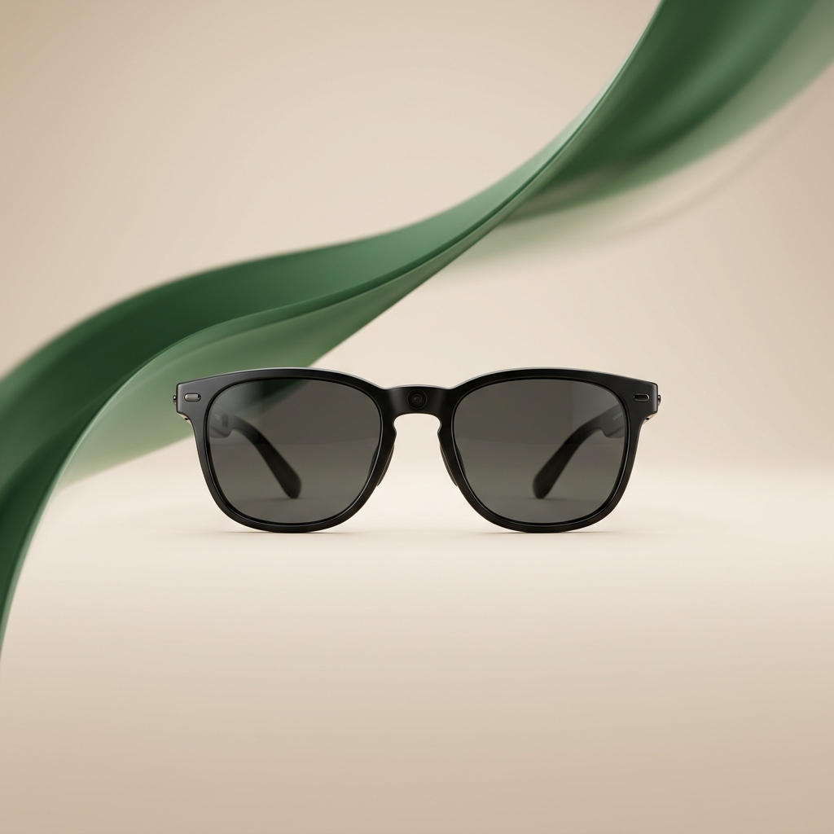
AURAPATH
Intelligent Eyewear for Cognitive Independence.

Slide 2
Memory Loss Is a Dignity Crisis.
• 55 million people worldwide live with dementia.
• 60% of dementia patients will wander, leading to trauma.
• Social Isolation: Failed recognition accelerates cognitive decline.
• Medication Danger: Prescription errors kill 7,000+ patients annually.
• Market Size: $360B annual cost of dementia care in the US.

Slide 3
AuraPath: A Digital Prosthetic for Memory.
• Social Recognition: Names whispered via bone-conduction audio.
• Medication Safety: Computer vision verifies labels before every dose.
• Wandering Prevention: Geofencing and haptic navigation guide users home.
• Privacy-First: All inference runs on-device via Apple MLX NPUs.
• No Stigma: Indistinguishable from normal eyewear.

Slide 4
Three Forces. One Inflection Point.
• Edge AI Power: Apple M-series NPUs enable local vision models (200ms latency).
• Aging Population: 10,000 boomers turn 65 daily; cases tripling by 2050.
• Category Gap: Passive aids react after failure; AuraPath prevents it proactively.

Slide 5
Raising $750K Pre-Seed.
• 40% Hardware R&D: MLX optimization and NPU feasibility.
• 25% Regulatory & IP: FDA classification and ISO 13485 QMS.
• 20% Clinical Pilot: Caregiver beta and facility partnerships.
• 15% Operations: Advisory board and team scaling.
• Terms: Post-Money SAFE | $4M–$6M Cap | 20% Discount

