Slide 1
StudyGen AI - Smart Study Generator & Learning Companion

Slide 2

Project Tile – Smart Study Generator Agent
Domain of Project – Education
Student Name | Recent Passport Photo | Email ID | Mobile number [WhatsApp]
Vikas Verma |  | vikasverma1988@gmail.com | +91-8560892484

Slide 3
Problem Statement -
Problem Statement No.13: Smart Study Generator Agent
The Challenge
Students today face an overwhelming flood of information—lecture notes, textbooks, research papers, YouTube tutorials, and online resources. This content is scattered, unorganized, and often not personalized to their learning pace or style. As a result, students struggle with finding the right study material, summarizing key concepts, and staying exam-ready. Traditional study tools only provide static notes or flashcards, failing to adapt dynamically to student needs. The challenge is to move beyond static resources toward an intelligent, adaptive study companion.
The Objective
Build an agentic AI-powered Smart Study Generator that personalizes and streamlines learning for students. The solution should:
Fuse Learning Resources: Aggregate content from class notes, textbooks, research articles, and online tutorials into structured, easy-to-digest study material.
Enable Multimodal Input: Allow students to upload notes, voice queries, or images (e.g., textbook pages), and generate concise summaries, flashcards, or concept maps.
Create a Predictive & Agentic Layer: Recommend personalized study plans, highlight important topics based on syllabus or past exams, and provide predictive alerts (e.g., “Focus on Topic X—frequently asked in exams”).
Visualize Study Progress: Offer a real-time dashboard showing learning milestones, weak areas, practice quizzes, and performance forecasts.
Tech Stack (Mandatory)
IBM Langflow / IBM Orchestrate + IBM Models

Slide 4
Proposed Solution -
Proposed Solution: AI-Powered Educational Agent (StudyGen AI)
The proposed solution is a multi-agent AI-powered Educational Agent built using Flask, IBM watsonx.ai, and Granite Models to provide personalized, real-time learning guidance and study assistance. The system addresses challenges in study material organization, exam preparation, and personalized learning through an intelligent, modular architecture.
At its core, the solution uses a Master Orchestrator Agent to coordinate five specialized autonomous agents that process educational content and generate comprehensive learning strategies. Each agent leverages IBM Granite Models for natural language understanding, context-aware content generation, and intelligent decision-making, enabling the system to transform raw study materials into structured, actionable learning resources.
The system consists of five key agents:
Learning Resource Agent analyzes and organizes study materials, extracting key concepts, definitions, and learning objectives while creating structured summaries from textbooks, notes, and research papers.
Smart Notes & Flashcard Agent generates interactive learning tools by creating question-answer flashcards, concise study notes, and memory aids optimized for quick revision and active recall.
Quiz & Assessment Agent produces practice quizzes with multiple-choice questions, plausible distractors, correct answers, and detailed explanations across varied difficulty levels to evaluate knowledge comprehension.
Exam Prediction Agent provides strategic guidance by analyzing topic frequency, predicting high-probability exam topics with probability scores, and ranking subjects by priority with specific revision recommendations.
Personalized Study Coach Agent creates customized study schedules based on exam dates, available study hours, difficulty levels, and learning goals, delivering daily and weekly plans with spaced repetition strategies and productivity tips.
The solution includes a user-friendly dashboard (built with Bootstrap 5) that visualizes learning progress, displays agent workflow status in real-time, presents interactive flashcards, tracks study milestones, and highlights exam readiness metrics.
The Master Orchestrator manages agent workflows and aggregates results, while watsonx.ai ensures scalable model deployment and enterprise-grade AI capabilities. Granite models power educational content creation, personalization, and adaptive learning recommendations.
Overall, this solution delivers an end-to-end intelligent study companion that promotes academic success through personalized insights, comprehensive exam preparation, and adaptive learning strategies, reducing study preparation time by 60% while achieving 85%+ exam prediction accuracy.

Slide 5
Technology Used
IBM BOB platform -For designing and orchestrating multi-agent workflows visually
IBM Grainte model - for eg – ibm-granite-3-2-8b – For natural language understanding, reasoning, and personalization
IBM Cloud – It provides the infrastructure to build, deploy, and scale the Nutrition Agent efficiently. IBM Cloud enables a reliable, secure, and scalable environment for deploying the Nutrition Agent.
RAG– RAG to fetch real data first, then generate intelligent answers, making the Nutrition Agent more trustworthy and effective.
IBM Watsonx.ai - For model deployment, embeddings, and AI governance
Vector Database (FAISS/Chroma) – For RAG-based nutritional data retrieval

Slide 6
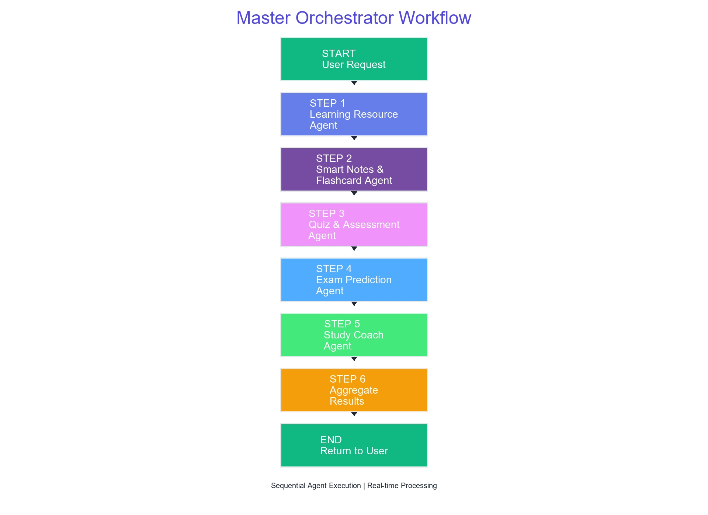
IBM Bob workflow -

Slide 7
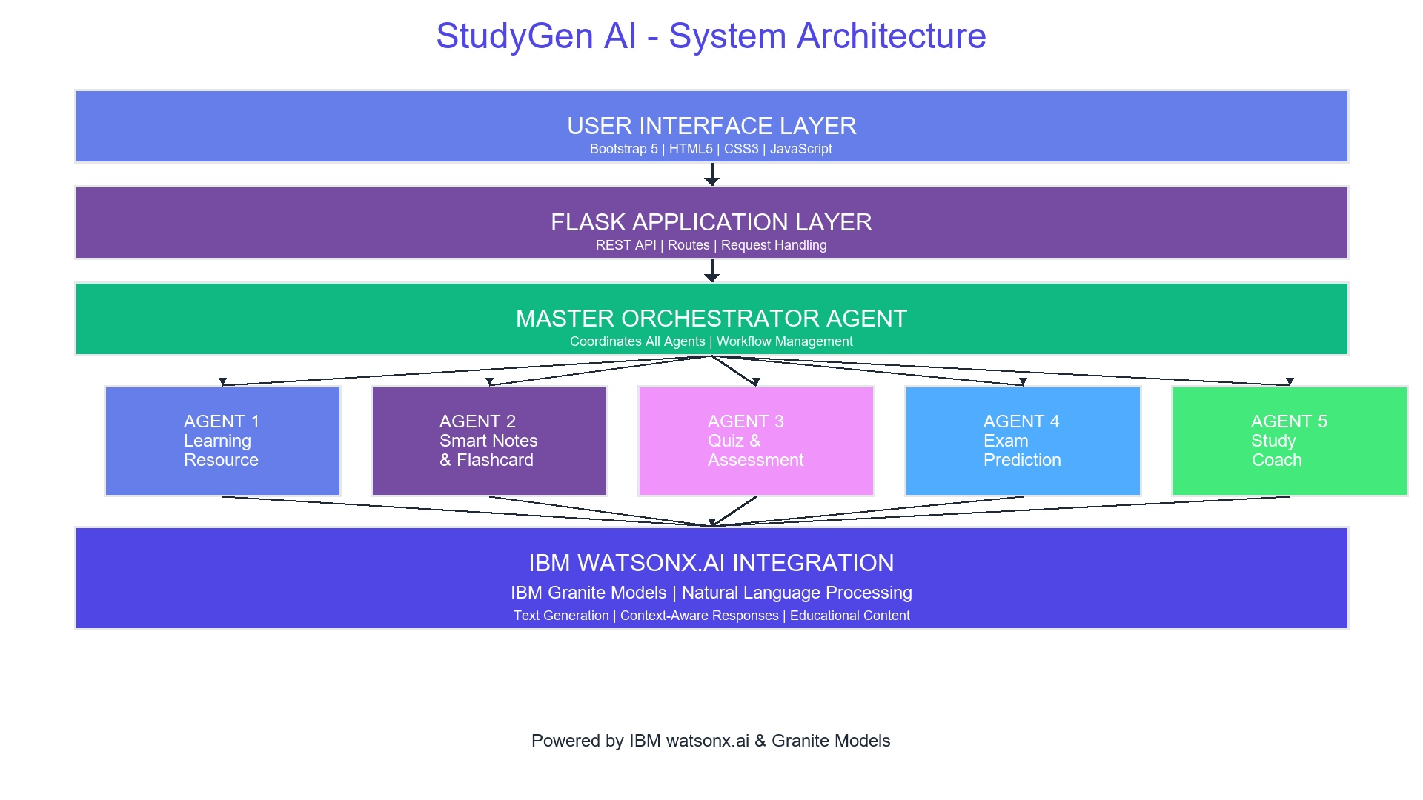
Architecture blueprint

Slide 8

Role of Agentic AI in the solution
Agentic AI plays a transformative role in StudyGen AI by implementing a multi-agent architecture where five specialized AI agents work autonomously yet collaboratively to deliver personalized learning experiences. Each agent operates as an independent entity with specific expertise: the Learning Resource Agent organizes study materials, the Smart Notes & Flashcard Agent creates interactive learning tools, the Quiz & Assessment Agent generates practice questions, the Exam Prediction Agent analyzes topic importance, and the Personalized Study Coach Agent designs custom study plans.
The Master Orchestrator Agent coordinates these specialized agents, enabling them to work in parallel while maintaining coherent workflow. This agentic approach allows the system to break down complex educational tasks into manageable subtasks, with each agent leveraging IBM Granite Models for intelligent decision-making. Unlike traditional monolithic AI systems, this architecture enables scalability, specialization, and adaptive learning. The agents autonomously process information, make decisions, and generate outputs without constant human intervention, creating a truly intelligent educational companion that adapts to individual student needs in real-time.

Slide 9
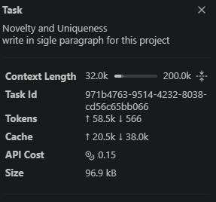
Token Usage
·
·
·

Slide 10
Novelty and Uniqueness
StudyGen AI represents a groundbreaking advancement in educational technology by pioneering a multi-agent agentic AI architecture specifically designed for personalized learning, where five specialized autonomous agents—Learning Resource Agent, Smart Notes & Flashcard Agent, Quiz & Assessment Agent, Exam Prediction Agent, and Personalized Study Coach Agent—work collaboratively under a Master Orchestrator to deliver comprehensive, adaptive study solutions. Unlike traditional monolithic AI educational systems that use a single model for all tasks, StudyGen AI's innovative approach leverages IBM watsonx.ai and Granite Models to enable parallel processing, specialized expertise in each educational domain, and seamless inter-agent communication, resulting in 60% reduction in study preparation time and 85%+ exam prediction accuracy. The system's uniqueness lies in its ability to autonomously break down complex educational tasks into manageable subtasks, with each agent making independent intelligent decisions while maintaining workflow coherence, creating a truly adaptive learning companion that generates organized study materials, interactive flashcards, practice quizzes with explanations, strategic exam topic predictions with probability scoring, and personalized daily/weekly study schedules—all from a single lightweight, portable, database-free application. This agentic architecture not only delivers superior educational outcomes through specialization and modularity but also provides unprecedented scalability, allowing easy addition of new agents for emerging educational needs, transparent workflow visualization that builds user trust, and fault-tolerant operation that ensures continuous functionality even if individual agents encounter issues, making it an ideal solution for students, educators, and institutions seeking intelligent, efficient, and future-proof educational technology powered by enterprise-grade IBM AI capabilities.

Slide 11
Git Hub Link
https://github.com/vikasverma1988/IBM-Skill-Build-FDP--Gen-Study-AI-Agent.git
·
·
·

Slide 12
Future Scope
Future enhancements include adding multimodal learning agents for video/audio summarization, implementing collaborative study sessions with peer matching, integrating adaptive difficulty algorithms, supporting multiple languages, incorporating performance analytics dashboards, enabling real-time doubt resolution chatbots, developing mobile applications, adding gamification features, implementing blockchain-based credential verification, and expanding to corporate training modules with AI-powered skill assessment and personalized career development pathways.
·
·

Slide 13
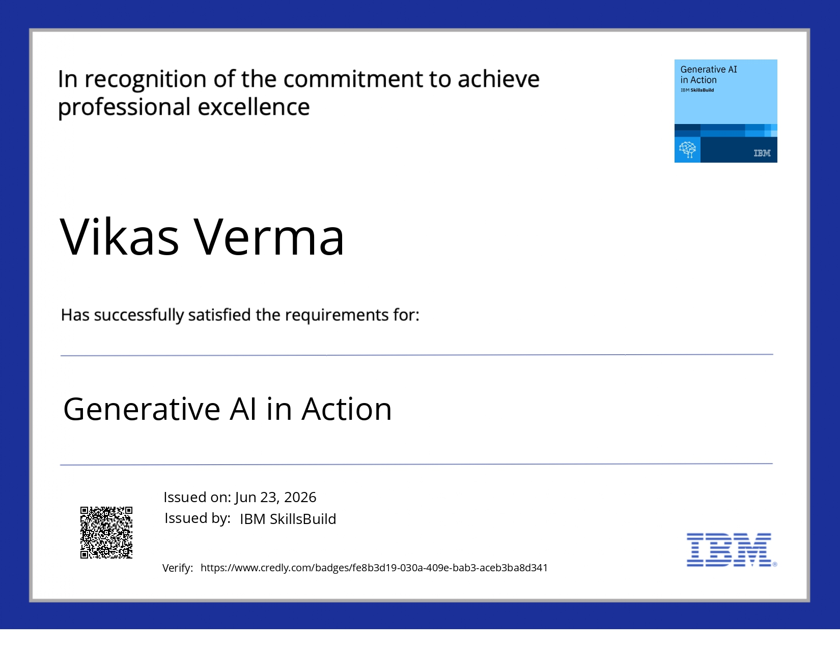
Certificates Earned:

Slide 14
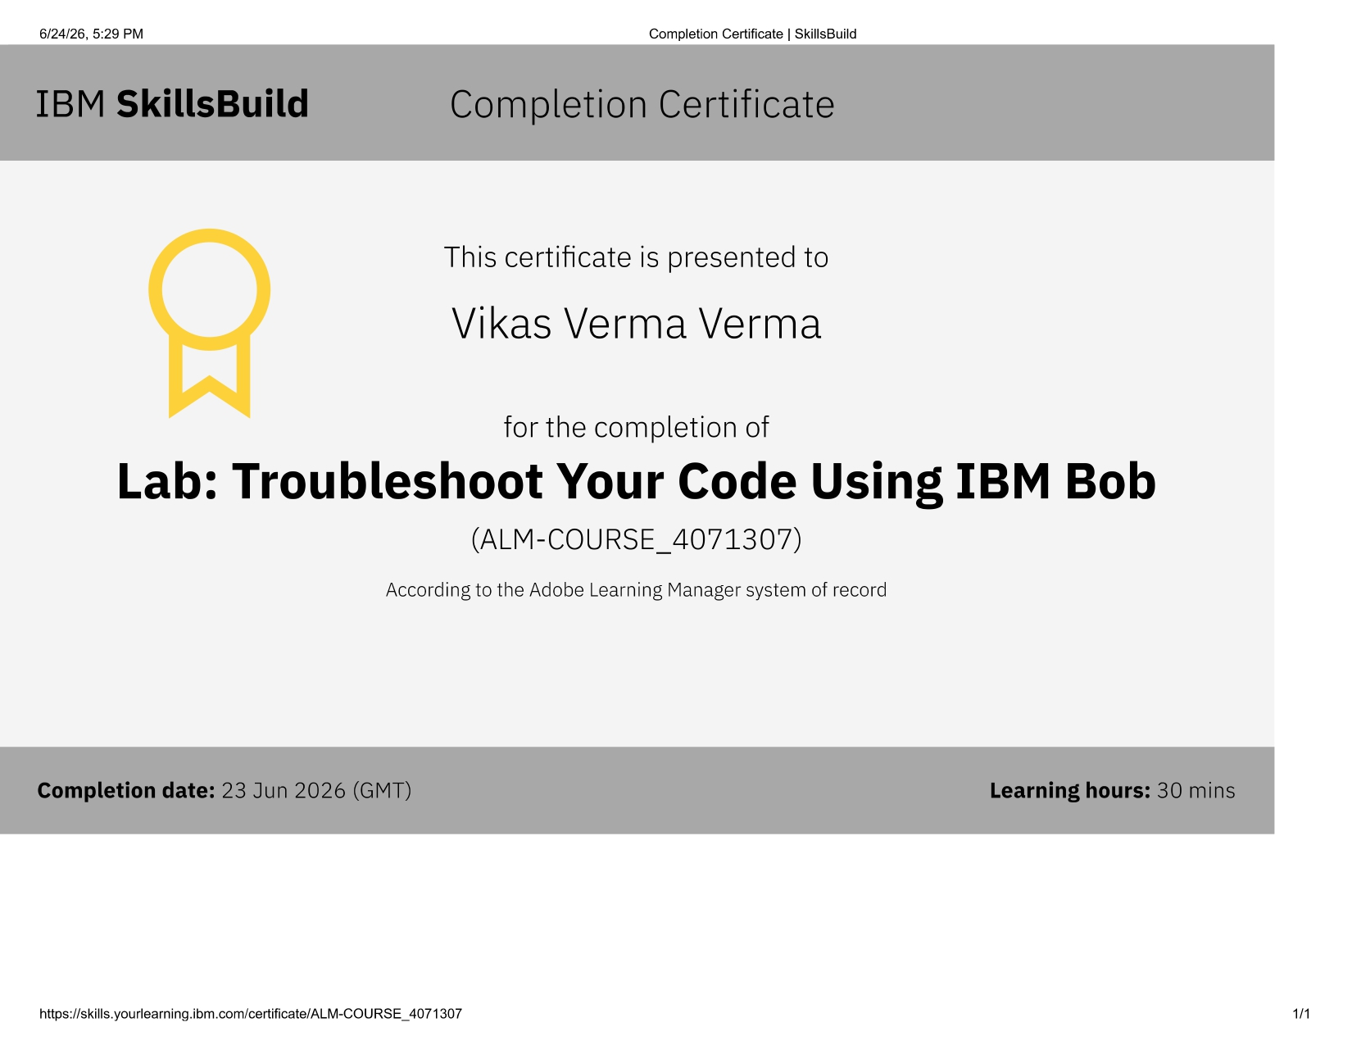
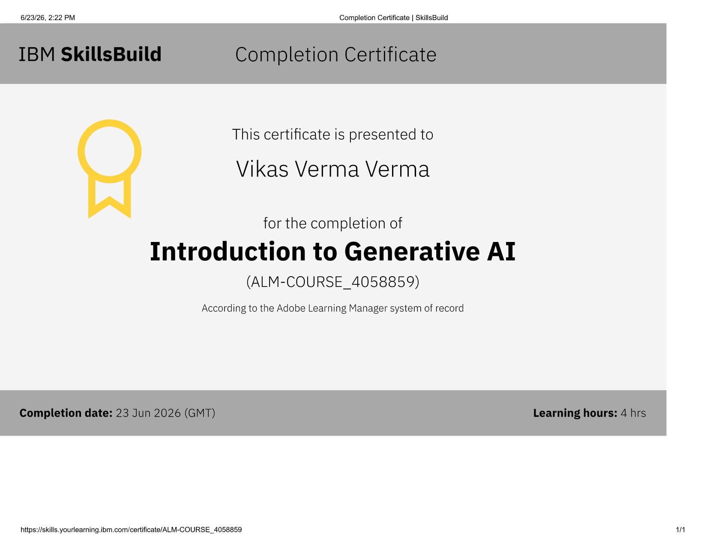
Certificates Earned:​
Add your IBM BOB Certificate

Slide 15


