Slide 1
Total vehicle quality management tv-435
Training on fmea(failure mode & effect analysis) method
TV-435 / DEC 2025

Slide 2
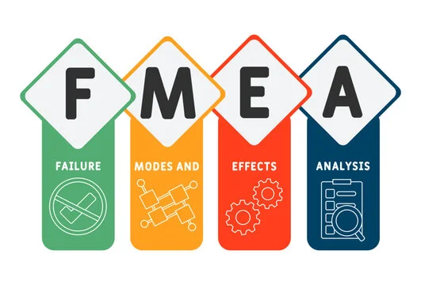
AN INTRODUCTION
FMEA

Slide 3
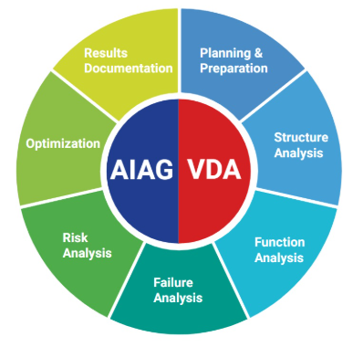
Introduction to vda fmea
VDA FMEA is the original German methodology for Failure Mode and Effects Analysis, developed by the Verband der Automobilindustrie (VDA) to standardize risk assessment in the automotive industry.
It focuses on a structured, detailed approach to analyzing failures in design and process before the later harmonization with AIAG.
Standardized approach for risk analysis in automotive supply chains
Focuses on structured worksheets and RPN (Risk Priority Number)
VDA FMEA

Slide 4
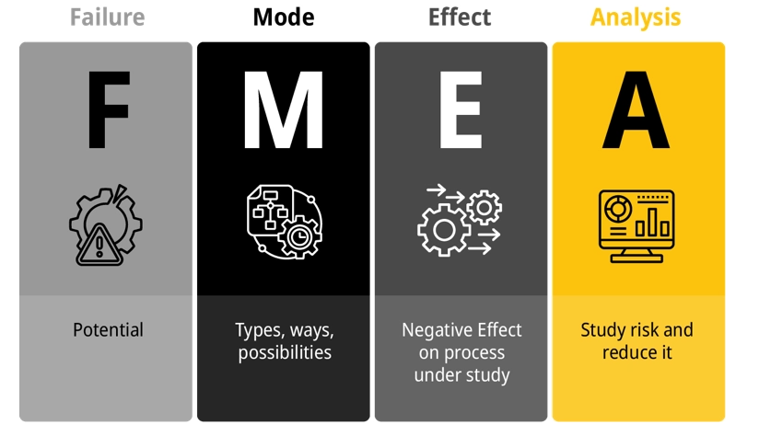
FAILURE MODE AND EFFECT ANALYSIS (fmea)
FMEA proactively identifies potential failure points, their effects, and criticality through Risk Priority Numbers (RPN).
By analysing severity, occurrence, and detection ratings, teams prioritize prevention efforts on highest-risk failures before they occur.
Use Case:
Deployed during product/process design to identify potential failures before production launch.
Example:
New assembly line design undergoes FMEA to identify where conveyor system might fail and impact production.

Slide 5
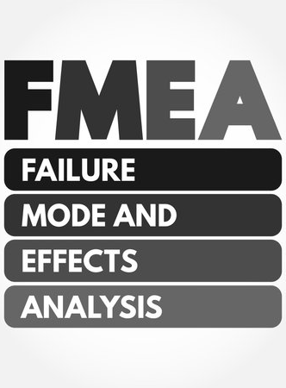
HISTORY AND ITS EVOLUTION
FMEA

Slide 6
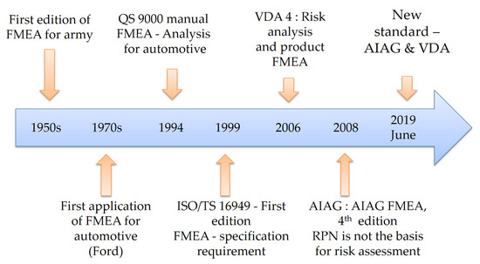
HISTORY AND EVOLUTION OF FMEA
The original/traditional approach was developed by US Military in late 1940’s.
It has been used as a risk identification & reduction tool.
Under the aegis of AIAG, it was used in the automotive industries since 1980’s.
In 2019, underwent a major change and a ‘harmonized’ AIAG & VDA FMEA has been introduced.

Slide 7
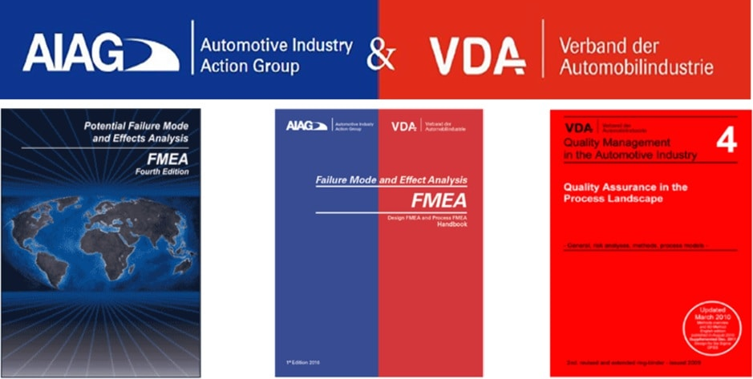
Evolution of fmea
AIAG FMEA
AIAG-VDA FMEA
VDA QMS

Slide 8
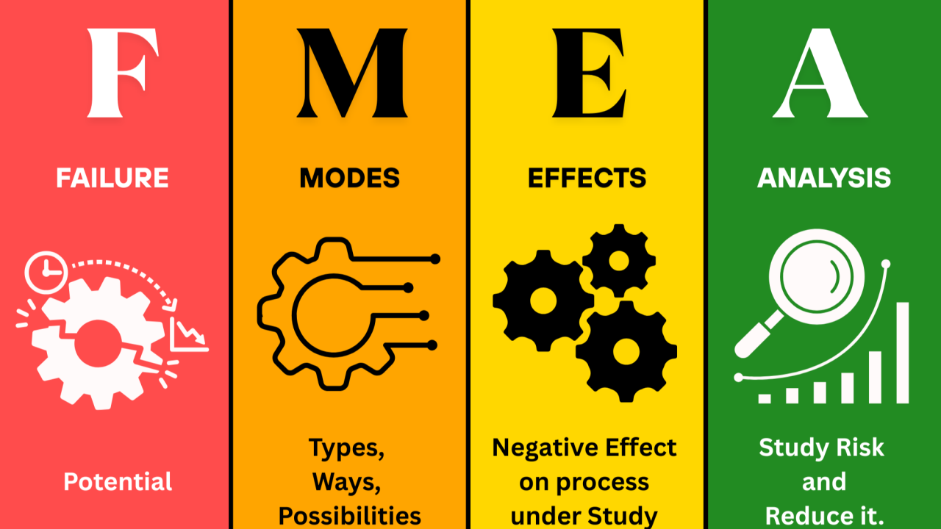
TYPES-ITS PURPOSE AND OUTCOME
FMEA

Slide 9
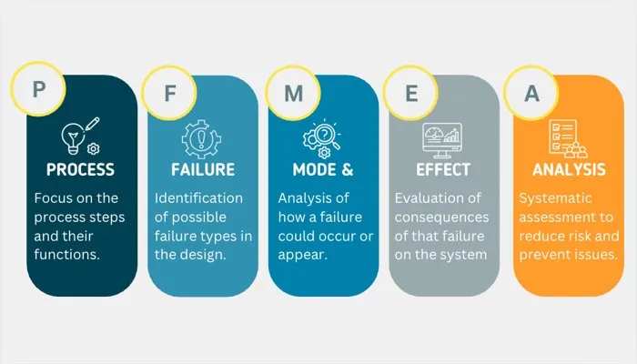
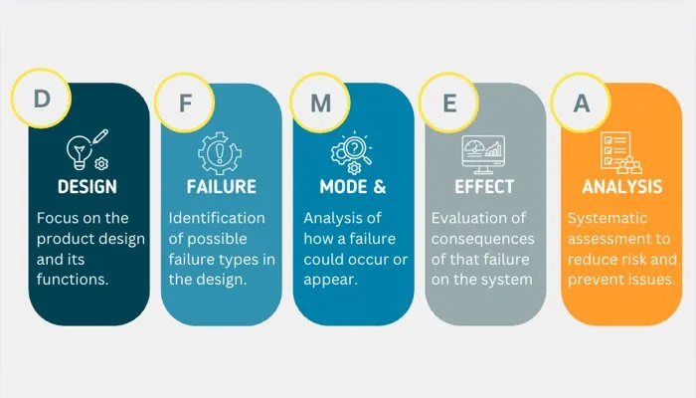
Types of VDA FMEA
1.Process FMEA (PFMEA)
Purpose
Analyzes risks in manufacturing and assembly processes.
Prevents defects and inefficiencies during production.
Outcome
Reliable production processes.
Consistent quality output.
2.Design FMEA (DFMEA)
Purpose
Identifies risks in the product design stage.
Ensures the product meets customer requirements and safety standards.
Outcome
Stronger, more robust designs before prototypes or production.

Slide 10
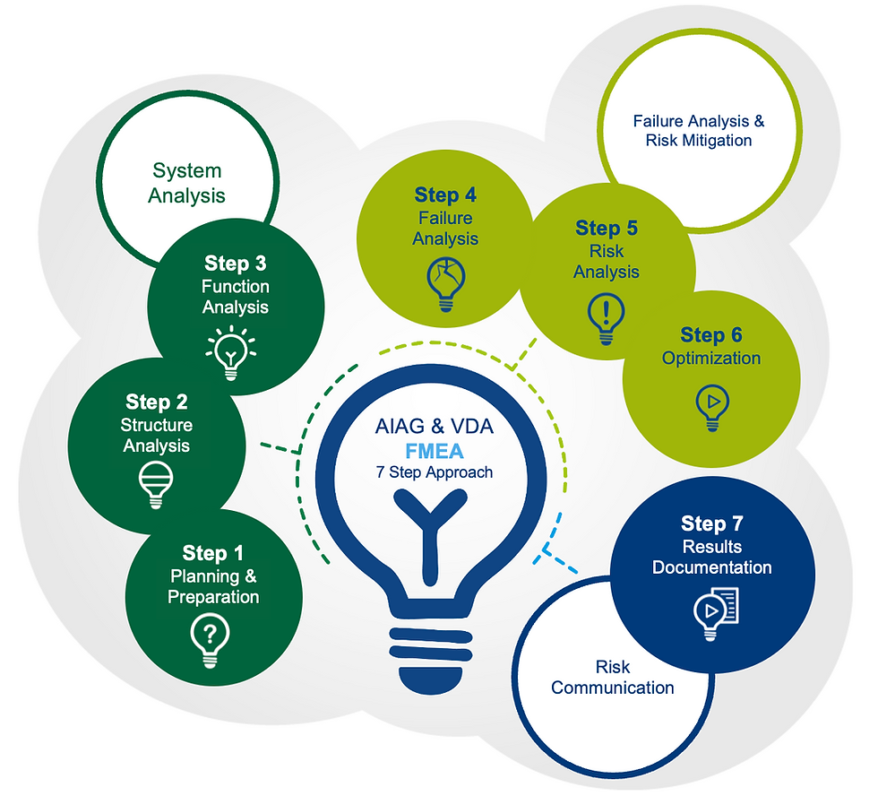
THE 7 STEP APPROACH
PFMEA

Slide 11
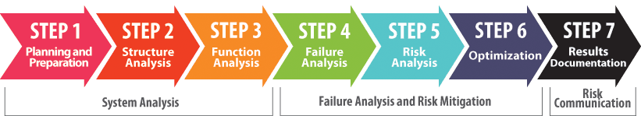
The 7 step approach in Process-fmea
The AIAG-VDA Harmonization Project defined a seven-step process for conducting FMEAs.
        Planning and Preparation
        Structure Analysis
        Function Analysis
        Failure Analysis
        Risk Analysis
        Optimization
        Results Documentation

Slide 12
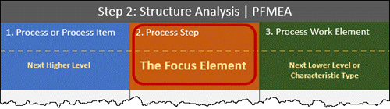
THE 7 STEP APPROACH
Step 1: Planning and Preparation
  The PFMEA study starts with a purposeful and careful definition of the scope.
  The management team is responsible for setting the scope of the study.
Step 2: Structure Analysis
  Structure Analysis is used to identify and breakdown the the process into its sequential steps, interfaces and logistical elements.
  The Structure Analysis uses the boundaries set by the definition of scope in Step 1 to identify each step, interface and logistical element of the process under study.
  Structure Analysis consists of three expanded columns whose purpose is to facilitate a thorough understanding of the process. Start with the Focus Element in the “middle column,” then identify the Process of which the Focus Element is a part and finally identify all Process Work Elements of the Focus Element.

Slide 13
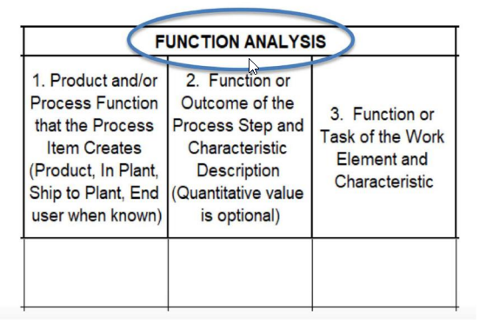
THE 7 STEP APPROACH
Step 3: Function Analysis
  Think of the Function Analysis step as exploring what the product should be doing and what the overall process (and each of its steps) should be doing and how that functionality is facilitated.
  Using the Structure Analysis developed in Step 2, each element is analyzed separately in terms of its function(s) and corresponding requirement(s).
  Association of characteristics to functions
  Tools:
        Function analysis tree
        Parameter diagram

Slide 14
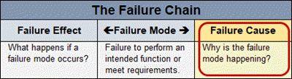
The 7 step approach
Step 4: Failure Analysis
  In Step 4, the concept of a “Failure Chain” is used to visualize failures as part of three links of a chain.
  The Failure Chain is comprised of the Failure Mode (FM), the corresponding Failure Effect (FE) and the Failure Cause (FC).
  A Failure Mode represents any manner in which an item (the Focus Element) could fail to meet its intended function.
  A Failure Cause is an indication of why a Failure Mode could occur.
  Analyzing failures involves identifying how the Focus Elements detailed during the Structure Analysis may fail to perform intended functions documented by the Function Analysis.
  Determining potential causes is at the heart of a PFMEA.

Slide 15
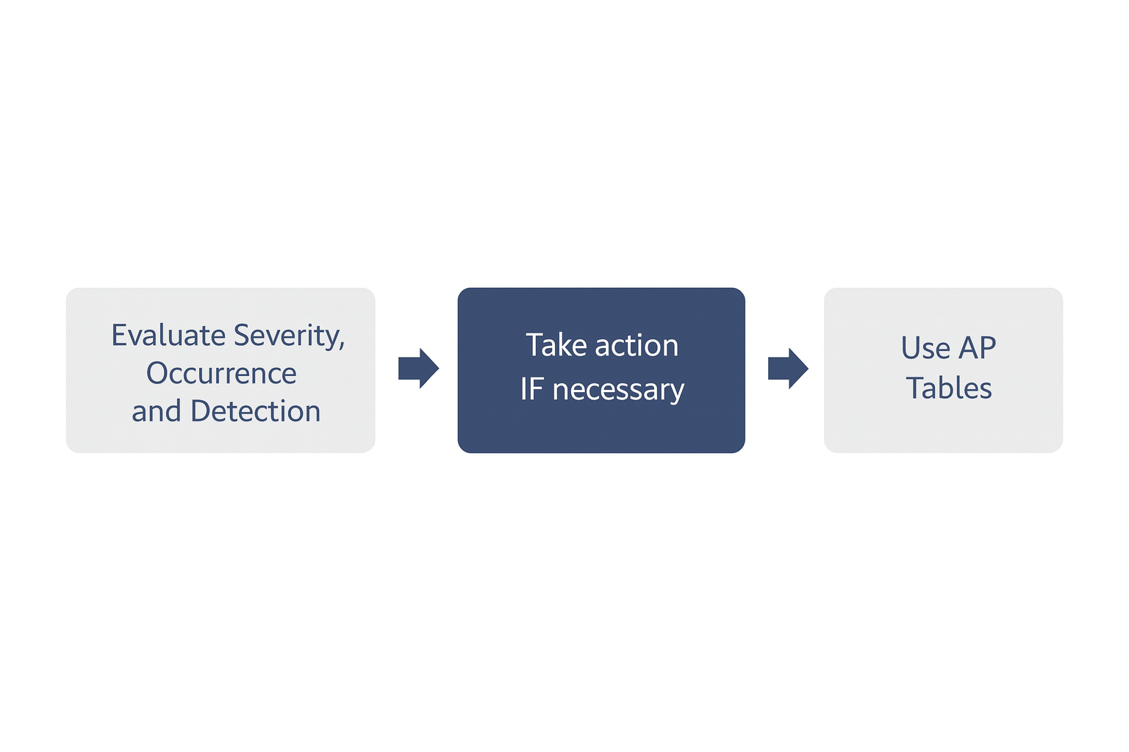
The 7 step approach
Step 5: Risk Analysis
  Evaluate S-O-D: Assess Severity, Occurrence, and Detection for each failure chain.
  Use AP Tables: Determine Action Priority (High, Medium, Low) based on S-O-D combinations.
  Purpose of AP: AP indicates priority for action—not risk level.
  Required Actions:
  High: Action or justification is mandatory.
  Medium: Action or justification is recommended.
  Low: Action is optional.

Slide 16
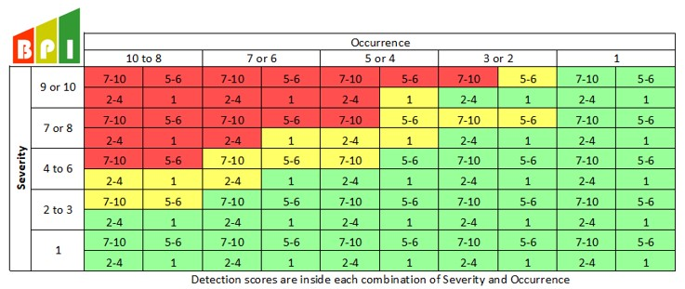
Action priority
RPN numbers will be replaced with Action Priority. Where RPN counts Severity, Occurrence and Detection equally, Action Priority puts most emphasis on Severity, then Occurrence and lastly Detection
    High (H): Required to identify appropriate action to improve Prevention and/or Detection Controls; OR justify and document why current controls are adequate
    Medium (M): Should identify appropriate actions to improve prevention and/or detection controls; OR, at the discretion of management, justify and document why current controls are adequate
    Low (L): Could identify actions to improve prevention or detection controls

Slide 17
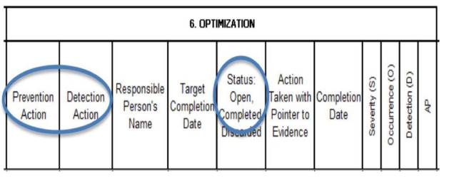
The 7 step approach
Step 6: Optimization
  The primary objective of the Optimization step is to develop actions that reduce risk and increase customer satisfaction by improving the process.
  Most actions will likely involve lowering the likelihood of the occurrence of failure causes or improving detection controls; either approach leads to a more robust process.

Slide 18
The 7 step approach
Step 7: Results Documentation
  The results of each FMEA study should be fully documented.
  An FMEA study is not finished until Step 7 has been completed.
  The FMEA report generally includes:
    A comparative statement of FMEA analysis results to the team’s original goals. This may include the 5Ts mentioned previously. (Intent, Timing, Team, Task, and Tool)
    A summary of the scope of the analysis along with identification of new content.
    A brief explanation of the method used to develop the design or process functions.
    Summary of the high-risk failures identified and the actions developed to mitigate the risk.

Slide 19
Process-fmea procedure
Inputs
Outputs
C&E Matrix
Process Map
Process History
Procedures
Knowledge
Experience
List of actions to prevent causes or detect failure modes
History of actions taken
PFMEA

Slide 20
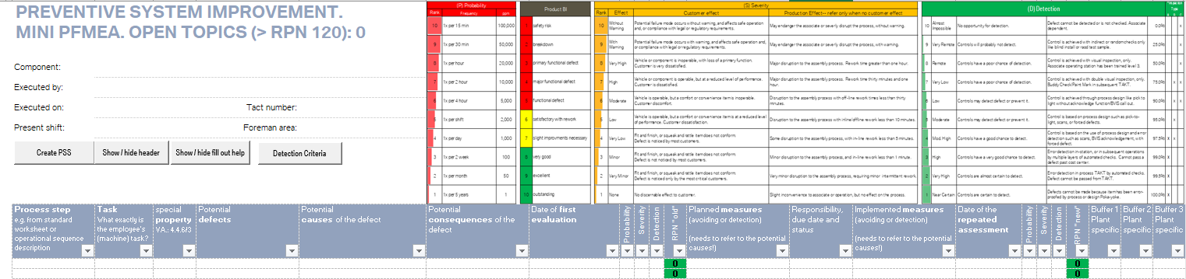
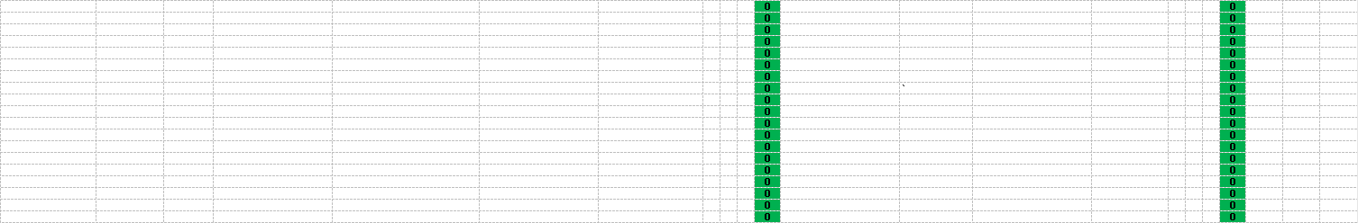
BMW mini process-fmea TEMPLATE

Slide 21
Sample of process-fmea method
1.Car Door Assembly – Hinge Installation & Wiring Harness
Process Step | Function / Requirement | Failure Mode | Effect of Failure | Severity (S) | Cause of Failure | Occurrence (O) | Detection (D) | RPN | Action Priority (AP)
Install Door Hinges | Ensure door opens/closes smoothly | Misaligned hinge | Door difficult to close, customer dissatisfaction | 7 | Improper positioning during assembly | 5 | 7 | 245 | High
wiring harness routing | electrical continuity | Harness pinched | Electrical short, window failure | 9 | Incorrect routing, missing clip | 5 | 6 | 378 | High

Slide 22
Sample of process-fmea method
1.Car Door Assembly – Hinge Installation & Wiring Harness
Process Step | Recommended Action | Occurrence (O) | Detection (D) | RPN | Action Priority (AP) | Action Taken / Result
Install Door Hinges | add jig, torque tool, training | 3 | 4 | 84 | Medium | Jig installed, torque tool added
wiring harness routing | routing guide, poka‑yoke clips, edge protection | 1 | 1 | 9 | Low | routing guide implemented, clips installed

Slide 23
Process-fmea activity
Scenario:
  During seat assembly on the production line, several issues have been reported:
    Seat height adjustment lever sometimes jams.
    Airbag sensor in the seat occasionally gives false signals.
    Seat fabric shows wrinkles after installation, leading to poor appearance.
Develop a Process Failure Mode and Effects Analysis (PFMEA) worksheet in Excel for the car seat assembly process.

Slide 24
Failure mode and effects analysis do’s and don’t’s
Do’s:
Must be performed as a team.
Prioritizing risk.
Collect vast data.
Breaking the analysis into smaller sections.
Diverse team.
Consider both external & internal failures.
Target for ‘Poke-Yoke’.
Linking with Control plan
Dont’s:
Performed by individual.
Reducing the risk.
Using recent data.
Performing for complete process in one take.
Majorly individuals working in the process.
Either external or internal failures considered.
Generic actions (inspection, training etc..)
Maintaining as standalone document.

