Slide 1

finding job postings based on user query
Legacy lies in finding a perfect job

Slide 2

Topic Weight
Have you ever noticed that while locating job opportunities is straightforward, finding a position that truly aligns with your skills and interests can be quite challenging?.
Nevertheless, applying filters is somewhat helpful, but there is always a chance the filters do not truly find the meaning.
Today, there are numerous novel avenues for delving into our passions and cultivating our professional trajectories. To be fair it’s a treasure hunt

Slide 3

Importance of Job recommending System
Its always a good choice to have AI and good recommending systems incorporated to find the suitable job.
While the system may not be 100% accurate in finding. It always accompanies us with the best fit results.
Use case- Reduced load, time saving with reduced use of filters, Relevancy.

Slide 4
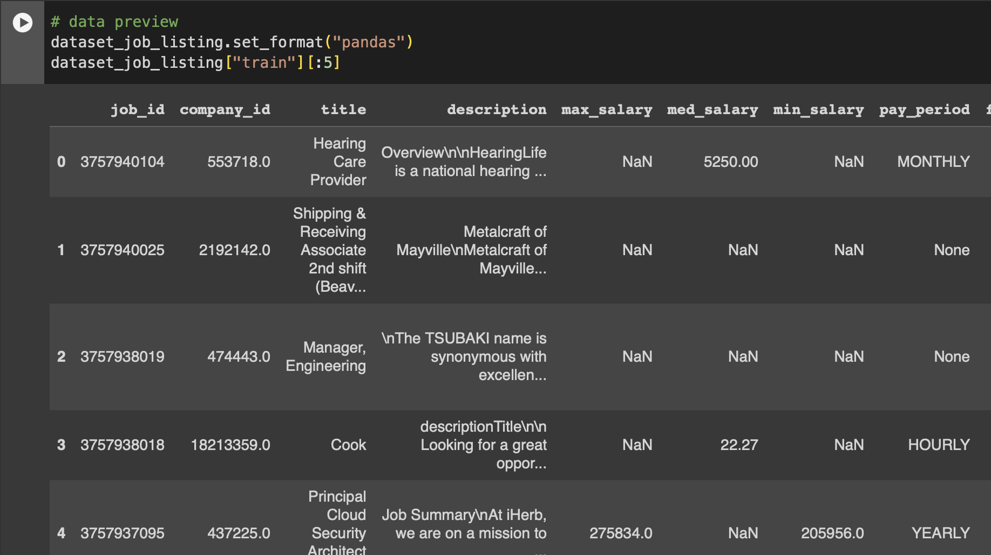
Data Interpolation
There are total of 28 columns and 33246 rows.
While the original dataset from Kaggle and GitHub has 11 different datasets with different attributes relating to a job. While postings dataset is the point of interest. Job_postings/Kaggle.
This Dataset was created

Slide 5
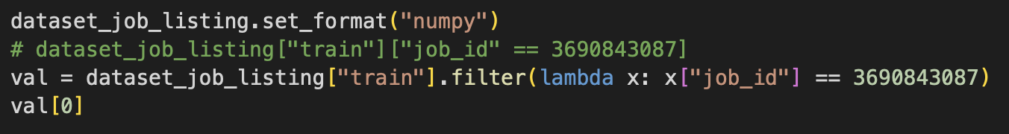
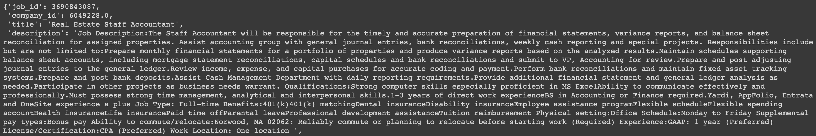
Sample Inspection

Slide 6
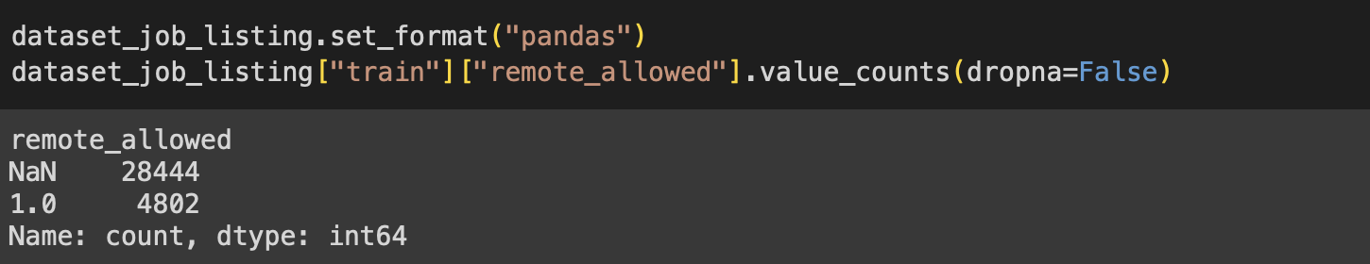
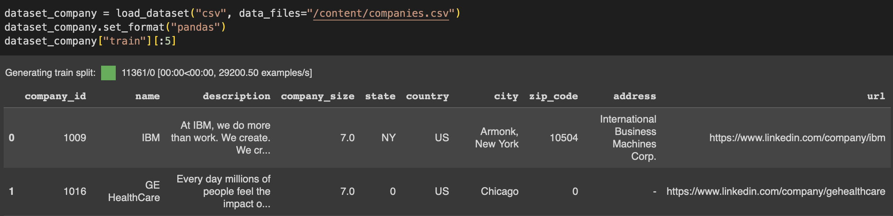
No of remote jobs available
No of companies
There are a total of 11,361 companies, that have posted job openings.

Slide 7
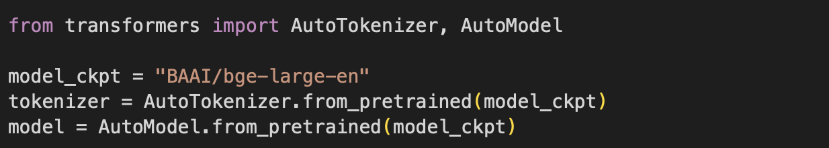
“BAAI/bge-large-en” Model Preview
The "BAAI/bge-large-en" Flag Embedding model from Beijing institute of Artificial Intelligence, which is designed to transform text into a compact, high-dimensional vector, facilitating tasks such as classification, clustering and “Searching for Relevancy”.
The model can take up to a vector length input up to 8192 tokens.
This model supports 100 languages.
Model can be imported from hugging face, or using the model checkpoint or using Flag Embedding package from python.
Model: Kaggle/BAAI-BGE-Large-en

Slide 8
Word Embedding
Word embedding is done using the predefined tokenizer for generating tokens for the input text that is suitable for the model input.
We initialize the pretrained model using Auto-model for our text classification and auto search.
Code reference : Slide 9

Slide 9
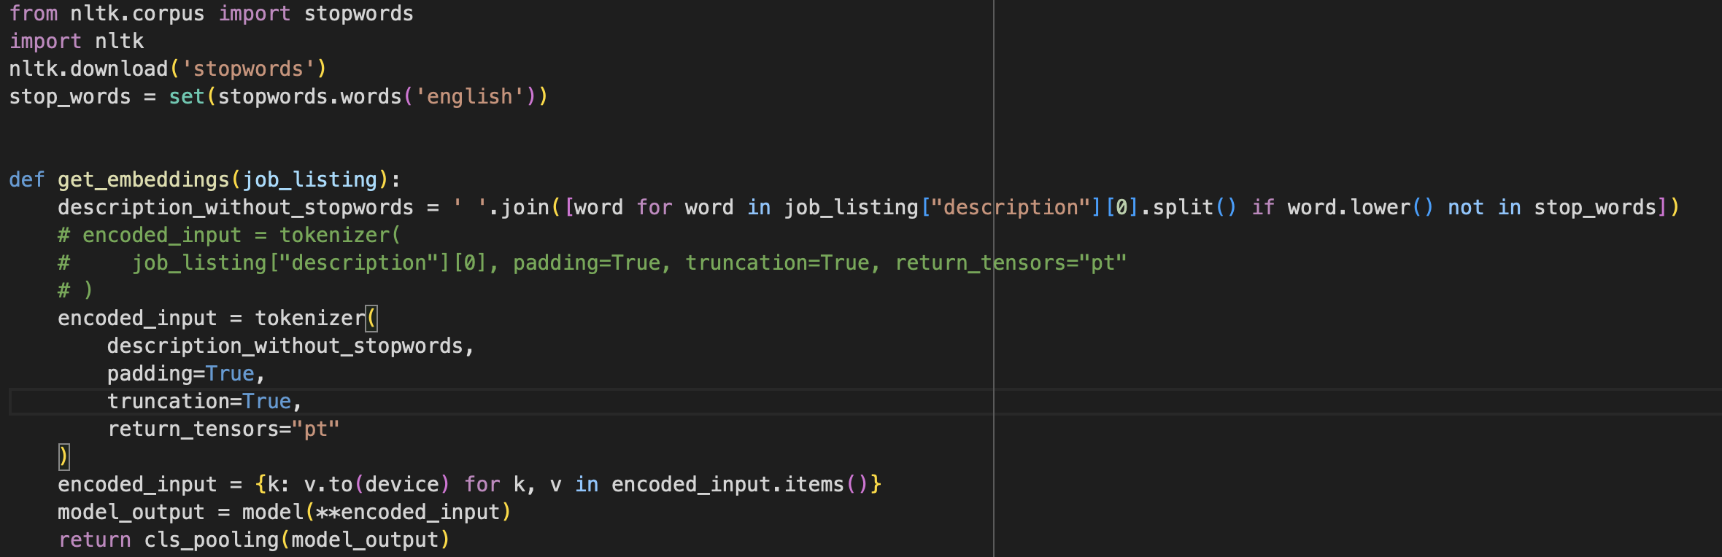
Preprocessing and word Embedding
Stop words for preprocessing.
We use the description without any stop words. To get the word embeddings for a single string.

Slide 10
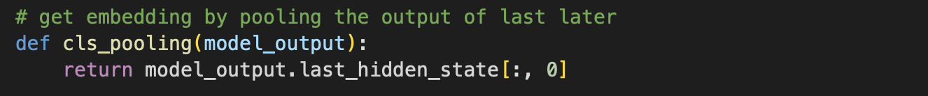
Layer pooling:
Extracting the CLS i.e classification layer of the “BAAI/bge-large-en” model.
Then collect the first column for all the rows for classification tokens.
which can be used for downstream tasks like text classification or regression.

Slide 11
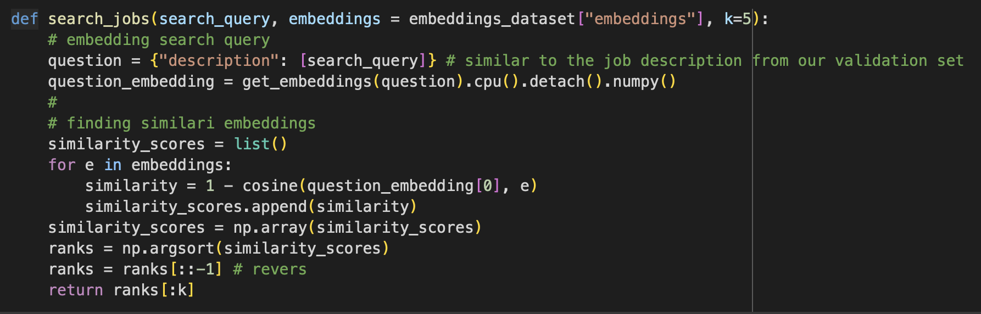
Search Queries
We use KNN for finding the nearest neighbors job description that aligns with our search query.

Slide 12
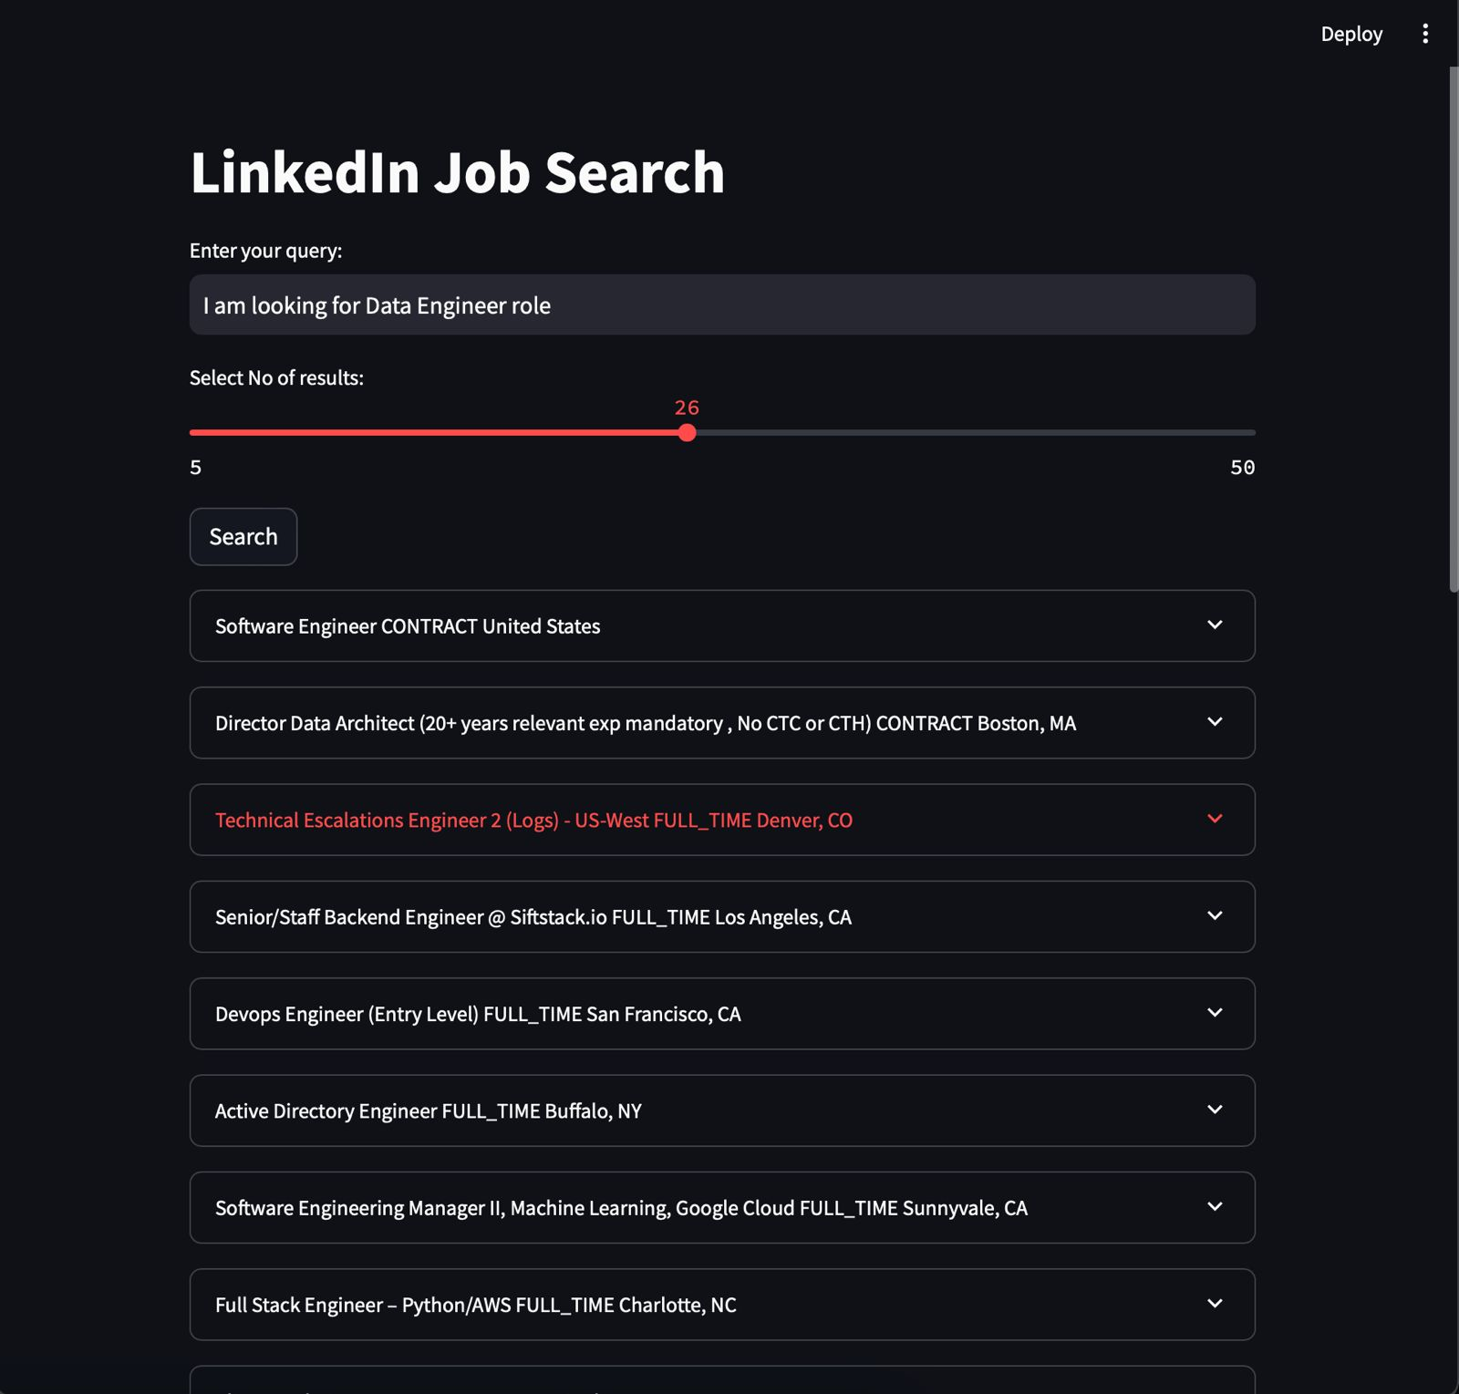
Results:

Slide 13
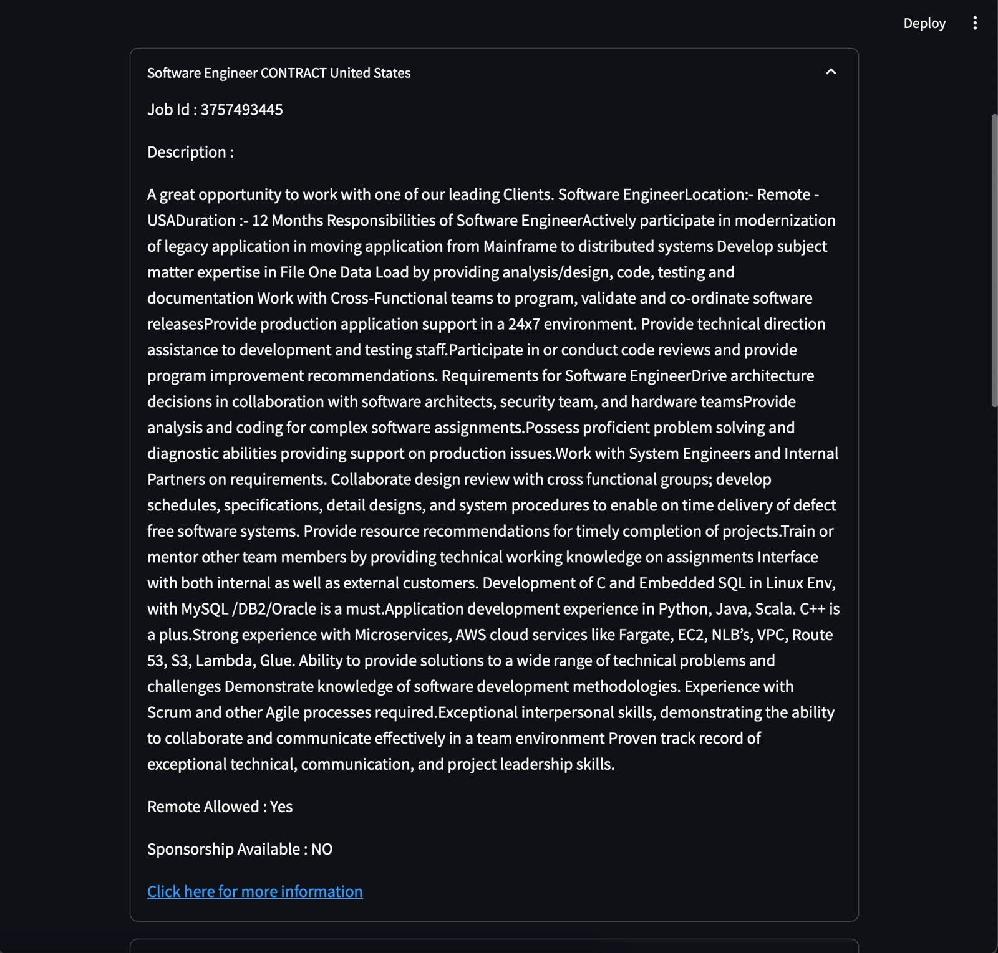

Slide 14
Thank you
Team:
Vigneswaran anandan
Preethi Bommineni
Manikanta
Vikas

