Slide 1
🔮 PLACEMENT PREDICTOR
Machine Learning se jaano ki aapki placement hogi ya nahi!
Flask (Python) • HTML/CSS/JavaScript • scikit-learn • Random Forest
Created by Vikas Yadav
October 2026

Slide 2
🌐 Ye Website Kya Karti Hai?
Idea ek line me: student ka data daalo → ML model prediction dega
Kaise Kaam Karta Hai?
Form me 8 Details Bharti Hain
Student apni details bharta hai (10th, 12th, CGPA, etc.)
• 10th Percentage (%)
e.g. 85
Website ye data Machine Learning model ko bhejti hai
• 12th Percentage (%)
e.g. 80
Model predict karta hai: placement hogi ya nahi
• CGPA (0 - 10)
e.g. 8.2
Saath me chance ka % bhi dikhata hai (gauge me)
• Internships ki sankhya
e.g. 2
Placed dikha to confetti celebration bhi hoti hai!
• Projects ki sankhya
e.g. 4
• Aptitude Score (0-100)
e.g. 78
• Communication Score (0-100)
e.g. 82
• Work Experience (Yes/No)
Yes / No

Slide 3
🧩 Technology aur Languages
Website 3 hisso se bani hai: Backend + ML + Frontend
🐍 Python 3.13
🌐 Flask
🧠 scikit-learn
Backend language
Web Framework
ML Library
Flask app + ML model — pura dimaag isi me hai
Python ki lightweight library — website chalati hai
Random Forest model train karne ke liye
🏠 HTML5
🎨 CSS3
⚡ JavaScript
Page Structure
Design + Animation
Interactivity
Website ka skeleton — forms, buttons, result box
Dark theme, glassmorphism, neon glow, animations
Form data bhejna, animations, cursor, confetti

Slide 4
📁 Project Structure
Har file ka kaam ek line me
placement-predictor/
|
|-- app.py <- Flask website (backend)
|-- train_model.py <- ML model train karta hai
|-- model.pkl <- Trained model (auto save)
|-- placement_data.csv <- Dataset (2000 students)
|-- requirements.txt <- zaroori packages
|-- runtime.txt <- Python version
|
|-- templates/
| |-- index.html <- Main website page
| |-- login.html <- Login page
|
|-- static/
| |-- style.css <- Design + animations
| |-- script.js <- Website ka JS logic
| |-- bg.js <- (backup background file)
Files ka Kaam
app.py — website ka dil: routes, login, predict API
train_model.py — dataset + model banata hai
model.pkl — trained Random Forest (auto load)
index.html — main page ka structure
login.html — login page (inline design)
style.css — poora design + 10+ animations
script.js — form logic + cursor + scan + confetti

Slide 5
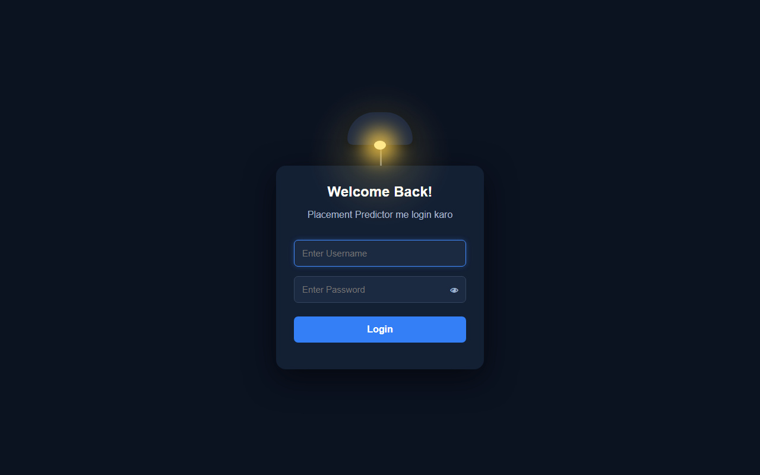
🔒 Login Page
Bina login kiye website nahi khulti — session security
Login Page Features
Lamp + bulb animation (upar latka hua lamp)
Username + Password form (POST se bhejta hai)
Password hide/show ka 👁 toggle button
Galat password par red error message
Session server par save hota hai (secret_key)
Credentials app.py me defined hain
Security: @login_required decorator har page ko protect karta hai — bina login ke / par redirect ho jata hai.

Slide 6
🔧 Login ka Backend Code (app.py)
Flask routes + session + decorator — sab simple hai
# Login credentials
VALID_USERNAME = "vikas yadav"
VALID_PASSWORD = "pit jaunpur"
# Har page ko protect karne wala decorator
def login_required(f):
@wraps(f)
def wrapper(*args, **kwargs):
if not session.get("logged_in"):
return redirect(url_for("login"))
return f(*args, **kwargs)
return wrapper
# Login route — GET se form, POST se check
@app.route("/login", methods=["GET", "POST"])
def login():
error = ""
if request.method == "POST":
username = request.form.get("username", "")
password = request.form.get("password", "")
if username == VALID_USERNAME \
and password == VALID_PASSWORD:
session["logged_in"] = True
return redirect(url_for("home"))
error = "Galat username ya password!"
return render_template("login.html", error=error)
Simple Bhasha Me
session — browser ke liye "identity card"
session['logged_in'] = True matlab login ho gaya
Decorator har page par check karta hai
Galat password par error variable me message
render_template() HTML file browser ko bhejta hai
url_for() sahi page ka path dhoondta hai

Slide 7
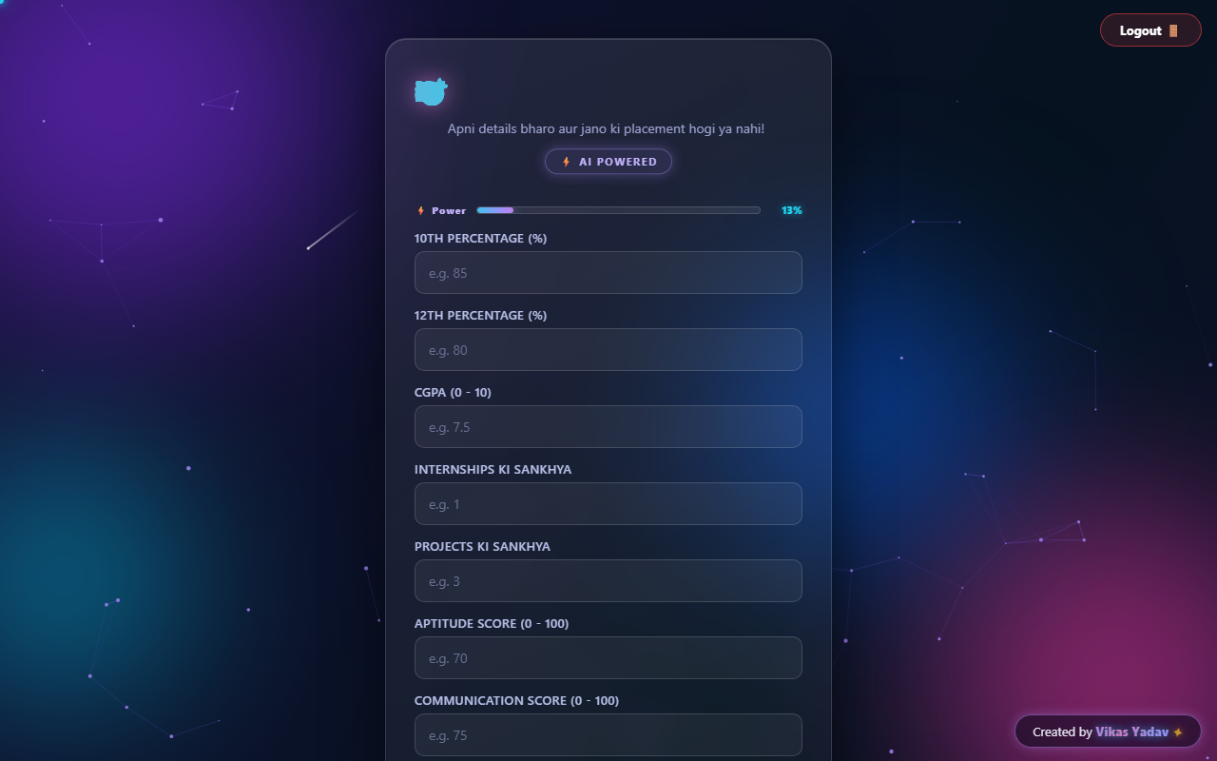
🏆 Main Website Page
Dark theme + glassmorphism card + animated background
Screen par Kya Dikhta Hai
Animated background — particles + shooting stars
Floating glowing orbs (mouse ke saath chalti hain)
Glassmorphism card — mouse par 3D tilt hota hai
Gradient animated title + typewriter subtitle
⚡ Power bar — fields bharo utna % badhta hai
Magnetic Predict button (cursor ko khichta hai)
Neon 'Created by Vikas Yadav' credit

Slide 8
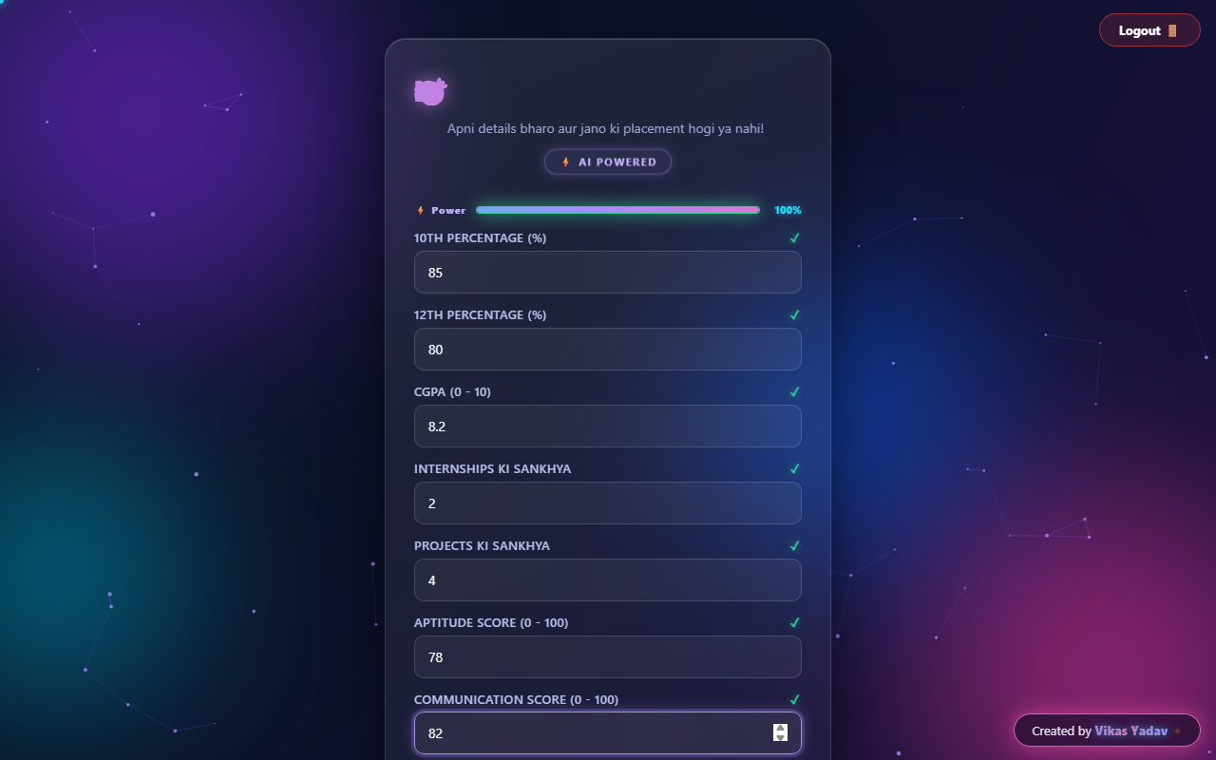
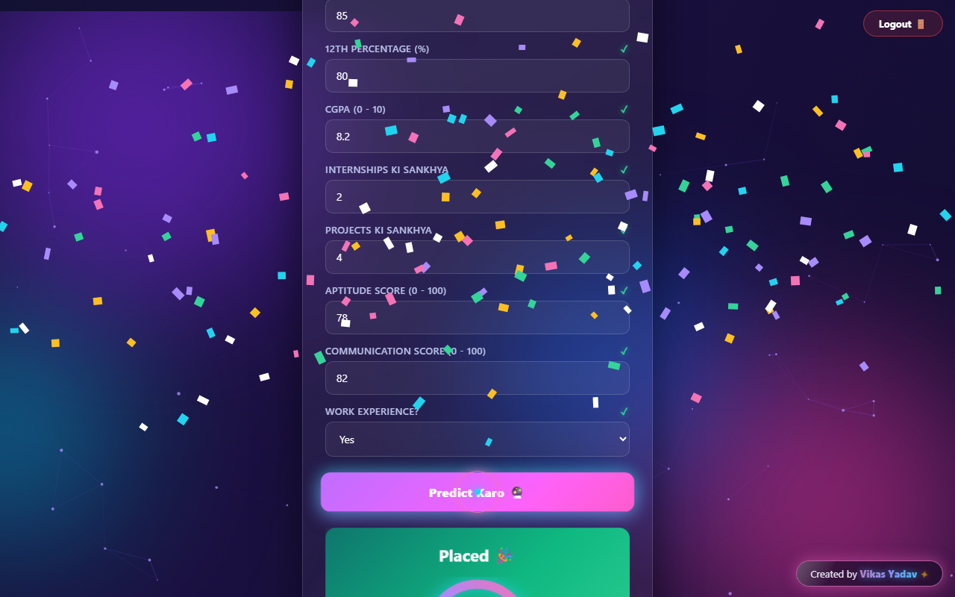
📋 Form Bharo → Prediction Lo
Form bharne par power bar full, submit par AI scan + result
Result Me Kya Milta Hai
Placed / Not Placed
Chance ka exact %
Neon circular gauge
Confetti celebration
Hologram glitch reveal
AI scan line animation
① Form bharte waqt — Power bar badhta hai
② Predict ke baad — Gauge + confetti

Slide 9
🤖 Prediction Ka Code (app.py)
Form ka data → model → JSON response
# Form se aane wale fields (same order me model ko bhejte hain)
FEATURES = [
"tenth_percent", "twelfth_percent", "cgpa",
"internships", "projects", "aptitude_score",
"communication_score", "work_experience",
]
@app.route("/predict", methods=["POST"])
@login_required
def predict():
# JavaScript se student ka data aata hai (JSON)
data = request.get_json()
# Form ki values ko number me badlo
values = [float(data[f]) for f in FEATURES]
# Model ko do — lag 0.5 se placement ka chance
prob = model.predict_proba([values])[0][1]
placed = prob >= 0.5
percent = round(prob * 100, 1)
# Browser ko JSON wapas bhejo
return jsonify({
"prediction": "Placed" if placed else "Not Placed",
"probability": percent,
"message": "Strong profile!" if placed else "Skills improve karo!",
})
Flow Samjho
1. JavaScript fetch() se JSON bhejta hai
2. Flask request.get_json() me padhta hai
3. model.predict_proba() chance nikalta hai
4. probability >= 50 → Placed, warna Not
5. jsonify() se browser ko JSON wapas
6. JS result ko animation ke saath dikhata hai

Slide 10
🧠 Machine Learning Model
Random Forest Classifier — scikit-learn se train hua
# train_model.py ka core hissa
# 1. Dataset banaya — 2000 students
n = 2000
tenth = rng.normal(78, 9, n) # 10th marks
cgpa = rng.normal(7.5, 0.9, n) # CGPA
# ... 8 features total
# 2. Placement chance ka formula
chance = (cgpa/10)*30 + (tenth/100)*15
+ internships*8 + projects*2
+ aptitude*0.15 + communication*0.15
+ work_exp*5
placed = (chance + noise > 75).astype(int)
# 3. Model train
model = RandomForestClassifier(n_estimators=100)
model.fit(X_train, y_train)
# 4. Save for website
joblib.dump(model, "model.pkl")
# accuracy: ~87%
Random Forest Kya Hai?
100 chhote decision trees ka group
Har tree apna guess karta hai
Sabka majority vote = final answer
8 features input: marks, CGPA, skills...
Output: 0 (Not Placed) ya 1 (Placed)
predict_proba() se % chance milta hai
Dataset: placement_data.csv (2000 rows)

Slide 11
🏠 HTML — Website ka Skeleton
index.html — ye structure browser ko bhejta hai
<!-- templates/index.html (simplified) -->
<canvas id="bgParticles"></canvas> <!-- background -->
<div class="container"> <!-- glass card -->
<header>
<h1 id="mainTitle">Placement Predictor</h1>
<p id="tagline">Apni details bharo...</p>
<div class="badge">AI Powered</div>
</header>
<div class="charge">...</div> <!-- power bar -->
<form id="predictForm">
<label>10th Percentage</label>
<input type="number" id="tenth_percent" />
<!-- ... 8 fields total ... -->
<button type="submit">Predict</button>
</form>
<div id="result" class="hidden"> <!-- result box -->
<h2 id="predictionText"></h2>
<div class="gauge"> <!-- neon ring -->
<svg>...</svg>
</div>
<p id="messageText"></p>
</div>
</div>
HTML Kya Fix Karta Hai
canvas — animated background ka drawing area
form + input — user ki 8 details
id='result' — JS isi me prediction likhta hai
SVG circle — neon gauge ring banati hai
hidden class — result pehle chhupa rehta hai
url_for() — CSS/JS ka sahi path deta hai

Slide 12
🎨 CSS — Design + 15+ Animations
style.css — website ko sundar aur jaandar banata hai
Design Techniques
Animations List
Glassmorphism — card par blur + transparency
• @keyframes float1/2/3 — orbs ka float
Neon glow — box-shadow se chamak
• @keyframes bgShift — background ka rang
• @keyframes letterIn — title ke letters
Gradient text — title me 3 rang badalte hain
• @keyframes caretBlink — typewriter cursor
Dark theme — #07071a background
• @keyframes shine — button par light sweep
CSS variables — ek jagah rang define, jagah jagah use
• @keyframes scanSweep — AI scan line
• @keyframes glitchIn — hologram result
Backdrop filter — background blur effect
• @keyframes eqBounce — thinking bars
• @keyframes neonFlicker — credit sign

Slide 13
⚡ JavaScript — Website ki Jaan
script.js — sab kuch chalata hai (500+ lines)
1. Background Animation
2. Title + Typewriter
3. 3D Tilt + Cursor
Canvas par 70 particles move + connect.
Mouse ke paas cyan lines.
Shooting stars aati rehti hain.
Har letter span me wrap.
Ek-ek karke uchhal ke aata hai.
Subtitle akshar-akshar likhta hai.
Card mouse ke saath tilt.
Custom neon dot + ring cursor.
Orbs parallax move karti hain.
4. Form + Fetch
5. Result Animations
6. AI Scan + Glitch
8 fields ka data collect.
fetch('/predict') se JSON bhej.
Response me prediction padh.
Gauge ring bharti hai (SVG).
% count-up hota hai.
Placed ho to confetti barish.
Scan line card par sweep.
Fields sequence me highlight.
Result hologram glitch se aata hai.

Slide 14
📝 JavaScript Code — Form Submit
User click karta hai → data jaata hai → result aata hai
// script.js — form submit hone par
document.getElementById("predictForm")
.addEventListener("submit", async function (e) {
e.preventDefault(); // page reload mat ho
// 1. Saari fields ka data lo
const data = {
tenth_percent: document.getElementById("tenth_percent").value,
twelfth_percent: document.getElementById("twelfth_percent").value,
cgpa: document.getElementById("cgpa").value,
internships: document.getElementById("internships").value,
projects: document.getElementById("projects").value,
aptitude_score: document.getElementById("aptitude_score").value,
communication_score: ...,
work_experience: ...,
};
startScan(); // AI scan animation chalu
// 2. Flask server ko bhejo
const response = await fetch("/predict", {
method: "POST",
headers: { "Content-Type": "application/json" },
body: JSON.stringify(data),
});
// 3. Result lo aur dikhao
const result = await response.json();
gaugeFill.style.strokeDashoffset = ...; // ring bharo
countUp(probText, result.probability); // % count-up
if (result.probability >= 50) fireConfetti(); // celebration
});
3 Steps Me
• data object — sab fields collect
• fetch() — server ko JSON bhejta hai
• await — response ka wait karta hai
• result.prediction — Placed/Not
• result.probability — % chance
• startScan() — AI scan animation
• countUp() — % smooth badhta hai
• fireConfetti() — celebration!

Slide 15
▶️ Kaise Chalayein aur Deploy Karein
2 command me website apne computer par
Computer Par Chalane Ka
Free Deploy (Render.com)
# Step 1 — model train (ek baar)
python train_model.py
# Step 2 — website chalao
python app.py
# Build command
pip install -r requirements.txt
# Start command
gunicorn app:app --bind 0.0.0.0:$PORT
# Instance: Free
Phir browser me kholo: http://127.0.0.1:5000
Dusre device (same WiFi) ke liye:
Terminal me jo IP print hota hai wahi use karo.
Credentials: vikas yadav / pit jaunpur
GitHub → Render → Web Service → repo select → Deploy.
Free plan: 15 min idle par website so jati hai (cold start).

Slide 16
✨ Website ki Khaas Baatein
Ek line me: simple code + tagda ML + zabardast animations
🧠 ML Powered — Random Forest (87% accuracy)
🎨 15+ custom CSS animations
🔒 Login Security — session + decorator
🖱 Custom neon cursor (dot + ring)
🎯 8 Features se accurate prediction
💨 Glassmorphism + 3D tilt card
📊 Neon gauge + count-up percentage
🚀 Zero external libraries — pure CSS/JS
🎉 Confetti celebration (Placed ho to)
📱 Mobile friendly + reduced motion support
🔍 AI scan animation (predict karte waqt)
🌐 Deploy ready — Render free hosting
Total Code: app.py (119 lines) + train_model.py (89) + index.html (118) + login.html (271) + style.css (868) + script.js (593) ≈ 2000+ lines — sab handwritten, koi library nahi!

Slide 17
Thank You!
Koi sawaal ho to poochh lo 🙂
Placement Predictor • Created by Vikas Yadav

