Slide 1
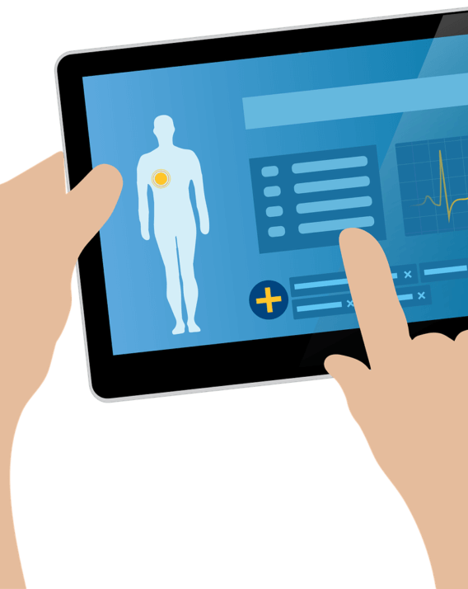
Health Monitoring App
A repository of a person’s health history, and much more.
Ayush Kumar : CS16B005
Atharva Gupta : CS16B002
Notes:
To change the image on this slide, select the picture and delete it. Then click the Pictures icon in the placeholder to insert your own image.

Slide 2
The Problem
There’s no digital way of keeping track of a person’s health over time.
There is a dire need to create a platform to keep a person’s prescriptions, the medications he has been on, and other statistics.
Prescriptions get piled up at home unnecessarily, and get lost at many times, which becomes a barrier in the person’s proper diagnosis when s/he gets sick.

Slide 3
Existing Solutions, and why don’t they work
The medical records of a patient are still kept and used in archaic way. It’s written by doctors at clinics.
There’s no way to keep track of one’s health over a period of time.

Slide 4
The Proposed Solution
We’re going to create a repository of a person’s medical history.
It’ll house detailed info about when a person got sick, what medicines were prescribed to him, etc.
Each person will have a unique identification number, using which a doctor can see the history of the patient, and diagnose accordingly.
The app will also have a format for writing prescriptions, like RDF.
We may integrate it with services like Netmeds, for doorstep delivery of the medicines.

Slide 5
Technologies to be used to implement the solution
HTML/CSS/Bootstrap/JavaScript
Angular
MySQL
Apache

Slide 6
Evaluation of the solution
The doctor should be able to get history of a patient by entering his unique ID.
The patient should have option to add details at any point of time.
The patient should get reminders for taking pills, regular checkups, etc.

