Slide 1
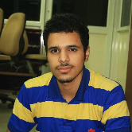
EDUCATION
B.E (E.C.E) | 2014-2018 | Netaji Subhas Institute of Technology, New Delhi | 62.5%
CBSE (Class XII) | 2014 | Spring Meadows Public School, New Delhi | 93%
CBSE (Class X) | 2012 | Spring Meadows Public School, New Delhi | 8.8 CGPA
Vikas Yadav
Full Stack Developer
[ IFFCO Tokio General Insurance ]
[ battleramp.com ]
Contact No
Email
Linkedin
Resume
+91-7503706240
vikasyadav250@yahoo.com
My Profile
My Digital Resume

