Slide 1

SDP Group 8
Notes:
Hello, we’re team Infin8, and we’re going to
Quickly discuss some of our design decisions, as well as address some ideas that didn’t work out for us.
We are team Infin8, a highly creative pun on team number 8!

Slide 2
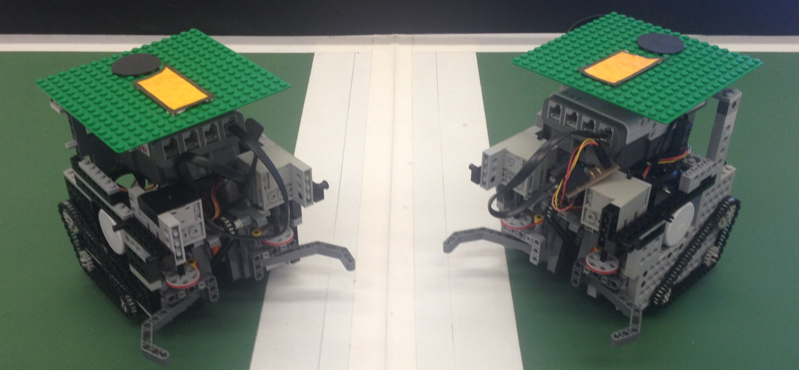

Challenge: Quickly make a pair of robots that follow the rules
Notes:
We’re thrown into this project, given an enormous
Amount of resources, plenty of time, and plenty of open
Ended options. Where do we begin?

Slide 3
Challenge: Quickly make a pair of robots that follow the rules
Java
Git
Eclipse
Trac
Notes:
We use java as an easy platform for all our team jump into
Quickly. We trust our software design skills to keep us
Running maintainable code, and consider previous years’
Code a valuable asset for comparing and improving our
Own work.
Git has become so fundamental to group software
Development that we can’t even imagine using anything
Else. Utilizing git’s branching system and easy commit
Cycles, we were able to work on concurrent, as well as
Independent, tasks and merge with little hassle.
Eclipse is the obvious choice when working with java, but
The addons available to us made subtle improvements to
Our work. Git Team Provider and Windowbuilder became
Valuable assets to our workflow.
Trac was an early choice we made for an issue tracker
We were all familiar with. Getting it set up and using it
Has been useful to us in keeping track of tasks, especially
During peak coursework periods where we needed to
Temporarily divert our attention away from SDP.

Slide 4
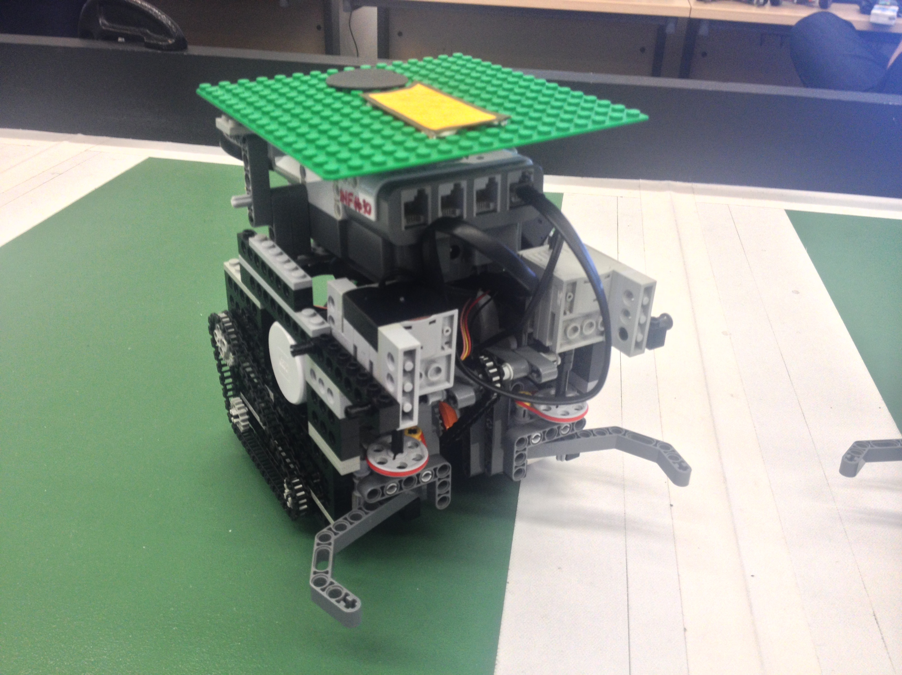
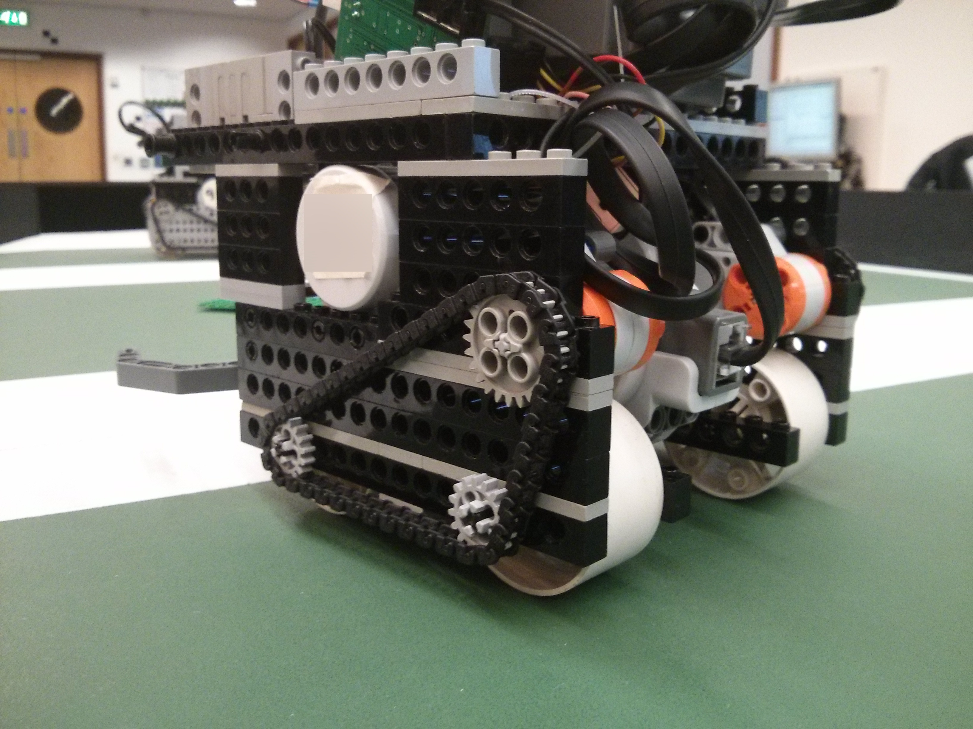
Hardware Design Choices
Gripless wheels
4-wheel drive, differential controller
I2C powered grabber
Chain powered driver, kicker
Notes:
Our four-wheel differential drive allows us to move and turn
Very fast. We removed the wheel grip to reduce
Unnecessary friction. All together we put the speed
Responsibility on software, while improving our speed limits
We use a separate I2C multiplexer to remove the 3-motor
Limit NXT bricks deal with. This allows us to move a
Kicker and grabber independently.
Too many gears cause a high loss in efficiency. We use our
Chain drives to improve space and power efficiency.

Slide 5
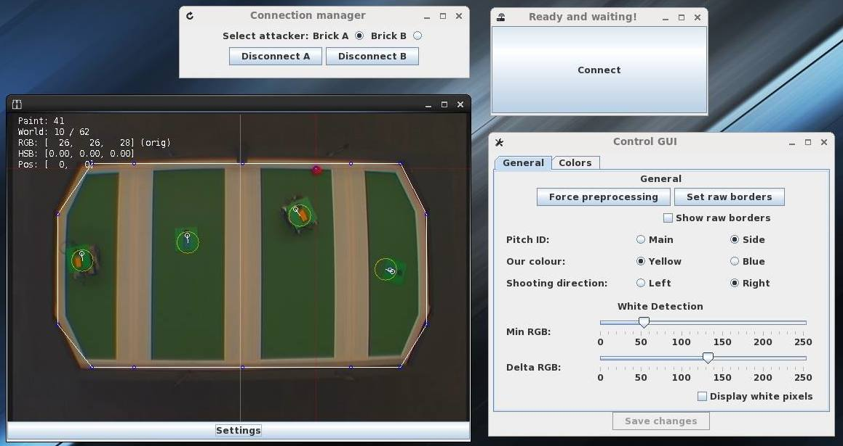
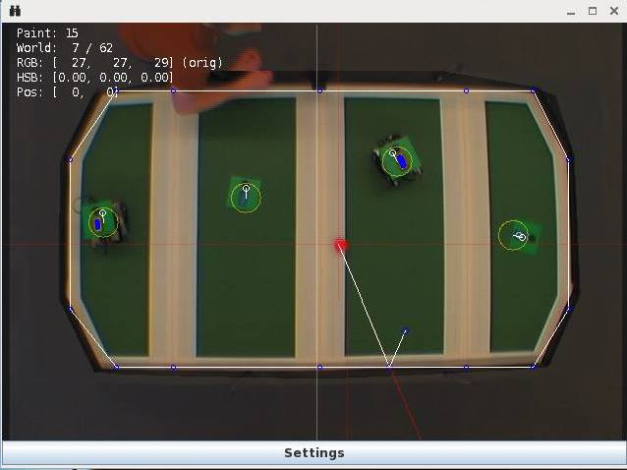
Software Design Choices
Gripless wheels, 4-wheel drive, differential controller
I2C powered grabber
Chain drive and kicker

Slide 6
Software Design Choices
Non-blocking AI functions
Accurate ball prediction
Automatic border calibration
Full-featured GUI
World State/Screen Drawing on separate threads
Distortion Correction
Notes:
By writing our AI code to be fully synchronous and
Non-blocking, we can interrupt any action or state with a
New one.
Our ball prediction allows us to recognise the best
Interception points, as well as predict the result of
Opponents who aim for bounce shots
By automating as much as possible and adding features to
Our GUI, we can rapidly design, test, repeat.
We’ve separated the world state updater from the thread
Which draws to our screen, which essentially guarantees
Our performance to match or exceed the camera framerate
We also correct distortion from the camera due to its small
Lens by using something like an inverse fisheye
transformation

Slide 7
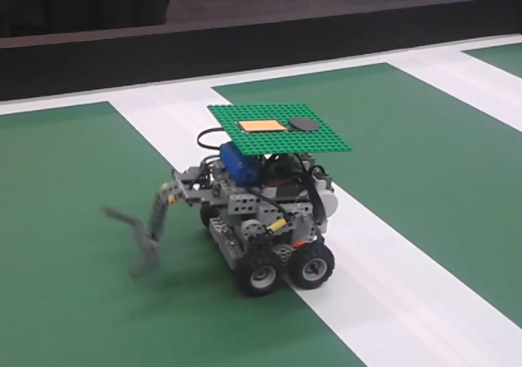
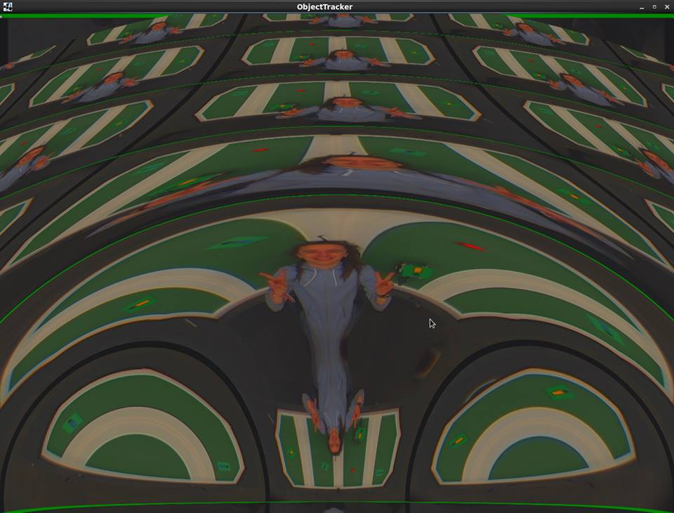
Subprojects that never worked out

Slide 8
Subprojects that never worked out
OpenGL
Pneumatic Kicker
Notes:
At one point we had a kicker functioning using
Pneumatics. It worked by using a small motor and battery to
pump up a tank which we could use to kick with high power.
We scrapped the idea because it was limited to about 30
Kicks before needing to reconnect to the pump – not
Suitable for back-to-back games.
We tried many solutions to normalize and invert distortion
In our camera feed. OpenCV crashed the JVM on our
Lab machines. OpenGL showed potential, but without a
Shared memory bus between Java and GL, we would have
To re-write a prohibitive amount of code in GLSL. Doing it
Manually in Java feels like a hack, but it’s better than
Nothing.

Slide 9
Questions?

