Slide 1
Reusable ML pipeline
Implementing an efficient, reusable, end to end ML pipeline framework
Vikram Hegde
W205 Spring 2016 Final Project

Slide 2
Problem statement
Is it possible to architect an efficient, reusable (dataset and ML algorithm agnostic) pipeline for ML Research?
As proof of its utility, can this pipeline be easily used to answer the following two ML research questions:
Do discriminative classifiers as typified by Logistic Regression really have lower asymptotic error ?
Do generative classifiers (such as Naïve Bayes) reach asymptotic error faster ?

Slide 3
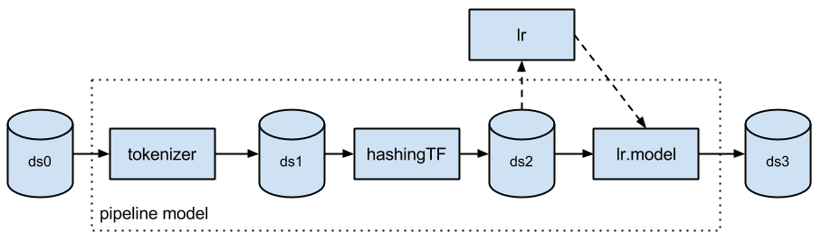
Why is this important ?
Common task in ML research: compare different algorithms
Algorithms are sometimes hand crafted (because they are novel)
Part of the processing usually shared (feature extraction)
Rest of the pipeline typically done sequentially.
Once project is over the scaffolding code is usually discarded.
This project tries to provide a solution.
Creates a plug and play framework for ML Pipelines

Slide 4
DatasetS
Million song dataset
Available on AWS as a 300 GB EBS snapshot
MNIST Digit data
Classic dataset used to test digit recognition
Relatively small dataset (53MB)

Slide 5
Application to Large dataset
This pipeline will be used with Machine Learning on two different and disparate datasets. On each dataset, both logistic regression and Naïve Bayes will be applied to perform classification and the results between the two methods compared.
We use 2 different algorithms and 2 different datasets (one large and one small) to demonstrate the applicability of this pipeline to a wide array of machine learning experiments
The two datasets used are:
Million song dataset (a large 300 GB dataset) to classify a song as pre-2000 or post-2000 (binary classification)
Digit recognition using MNIST data (a multiclass classification problem using a relatively small 53 MB dataset)

Slide 6
Proposed plan
Use a single EC2 instance
Two different ML classifiers
Two different tasks (binary song era classification and multiclass digit classification)
Transparently use minimal reclaimable, shared storage for raw data and extracted features
Ease of use of framework demonstrated
Potential challenge: Size of EC2 unclear

Slide 7
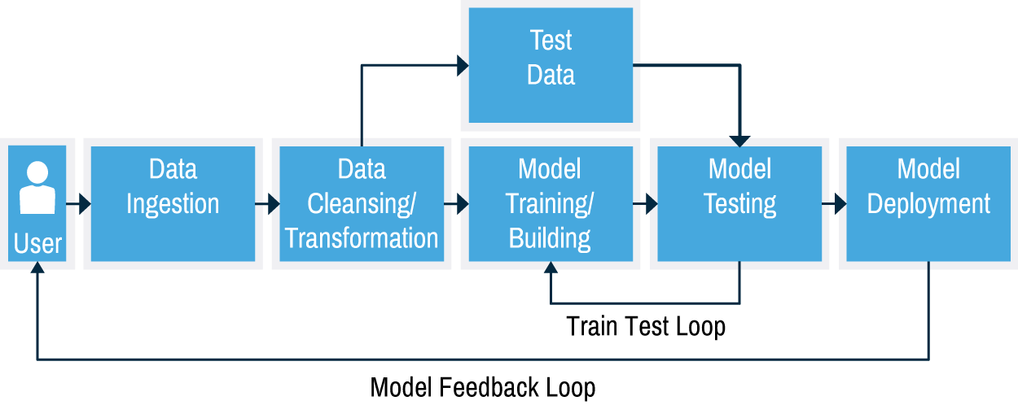
Characteristics OF ML APPLICATION
ML inherently an iterative process.
Unlike software development.
Some iterative processes in ML:
Try different number and types of features
Try different algorithms
Tune hyper-parameters
Train, evaluate model, change something, repeat, … finally, test
Notes:
If you follow good software engineering processe, it can be mostly done on the first iteration (except for the ever present debugging and feature enhancement phases). Even if iterations are required, they are mostly done by the first few iteraons with subsequent ieteration touching and modify a small portion of software. Look at ML in contrast – we need to try different features and see what works, we need to scale or normalize features, we need to extract information from raw data, we need to tune hyperparameters, we need to be able to do cross valiation to do an accurate evaluation of a model, we need a way to generate extra data to prevent overfitting, we need to select a batch size, we need to chose different algorithms or different implementations of the same algorithm. If the first iteration does not do well we need to go over the same process all over again with potentially major changes to every phase in training, validation and testing. Much of the joy of trying different models is lost due to the burden of data engineering.

Slide 8
What this Isn’t
Targets ML research and product research
Why not production pipeline ?
Production:
need to be optimized
need to interact with many subsystems, possibly proprietary
need a variety of feedback, reporting, monitoring and analysis tools
Creating useful/generic/optimized/flexible production pipeline too big a task
Not ruling out use of architecture in production, but …
Production code is not primary focus.

Slide 9
What THIS IS
Work during “research” phase (academic/industry) characterized by
many iterations
a lot of change to the ML pipeline
Time spent in data engineering far exceeds time spent in modelling
Project targets handling all the heavy lifting (data engineering) of the “research” phase.

Slide 10
APPROACH
My approach to designing the pipeline
Step 1 – Build a generic pipeline
Issues – How generic do we make this pipeline.
Step 2 – Make it modular. Teams can swap part in or out
Ok, pipeline should be modular and generic, but how do we actually build it ?
Ans – Go to the highest level of abstraction and find those phases that are common to *every* machine learning experiment:
Fetch data
Extract Features
Split labels into train, validate/dev, test
Train model
Validation/hyper-parameter tuning
repeat previous steps until …
Finally test
Notes:
What is generic enough for one research team may be be too rigid for others. Or a pipeline can be too flexible and team wastes time interacting with more flexibility than they need
(inspired by modular cell phones that Google etc are working on just swap out parts.) Start out with a bunch of existing modules and swap them out to fit your needs
Fetch raw data
Select subset of raw data
extract features from raw data
Find or assign labels
Split labelled data into train, validate/development set and test set
Set hyper parameters
Train model` with extracted features
Plot curves during or after training
Validation phase iterate going back to any of the previous steps
Plot curves during or after validation
Test phase
Plot curves during test phase

Slide 11
Approach…
Should scale from simple to complex
Answer is hierarchical modularization.
Inspired by top down software development methodology.
Start out with the fundamental phases in ML Research (highest level of abstraction)
Allow users to inherit from abstract classes
Define clean, well defined and generic semantics and interfaces between all modules.
Provide a basic implementation that implements a few levels in the hierarchy
Users can decompose this pipeline into as many sub components as they want

Slide 12
The Basic Design
A tree
The root node is an abstract single monolithic 1 – stage pipeline.
Pipeline is data references flowing in a depth first traversal of the leaves
Modules can be inserted and deleted from the pipeline tree as desired (similar to UNIX Streams)
Each module uniquely identified by its path to the root node.
Operations on the data as well as modules resemble file system operations. (procfs)

Slide 13
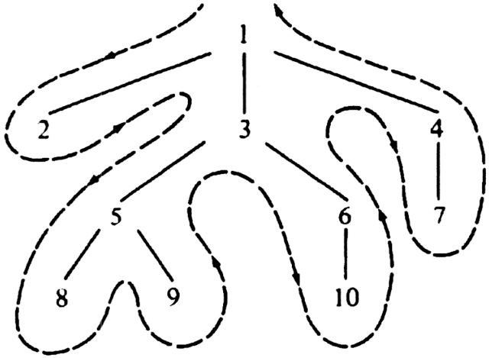
Depth first leaf traversal

Slide 14
NODE METHODS and helpers
Node methods:
do_mount()/do_umount()
do_compile()
do_run()
do_setprop()
do_save()
do_read()
do_delete()
do_print()
do_walk()
Helper functions:
get_file_type()

Slide 15
Design Details
Three additional design goals:
Save as much data for reuse as possible
Minimize data movement, so we use references to data rather than data itself
Move or transform data lazily
Root base class is MLRoot. The MLRoot class is mandatory.
Three subclasses provided: MLFetch, MLDerive, MLModel
Clients can create their own subclasses of MLRoot.
MLFetch – MLIngest, MLDecompress, MLUnarchive, MLRaw
MLDerive – Can be subclassed by user to derive features from raw data
MLModel – Can be subclassed by user to implement ML models

Slide 16
More subclasses
Subclasses provided by framework:
MLIngest – MLHttpDownload, MLFSDownload
MLDecompress – MLDecompressZip, MLDecompressBzip2, MLDecompressGzip
MLUnarchive – MLUnarchiveTar
MLRaw – Has no subclasses defined by implementation, clients can define their own
MLDerive, MLModel, MLRaw are abstract classes.
MLRoot enforces constraints and provide methods to manipulate pipeline
Clients can use as much or as little as of tree as needed (only MLRoot is required)

Slide 17
MLRoot and mount
Use of the pipeline divided into sessions.
Data between sessions saved in pickle files.
MLRoot exports methods for running the pipeline
Session starts with instantiating an MLRoot object (say mlroot)
mlroot.mount(mount_spec=“/path/to/mount/spec”) mounts all the nodes
mount_spec is a file in json format (allows comments)
Sample mount spec:
[
{ “comment” : “this key is ignored. Dictionaries with only comments are ignored” }
{ “resource” : “MLRoot” , “mount_point” : “/”, “node_options” : [ {“root_op_1” : op1}, {“root_op2” : op2}] },
{ “resource” : “MLFetch”, “mount_point” :”/fetch”, “global_options” : [], “comment” : “this key is ignored” },
{ … },
…
]
Options: node_options passed to node, global_options are for framework.
Children of a parent node are ordered in the sequence in which they appear in the mount_spec
Notes:
Based on /etc/fstab

Slide 18
Compile
Once the tree is mounted, user calls compile
mlroot.compile()
Compile ensures well formed tree with no cycles.
Also ensures input and output between neighboring modules mesh together
Compile checks done by both the framework and individual nodes
Once compile phase complete, the pipeline can be run

Slide 19
RUN
mlroot.run(save,[resume=“/path”],[state=<pickle-file-path>])
save is mandatory argument
If save is True, state from the run saved
If save is False, no saved state and restarts always start with clean slate
resume: (optional) Can be “/root” or “/path/to/node”
state: (optional) path to previous state in pickle file
run() can be directly resumed with pickle file without mount() or compile()

Slide 20
Sample USAGE
Sample usage:
A fresh session
mlroot = MLRoot()
mlroot.mount(mount_spec)
mlroot.compile()
mlroot.run(save=True, input_data, state=/path/for/saving/pickle/file)
Restart the old session, starting where we left off:
mlnewroot = MLRoot()
# we choose not to save state this time
mlnewroot.run(save=False,resume=“/root/model”, state=“/saved/pickle/file”)

Slide 21
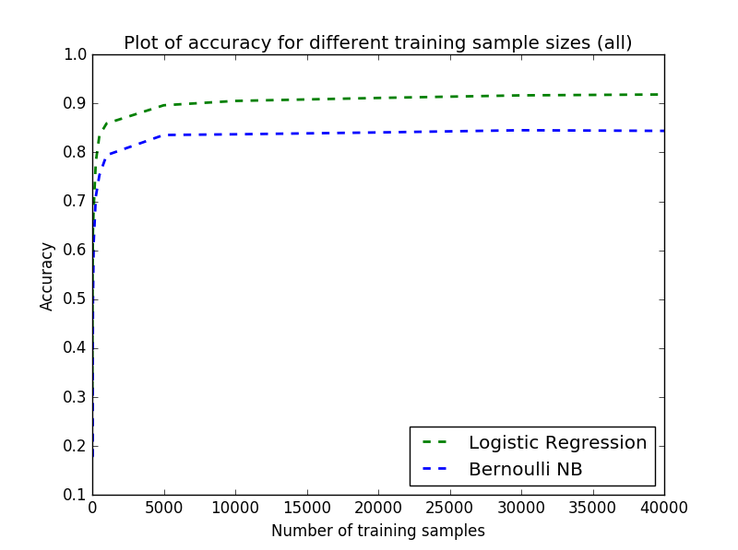
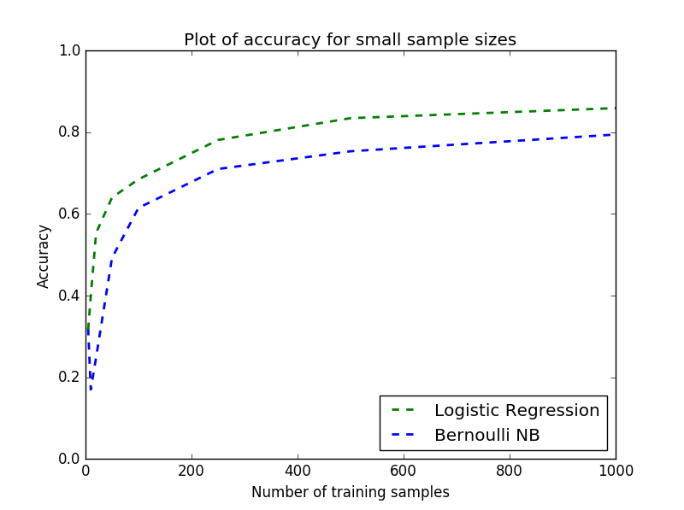
MNIST DIGIT CLASSIFICATION

Slide 22
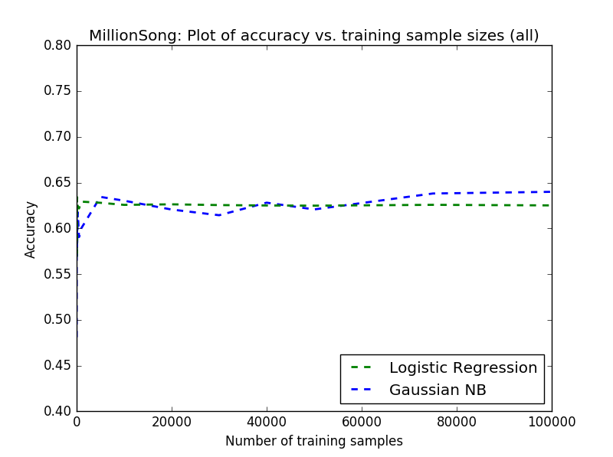
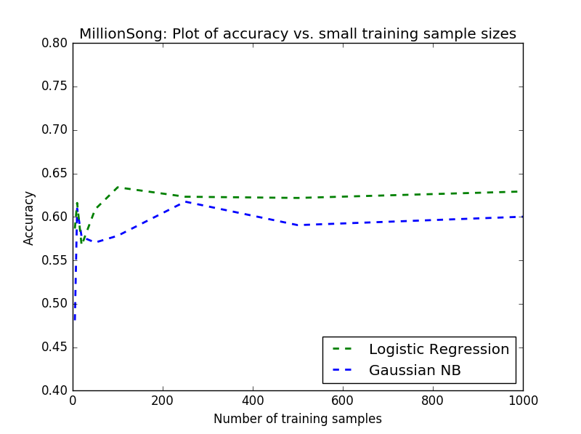
Million Song – song era classification

Slide 23
Summary
Summary of MLRoot() methods:
MLRoot() # instantiate an MLRoot object
mlroot.mount(mount_spec) # Hookup the pipeline
mlroot.compile() # Make pipeline runnable by checking constraints
mlroot.run() # Run the pipeline or resume the pipeline
mlroot.umount() # Release resources and terminate session

Slide 24
Results
With MNIST digit classification, one of our theories proved true and that is the discriminative classifier (Logistic Regression) has lower asymptotic error (i.e. higher asymptotic accuracy)
The other theory did not hold for MNIST dataset – logistic regression reached asymptotic error faster
With Million Song Dataset song era prediction neither theory held. The generative classifier (Gaussian Naïve Bayes) reached asymptotic error slower and in the end had lower asymptotic error than logistic regression.

Slide 25
Future enhancements
Future work
Make it distributed
Allow cycles in the graph to support iterative processing
Supply more framework provided subclasses
Allow clients to specify storage mechanism. This is currently transparent to the client (uses postgres).

