Slide 1
Balanced scorecard slide 5
PRESENT TENSE
Виражає звичайну, регулярну або фактичну дію
PRESENT
PAST
FUTURE
I
work
worked
will work
You
work
worked
will work
He/She/It
works
worked
will work
We
work
worked
will work
They
work
worked
will work

Slide 2
Balanced scorecard slide 5
PRESENT PERFECT TENSE
Показує, що дія триває у певний момент часу
PRESENT
PAST
FUTURE
I
am working
was working
will be working
You
are working
were working
will be working
He/She/It
is working
was working
will be working
We
are working
were working
will be working
They
are working
were working
will be working

Slide 3
Balanced scorecard slide 5
PRESENT PERFECT TENSE
Показує, що дія вже відбулася і має зв’язок із теперішнім
PRESENT
I
have been working
You
have been working
He/She/It
has been working
We
have been working
They
have been working

Slide 4
Balanced scorecard slide 5
NEGATIVE SENTENCES
Потрібно вставити not після to be, do, did, will, have
Present
Past
Future
SIMPLE
I do not work
I did not work
I will not work
CONTINUOUS
I am not working
I was not working
I will not be working
PRESENT PERFECT
I have not worked
I had not worked
I will not have worked

Slide 5
Balanced scorecard slide 5
INTERROGATIVE SENTENCES
Потрібно перемістити to be, do, did, will, have на перше місце
Present
Past
Future
SIMPLE
Do you work?
Did you work?
Will you work?
CONTINUOUS
Are you working?
Were you working?
Will you be working?
PRESENT PERFECT
Have you worked?
Had you worked?
Will you have worked?

Slide 6
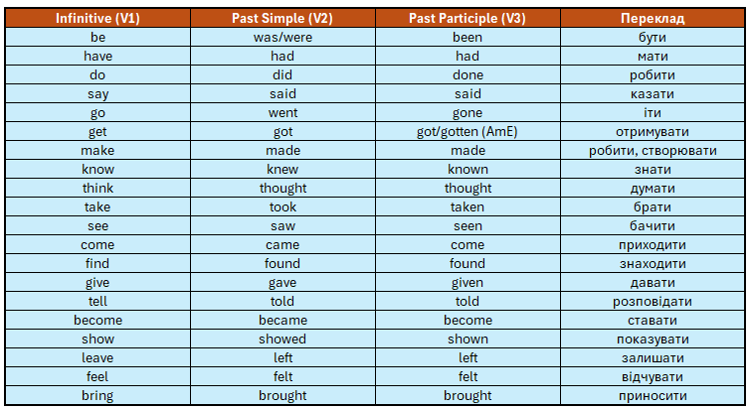
Balanced scorecard slide 5
IRREGULAR VERBS
Неправильні дієслова — це дієслова, які утворюють форми минулого часу (Past Simple) і причастя (Past Participle) не за правилом (тобто не додаючи просто -ed)

