Slide 1
Intelligent Post-Lock Down Management System For Public Transportation
Team name – Vikhyat
Team member – Vikhyat bhatnagar
Application id - SPS_CH_APL_20200003225

Slide 2
Technologies used
HTML
CSS
Javascript
IBM Watson Visual Recognition Service

Slide 3
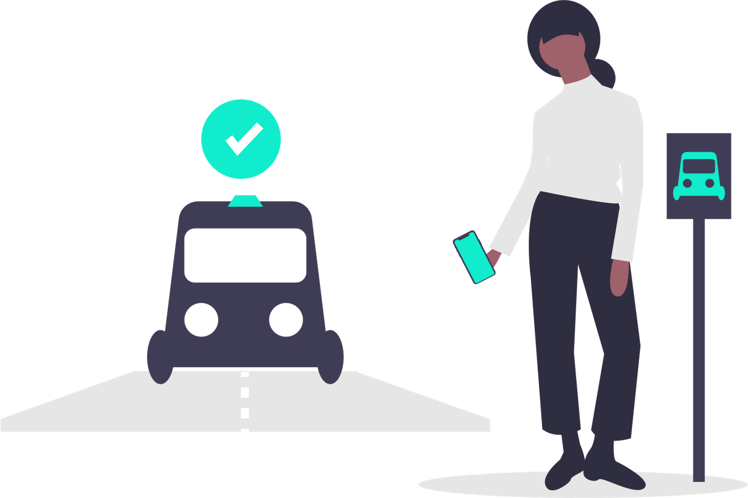
Procedure for booking the ticket
First Allow the computer to click your picture.
After the photograph is clicked press the submit button
Then it checks whether the user is wearing a mask or not and classifies whether he/she is eligible to book a ticket or not.
If a person satisfies the eligibility criteria, then the booking page will be displayed, and you can book your ticket to your destination.

Slide 4
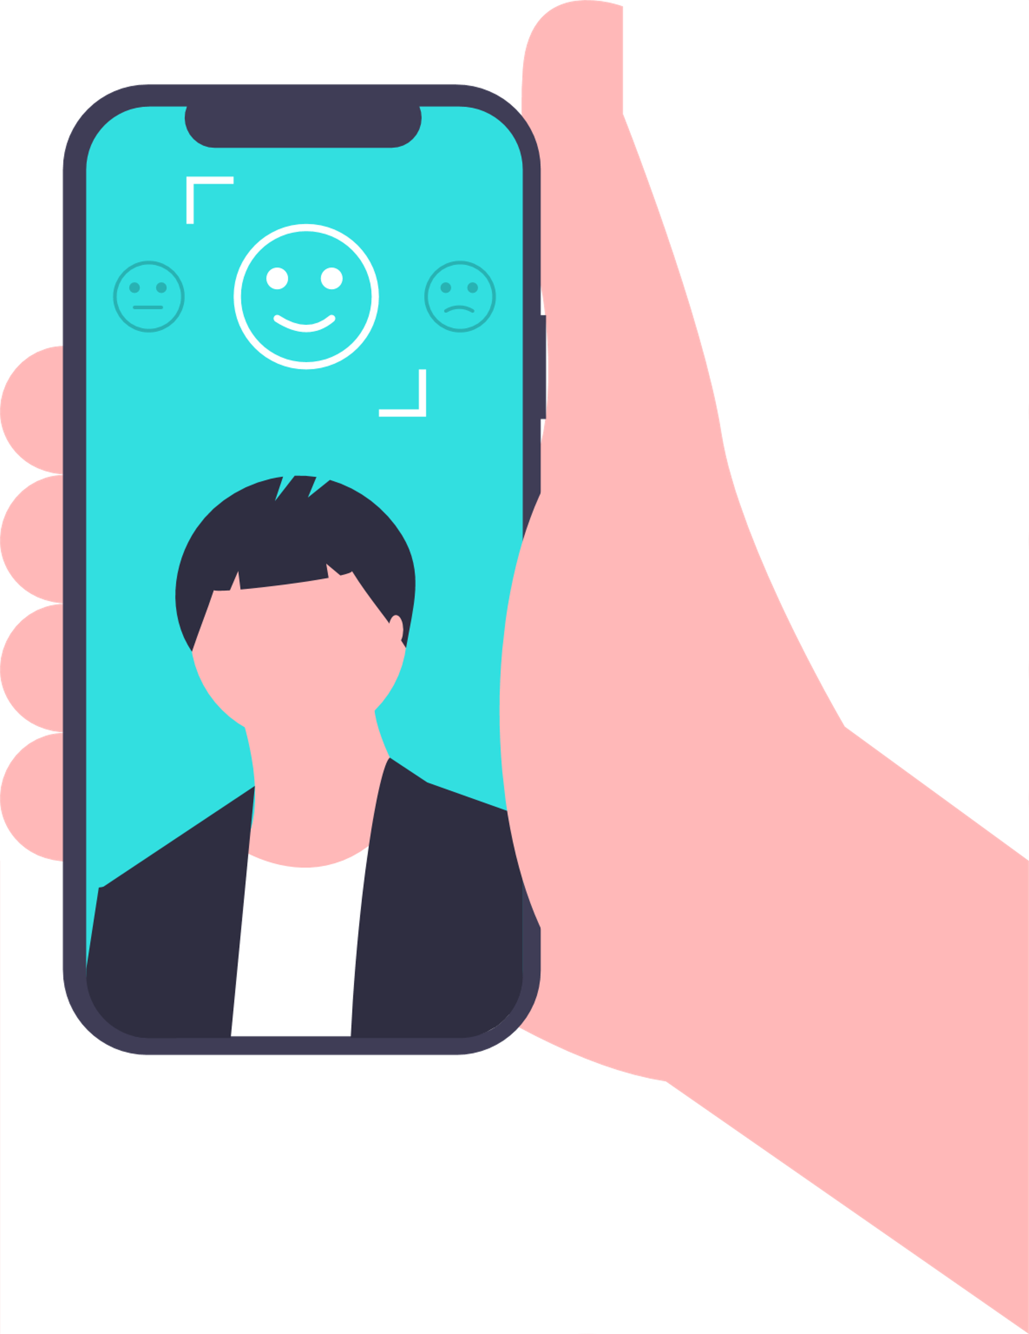
Let's move on to the practical implementation of the project
Please wear a mask for the computer to proceed further

Slide 5
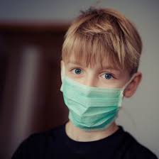
After wearing a mask a person is eligible to book a ticket to the required destination
Press the mentioned link to book your ticket

