Slide 1
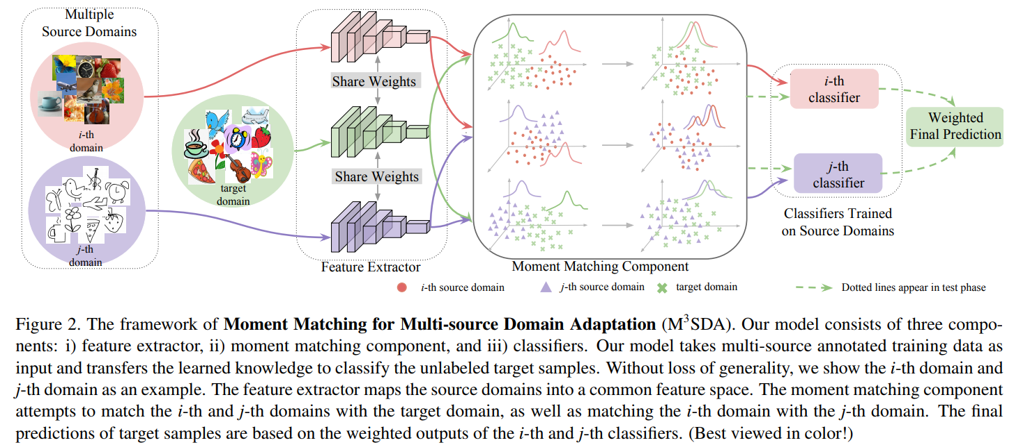
regression
regression

Slide 2
DA
25\55 pretrain -》MLP source model
35 (200) finetuning last_layer (navie)
45

