Slide 1
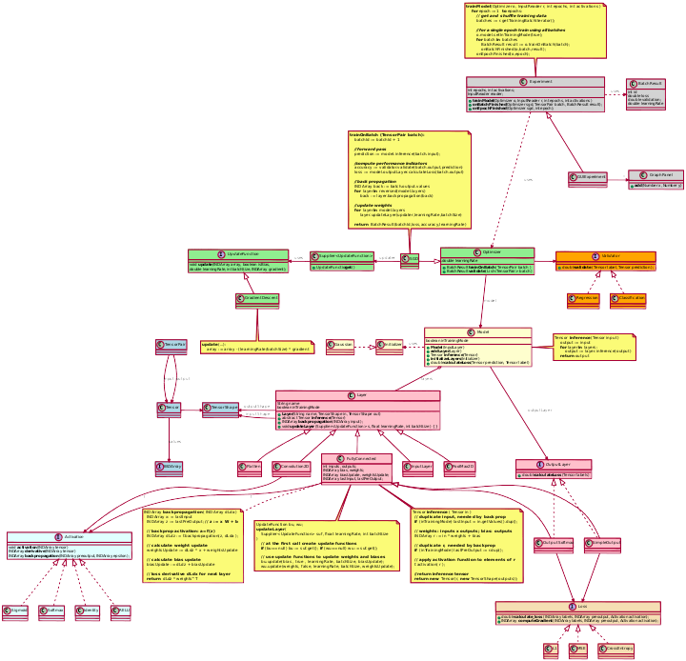
2ID90-DL – package
Huub van de Wetering
TU/e, 2ID90
2018-2019-Q3

Slide 2
Overview
Introduction
Sample Usage
UML diagrams

Slide 3
Introduction 2ID90-DL
package for handling Artificial neural networks
support for
  Fully connected networks
  Convolutional networks
  Backpropagation
  Gradient Descent
GUI
  showing details of the learning process
Based on Nd4j
  an optimized library for handling high-dimensional vectors, matrices, tensor, …
  based on BLAS (Basic Linear Algebra Subprograms)

Slide 4
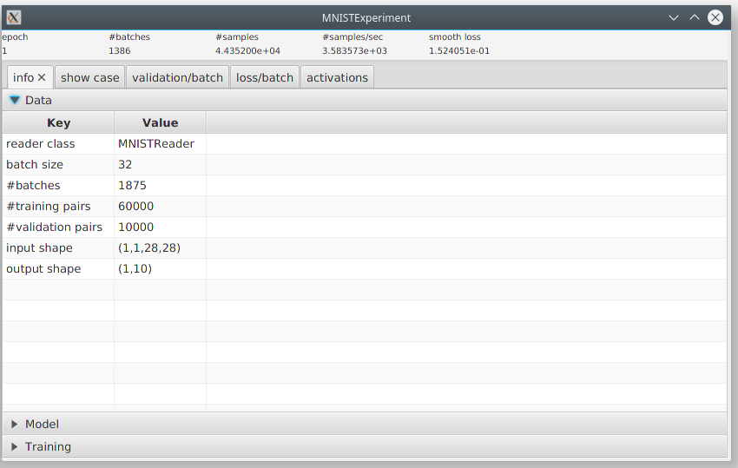
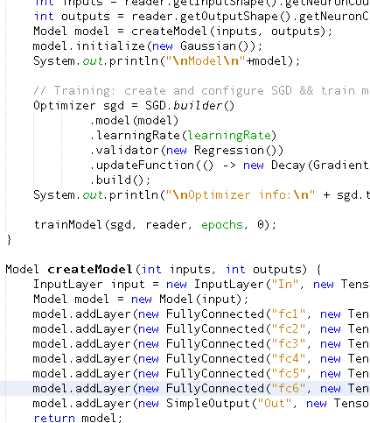
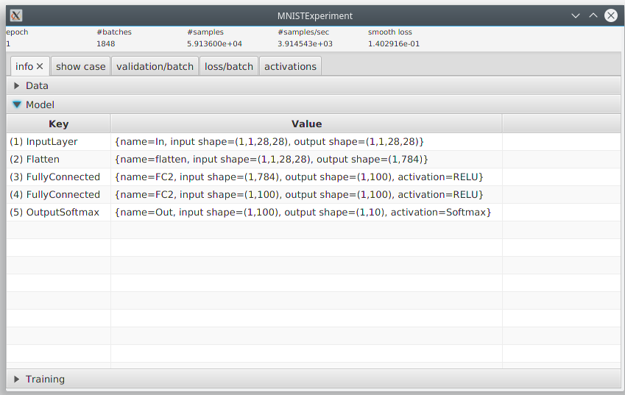
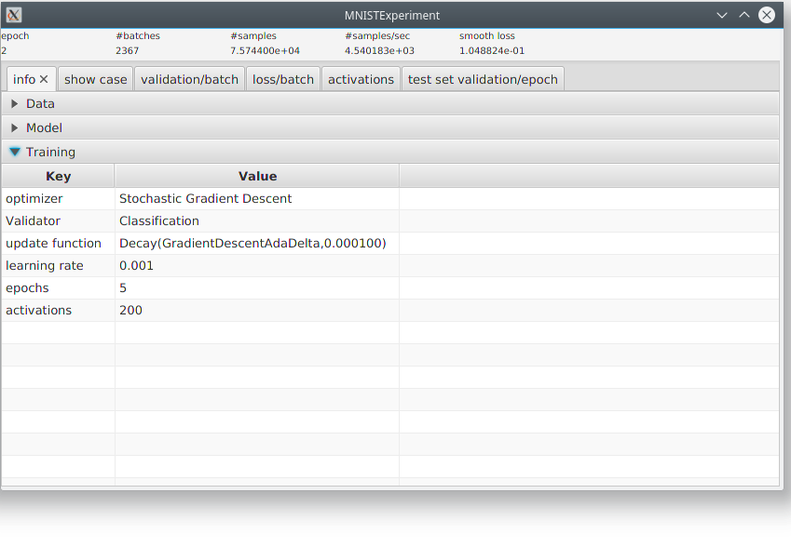
Sample Usage - 1
MyExperiment.java
Read data
Create Model
INITIALIZE SGD
Start TRAINING
Run experiment

Slide 5
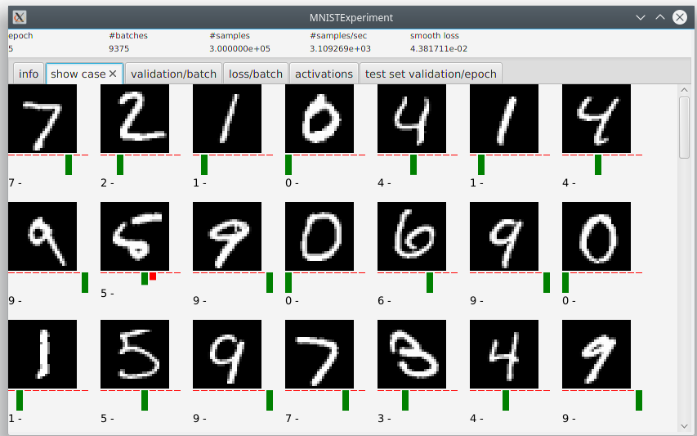
Sample Usage - 2
Show case: shows samples from
the test data annotated with the
current network’s classification.
All samples are correctly classified,
but the network hesitates whether
one of the fives is actually a six.

Slide 6
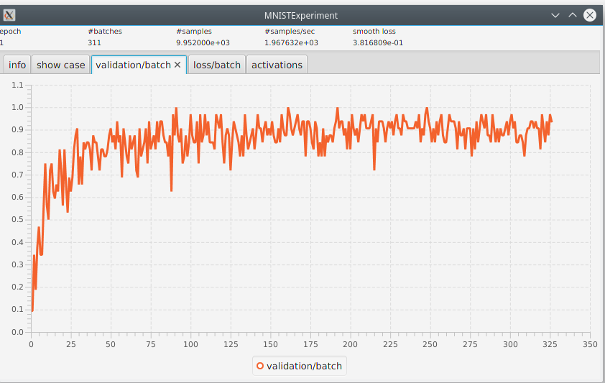
Sample Usage - 2
Validation
Validation per batch:
here fraction of correctly
classified samples in the
batch.
Batch Id

Slide 7
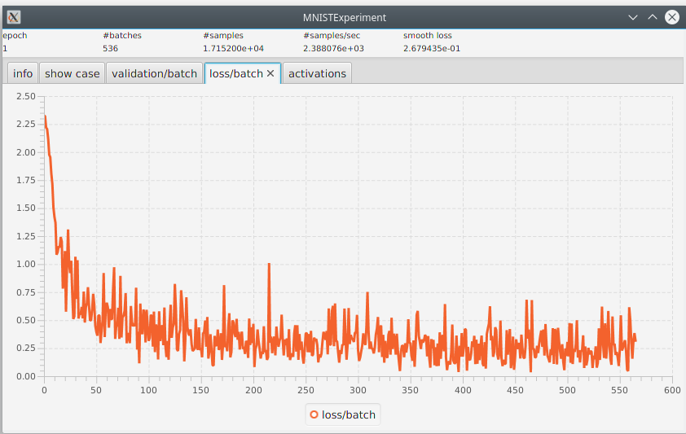
Sample Usage - 3
Loss
Loss per batch:
here the average error
made in classifying the
samples in a batch.
Batch Id

Slide 8
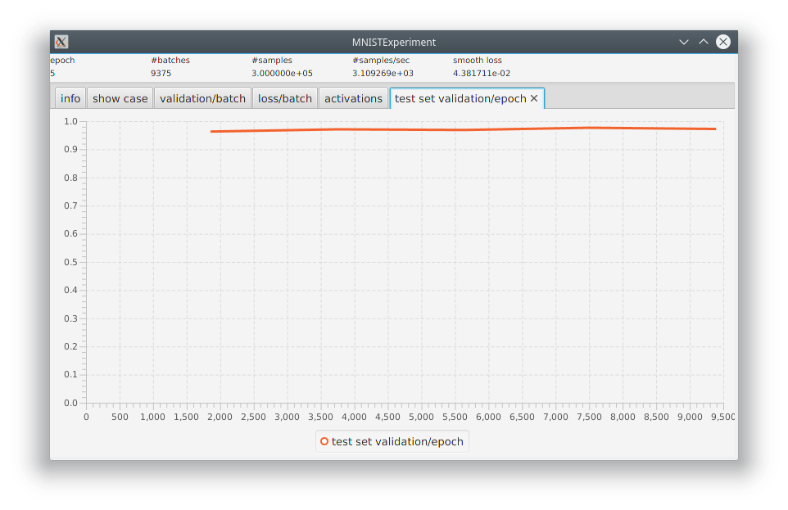
Sample Usage - 4
Validation
Test set validation per epoch
- computed at end of epoch
- validation based on test data
- here: percentage correctly
classified
Batch Id

Slide 9
Sample Usage - 5
Current status of the training:
- current epoch
- total number of processed batches
- total number of processed samples = #batches * batchsize
- #samples/second : gives an indication of efficiency of network
- smooth loss is updated after each batch according to
smoothLoss := 0.99 * smoothLoss + 0.01 * lossOfLastbatch

Slide 10
UML - Overview

Slide 11
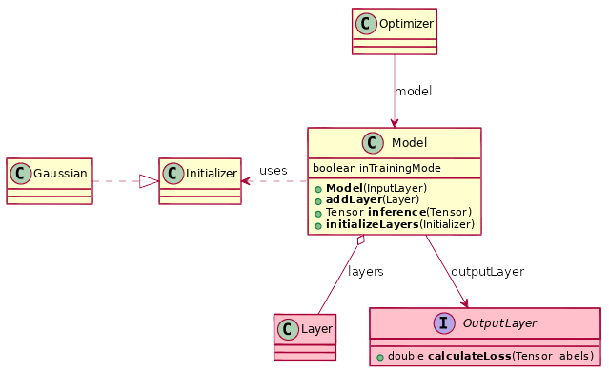
Network Model

Slide 12
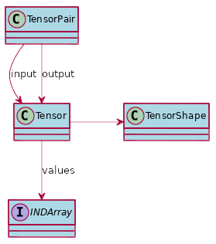

Tensors
Input network: List of TensorPairs
TensorPair: (input,output)
Tensor has a shape, e.g.
  input shape: 28x28x1 (image)
    greyscale image of size 28x28
  output shape: 10
    Probability distribution over ten possible class values (0 ..9)

Slide 13


Tensors
Input shape of a network: nx28x28x1
  n greyscale images of size 28x28
Output shape of a network: nx10
  n probability distributions
Network then maps: nx28x28x1 Tensor on nx10 Tensor
28x28x1
0
28x28x1
One tensor with
shape 3x10.
One tensor with
shape 3x28x28x1.
1
28x28x1
2

Slide 14
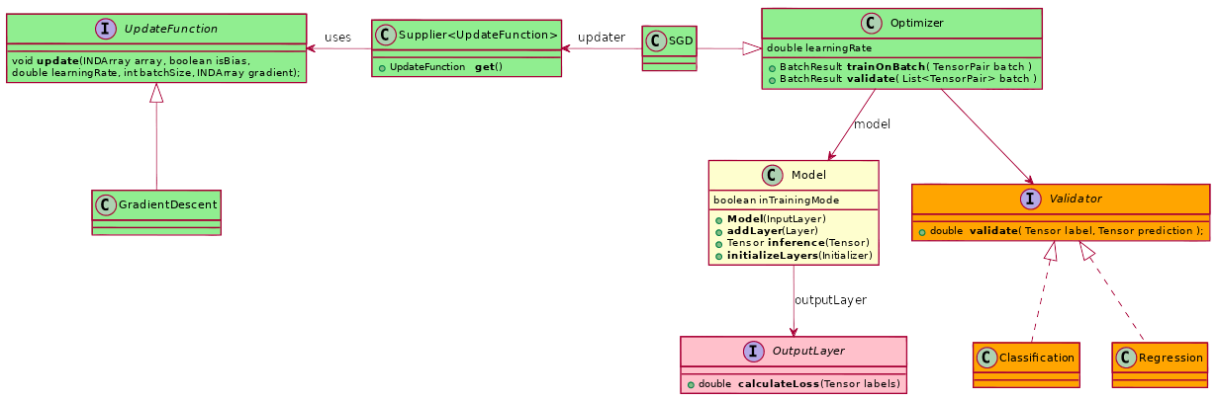
Optimizer - 1
One implementation: SGD
  Uses gradient descent
  to train model
Two Validators
  Regression: MSE
  Classification: fraction of correctly classified samples

Slide 15
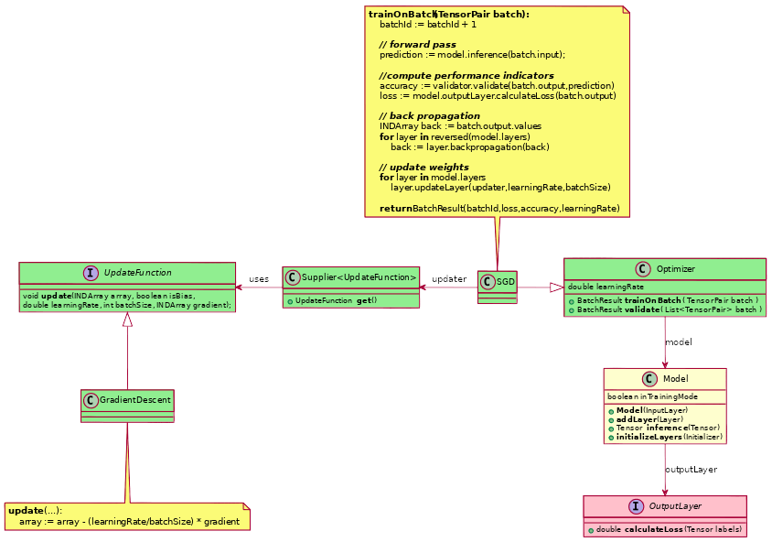
Optimizer – 2

Slide 16
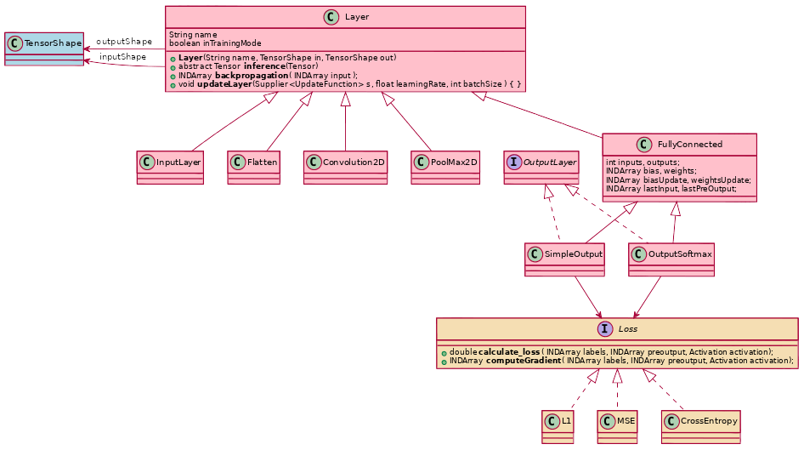
Layers - 1

Slide 17
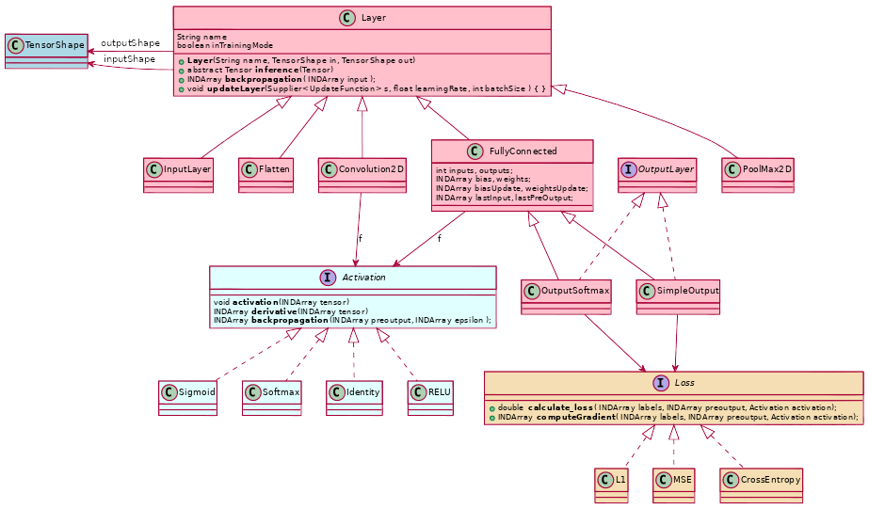
Layers - 2

Slide 18
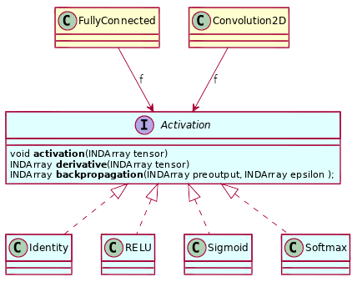
Activations

Slide 19
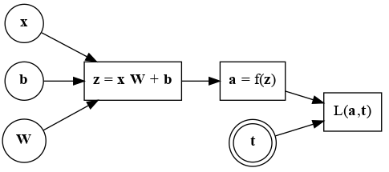
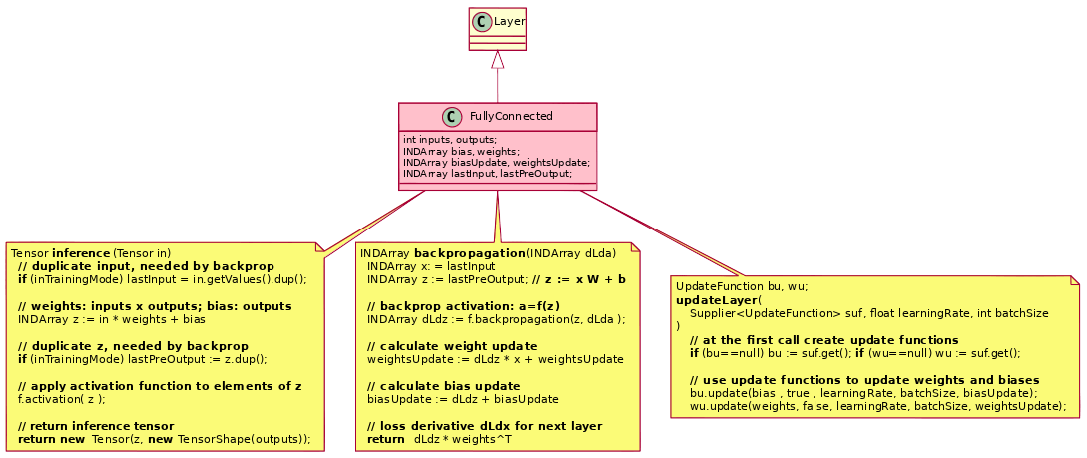
FullyConnected layer
One layer example
input
activation
bias
Error / loss
weights
target

Slide 20
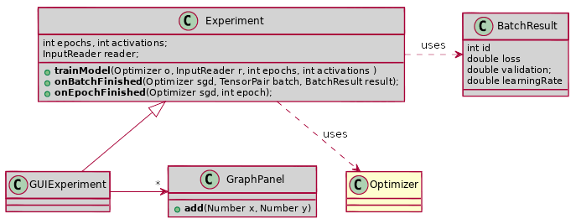
Experiment - 1
Create experiment
Read data
Create model
  Initialize model
Build optimizer
Call trainModel
  React on onBatch/EpochFinished events
    to fill plots
    ...

Slide 21
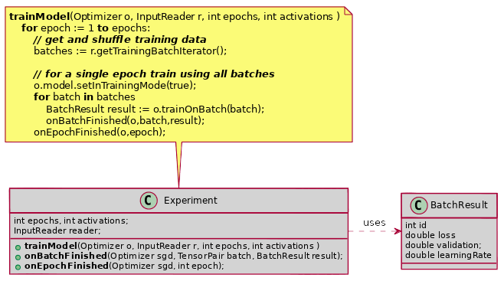
Experiment - 2

