Slide 1
AWS Honolulu User Group
2018-07-19
Alexa Skill Development
Mark Watkins

Slide 2
Agenda
An introduction to Alexa Skill Development
Overview of development process
You build an Alexa Skill

Slide 3
About me
Amateur Alexa developer
“What should I read next”, “Cambridge Recycling”
Entrepreneur:
Creator of Bookship, a Social Reading App
co-founder & ceo goby, acquired by Telenav
VP Engineering Endeca, acquired by Oracle
Avid Book lover
Senior Advisor to Flybridge Venture Capital
Boston-area VC firm interested in Hawaii

Slide 4
The Ascent of Voice Interfaces
Siri, Google Now, your car, Alexa, chatbots…
Why / When Build a skill?
Hands-free use cases; info dumps
Consumer-facing, task-oriented things
Games, Brands
Enterprise Skills value less clear
Rewards
Perks: free tshirts, etc (this may be on hold now)
AWS Credits (up to $100 a month!)
Developer Rewards – cash for popular skills
Alexa Fund – investment in voice-related startups

Slide 5
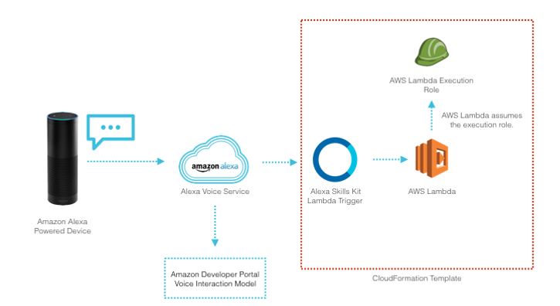
How Alexa Works

Slide 6
“Alexa: Ask da Bus when is the next bus at stop 127?”
Basic Lingo: Invocation name, Intents, Slots, Utterances, Handlers
Invocation Name – The Name of your Skill
“Da Bus” in our case
Intents - actions the user can take with your skill
You declare them (Slots + Sample Utterances); Alexa decides what the user meant.
In our case: nextBus
Slots – typed variables
You declare them: {‘name’: ‘Stop’, ‘type’: AMAZON.NUMBER’}
Sample Utterances – how users might speak your Intents
Includes how Slots might show up – inside {}
E.g. "when is the next bus at stop {Stop}”

Slide 7
“Alexa: Ask da Bus when is the next bus at stop 127?”
Alexa deciphers user input into Intents and Slots
and gives them to your skill via Handlers
Handlers – how you want your intents Handled.
Handlers do two things:
a) decide whether they can handle an Intent, and if so,
b) respond with text (& optionally images).
Alexa handles converting your text to audio / speech output
At query time:
Alexa hits up your handlers, in order, to see if they can handle
Then executes the first thing it finds that works

Slide 8
High level development process
Define your Skill (on developer.amazon.com)
Defines your invocation name, intents, slots, and sample utterances.
Define your Handlers (on aws.amazon.com)
Defines how to respond to each intent sent to you.
1) Speech output; 2) whether to listen for another command.
(can be done outside Amazon Lambda but we won’t discuss today)
Connect the two up (simple steps on both sites)
Test in browser, Alexa app, Alexa device
Get Certified and put in production.

Slide 9
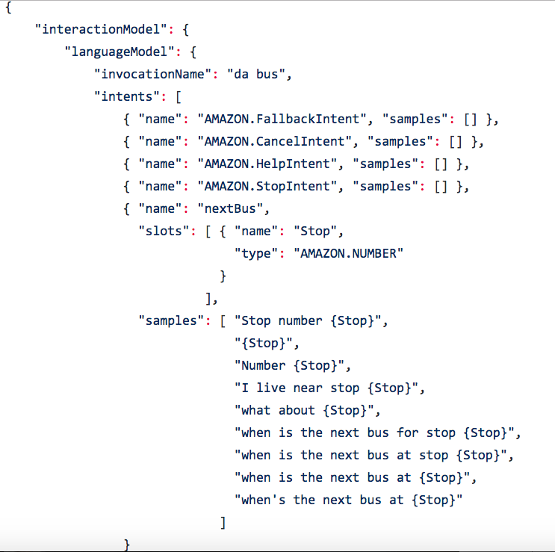
Skill.js for da Bus

Slide 10
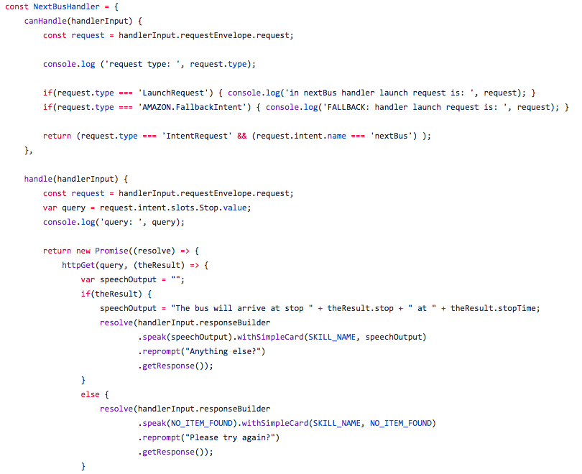
index.js for lambda function (partial)
Notes:
Probably will end up uploading a zip file
Smaller projects can be edited in line on the console.

Slide 11
The Achilles heel of all this is discovery
People have to ask for your skill by name. (w/exceptions)
And they often have to manually enable it in their alexa app.
This means they have to know about it before they can use it.
Discovery in Alexa app & Amazon site, but…it’s hard to get usage
CanFulfillIntentRequest
Beta feature where they don’t need to know your name
Analytics a bit of a challenge as well

Slide 12
For example:
What Should I Read Next, Cambridge Recycling, my two skills…
Lucky if they get 1 hit per day
Marketing is required ☺

Slide 13
OK. Let’s build da Bus.

Slide 14
Prerequisites
An Amazon Developer account.
Required to create and configure Alexa skills.
An Amazon Web Services (AWS) account.
We will implement our Handlers on AWS Lambda
Lambda is a way to run chunks of Javascript in the cloud.
NPM & installation of Node.js Alexa Ask SDK. (optional for today)
“npm install --save ask-sdk”
https://github.com/alexa/alexa-skills-kit-sdk-for-nodejs/tree/2.0.x/ask-sdk
You should understand Javascript and Javascript promises

Slide 15
Define the Skill
go to dev console: https://developer.amazon.com/alexa/console/ask, sign in
Create Skill (give name, pick Custom, create Skill)
Pick Json Editor. Cut-paste skill.js here.
(https://github.com/viking2917/daBus/blob/master/skill/skill.js)
Save Model. Build model.

Slide 16
Define the Handlers/Lambda
Go to AWS Console (https://console.aws.amazon.com), then Lambda.
Create Function. "Serverless Application Repository”
Enter fact to search for the application repository named alexa-skills-kit-nodejs-factskill.
Search by name if needed, Click on the application. (set app name, then hit “Deploy”)
Go to it, replace index.js contents with our github repo index.js
Replace API key tag (<insert-your-key-here>) with your api key, then Save
Configure trigger (Delete existing trigger, click Alexa Skills Kit trigger).
Under “Designer” panel, Enter your Skill ID from skill created above. (can get from Skill Dashboard). Save.
Copy the ARN from the top of the page.
E.g.: arn:aws:lambda:us-east-1:820633754804:function:aws-s….
Go back to Alexa Dev Console
Hit “Endpoint”, then AWS Lambda RN, paste ARN to Default Region, hit Save Endpoints.
Notes:
Picking "Serverless Application Repository" We have created an application in the repository as a shortcut to getting everything set up for your skill.
Picking a blueprint - This template will create the Lambda function, grant the Alexa Skills Kit permission to invoke it, and set up an IAM role for you. It will also add the code from this GitHub repo and include the required dependencies so that you don't have to upload them yourself. Avoids having to npm setup the Alexa SDK. In real life you will probably need/want to.

Slide 17
Test it!
Pick Test. Pick Enable Testing.
Enter “da bus”, or whatever you set for the invocation name, into the text box

Slide 18
Simple mods to try
Change the invocation Name (Skill)
In Alexa Dev Console, Build->Invocation -> set to “Next Bus Hawaii”
Save Model, Build Model.
Change the response text (Lambda)
speechOutput = "Yo ho ho and a bottle of rum. The bus will arrive at stop " + theResult.stop + " at " + theResult.stopTime;
Less Simple
Add slot for Bus Route, filter responses from API so only next bus time for a given route is returned. (many bus stops have more than one route)
Even less Simple:
How do you know the number of the stop?
Add some kind of intent to find a stop by address or similar
(btw Stop Numbers are visible on Google Maps)

Slide 19
(time permitting or as needed)

Slide 20
Common “gotchas” & tips
I have found the Alexa console a bit finicky.
Sometimes must re-Build the model or delete/re-add something
Sometimes you need to disable then re-enable testing after changes
Devices must be registered w/developer.amazon.com e-mail to be visible to actual devices
If your slot is your entire sample utterance, sometimes Alexa gets confused.
E.g. “samples”: [“{Stop}”]
Order of sample Utterances seems to matter
Timeouts – your response must be faster than 3 seconds.
Note: you can alter the timeouts for lambdas in the console
Building Tests in AWS speeds iterations, you don’t have to go through the talking
Cut/paste the Skill I/O JSON from Alexa console to Lambda console

Slide 21
Advanced features (time permitting)
Echo Show/Echo Spot/Alexa App output – e.g., Images/Media
Conditional routing - re-route from one handler to another
Account Linking – e.g. link your Dominoes account
In-skill purchasing – one time or subscription
Amazon Pay - using Amazon payments
Amazon Voice Processing outside Alexa - AVS

Slide 22
Resources
Github repo of our example: https://github.com/viking2917/daBus
Da Bus API: http://hea.thebus.org/api_info.asp
Amazon Developer: https://developer.amazon.com
AWS Services: https://aws.amazon.com
Alexa: https://developer.amazon.com/alexa
Alexa Skills Kit (SDK): https://developer.amazon.com/alexa-skills-kit
AWS Credits for Alexa: https://developer.amazon.com/alexa-skills-kit/alexa-aws-credits
Blueprints (personal (not public) Alexa Skills with no coding): https://blueprints.amazon.com
Alexa Fund: https://developer.amazon.com/alexa-fund
Blog: https://developer.amazon.com/blogs/alexa/
Rewards (may be on hold): https://developer.amazon.com/alexa-skills-kit/alexa-developer-skill-promotion
Github: https://github.com/alexa/

