Slide 1
MLOPs

Slide 2

ML Lifecycle

Slide 3
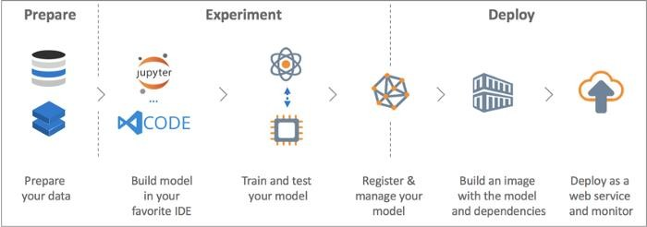






Typical workflow for creating a machine learning model:

Slide 4
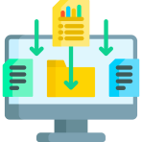




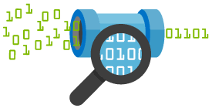

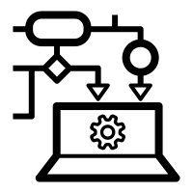

Gathering Data
Deployment
Data preparation
Test the model
Data Wrangling
Train the model
Analyse Data

Slide 5
State of machine learning
Last decade
By end of 2024
75% of organizations will shift from piloting to operationalizing AI
Focusing mostly on building ML model
Operationalization was an
afterthought
Today
53% of POC make it into production
Average 9 months
Source AWS AI conclave 2023, Bangalore, India

Slide 6
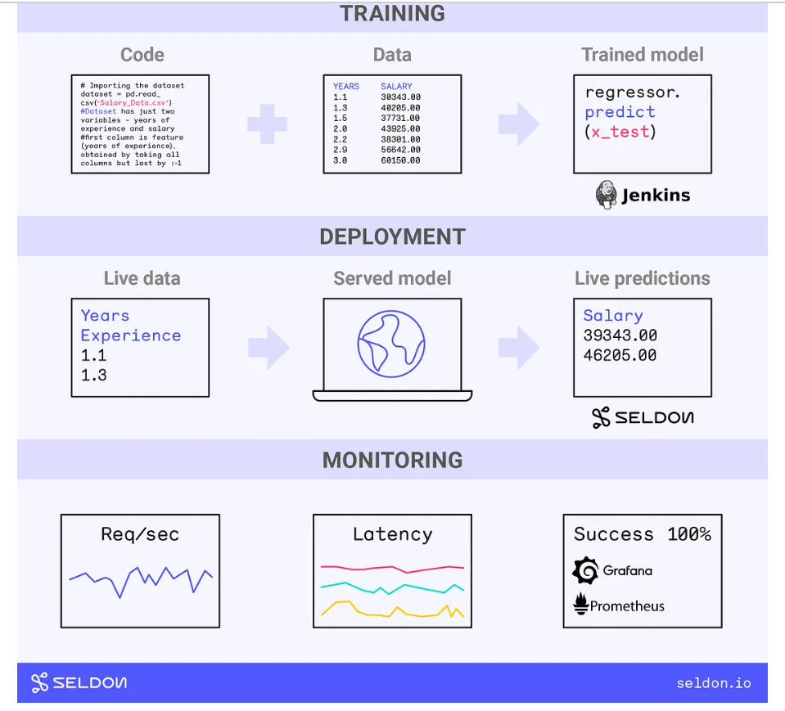
What is MLOPs
Machine Learning + Operations
MLOps, short for Machine Learning Operations, is a set of practices and tools that aim to streamline and automate the process of developing, deploying, monitoring, and managing ML/DL models in production environments.
MLOPs Goal is to standardize the deployment, management of ML Models.
Operationalizations of ML Models
Release
Monitoring
Performance tracking
Reuse
Maintenance
Managing ML artifacts
Example: Simplified MLOps Flow

Slide 7
Continued...
Machine Learning + Operations
MLOps is a set of practices for collaboration and communication between data scientists, data engineers and operations professionals.
Applying these practices increases the quality, simplifies the management process, and automates the deployment of Machine Learning and Deep Learning models in large-scale production environments.

Slide 8
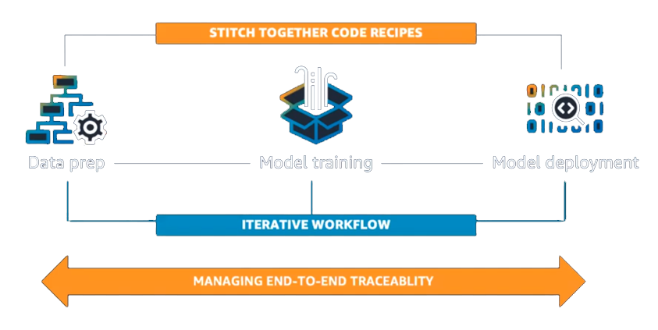
MLOps challenges
Creating & managing Machine Learning workflows involves lot of challenges
Data Preparation
Model Training
Model Deployment
Model Training
Data Prep
Model deployment

Slide 9
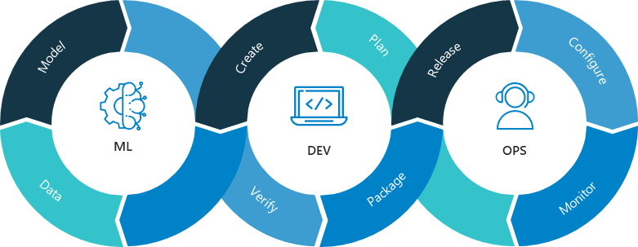

Slide 10
MLOps Vs DevOps
DevOps is the prerequisite of MLOps
DevOps – Building and Deploying a piece of software in a consistent manner.
A successful ML team needs expertise of DevOps in order to successfully release a useful piece of software backed with ML.
MLOps supports the ML Development just like DevOps supports any software Development.
MLOps borrows concepts from DevOps (Development Operations) and applies them specifically to the machine learning workflow.

Slide 11
Stages of MLOPs
MLOPS is not about:-
Tracking the experiments
Placing the ML model behind an API endpoint
Instead:-
Building an automated environment and processes for consistently building and delivering ML projects to Production environment
Data Collection and Preparation
Model Training and Development
ML Service Deployment
Continuous feedback and Monitoring
Retraining sometime

Slide 12
Model Development and Training in MLOPs
ML Pipeline and its features
Modularization of code
Tracking experiments, data, parameters, code , package dependencies, outputs at each and every step of the pipeline
Versioning data and artifacts used through out the pipeline
Source code and config file version controlled in Git
CI pipeline – Build process
CI Pipeline
Azure DevOps
Source Code
AWS Code Commit
VS Code
GitHub
Build Output
Configuration
GitLab
Jenkin

Slide 13
ML Service Deployment
Packaged Model from Build Process:
saving the model's parameters, architecture, and any necessary dependencies into a Container- Docker
Setting Up Infrastructure:
This may involve provisioning servers, setting up networking, and configuring security measures to ensure the model's availability and reliability. – Azure /AWS etc
Deployment Configuration:
specifying how the model will be accessed - API
Deployment Automation
deployment automation tools and scripts - Kubernetes, Jenkin, Airflow, AWS Beanstalk, Teraform
Testing and Validation:
integration tests, performance tests, and end-to-end tests to verify the model's functionality and performance. – Pytest, Postman, MLFLOW etc
Rollout and Monitoring:
Kubernetes, ISTIO, Prometheus, Grafana, ELK (Elasticsearch, Logstash, Kibana), Azure Monitor, AWS CloudWatch

Slide 14
ML Deployment
Integrate with existing application
Create a frontend
Containerize the application
API services
Model endpoints

Slide 15
Continuous feedback and Monitoring
Data Monitoring
Model Performance Monitoring:
Matrices pertaining to infrastructure
Anomaly Detection
Alert mechanism

Slide 16
Retraining
Drift Monitoring
Model performance threshold
Alerts
Approval Process
Retraining triggers

Slide 17
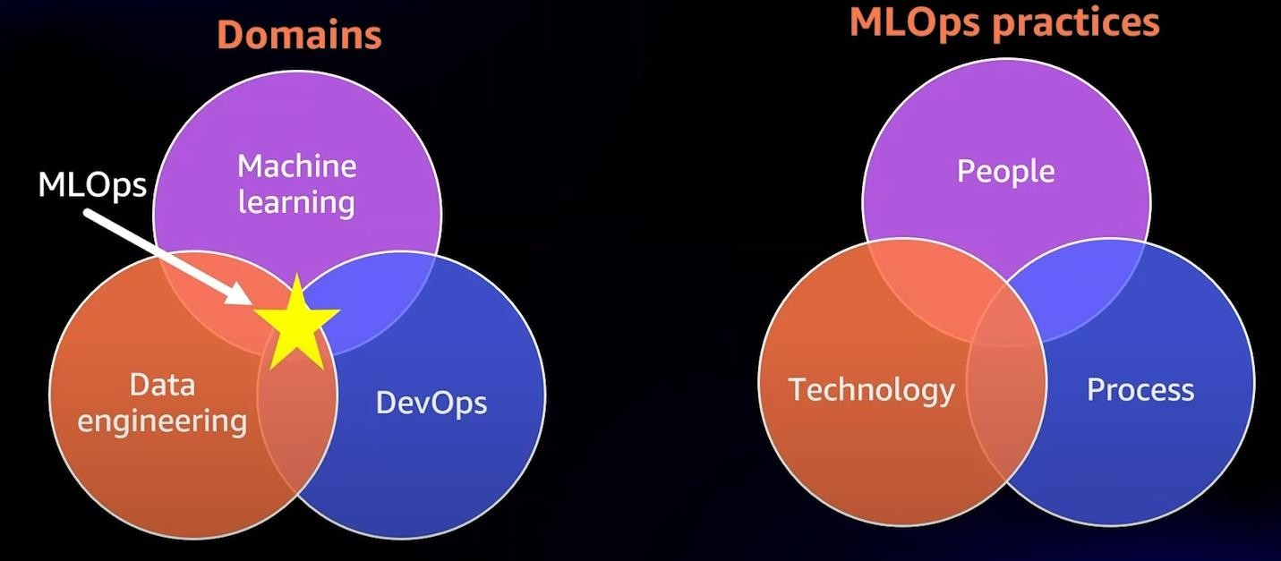
MLOps Motivation: High-level view
MLOps is the discipline that sits at the intersection between the domains of Machine Learning, Data engineering & DevOps.
MLOps as a discipline is enabled by core set of practices that span people, process & technology

Slide 18
CI/CD in Production
One of the core concepts in DevOps that is now making its way to machine learning operations (MLOps) is → CI/CD—Continuous Integration and Continuous Delivery or Continuous Deployment.
Continuous integration (CI) is the practice of automating the building and testing of code every time it is committed with version control and pushed to a code repository (to build the application).
Continuous delivery (CD) is the practice of deploying every build to a production-like environment and performing automated integration and testing of the application before it is deployed.
Continuous deployment (CD) compliments continuous integration with additional steps by automating the configuration and deployment of the application to a production environment.

Slide 19









MLOps Components
Use Case Discovery
Data Engineering
Machine Learning
Pipeline
Production Deployment
Production Monitoring
Business Understanding
Data
preparation
Deploy
Learning Algorithms
Model Serving
Optimize
Feasibility Study
Use Case
Identification
Automate
Model
Evaluation
Model Building
/Training
Monitor
Data
Understanding
Model
Experimentation
Operate

Slide 20

Major Phases - what it takes to master MLOps
Mastering MLOps (Machine Learning Operations) can be a complex and multifaceted
endeavor, as it involves both machine learning expertise and operations experience.
key areas that are important to master in MLOps:
Machine Learning
Cloud Computing and Infrastructure
CI/CD and Automation
Monitoring and Evaluation
Security and Compliance
Data Engineering and Operations

Slide 21
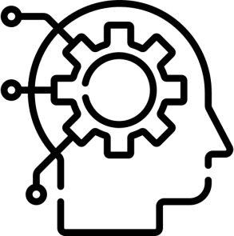

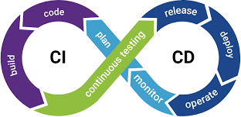
Major Phases - what it takes to master MLOps
Machine Learning
To master MLOps, you should have a solid understanding of machine learning concepts, algorithms, and frameworks.
This will allow you to develop, train, and deploy machine learning models effectively.
Cloud Computing and Infrastructure
Experience with cloud computing platforms, such as AWS, Azure, or GCP.
Experience with container orchestration tools like Kubernetes.
These are crucial for MLOps as they are often used to deploy and manage machine learning models in production.
CI/CD and Automation
To be effective in MLOps, you should be proficient in using continuous integration and continuous delivery (CI/CD) tools
Automation frameworks to build, test, and deploy machine learning models and
infrastructure.

Slide 22


Major Phases - what it takes to master MLOps
Monitoring and Evaluation
MLOps also require being able to monitor the performance and behavior of machine learning models in production
Including logging, alerting and tracking of the models performance over time to measure their effectiveness.
Security and Compliance
Machine learning models can process sensitive data
Important to have a solid understanding of data security and compliance best practices
To ensure that the models are deployed and managed securely.

Slide 23
Major Phases - what it takes to master MLOps
Data Engineering and Operations
Considering data is the lifeblood of machine learning models
A solid understanding of data engineering and operations is crucial in MLOps
Strong data pipeline and storage skills will be very beneficial in this regard

Slide 24
Appendix

Slide 25
Build and its outputs
Generated Artifacts:
The output of your build process might include various artifacts generated during the build, such as:
Compiled code (if applicable).
Model files: These could be serialized machine learning models saved in formats like pickle, joblib, or TensorFlow's SavedModel format.
Supporting files: Any additional files required for your ML application to run, such as configuration files, data preprocessing scripts, or documentation.
Test Reports:
If you've implemented automated tests as part of your CI pipeline, the output might include test reports in a specific format (e.g., JUnit XML, HTML) detailing the results of these tests. These reports can provide valuable insights into the quality and correctness of your ML application.
Packaged Application:
Depending on your requirements, you might package your ML application into a deployable format. This could include packaging your Python code along with its dependencies into a distributable package (e.g., wheel, source distribution), Docker container, or any other containerization format.

Slide 26
Build and its outputs
Documentation:
It's essential to include documentation as part of your build output. This could be in the form of README files, API documentation, or user guides, providing information on how to use and deploy your ML application effectively.
Logs and Metadata:
Jenkins typically generates logs during the build process, which can be valuable for debugging and troubleshooting. Additionally, you might include metadata about the build itself, such as the commit SHA(Secure Hash Algorithms, is a unique identifier for a specific commit in a version control system (VCS) like Git), build timestamp, and version information, to track changes and facilitate versioning.

