Slide 1
Prerequisites

Slide 2
Book
Introducing MLOPs –Mark Treveil

Slide 3
VSCode Installation
https://code.visualstudio.com/download

Slide 4
Git
Install Git Bash
Create Github Account
https://git-scm.com/downloads
https://github.com/

Slide 5
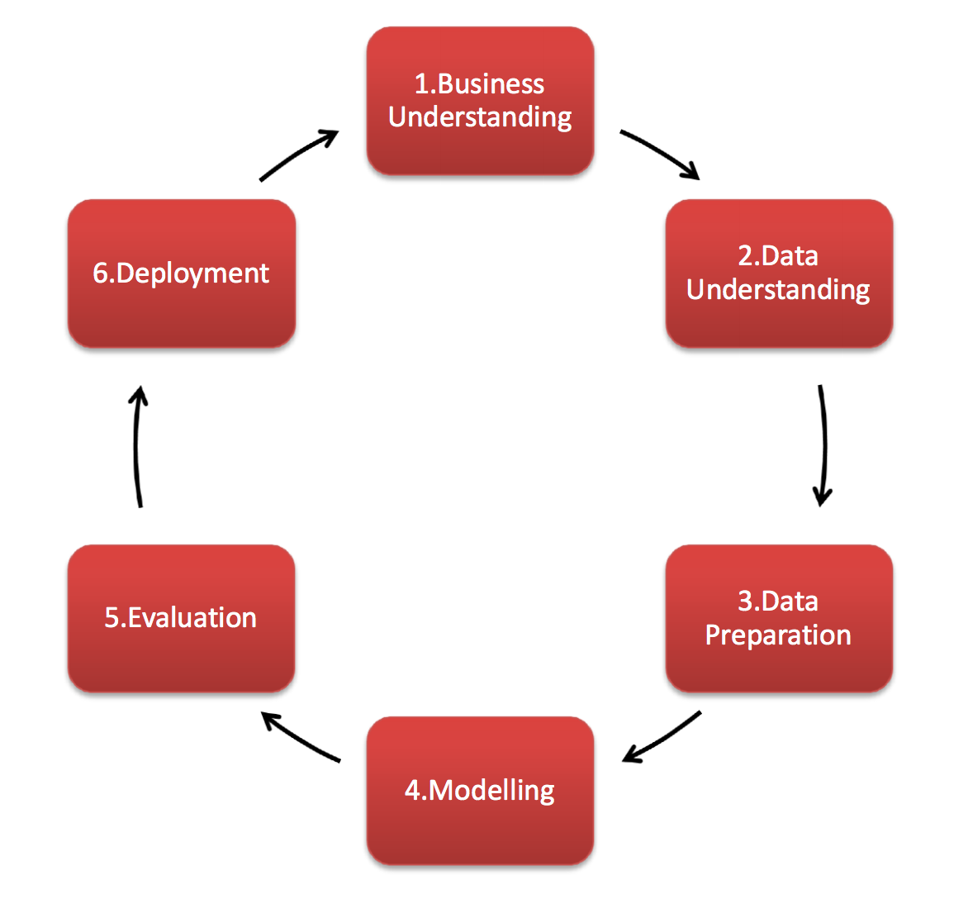
Intro to CRISPDM

Slide 6
CRISPDM- Cross-Industry Standard Process for Data Mining
Why CRISP-DM is Important:
Structured Approach: CRISP-DM provides a systematic framework for data science projects, ensuring all crucial steps are considered and addressed.
Improved Communication: The defined phases facilitate communication between data scientists, stakeholders, and domain experts involved in the project.
Project Reusability: By following a standard methodology, projects become more reproducible and reusable, making it easier to build upon previous work.
Reduced Risk: By focusing on business understanding and data quality early on, CRISP-DM helps mitigate project risks and ensures the project aligns with business needs.

Slide 7
Python
Functional Programming Basics
Create Data Engineering Pipeline
Create ML Pipeline
Develop a Multi Class classification model
Create a Streamlit App

Slide 8
Pillars of MLOps
Scalability
Reproducibility
Automation CI CD CT
Versioning
Code
Data
Model

Slide 9
Command Prompt
Cd
Dir
Mkdir
..\
Cp
Echo
Rm
Present directory

