Slide 1
Model Deplyment Strategies

Slide 2
Why Deployment Strategy Matters in MLOps
Goal of deployment:
Serve ML models safely, reliably, and scalably to real-world users or applications.
ML deployment is different from software:
Data drift and model staleness
Latency vs accuracy trade-offs
Monitoring + rollback is critical
A good deployment strategy:
Minimizes risk
Supports continuous improvement
Aligns with business SLAs

Slide 3
Types of Model Deployment Strategies
Strategy | Description | Use When...
Shadow Deployment | Model runs in background; not exposed to users | Testing model in production
A/B Testing | Users split across models (e.g., 50/50 old vs new) | Comparing performance
Canary Release | Gradual rollout to small % of users | Safer rollout with rollback path
Blue-Green | Deploy new model alongside old one, switch traffic | Need zero downtime
Batch Inference | Process data in batches (e.g., nightly predictions) | Offline scoring
Real-Time Inference | API-based prediction (e.g., via FastAPI or Flask) | When latency is critical

Slide 4
Tools for Deployment in MLOps
Tool | Purpose
FastAPI / Flask | Real-time REST API serving
Docker | Containerized deployment
Kubernetes | Scalable, orchestrated serving
MLflow | Serve and manage model versions
Seldon Core / KServe | Advanced K8s model serving
Airflow / Prefect | Orchestrate batch deployment
AWS SageMaker / Azure ML / Vertex AI | Managed serving

Slide 5
CI/CD for ML Deployment
Continuous Training + Continuous Deployment
Steps in CI/CD pipeline:
Train and validate model
Save artifacts
Run unit tests (data, model, integration)
Push to Model Registry
Auto-deploy to Staging / Production
Monitor and rollback if needed
Tools: GitHub Actions, GitLab CI, Azure DevOps, Jenkins, Argo

Slide 6
Best Practices for Safe Deployment
✅ Monitor key metrics: accuracy, latency, drift ✅ Always support rollback to previous version ✅ Test new models in Staging, not just locally ✅ Store feature preprocessing logic with the model ✅ Automate deployment with approvals and notifications ✅ Document every version that goes to production

Slide 7
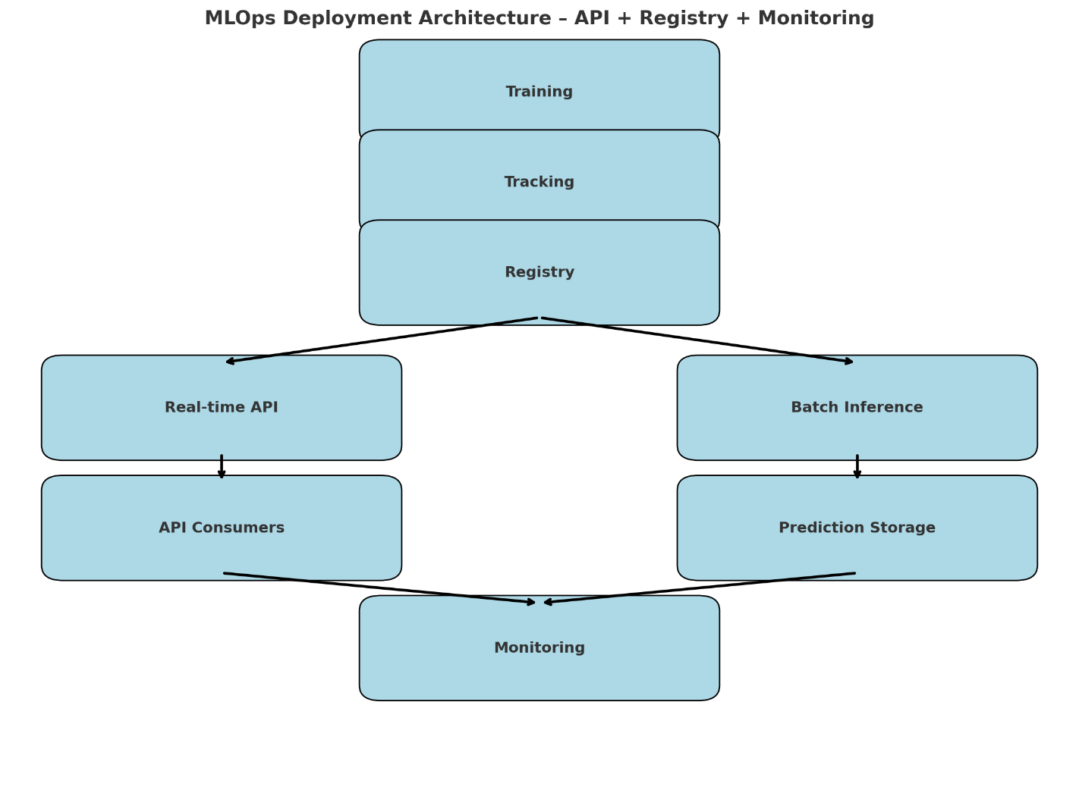
MLOps Deployment Architecture – API + Registry + Monitoring

Slide 8
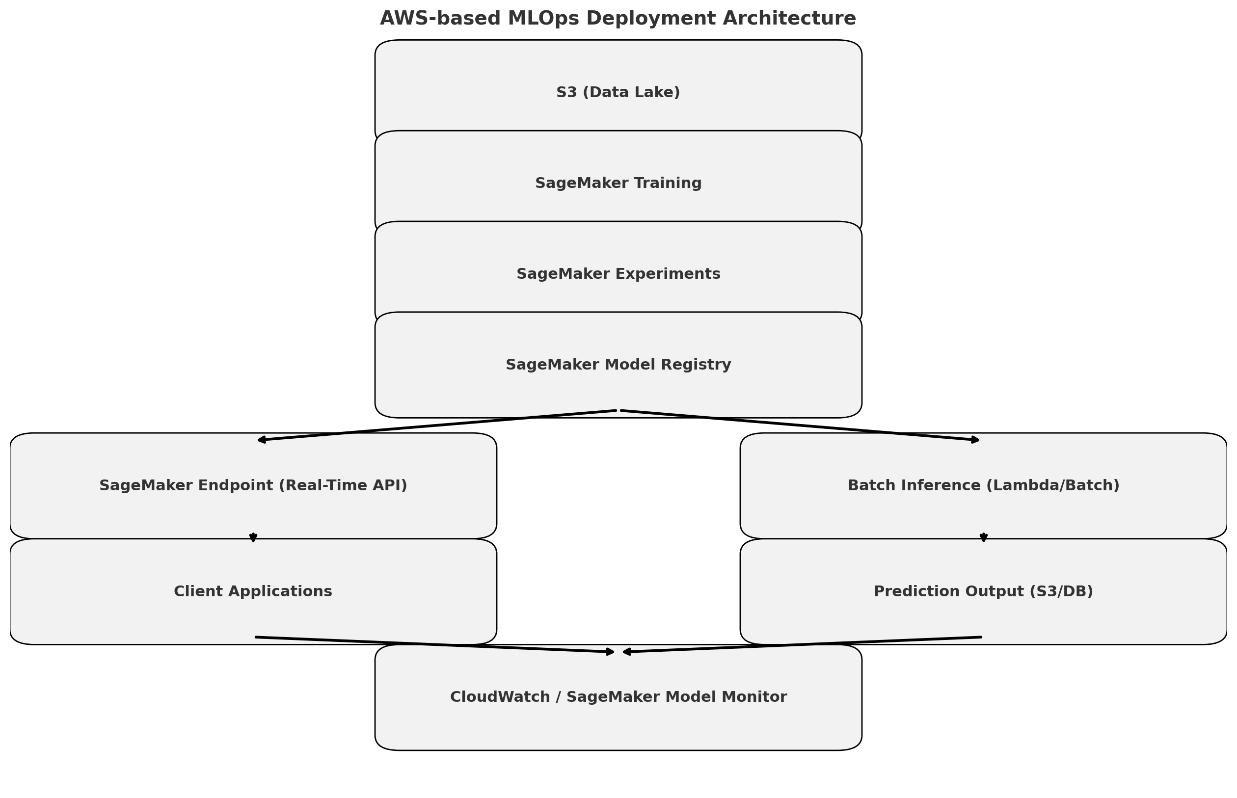
AWS Deployment architecture

Slide 9
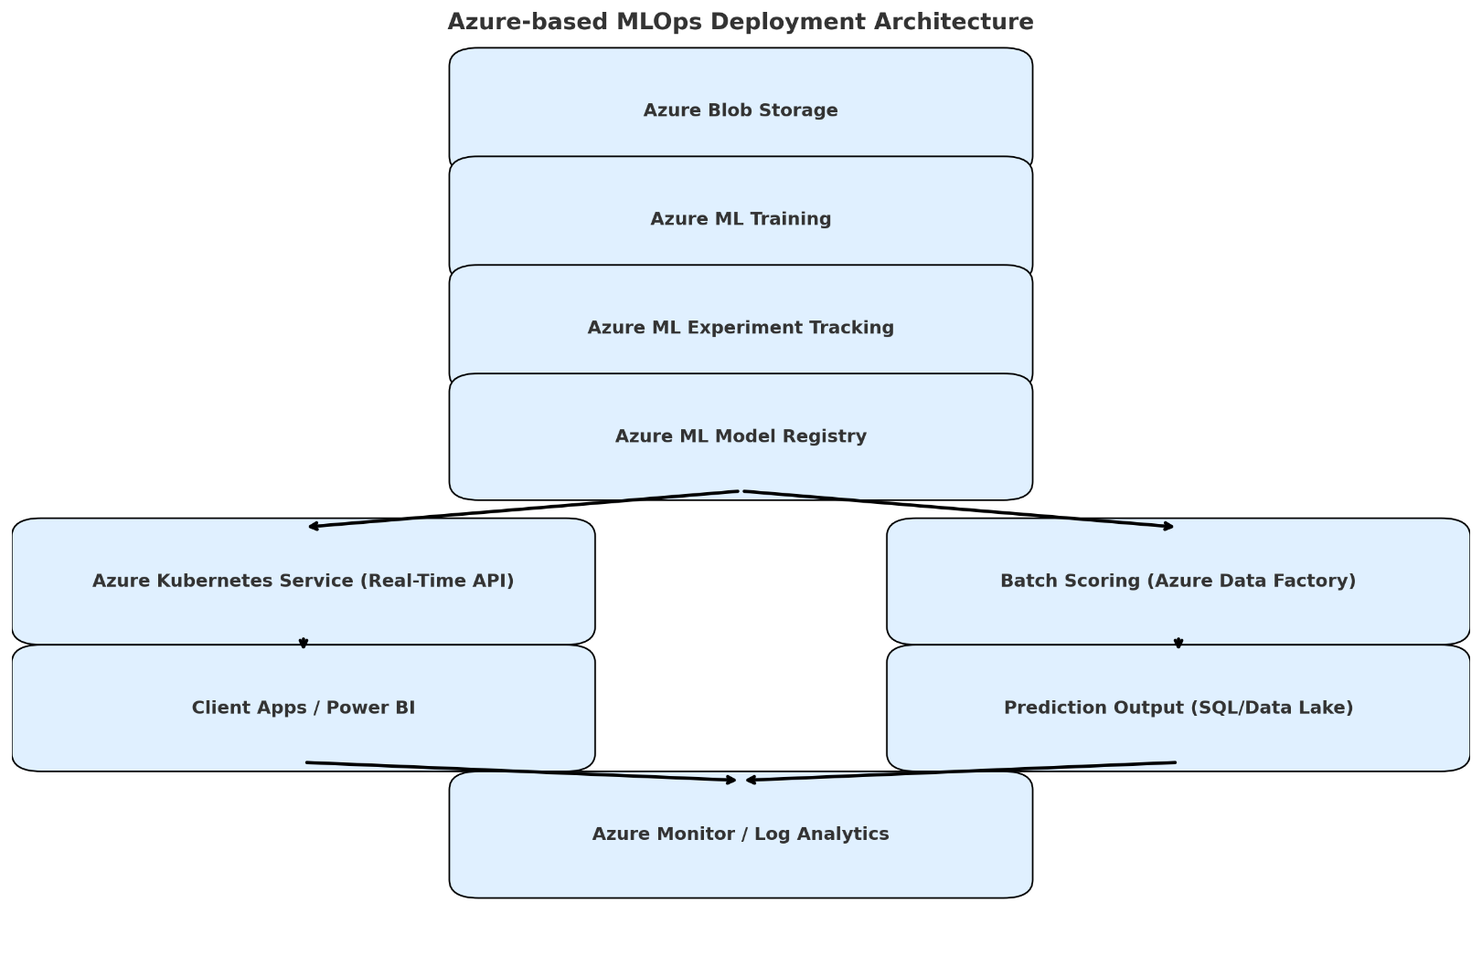
Azure Deployment architecture

Slide 10
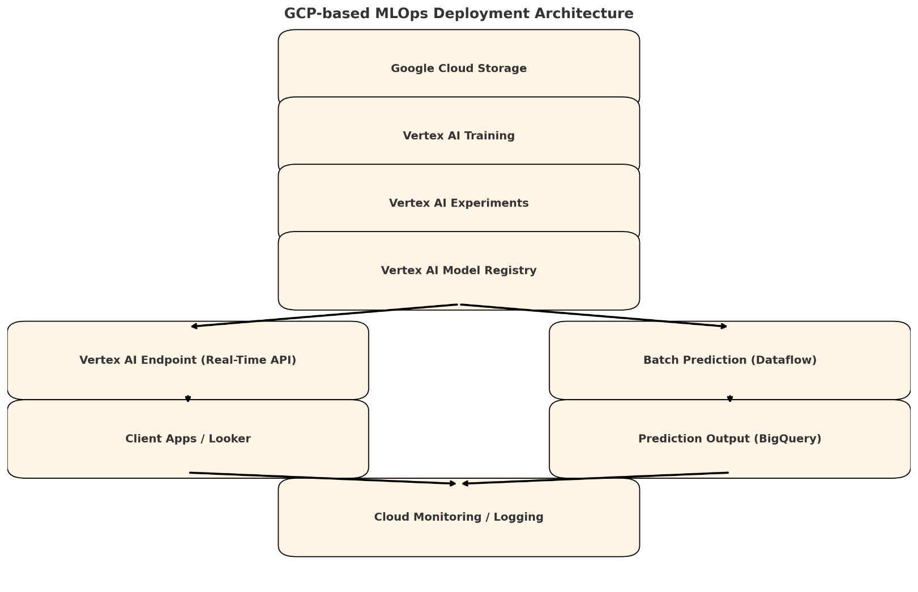
GCP Deployment architecture

