Slide 1


Slide 2
Abstract
This presentation explores a robust methodology for detecting deepfake face swaps, a growing concern in digital media. We leverage the power of deep learning and computer vision to analyze visual anomalies, inconsistencies, and subtle artifacts inherent in synthetically generated images. Our approach aims to differentiate genuine human faces from sophisticated deepfake creations with high accuracy, contributing to the integrity of visual information.

Slide 3




Libraries Used
Python
The core programming language for model development and implementation.
TensorFlow
A powerful open-source library for machine learning, crucial for building and training neural networks.
Keras
A high-level neural networks API, running on top of TensorFlow, enabling rapid prototyping.
OpenCV
An extensive computer vision library used for image processing and feature extraction.
NumPy
Fundamental package for numerical computation in Python, essential for data manipulation.
Scikit-learn
Provides simple and efficient tools for data mining and data analysis.

Slide 4
Block Diagram: Detection Workflow
Input Video
Source footage for analysis
Feature Extraction
Deep learning model features
Classification
Label as Deepfake or Real
Preprocessing
Face detection and alignment
Anomaly Detection
Identify unusual patterns
This diagram illustrates the sequential steps involved in our deepfake detection process, from initial video input to the final classification of real or manipulated content.

Slide 5
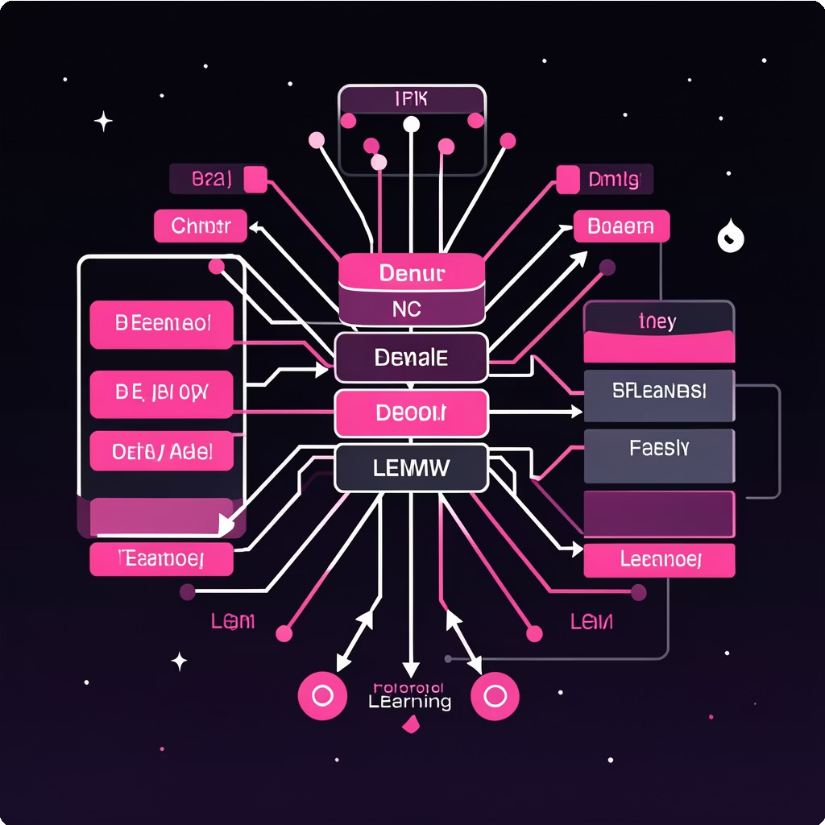
Model Description
Our detection model is built upon a Convolutional Neural Network (CNN) architecture, specifically designed to identify subtle discrepancies introduced during the deepfake generation process. It focuses on:
Spatial Inconsistencies: Detecting artifacts at the pixel level that betray manipulation.
Temporal Inconsistencies: Analyzing frame-to-frame variations that are unnatural for genuine video.
Physiological Anomalies: Identifying strange blinking patterns, unnatural skin textures, or incorrect head movements.
Frequency Domain Analysis: Exploiting frequency spectrum differences between real and fake images.
The model is trained on a vast dataset of both authentic and deepfake videos to learn intricate patterns.

Slide 6
Working Principle
01
02
03
Video Input & Frame Extraction
The process begins by receiving a video input, which is then broken down into individual frames for detailed analysis.
Face Detection & Alignment
Using advanced computer vision techniques, faces within each frame are accurately detected and precisely aligned to a standardized size and orientation.
Feature Extraction (CNN)
A pre-trained Convolutional Neural Network extracts high-level features from the detected faces, focusing on minute details and potential anomalies.
04
05
Temporal & Spatial Analysis
Both individual frames (spatial) and sequences of frames (temporal) are analyzed for inconsistencies characteristic of deepfakes.
Classification
Based on the extracted features and anomaly scores, the model classifies the input as either a "Real" video or a "Deepfake" with a confidence score.

Slide 7




Result: High Accuracy Detection
Our deepfake detection model demonstrates impressive performance across various benchmark datasets. Initial results show an accuracy of over 95% in distinguishing between real and synthetically generated face swaps.
Precision: Measures the accuracy of positive predictions.
Recall: Identifies the proportion of actual positives that were correctly identified.
F1-Score: A balance between precision and recall, providing a comprehensive measure of accuracy.
Accuracy
F1-Score
Precision
Recall

Slide 8

Advantages
Prevents Misinformation
Helps identify fake or manipulated videos, reducing the spread of false information on social media and digital platforms.
Real-time Processing Capability
Designed for efficient analysis, enabling near real-time detection crucial for live streaming and social media platforms.
Law Enforcement Support
Assists cybercrime and forensic departments in verifying video authenticity for investigations and legal evidence.
Comprehensive Feature Analysis
Utilizes a multi-faceted approach, examining both spatial and temporal inconsistencies for superior detection.

Slide 9









Limitations
Computational Cost
High-resolution video analysis requires significant computational resources, potentially limiting deployment on low-power devices.
Adversarial Attacks
Sophisticated deepfake creators might develop techniques to fool detection models, necessitating ongoing research and updates.
Data Imbalance
The scarcity of diverse and realistic deepfake datasets can sometimes lead to biases in model training and performance.
Generalization Challenges
While robust, the model may struggle with deepfakes generated using entirely novel techniques unseen during training.

Slide 10



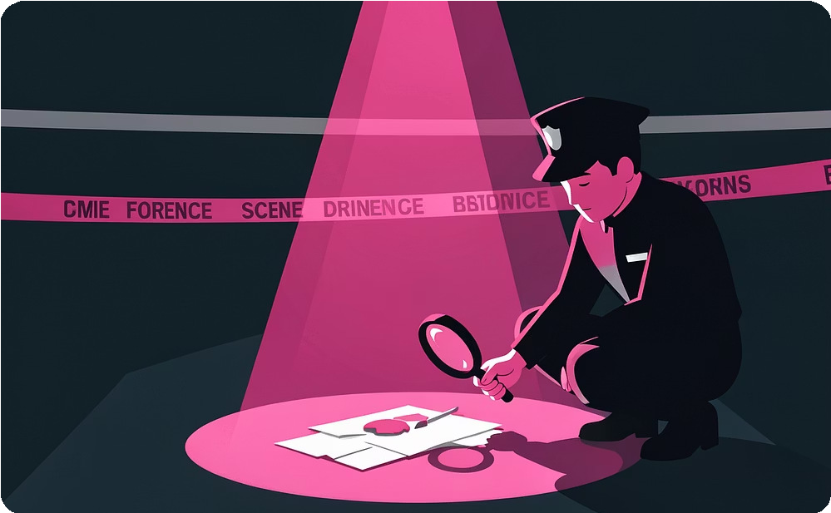
Applications
Social Media Platforms
Automated detection of malicious deepfakes to protect users from misinformation and harassment.
Journalism & Media Verification
Ensuring the authenticity of news footage and interviews, combating the spread of fake news.
Cybersecurity & Authentication
Enhancing biometric security systems to prevent deepfake-based impersonation attacks.
Forensic Analysis
Aiding law enforcement in identifying digitally altered evidence and prosecuting related crimes.

Slide 11



Future Work & Research Directions
Advanced Model Architectures
Explore novel deep learning architectures and transformer models to improve detection of emerging deepfake generation techniques and enhance resilience against adversarial attacks.
Multimodal Detection
Integrate audio analysis, physiological signals, and other contextual data streams alongside video to build a more robust and comprehensive deepfake detection system.
Real-time Optimization
Further optimize the model for faster inference and lower computational footprint, enabling seamless deployment in real-time streaming, social media platforms, and edge devices.
Explainable AI (XAI)
Develop interpretability features to provide clear insights into why a deepfake is detected, increasing user trust and aiding forensic analysts in understanding manipulation patterns.

