Slide 1

Unit 3 Underlying Technologies

Slide 2
IEEE LAN STANDARDS

Slide 3
Wired Local Area Networks
A local area network (LAN) is a computer network that is designed for a limited geographic area such as a building or a campus.
LANs today are also linked to a wide area network (WAN) or the Internet.
The LAN market has seen several technologies such as Ethernet(802.3), token ring (802.5), token bus(802.4), FDDI, and ATM LAN, but Ethernet(802.3) is by far the dominant technology.
Notes:
At first you might think this problem is so trivial(simple) that there is no software to study—machine A just puts the bits on
the wire, and machine B just takes them off.
Unfortunately, communication circuits make errors occasionally, finite data rate, propagation delay limitation puts limitation on the efficiency of the data transfer. The protocols used for communications must take all these factors into consideration.
think of the Internet as a series of backbone networks that are
run by international, national, and regional ISPs. The backbones
are joined together by connecting devices such as routers or switching
stations. The end users are either part of the local ISP LAN or connected
via point-to-point networks to the LANs.
Conceptually, the Internet is a set of switched WANs (backbones), LANs, point-to-point WANs, and
connecting or switching devices.
TCP/IP Protocol Suite is normally shown as a five-layer stack, it only defines the three upper layers;
TCP/IP is only concerned with the network, transport, and application layers.
This means that TCP/IP assumes the existence of these WANs, LANs, and the connecting devices
that join them.
We touch upon some of these underlying technologies- LAN(in this discussion) ,WAN, connecting device

Slide 4
IEEE STANDARDS
In 1985, the Computer Society of the IEEE started a project, called Project 802, to set standards to enable intercommunication among equipment from a variety of manufacturers
Project 802 is a way of specifying functions of the physical layer and the data link layer of major LAN protocols
The standard was adopted by the American National Standards Institute (ANSI)
In 1987, the International Standards Organization (ISO) also approved it as an international standard under the designation ISO 8802
Notes:
TcpIp illustrated -Vol-1.pdf
TCP/IP supports many different link layers, depending on the type of networking hardware being used: Ethernet, token ring, FDDI (Fiber
Distributed Data Interface), RS-232 serial lines, and the like.
The term Ethernet generally refers to a standard published in 1982 by Digital Equipment Corp., Intel Corp., and Xerox Corp.
It is the predominant form of local area network technology used with TCP/IP today.
It uses an access method called CSMA/CD, which stands for Carrier Sense, Multiple Access with Collision Detection. It operates at 10 Mbits/sec and uses 48-bit addresses.
IEEE 802.3 covers an entire set of CSMA/CD networks, 802.4 covers token bus networks, and 802.5 covers token Ring networks.

Slide 5
IEEE STANDARDS
The IEEE has subdivided the data link layer into two sublayers: logical link control (LLC) and media access control (MAC)
IEEE has also created several physical layer standards for different LAN protocols.
Notes:
TcpIp illustrated -Vol-1.pdf
TCP/IP supports many different link layers, depending on the type of networking hardware being used: Ethernet, token ring, FDDI (Fiber
Distributed Data Interface), RS-232 serial lines, and the like.
The term Ethernet generally refers to a standard published in 1982 by Digital Equipment Corp., Intel Corp., and Xerox Corp.
It is the predominant form of local area network technology used with TCP/IP today.
It uses an access method called CSMA/CD, which stands for Carrier Sense, Multiple Access with Collision Detection. It operates at 10 Mbits/sec and uses 48-bit addresses.
IEEE 802.3 covers an entire set of CSMA/CD networks, 802.4 covers token bus networks, and 802.5 covers token Ring networks.

Slide 6
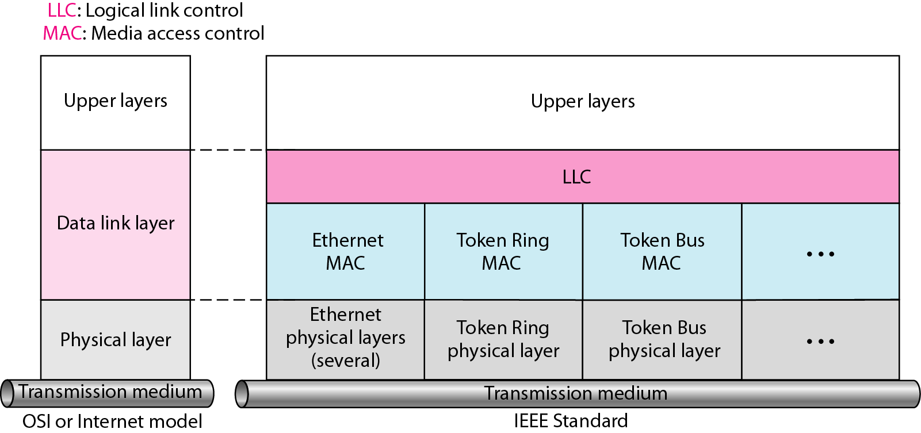
IEEE standard for LANs
Figure 3.1 IEEE Standard for LANs
Notes:
Above multiplexing/de-multiplexing – is simultaneously transmitting frames of different sources(or frames containing data of different sender) and demultiplexing is reverese
Statistical multiplexing is a type of communication link sharing, very similar to dynamic bandwidth allocation (DBA). In statistical multiplexing, a communication channel is divided into an arbitrary number of variable bitrate digital channels or data streams. The link sharing is adapted to the instantaneous traffic demands of the data streams that are transferred over each channel. This is an alternative to creating a fixed sharing of a link, such as in general time division multiplexing (TDM) and frequency division multiplexing (FDM). When performed correctly, statistical multiplexing can provide a link utilization improvement, called the statistical multiplexing gain.

Slide 7
IEEE standard for LANs
LLC is responsible for handling multiple Layer3 protocols (multiplexing/de-multiplexing) and link services like reliability and flow control.
MAC is responsible for framing and media access control for broadcast media.
Notes:
Above multiplexing/de-multiplexing – is simultaneously transmitting frames of different sources(or frames containing data of different sender) and demultiplexing is reverese
Statistical multiplexing is a type of communication link sharing, very similar to dynamic bandwidth allocation (DBA). In statistical multiplexing, a communication channel is divided into an arbitrary number of variable bitrate digital channels or data streams. The link sharing is adapted to the instantaneous traffic demands of the data streams that are transferred over each channel. This is an alternative to creating a fixed sharing of a link, such as in general time division multiplexing (TDM) and frequency division multiplexing (FDM). When performed correctly, statistical multiplexing can provide a link utilization improvement, called the statistical multiplexing gain.

Slide 8
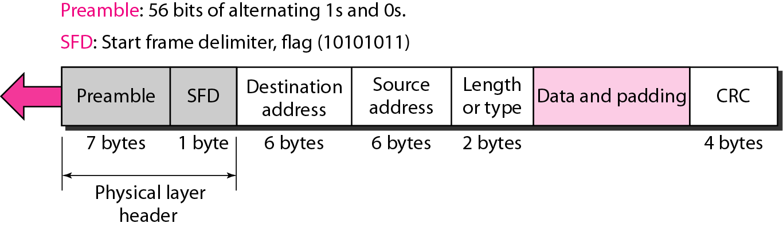
802.3 MAC Frame
Figure 3.2 802.3 MAC Frame
Notes:
Min – 64 bytes(min data 46+18 header) Max – 1518 bytes(max data 1500+18 header).
Preamble. The first field of the 802.3 frame contains 7 bytes (56 bits) of alternating
0s and 1s that alerts the receiving system to the coming frame and enables it to
synchronize its input timing. The pattern provides only an alert and a timing pulse.
The 56-bit pattern allows the stations to miss some bits at the beginning of the
frame. The preamble is actually added at the physical layer and is not (formally)
part of the frame.
Start frame delimiter (SFD). The second field (1 byte: 10101011) signals the
beginning of the frame. The SFD warns the station or stations that this is the last
chance for synchronization. The last 2 bits are 11 and alert the receiver that the
next field is the destination address. The SFD is also added at the physical layer.
Destination address (DA). The DA field is 6 bytes and contains the physical
address of the destination station or stations to receive the packet. We will discuss
addressing shortly.
❑ Source address (SA). The SA field is also 6 bytes and contains the physical
address of the sender of the packet.
❑ Length or type. This field is defined as a type field or length field. The original
Ethernet used this field as the type field to define the upper-layer protocol (Example- ARP protocol of Network layer may be using MAC frame,
in this case Type value will be 0x806)using the MAC frame.
The IEEE standard used it as the length field to define the number of bytes in the data field. Both uses are common today.
Data. This field carries data encapsulated from the upper-layer protocols. It is a
minimum of 46 Bytes and a maximum of 1500 bytes, as we will see later.
CRC (Cyclic Redundancy Check). The last field contains error detection information, in this case a CRC-32.

Slide 9
802.3 MAC frame
Preamble (7 bytes): used to synchronize receiver, sender clock rates.
SFD (1 byte): Start Frame Delimiter, flag (10101011): Signals the beginning of the frame. Last two bits 11 alert the receiver that the next field is the destination address.
Destination and source address: MAC address of source and destination.
Type/Length (2 Bytes): Length: Up to 1500 (max length)
Type: Identify higher-layer data(0x0800 –IPv4 , 0x0806-ARP)
CRC(Cyclic Redundancy Check 4 Bytes): Checked at receiver, if error is detected, the frame is simply dropped
Data: 46 to 1500 Bytes (if shorter: add pad)Why?
Notes:
3.2.6 Length/Type field-
This two-octet field takes one of two meanings, depending on its numeric value. For numerical evaluation, the first octet is the most significant octet of this field.
If the value of this field is less than or equal to the value of maxValidFrame (as specified in 4.2.7.1)1500 decimal, then the Length/Type field indicates the number of MAC client data octets contained in the subsequent data field of the frame (Length interpretation).
b) If the value of this field is greater than or equal to 1536 decimal (equal to 0600 hexadecimal), then the Length/Type field indicates the nature of the MAC client protocol (Type interpretation). For example, an Type value of 0x0800 signals that the frame contains an IPv4 datagram. Likewise, an Type of 0x0806 indicates an ARP frame

Slide 10
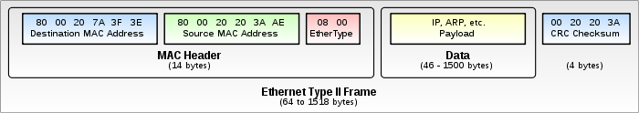
Example: IEEE 802.3 frame
Figure 3.3 IEEE 802.3 Frame
Notes:
Example: IEEE802.3 frame

Slide 11
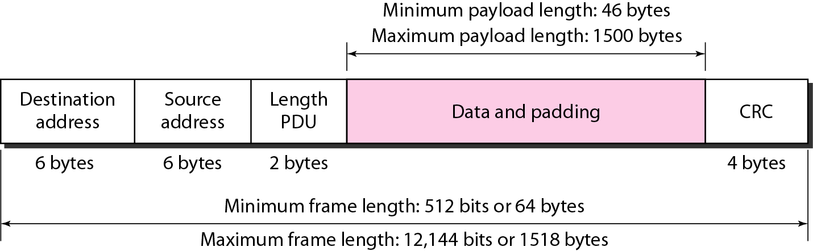
IEEE 802.3 frame
Min Frame Length
46 byte min Data payload + 18bytes Header &CRC =64 bytes.
Max Frame Length
1500 byte max Data payload + 18bytes Header &CRC=1518 bytes
Notes:
2 reasons –
This collision detection requirement also defines the maximum propagation delay along the cable, and hence the maximum cable segment length. 46byte Data payload+18bytes Header &CRC =6 bytes At the other end of the range - 1500 bytes, there were two factors that lead to the introduction of this limit. First, if the packets are too long, they introduce extra delays to other traffic using the Ethernet cable. The other factor was a safety device built into the early shared cable transceivers. This safety device was an anti-babble system. If the device connected to a transceiver developed a fault and started transmitting continuously, then it would effectively block any other traffic from using that Ethernet cable segment. To protect from this happening, the early transceivers were designed to shut off automatically if the transmission exceeded about 1.25 milliseconds. This equates to a data content of just over 1500 bytes. However, as the transceiver used a simple analogue timer to shut off the transmission if babbling was detected, then the 1500 limit was selected as a safe approximation to the maximum data size that would not trigger the safety device.
Babble: An error condition caused by an Ethernet node transmitting longer packets than allowed. Sometimes babble is used interchangeably with jabber.
1.25*10⁻³ * 10*10⁶= 1250 bytes
However, as the transceiver used a simple analogue timer to shut off the transmission if babbling was detected, then the 1500 limit was selected as a safe approximation to the maximum data size that would not trigger the safety device.

Slide 12
Example
An Ethernet MAC sublayer receives 1510 bytes of data from the upper layer. Can the data be encapsulated in one frame? If not, how many frames need to be sent? What is the size of the data in each frame?
Solution
The maximum data size in the Standard Ethernet is 1500 bytes. The data of 1510 bytes, therefore, must be split between two frames.
The standard dictates that the first frame must carry the maximum possible number of bytes (1500);
the second frame then needs to carry only 10 bytes of data (it requires
padding). The following shows the breakdown:
Data size for the first frame: 1500 bytes
1st Frame Size =1500 data + 18 header & CRC =1518 Bytes
Data size for the second frame: 46 bytes (10 Payload+36 padding)
2nd Frame Size =46 Byte Data + 18 header & CRC =64 Bytes
Notes:
Number of frames required to transmit

Slide 13
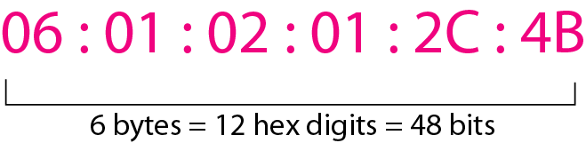
Addressing
Each station on an Ethernet network (such as a PC, workstation, or printer) has its own network interface card (NIC)
The NIC fits inside the station and provides the station with a 6-byte physical address
Ethernet address is 6 bytes (48 bits), normally written in hexadecimal notation, with a colon between the bytes
The address normally is referred to as the data link address, physical address, or MAC address
Figure 2.5 Ethernet Address
Notes:
Each station on an Ethernet network (such as a PC, workstation, or printer) has its own
network interface card (NIC). The NIC fits inside the station and provides the station
with a 6-byte physical address. As shown in Figure 3.4, the Ethernet address is 6 bytes
(48 bits), normally written in hexadecimal notation, with a colon between the bytes.
The address normally is referred to as the data link address, physical address, or MAC
address.

Slide 14
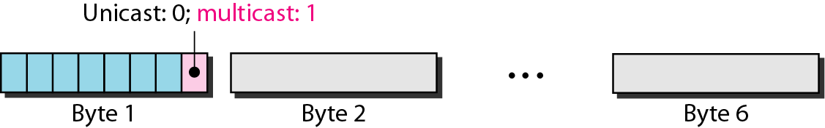
Unicast, Multicast, and Broadcast Addresses
A source address is always a unicast address—the frame comes from only one station
The destination address can be unicast, multicast, or broadcast
If the least significant bit of the first byte in a destination address is 0, the address is unicast; otherwise, it is multicast
The broadcast destination address is a special case of the multicast address in which all bits are 1s

Slide 15
Example
Show how the address 47:20:1B:2E:08:EE is sent out on line.
Solution
The address is sent left-to-right, byte by byte; for each byte, it is sent right-to-left, bit by bit, as shown below:
← 11100010 00000100 11011000 01110100 00010000 01110111
Decimal value 7=0111
Decimal value 4=0100
Decimal value E=1110
Decimal value E=1110
47 is 0100 0111
The right-to-left order is
1110 0010 – LSB is 1 Multicast
The transmission is left-to-right, byte by byte; however, for each byte, the least significant bit is sent first and the most significant bit is sent last. This means that the bit that defines an address as unicast or multicast arrives first at the receiver.
Notes:
47 = 0100 0111 sent in reverse (right to left) 1110 0010
20=0010 0000 sent in reverse (right to left) 0000 0100
1B=0001 1011 sent in reverse (right to left) 1101 1000
2E= 0010 1110 sent in reverse (right to left) 0111 0100
08= 0000 1000 sent in reverse (right to left) 0001 0000
EE= 1110 1110 sent in reverse (right to left) 0111 0111

Slide 16
Example
Define the type of the following destination addresses:
a. 4A:30:10:21:10:1A b. 47:20:1B:2E:08:EE
c. FF:FF:FF:FF:FF:FF
Solution
To find the type of the address, we need to look at the second hexadecimal digit from the left. If it is even, the address is unicast. If it is odd, the address is multicast. If all digits are F’s, the address is broadcast. Therefore, we have the following:
a. This is a unicast address because A in binary is 1010. lsb is 0
b. This is a multicast address because 7 in binary is 0111. lsb is 1
c. This is a broadcast address because all digits are F’s , all 1’s.
Notes:
4A – 0100 1010 reverse 0101 0010 - unicast
47- 0100 0111 reverse 1110 0010 - Multicast
FF -1111 1111 all 1s

Slide 17
Meaning of some Terms
Propagation Delay(T_{p}): Amount of time it takes for the first bit of signal to travel from the sender to the receiver.
T_{P} = d/c where d is the distance between the sender and the receiver and c is the speed of light ( 3 * 10^8 m/s).
Transmission Delay(T_{d}): It is the amount of time required to push all of the packet's bits into the wire. In other words, this is the delay caused by the data-rate of the link.
Transmission delay is a function of the packet's length and has nothing to do with the distance between the two nodes. This delay is proportional to the packet's length in bits. It is given by the following formula:
T_{d} = N/R where N is the number of bits, and R is the rate of transmission (say in bits per second)
Notes:
Meaning of some Terms

Slide 18
Example
The stations on a wireless network are a maximum of 300 km apart. If the network transmits 400-bit frames on a shared channel of 200 kbps. Find the propagation and Transmission Delay
Solution
Propagation Delay : = T_{P} = d/c
=300 X 1000 / 3 X 10^8 =0.001 sec= 1ms
Transmission delay = T_{d} = N/R
400/(200 X 10^3) = =0.002 sec=2ms

Slide 19
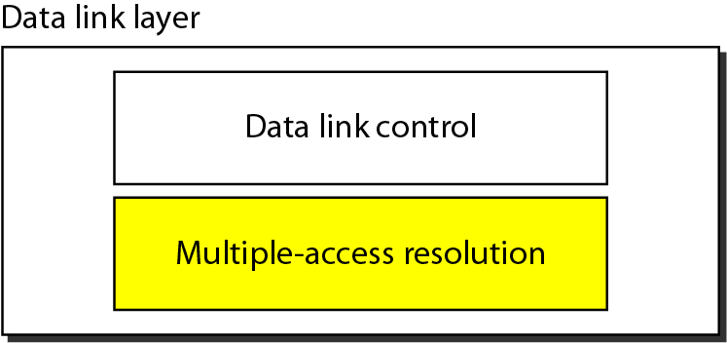
Data link layer -Sublayers
The data link layer has two sublayers: (similar to sublayers in IEEE)
The upper sublayer is responsible for data link control, and the lower sublayer is responsible for resolving access to the shared media
If the channel is dedicated, we do not need the lower sublayer
Notes:
Refer : DCN –Forouzan
We can consider the data link layer as two sublayers. The upper sublayer is responsible
for data link control, and the lower sublayer is responsible for resolving access to the
shared media. If the channel is dedicated, we do not need the lower sublayer.
The upper sublayer that is responsible for flow and error control is called the logical
link control (LLC) layer; the lower sublayer that is mostly responsible for multiple access
resolution is called the media access control (MAC) layer.
When nodes or stations are connected and use a common link, called a multipoint
or broadcast link, we need a multiple-access protocol to coordinate access to the link.
The problem of controlling the access to the medium is similar to the rules of speaking in assembly.

Slide 20
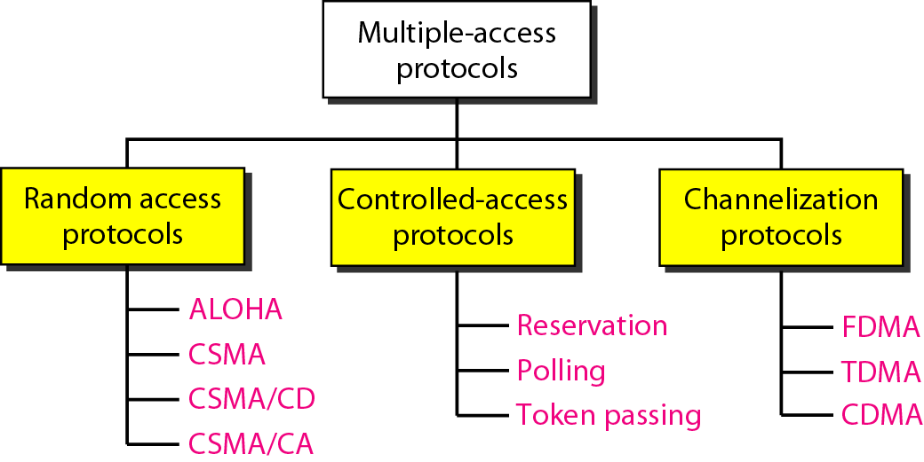
Multiple-Access Protocols
When nodes or stations are connected and use a common link, called a multipoint or broadcast link, a multiple-access protocol is needed to coordinate access to the link
Taxonomy of Multiple-access protocols
Notes:
In random access or contention(struggle) methods, no station is superior to another station and
none is assigned the control over another. No station permits, or does not permit,
another station to send. At each instance, a station that has data to send uses a procedure
defined by the protocol to make a decision on whether or not to send.
Controlled-Access Protocols:
In controlled access, the stations consult one another to find which station has the right
to send. A station cannot send unless it has been authorized by other stations.
Channelization is a multiple-access method in which the available bandwidth of a link
is shared in time, frequency, or through code, between different stations. In this section,
we discuss three channelization protocols: FDMA, TDMA, and CDMA.

Slide 21
Random Access Methods
In random access or contention methods, no station is superior to another station and none is assigned the control over another.
No station permits, or does not permit another station to send.
At each instance, a station that has data to send follows a procedure defined by the protocol to decide on whether or not to send.
Notes:
Contend: to compete in order to win something

Slide 22
Random Access Methods
Two features give this method its name:
First, there is no scheduled time for a station to transmit. Transmission is random among the stations. That is why these methods are called random access.
Second, no rules specify which station should send next. Stations compete with one another to access the medium. That is why these methods are also called contention methods.
In a random access method, each station has the right to the medium without being controlled by any other station
However, if more than one station tries to send, there is an access conflict-collision-and the frames will be either destroyed or modified.
Notes:
Contend: to compete in order to win something
No Schedule
Who to Send Next
Collision

Slide 23
Random Access Methods
To avoid access conflict or to resolve it when it happens, each station follows a procedure that answers the following questions:
When can the station access the medium?
What can the station do if the medium is busy?
How can the station determine the success or failure of the transmission?
What can the station do if there is an access conflict?

Slide 24
Random Access Methods
Random access methods have evolved from a protocol known as ALOHA, which used a very simple procedure called multiple access (MA)
The method was improved with the addition of a procedure that
forces the station to sense the medium before transmitting. This
was called carrier sense multiple access (CSMA)
CSMA evolved into two parallel methods:
Carrier Sense Multiple Access With Collision Detection (CSMA/CD)
Carrier Sense Multiple Access With Collision Avoidance (CSMA/CA)
CSMA/CD tells the station what to do when a collision is detected
CSMA/CA tries to avoid the collision.

Slide 25
Carrier Sense Multiple Access (CSMA)
To minimize the chance of collision and, therefore, increase the performance, the CSMA method was developed
The chance of collision can be reduced if a station senses the medium before trying to use it
Carrier sense multiple access (CSMA) requires that each station first listen to the medium (or check the state of the medium) before sending
CSMA is based on the principle "sense before transmit" or "listen before talk"
CSMA can reduce the possibility of collision, but it cannot eliminate it

Slide 26
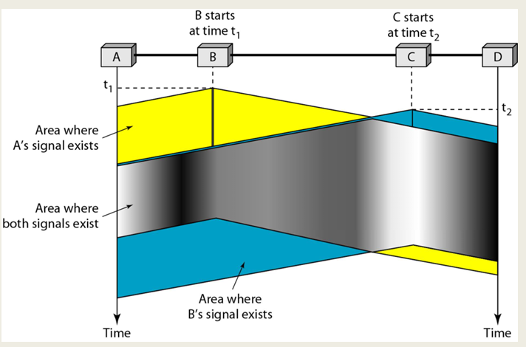
Carrier Sense Multiple Access (CSMA)

Slide 27
CSMA-Vulnerable Time
The vulnerable time for CSMA is the propagation time Tp . This is the time needed for a signal to propagate from one end of the medium to the other
When a station sends a frame, and any other station tries to send a frame during this time, a collision will result
But if the first bit of the frame reaches the end of the medium, every station will already have heard the bit and will refrain from sending

Slide 28
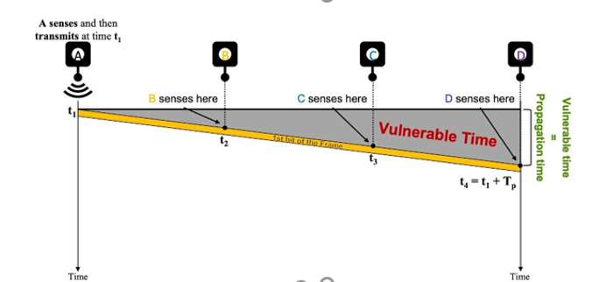
CSMA-Vulnerable Time
The leftmost station A sends a frame at time t1 which reaches the rightmost station
D at time t1 + Tp

Slide 29
CSMA-Persistence Methods
What should a station do if the channel is busy?
What should a station do if the channel is idle?
Three methods have been devised to answer these questions:
1-persistent Method
Nonpersistent method
P-persistent method

Slide 30
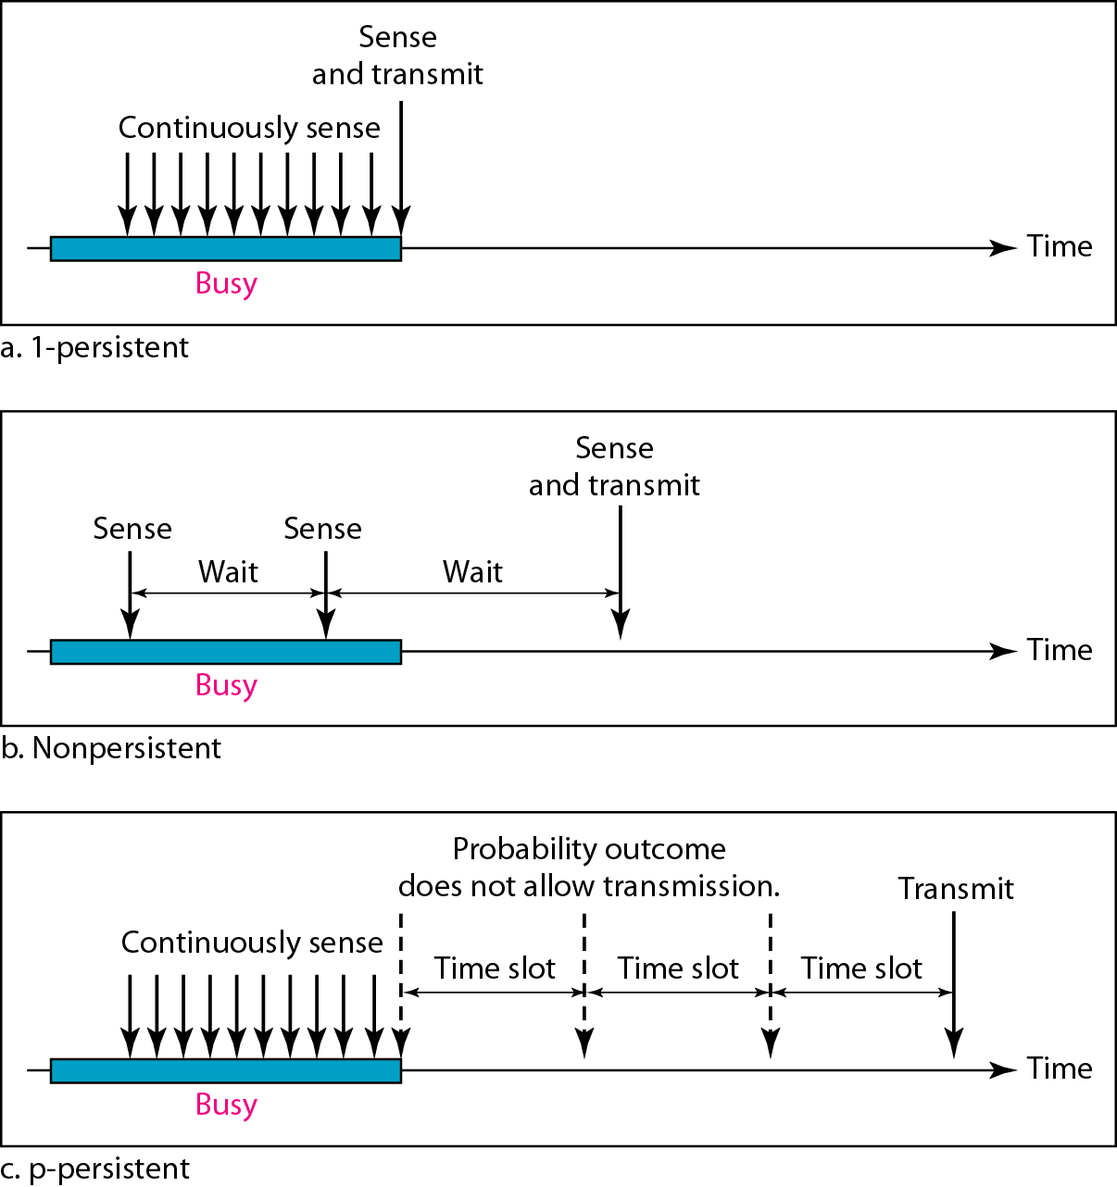
Behavior of three persistence methods
Notes:
Persistent Methods –tells what to if media sensed is busy or if idle?
In CSMA protocols, when a station wants to transmit data, it first checks if the channel is busy (carrier sense). If it's busy, the station waits until the channel becomes idle. In a "1-persistent" CSMA protocol, if the channel is idle, the station has a probability of 1 of transmitting immediately. This means that if the channel is free, the station will always transmit its data right away without further delay. The "persistence" factor refers to the probability of transmission.
In "1-persistent" CSMA, the station is very aggressive and attempts to transmit as soon as it senses the channel is idle. This approach can lead to higher chances of collisions, especially in scenarios where multiple stations are trying to transmit at the same time.
In contrast, there are also "non-persistent" CSMA protocols where a station listens to the channel and if it's busy, it waits for a random period of time before attempting to transmit again. This reduces the likelihood of collisions compared to the more aggressive "1-persistent" approach.
The p-persistent CSMA (Carrier Sense Multiple Access) method is another variation of the CSMA protocol. In this method, the "p" refers to the probability of transmission by a station when it senses that the channel is idle. It is a compromise between the aggressive 1-persistent method and the more cautious non-persistent method.
Here's how the p-persistent CSMA method works:
When a station has data to transmit, it first checks the channel to determine if it is busy (carrier sense).
If the channel is busy, the station waits until it becomes idle.
Once the channel is detected as idle, instead of transmitting immediately (as in 1-persistent CSMA), the station transmits with a probability "p."
If the station chooses not to transmit (which happens with probability 1 - p), it waits for the next time slot and checks the channel again.
The station continues this process until it successfully transmits its data or another station starts transmitting.
The p-persistent method introduces a controlled randomness into the transmission process. If "p" is set to a higher value (close to 1), stations are more likely to transmit immediately upon detecting an idle channel, resembling the behavior of 1-persistent CSMA. If "p" is set to a lower value (close to 0), stations are more cautious and may wait for a longer time before attempting to transmit, similar to non-persistent CSMA.
The choice of the value of "p" depends on the network characteristics and the desired trade-off between efficiency and collision avoidance. A higher "p" can lead to increased throughput but also potentially more collisions, while a lower "p" can reduce collisions but might result in underutilization of the channel. The goal is to find an appropriate value of "p" that balances these factors for the specific network environment.

Slide 31
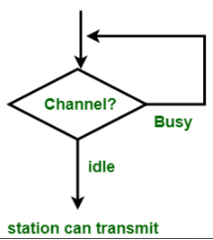
1-persistent CSMA
1-persistent CSMA (Carrier Sense Multiple Access): To send data, a station first listens to the channel to see if anyone else is transmitting.
If so, the station waits (keeps sensing it) until the channel becomes idle. Otherwise, it transmits a frame.
If a collision occurs, the station waits a random amount of time and starts all over again.

Slide 32
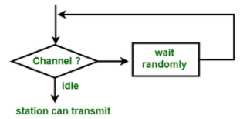
Non-persistent CSMA
To send data, a station first listens to the channel to see if anyone else is transmitting
If so, the station waits a random period of time (instead of keeping sensing until the end of the transmission) and repeats the algorithm. Otherwise, it transmits a frame.
If a collision occurs, the station waits a random amount of time and starts all over again.

Slide 33
P-Persistent CSMA
The p-persistent method is used if the channel has time slots with a slot duration equal to or greater than the maximum propagation time.
In this method, after the station finds the line idle it follows these steps:
1. With probability p, the station sends its frame.
2. With probability q = 1 - p, the station waits for the beginning of the next time slot and checks the line again.
a. If the line is idle, it goes to step 1.
b. If the line is busy, it acts as though a collision has occurred and uses the back off procedure.
Notes:
The p-persistent CSMA (Carrier Sense Multiple Access) method is another variation of the CSMA protocol. In this method, the "p" refers to the probability of transmission by a station when it senses that the channel is idle. It is a compromise between the aggressive 1-persistent method and the more cautious non-persistent method.
Here's how the p-persistent CSMA method works:
When a station has data to transmit, it first checks the channel to determine if it is busy (carrier sense).
If the channel is busy, the station waits until it becomes idle.
Once the channel is detected as idle, instead of transmitting immediately (as in 1-persistent CSMA), the station transmits with a probability "p."
If the station chooses not to transmit (which happens with probability 1 - p), it waits for the next time slot and checks the channel again.
The station continues this process until it successfully transmits its data or another station starts transmitting.
The p-persistent method introduces a controlled randomness into the transmission process. If "p" is set to a higher value (close to 1), stations are more likely to transmit immediately upon detecting an idle channel, resembling the behavior of 1-persistent CSMA. If "p" is set to a lower value (close to 0), stations are more cautious and may wait for a longer time before attempting to transmit, similar to non-persistent CSMA.
The choice of the value of "p" depends on the network characteristics and the desired trade-off between efficiency and collision avoidance. A higher "p" can lead to increased throughput but also potentially more collisions, while a lower "p" can reduce collisions but might result in underutilization of the channel. The goal is to find an appropriate value of "p" that balances these factors for the specific network environment.

Slide 34
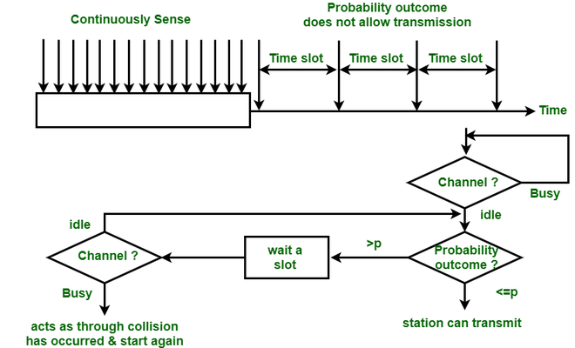
P-Persistent CSMA
Notes:
The p-persistent CSMA (Carrier Sense Multiple Access) method is another variation of the CSMA protocol. In this method, the "p" refers to the probability of transmission by a station when it senses that the channel is idle. It is a compromise between the aggressive 1-persistent method and the more cautious non-persistent method.
Here's how the p-persistent CSMA method works:
When a station has data to transmit, it first checks the channel to determine if it is busy (carrier sense).
If the channel is busy, the station waits until it becomes idle.
Once the channel is detected as idle, instead of transmitting immediately (as in 1-persistent CSMA), the station transmits with a probability "p."
If the station chooses not to transmit (which happens with probability 1 - p), it waits for the next time slot and checks the channel again.
The station continues this process until it successfully transmits its data or another station starts transmitting.
The p-persistent method introduces a controlled randomness into the transmission process. If "p" is set to a higher value (close to 1), stations are more likely to transmit immediately upon detecting an idle channel, resembling the behavior of 1-persistent CSMA. If "p" is set to a lower value (close to 0), stations are more cautious and may wait for a longer time before attempting to transmit, similar to non-persistent CSMA.
The choice of the value of "p" depends on the network characteristics and the desired trade-off between efficiency and collision avoidance. A higher "p" can lead to increased throughput but also potentially more collisions, while a lower "p" can reduce collisions but might result in underutilization of the channel. The goal is to find an appropriate value of "p" that balances these factors for the specific network environment.

Slide 35
CSMA/CD
Carrier Sense Multiple Access with Collision Detection (CSMA/CD) augments the algorithm to handle the collision.
In this method, a station monitors the medium after it sends a frame to see if the transmission was successful
If a collision is detected, the station aborts the transmission
No Acknowledgment
Notes:
No acknowledgement is used ,hence sender ensures delivery by observing Collision in the media while transmitting(Collision Detection)

Slide 36
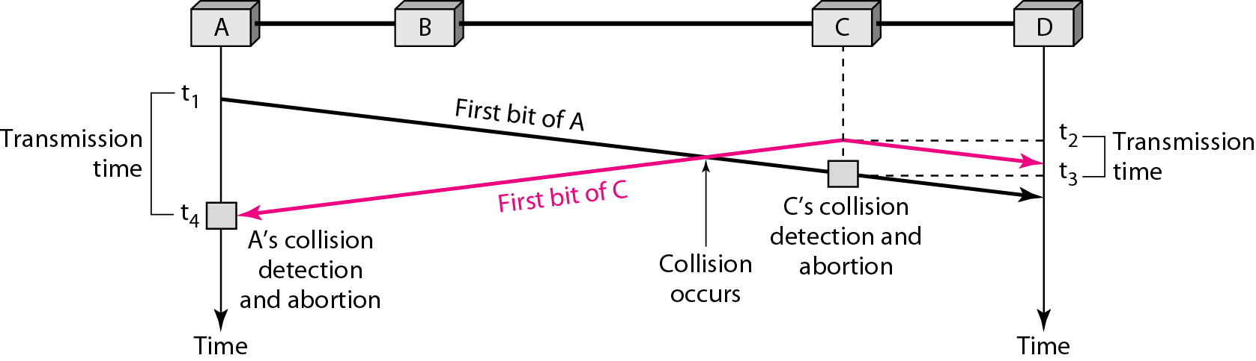
Collision in CSMA/CD
Collision is detected by every station in the Network
Notes:
Collision is detected by every station in the Network
At time t1, station A has executed its persistence procedure and starts sending the
bits of its frame. At time t2, station C has not yet sensed the first bit sent by A. Station C
executes its persistence procedure and starts sending the bits in its frame, which propagate
both to the left and to the right. The collision occurs sometime after time t2' Station C
detects a collision at time t3 when it receives the first bit of A's frame. Station C immediately
(or after a short time, but we assume immediately) aborts transmission. Station A
detects collision at time t4 when it receives the first bit of C's frame; it also immediately
aborts transmission. Looking at the figure, we see that A transmits for the duration t4 – t1;
C transmits for the duration t3 - t2' Later we show that, for the protocol to work, the
length of any frame divided by the bit rate(i.e. time required to transmit entire frame on to link)
in this protocol must be more than either of these durations. At time t4, the transmission of A’s frame, though incomplete, is aborted; at time t3, the transmission of B's frame, though incomplete, is aborted.
Now that we know the time durations for the two transmissions, we can show a
more complete graph in Figure

Slide 37
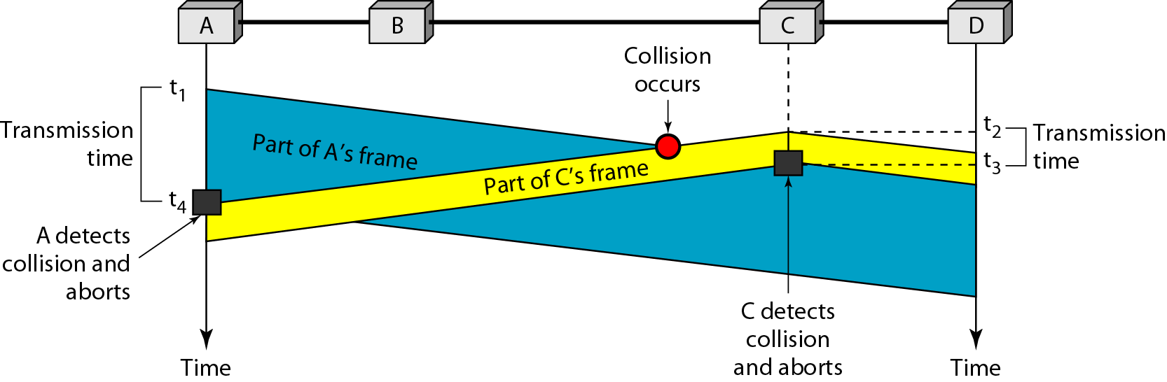
Collision and abortion in CSMA/CD
(t₄-t₁)*data rate –amount of data transmitted by A before detecting collision.
Figure 2.12 Collision and Abortion in CSMA/CD
Notes:
(t4-t1)*data rate –amount of data transmitted by A before detecting collision.

Slide 38
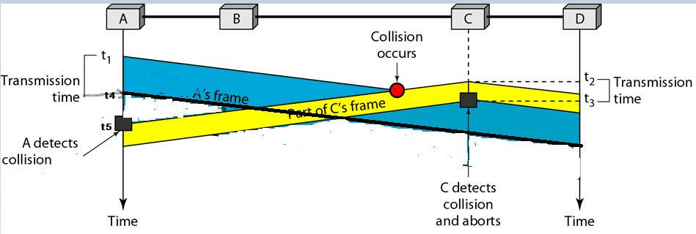
What if Frame size is smaller?
Station ‘A’ never understands that- collision happened with it’s own Signal
Once the entire frame is sent, does not keep a copy of the frame and does not monitor the link for collision detection.
Notes:
What if Frame size is smaller?
A never understands that- collision Happened with it’s own Signal

Slide 39
Minimum Frame Size
For CSMA/CD to work, we need a restriction on the frame size. Before sending the last bit of the frame, the sending station must detect a collision, if any, and abort the transmission
This is so because the station, once the entire frame is sent, does not keep a copy of the frame and does not monitor the link for collision detection
In the worst case scenario, If the two stations involved in a collision are the maximum distance apart, the signal from the first takes time T_{p} to reach the second, and the effect of the collision takes another time T_{p} to reach the first
Therefore, the frame transmission delay T_{fr}(also called as T_{d} )must be at least two times the maximum propagation time T_{p}
T_{fr}>=2*T_{p}
Notes:
For CSMA/CD to work, we need a restriction on the frame size. Before sending the last bit of the frame, the sending station must detect a collision, if any, and abort the transmission. This is so because the station, once the entire frame is sent, does not keep a copy of the frame and does not monitor the line for collision detection. Therefore, the frame transmission time Tfr must be at least two times the maximum propagation time Tp.
To understand the reason, let us think about the worst-case scenario. If the two stations involved in a collision are the maximum distance apart, the signal from the first takes time Tp to reach the second and the effect of the collision takes another time Tp to reach the first. So the requirement is that the first station must still be transmitting after 2Tp .
T_{fr} >= 2T_{p}
T_{fr} = N/R where N- Length of packet in terms of bits; R-Data rate
N/R >= 2T_{p}
N>=2T_{p} * R
We know T_{p} = d/c where d –distance i.e. length of cable c- speed of light(signal-for copper wire 2/3 of speed of light)
N>=2*d/c * R
Chapter 13-pdf page 438-439
Standard Ethernet uses 1-persistent CSMA/CD (see Chapter 12).
Slot Time In an Ethernet network, the round-trip time required for a frame to travel
from one end of a maximum-length network to the other plus the time needed to send
the jam sequence is called the slot time.
Slot time =round-trip time + time required to send the jam sequence
The slot time in Ethernet is defined in bits. It is the time required for a station to
send 512 bits. This means that the actual slot time depends on the data rate; for traditional
10-Mbps Ethernet it is 51.2 micro-sec.
Slot Time and Collision The choice of a 512-bit slot time was not accidental. It was
chosen to allow the proper functioning of CSMA/CD. To understand the situation, let
us consider two cases.
In the first case, we assume that the sender sends a minimum-size packet of 512 bits.
Before the sender can send the entire packet out, the signal travels through the network
and reaches the end of the network. If there is another signal at the end of the network
(worst case), a collision occurs. The sender has the opportunity to abort the sending of
the frame and to send a jam sequence to inform other stations of the collision. The
round-trip time plus the time required to send the jam sequence should be less than the
time needed for the sender to send the minimum frame, 512 bits. The sender needs to
be aware of the collision before it is too late, that is, before it has sent the entire frame.
In the second case, the sender sends a frame larger than the minimum size
(between 512 and 1518 bits). In this case, if the station has sent out the first 512 bits and
has not heard a collision, it is guaranteed that collision will never occur during the
transmission of this frame. The reason is that the signal will reach the end of the network
in less than one-half the slot time. If all stations follow the CSMA/CD protocol,
they have already sensed the existence of the signal (carrier) on the line and have
refrained from sending. If they sent a signal on the line before one-half of the slot time
expired, a collision has occurred and the sender has sensed the collision. In other
words, collision can only occur during the first half of the slot time, and if it does, it can
be sensed by the sender during the slot time. This means that after the sender sends the
first 512 bits, it is guaranteed that collision will not occur during the transmission of
this frame. The medium belongs to the sender, and no other station will use it. In other
words, the sender needs to listen for a collision only during the time the first 512 bits
are sent.
Ofcourse, all these assumptions are invalid if a station does not follow the CSMAlCD
protocol. In this case, we do not have a collision, we have a corrupted station.

Slide 40
Minimum Frame Size
T_{fr} >= 2 * T_{p} and T_{d} = N/R
N- length of frame in bits
R- Data rate
N/R >= 2 * T_{p}
N>=2 * T_{p} * R
Frame Size >= (2 * T_{p})* R
Frame Size >= (2 * d/c)* R
because T_{P} = d/c

Slide 41
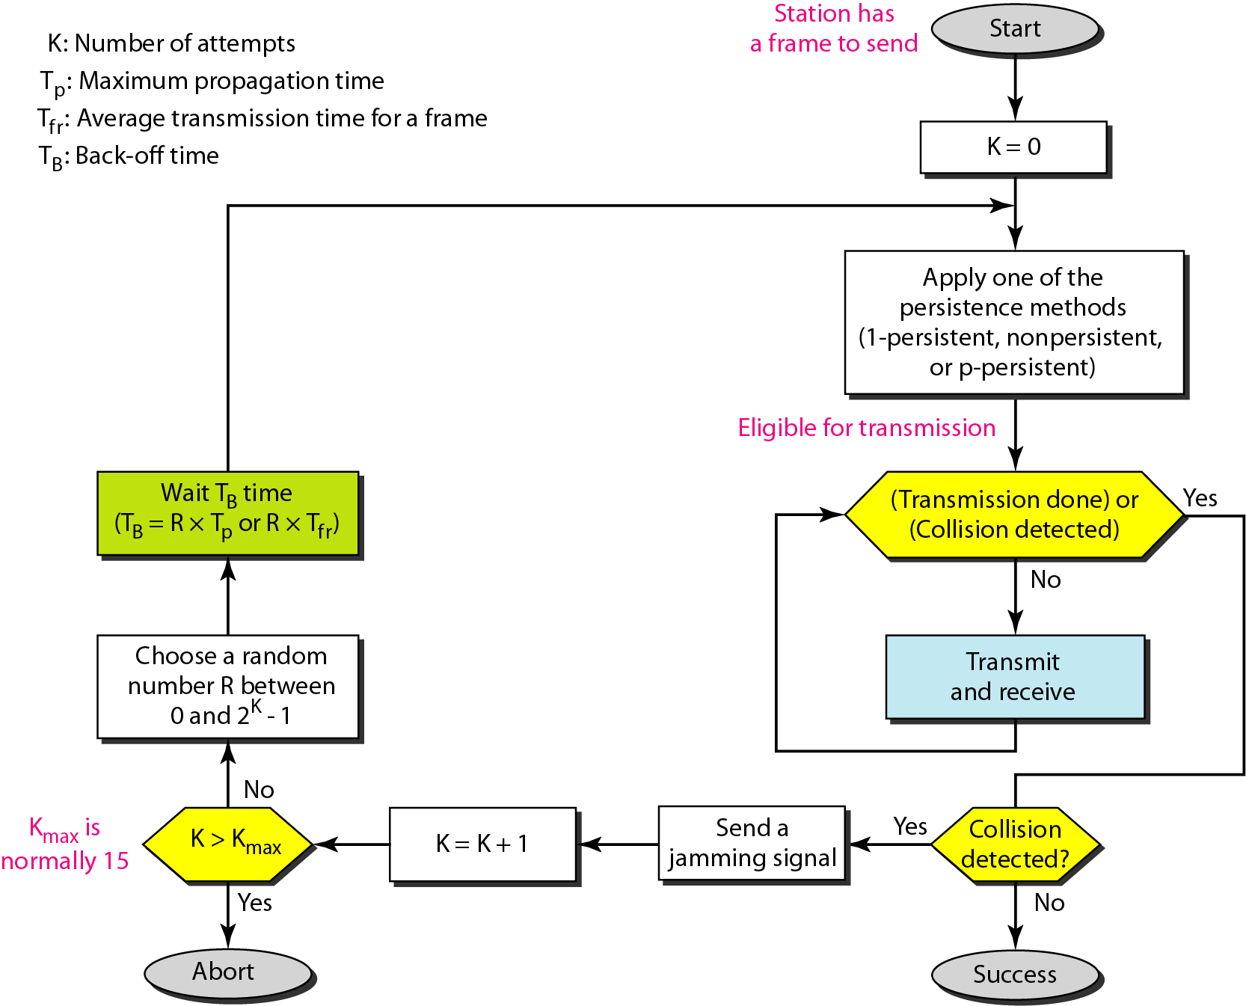
Flow diagram for the CSMA/CD
Persistent Methods –tells what to do if media sensed is busy or if idle?
Notes:
We need to sense the channel before we start sending the frame by using one of the persistence processes we discussed previously (non-persistent, 1-persistent, or p-persistent)
In CSMA/CD, transmission and collision detection is a continuous process. We do not send the entire frame and then look for a collision.
We use a loop to show that transmission is a continuous process. We constantly monitor in order to detect one of two conditions: either transmission is finished or a collision is detected. Either event stops transmission. When we come out of the loop, if a collision has not been detected, it means that transmission is complete; the entire frame is transmitted. Otherwise, a collision has occurred.
The third difference is the sending of a short jamming signal that enforces the collision
in case other stations have not yet sensed the collision.
A short jamming signal that enforces the collision in case other stations have not yet sensed the collision.

Slide 42
Example
A network using CSMA/CD has a bandwidth of 10 Mbps. If the maximum propagation time (including the delays in the devices and ignoring the time needed to send a jamming signal, as we see later) is 25.6 μs, what is the minimum size of the frame?
Solution
The frame transmission time is T_{fr} = 2 × T_{p} = 51.2 μs. This means, in the worst case, a station needs to transmit for a period of 51.2 μs to detect the collision.
The minimum size of the frame is 10 Mbps × 51.2 μs = 512 bits or 64 bytes. This is actually the minimum size of the frame for Standard Ethernet.
Notes:
What if a packet is of lesser size than minimum size then, extra padding bits needed to ensure that sent frame is of minimum size.

Slide 43
Problem
In a CSMA/CD network with a data rate of 10 Mbps, the minimum frame size is found to be 512 bits for the correct operation of the collision detection process.
What should be the minimum frame size if we increase the data rate to 100 Mbps? To 1 Gbps? To 10 Gbps?
Notes:
T_{fr} = N/D N-length of frame(in bits) D-data rate
T_{fr}=2*T_{p}
N/D=2*T_{P}
N= D*2*T_{P}

Slide 44
Solution
Let us find the relationship between the minimum frame size and the data rate. We
know that-
or
(frame size) = [2 × (distance) / (propagation speed)] × (data rate)]
or
frame size = K × (data rate)
This means that minimum frame size is proportional to the data rate (K is a constant).
When the data rate is increased, the frame size must be increased in a network with a fixed length to continue the proper operation of the CSMA/CD.
We calculate the minimum frame size based on the above proportionality relationship
Data rate = 10 Mbps → minimum frame size = 512 bits
Data rate = 100 Mbps → minimum frame size = 5120 bits
Data rate = 1 Gbps → minimum frame size = 51,200 bits
Data rate = 10 Gbps → minimum frame size = 512,000 bits
Frame Size >= (2 * T_{p})* R
Frame Size >= (2 * d/c)* R
Notes:
N/R = 2*d/c
T_{fr} = N/R N-length of frame(in bits) R-data rate
T_{fr}=2*T_{p}
N/R=2*T_{P}
N= R*2*T_{P}
There is also a new “Auto Negotiation” feature, which allows Fast Ethernet (100Mbps)
to talk to the regular Ethernet (10Mbps).
In Gig Ethernet, it would be necessary to reduce the LAN size to 25 m in order to retain the min frame size of 64 bytes. Instead, Gigabit Ethernet uses a bigger slot size of 512 bytes. To maintain compatibility with Ethernet, the minimum frame size is not increased, but the "carrier event" is extended. If the frame is shorter than 512 bytes, then it is padded with extension symbols. These are special symbols, which cannot occur in the payload. This process is called Carrier Extension (performed by the NIC card in hardware and is stripped away before the FCS is calculated on the receiving side
T_{P} =d/c d-distance c-signal speed=light speed. It is fixed for given network(in example, only data rate is changed , but distance and signal speed remains same)
N=R*K where K- constant
N proportional to R
If R=10Mbps , min N=512 bits
If R=100Mbps, min N also increase by that 5120 bits

Slide 45
Fast Ethernet
Fast Ethernet operates at 100Mbps. For the most part, the scheme/protocol remains the same as the 10Mbps case, except now the maximum length of the network is shortened.
Minimum frame size is still kept at 64 bytes (for backward compatibility), which now arrive 10 times faster than they do in 10Mbps Ethernet.
Frame Size >= (2 * T_{p})* R
Hence the maximum length of the network must be 10 times smaller or about around 250 meters.
Frame Size >= (2 * d/c)* R
Notes:
TCP/IP Protocol Suite

Slide 46
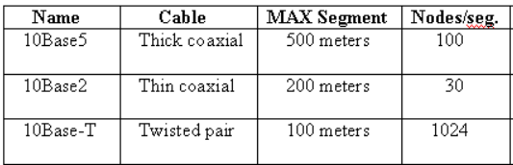
IEEE 802.3 (Ethernet) Cabling
10Base5 cabling: This type of cabling is popularly referred to as thicknet. It was one of the earliest types of cables used for LAN’s. The notation 10Base5 suggests that the LAN operates at 10 Mbps, uses baseband signaling and can support segments of up to 500 meters.
10Base2 cabling: 10Base2 or thinnet, which in contrast to thicknet, bends easily. 10Base2 cables are easier to install and are relatively inexpensive. The only drawback of using the 10Base2 cable is that it can run for only 200 meters and can handle only 30 stations per cable segment.
10Base-T cabling: there is no single, main cable because each station has a cable running to a central hub (a big repeater). Adding or removing stations is simpler in this configuration and cable breaks can be detected easily. The disadvantage of 10Base-T is that the maximum cable run from the hub is only 100 meters, sometimes 150 meters (if high quality twisted pairs are used). 10Base-T is most popular due to the ease of maintenance.
Notes:
10Base5 translates to 10 Mbps (theoretical transmission rate), Baseband (one transmission at a time over a single, shared channel), and 500 meters maximum segment length.
10Base5: Connections to this cable are made using vampire taps, in which a pin is carefully forced halfway into the coaxial cable’s core.
10 Base2: Connections to this cable are made using industry standard BNC connectors to form T-junctions.
10 BaseF: uses fiber optics; max segment length = 2000 m and supports 1024 nodes/seg; best between buildings; more expensive

Slide 47
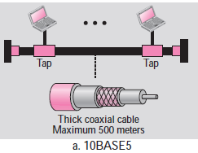
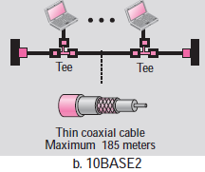
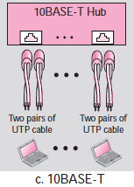
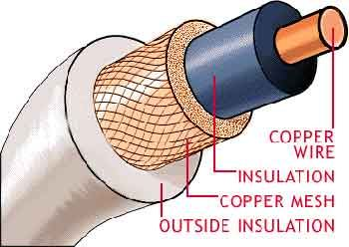
IEEE 802.3 (Ethernet) Cabling
Notes:
10Base5 translates to 10 Mbps (theoretical transmission rate), Baseband (one transmission at a time over a single, shared channel), and 500 meters maximum segment length.
10Base5: Connections to this cable are made using vampire taps, in which a pin is carefully forced halfway into the coaxial cable’s core.
10 Base2: Connections to this cable are made using industry standard BNC connectors to form T-junctions.
10 BaseF: uses fiber optics; max segment length = 2000 m and supports 1024 nodes/seg; best between buildings; more expensive

Slide 48
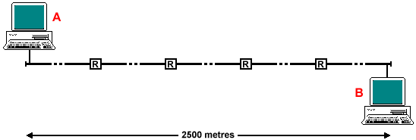
IEEE 802.3 (Ethernet)
IEEE 802.3 has a certain maximum cable length/segment. To allow larger networks, multiple cables are connected by repeaters which amplifies and retransmits signals in both directions.
Maximum distance between any 2 stations is 2500 m (with 5 segments each of 500 m) and no more than 4 repeaters (assume delay added by repeater- 3µSec) can separate any 2 stations.
Notes:
In practice, maximum distance between any 2 stations is 1500 m and no more than 2 repeaters can separate any 2 stations.

Slide 49
The maximum length (1518 bytes) restriction has two historical reasons:
First, memory was very expensive when Ethernet was designed: A maximum length restriction helped to reduce the size of the buffer.
Second, the maximum length restriction prevents one station from monopolizing the shared medium, blocking other stations that have data to send.

Slide 50
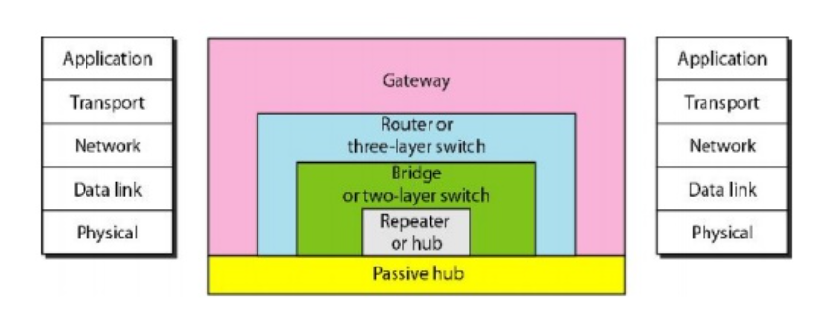
Connecting Devices
Notes:
Connecting Devices

Slide 51
Connecting Devices
There are several ways of interconnecting Networks
When two or more networks are interconnected at the physical layer the type of device is called as a repeater.
When two or more devices are interconnected at the MAC layer or data link layer, the type of the device is called as a bridge
When two or more devices are interconnected at the network layer, the type of the device is called as a router
The device that interconnects at higher level is called as gateway, which generally performs some protocol conversion and security functions.
Notes:
A Gateway, on the other hand, joins dissimilar systems. Gateway it is defined as a network entity that allows a network to interface with another network with different protocols. Gateways acts as a network point that acts as an entrance to another network. The gateway can also allow the network to connect the computer to the internet.

Slide 52
Repeaters
If Range extension is the problem – use repeaters.
A repeater is a device that operates only in the physical layer.
Signals that carry information within a network can travel a fixed distance after that distance signal fade outs(loose the integrity of data carried)
A repeater receives a signal and, before it becomes too weak or corrupted, regenerates the original bit pattern and retransmits the refreshed signal.
Ethernet LANs were using bus topology, a repeater was used to connect two segments of a LAN to overcome the length restriction of the coaxial cable.
In a star topology, a repeater is a multiport device, often called a hub, that can be used to serve as the connecting point and at the same time function as a repeater.
Notes:
Passive Hubs: A passive hub is just a connector. It connects the wires coming from different branches.
Active Hubs: An active hub is actually a multipart repeater. It is normally used to create connections between stations in a physical star topology.
The main difference between repeater and an amplifier is, an amplifier cannot discriminate between the intended signal and noise; it amplifies equally everything fed into it.
A repeater does not amplify the signal; it regenerates the signal. When it receives a weakened or corrupted signal, it creates a copy, bit for bit, at the original strength.

Slide 53
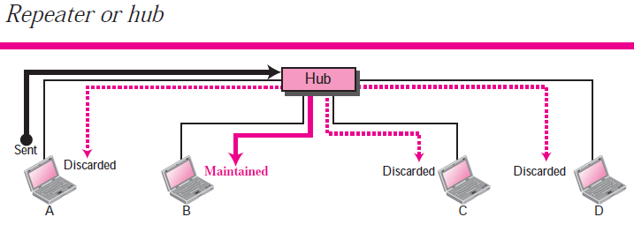
Repeaters
Repeater forwards every bit; it has no filtering capability.
A hub or a repeater is a physical-layer device
They do not have any data-link address and they do not check the data-link address of the received frame

Slide 54
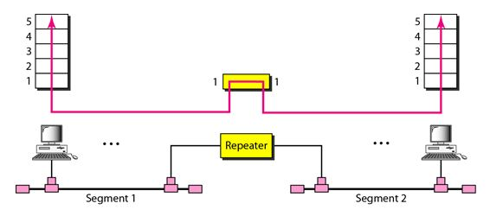
Repeaters

Slide 55
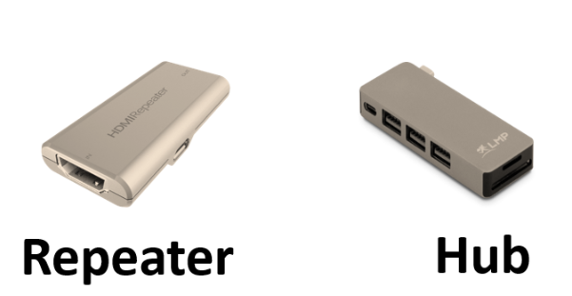
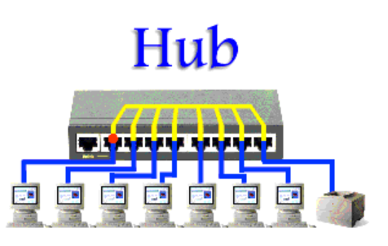
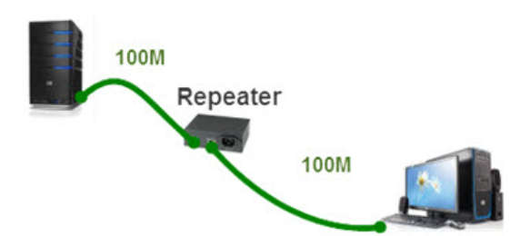

Slide 56
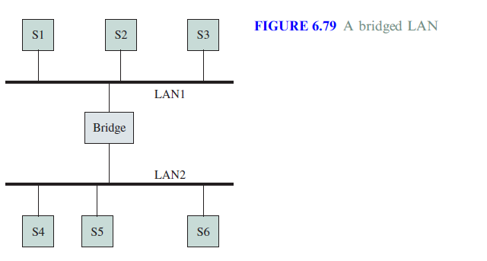
Bridges
There may be requirement in the organization that- they need to interconnect the departmental LANs in order to share the resources.
Thus Bridges are used for connecting multiple LANs as shown in the figure.
Bridged LAN or Extended LAN
Notes:
Why Bridges

Slide 57
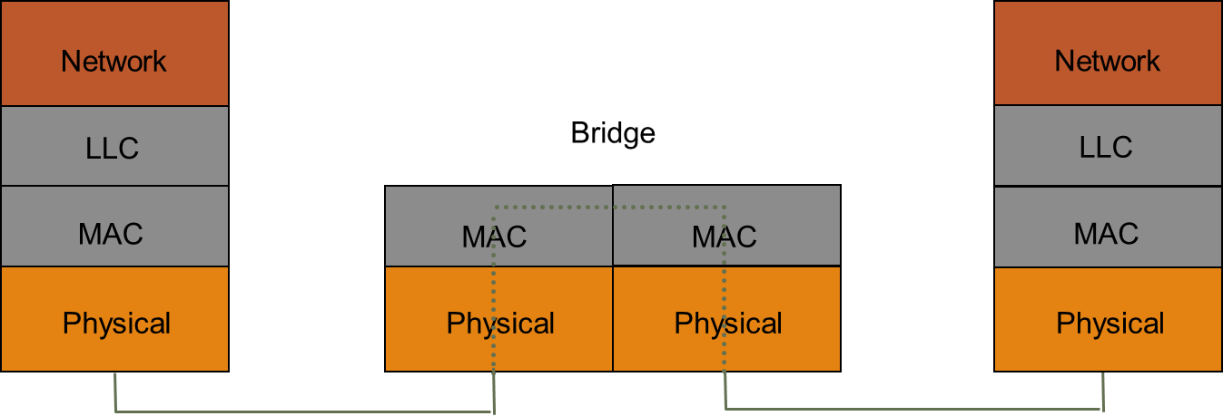
Bridges
A bridge operates in both the physical and the data link layers.
As a physical-layer device-
It regenerates the signal it receives
As a data link layer device,-
It can check the MAC addresses (source and destination) contained in the frame

Slide 58
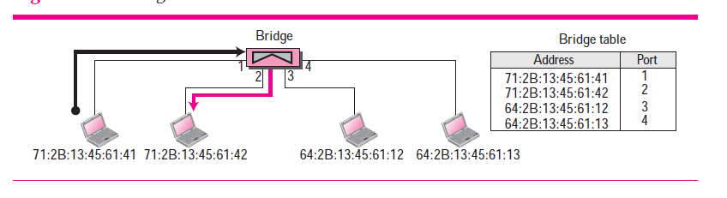
Bridges

Slide 59
Types of Bridges
There are two types of bridges which are widely used:
Transparent Bridges: These bridges are widely used in Ethernet LANs
Source Routing Bridges: These bridges are widely used in Token Ring LANs and FDDI(Fiber Distributed Data Interface) networks

Slide 60
Transparent Bridges
These bridges were defined by the 802.1d committee.
The term transparent refers to the fact that the stations are completely unaware of the presence of the bridges in the network
Thus introducing a bridge doesn’t require the stations to be configured.
Following are the functions of the transparent bridges:
Forward Frames from one LAN to another
Learn from frame movements which stations are attached to a given LAN
Avoid Loops in the topology

Slide 61
Bridge Learning
When frame arrives on one of the ports of the bridge, the bridge has to decide whether it has to forward the frame.
To do so it needs to maintain a table called as the forwarding table or forwarding database
Use table lookup, and
discard frame, if source & destination in same LAN
forward frame, if source & destination in different LAN
use flooding, if destination is unknown.
Use backward learning to build table
observe source address of arriving LANs
handle topology changes by removing old entries
Notes:
Backward learning : tables at each bridge gets modified by information from the incoming packets
The Basic process works as follows-
When a bridge receives a frame
-Compares Source address with each entry in the forwarding Table.
If entry do not exists then it adds to forwarding table (Source MAC & Port from which frame is received)
-Compares Destination address with each entry in the forwarding Table.
If entry is found then forwards the frame to the port indicated in the entry. If the port number entry is same as port number on which frame is received then No Forwarding and Frame is discarded.
- If the port entry is not found in the table then “flood” the frame on all ports except the one through which the frame was received.
From CISCO
Bridges and switches extend the effective length of a LAN. Bridges are capable of filtering frames based on any Layer 2 fields. For example, a bridge can be programmed to reject (not forward) all frames sourced from a particular network. Bridges are generally used to segment a LAN into a couple of smaller segments. Bridges generally have only a few ports for LAN connectivity, whereas switches generally have many

Slide 62
Example: How Table is built ?
S1
S2
S3
S4
S5
LAN1
LAN2
LAN3
B1
B2
Port 1
Port 2
Port 1
Port 2
Address Port
Address Port
Notes:
How entries are filled ?
Admin can record and load up during system start up. Not desirable
The Basic process works as follows- 6.11.1 Garcia
When a bridge receives a frame
-Compares Source address with each entry in the forwarding Table.
If entry do not exists then it adds to forwarding table (Source MAC & Port from which frame is received)
-Compares Destination address with each entry in the forwarding Table.
If entry is found then forwards the frame to the port indicated in the entry. If the port number entry is same as port number on which frame is received then No Forwarding and Frame is discarded.
- If the port entry is not found in the table then “flood” the frame on all ports except the one through which the frame was received.
Example: How Table is built

Slide 63
S1→S5
S1
S2
S3
S4
S5
S1 to S5
S1 to S5
S1 to S5
S1 to S5
LAN1
LAN2
LAN3
B1
B2
Port 1
Port 2
Port 1
Port 2
Address Port
Address Port
S1
1
S1
1

Slide 64
S3→S2
S1
S2
S3
S4
S5
S3→S2
S3→S2
S3→S2
S3→S2
S3→S2
LAN1
LAN2
LAN3
B1
B2
Port 1
Port 2
Port 1
Port 2
Address Port
Address Port
S1
1
S1
1
S3
2
S3
1
Notes:
Note: S3-> S2 in Lan3 is waste, since S2 lies in the Lan1 , but as per rule S3->S2 is forwarded into LAN3

Slide 65
S4→S3
Details of S4 will be recorded in both B1 and B2 because S3 and B1 are connected in bus topology, therefore if a packet is forwarded it is received by all the nodes connected to the LAN
S1
S2
S3
S4
S5
S4 S3
S4→S3
S4→S3
S4→S3
LAN1
LAN2
LAN3
B1
B2
Port 1
Port 2
Port 1
Port 2
Address Port
Address Port
S1
1
S1
1
S3
2
S3
1
S4
2
S4
2

Slide 66
S2→S1
S1
S2
S3
S4
S5
S2→S1
LAN1
S2→S1
LAN2
LAN3
B1
B2
Port 1
Port 2
Port 1
Port 2
Address Port
Address Port
S1
1
S1
1
S3
2
S3
1
S4
2
S4
2
S2
1
S2->S1 Traffic is completely isolated now,
What happens if S4->S2 now.
Note that bridges change collision domains.
Notes:
Traffic is completely isolated now. S2 traffic not forwarded to LAN2 , remains at LAN1 only (Because, both S2,S1 locations are known to B1).
So Now B2 will not learn where S2 is. Here Learning Stops, but nothing remains static.
Nothing stays static in real life. What if station moves from one LAN to other.
Bridges can adopt to Dynamics of the Network.
For each entry , a timer(of order some minutes) is maintained(time stars when entry made in the table).
With in the timer , if frame from a source is received and that entry exist in the table then timer is refreshed.
If for an existing entry timer expires then bridge removes the entry from the table.
When a bridge receives a frame from a station that was in say LAN1 and moved to LAN2 then relearning and entry is done in the Bridge.

Slide 67
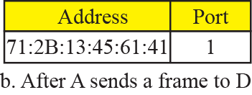
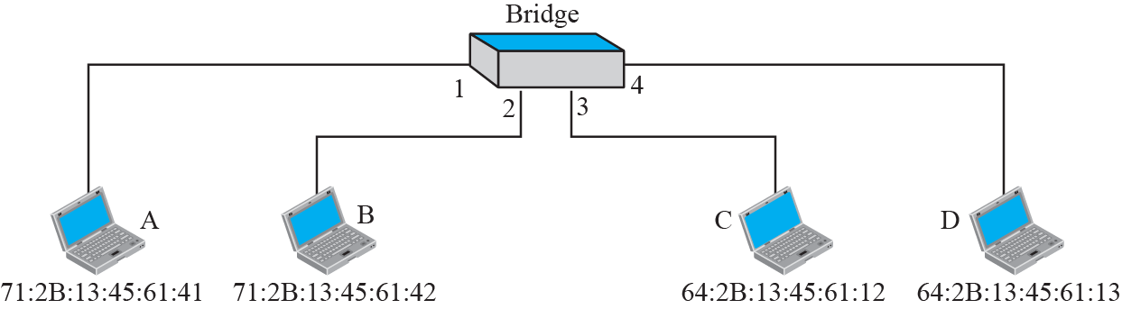
Example-Learning bridge

Slide 68
Adaptive Learning
Bridges can adopt to Dynamics of the Network
In a static network, tables eventually store all addresses & learning stops
In practice, stations are added & moved all the time
Introduce timer (minutes) to age each entry & force it to be relearned periodically
If frame arrives on port that differs from frame address & port in table, update immediately
Two-Layer Switch
A two-layer switch performs at the physical and data link layer; it is a sophisticated bridge with faster forwarding capability.
Notes:
A three-layer switch is a router, but a faster and more sophisticated.

Slide 69
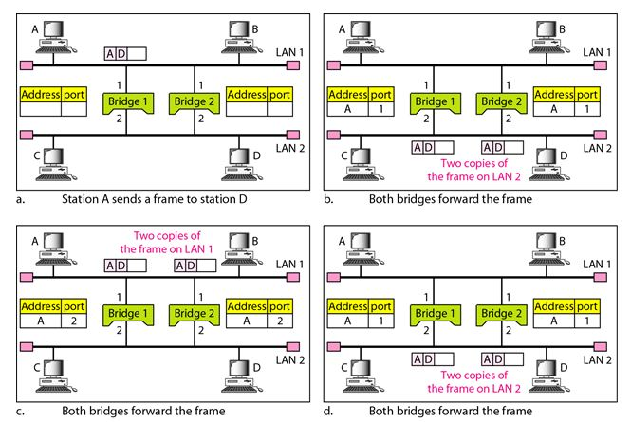
Problem: Loops in the topology
Even though redundant Bridge make the network more reliable, but can create loops in the system, which is very undesirable.
The spanning tree algorithm is used to create a loop less topology
Notes:
Transparent bridges work fine as long as there are no redundant bridges in the system. Systems administrators, however, like to have redundant bridges (more than one bridge between a pair of LANs) to make the system more reliable. If a bridge fails, another bridge takes over until the failed one is repaired or replaced. Redundancy can create loops in the system, which is very undesirable.
Even though redundant Bridge make the network more reliable, but can create loops in the system, which is very undesirable.
To solve the looping problem, the bridges use the spanning tree algorithm to create a loop less topology.

Slide 70
Routers
A router is a three-layer device; it operates in the physical, data link, and network layers.
physical layer device, it regenerates the signal it receives.
data link layer device, the router checks the physical addresses (source and destination).
network layer device, a router checks the network layer addresses(addresses in the IP layer)
A router can connect LANs/WANs/LAN and WAN together. So Router is a an internetworking device; it connects independent networks together to form an internetwork
A router is a three-layer (physical, data link, and network) device.
Notes:
Note that bridges change collision domains, but routers limit broadcast domains.

Slide 71
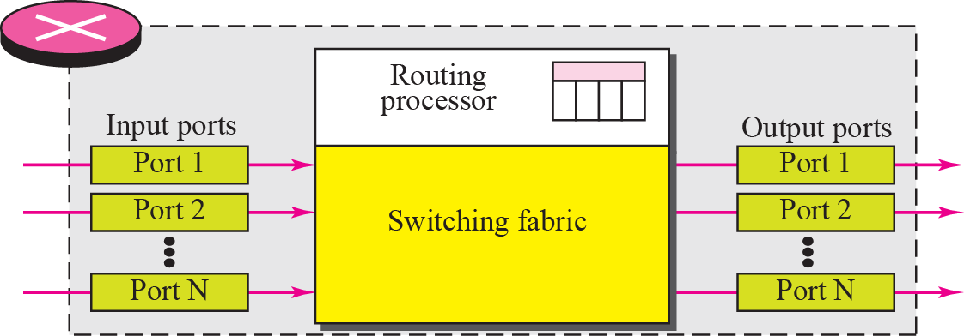
Structure of Router
Components :
Input ports, Output ports, the Routing processor, and the Switching fabric
Notes:
Structure of Router

Slide 72
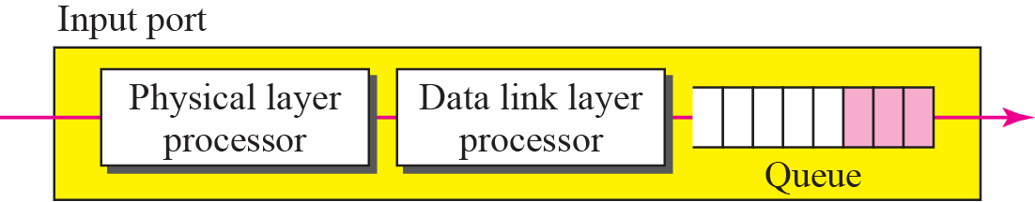
Input port
An input port performs the physical and data link layer functions of the router.
The bits are constructed from the received signal.
Decapsulated from the frame. Errors are detected and corrected
Packet is stored into input port buffer queue for further forwarding job.

Slide 73
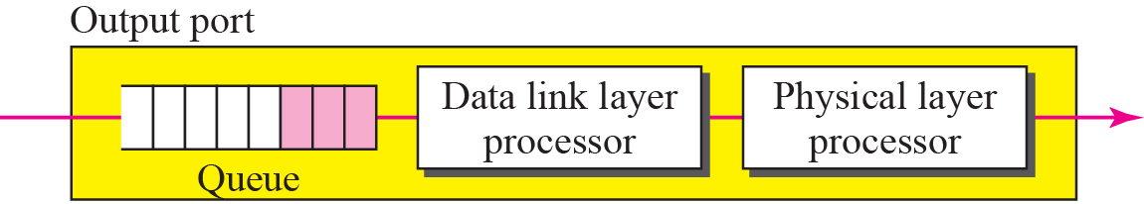
Output port
An output port performs the same functions as the input port, but in the reverse order
Once packet is forwarded from input port buffer to output port buffer
Outgoing packets are queued into output port buffer
The packet is encapsulated in a frame
Finally the physical layer functions are applied to the frame to create the signal to be sent

Slide 74
Routing Processor
The routing processor performs the functions of the network layer
The destination address is used to find the address of the next hop and, at the same time, the output port number from which the packet is sent out
This activity is sometimes referred to as table lookup because the routing processor searches the routing table.

Slide 75
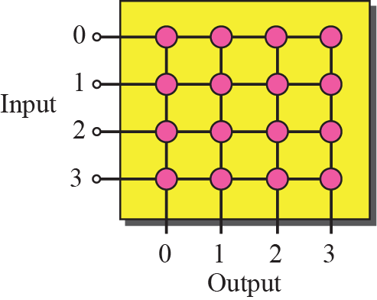
Crossbar switch
Switching fabric is responsible for moving the packet from the input queue to the output queue.
The simplest type of switching fabric is the crossbar switch.
A crossbar switch connects n inputs to n outputs in a grid, using electronic microswitches at each Crosspoint.
Similarly other kind of switches- Banyan Switch, Batcher-Banyan Switch

Slide 76
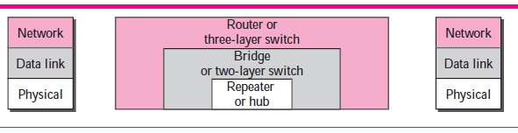
Connecting Devices and Layers
Notes:
Connecting Devices and Layers

Slide 77
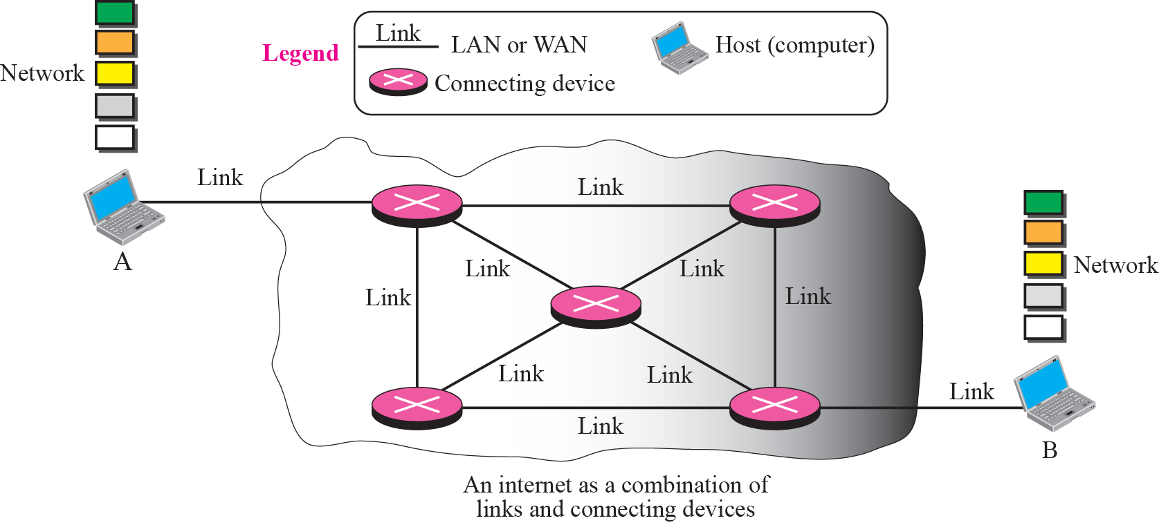
Switching
Figure :An imaginary small internet with a few networks and a few connecting devices
How data flows from A to B ? - Role of Routers. Switching Process
Notes:
Connection is switched from one port to another port

Slide 78
Switching
When a message reaches a connecting device, a decision needs to be made to select one of the output ports through which the packet needs to be send out
The connecting device acts as a switch that decides and connects one port to another port. This process is known as - Switching
Notes:
Connection is switched from one port to another port

Slide 79
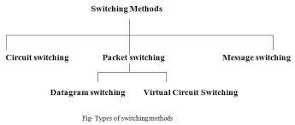
Types of Switching
Notes:
Following are the three ways to achieve Switching.- Circuit switching, Message Switching and Packet Switching(further divided as Virtural Circuit and datagram switching)
Traditionally, three methods of switching have been important: circuit switching,
packet switching, and message switching. The first two are commonly used today. The
third has been phased out in general communications but still has networking applications.
We can then divide today's networks into three broad categories: circuit-switched networks,
packet-switched networks, and message-switched. Packet-switched networks can funher
be divided into two subcategories-virtual-circuit networks and datagram networksas
In message switching, each switch stores the whole message and forwards it to the next switch. Although, we don't see message switching at lower layers,
it is still used in some applications like electronic mail (e-mail). We will not discuss this topic in this book (DCN –chapter 8, page 214, pdf page 251).

Slide 80
Circuit Switching
A physical circuit (or channel) is established between the source and destination of the message before the delivery of the message
Then the entire message is transformed from the source to the destination without being divided into packets
The source can then inform the network that the transmission is complete, which allows the network to open all switches and use the links and connecting devices for another connection
Implemented mostly at the physical layer; not at the network layer
Example:Early telephone systems in which the path was established between a Caller and a Callee, when the Caller dialed the telephone number of the Callee
Notes:
One solution to the switching is referred to as circuit switching, in which a physical circuit (or channel) is established between the source and destination of the message before the delivery of the message. After the circuit is established, the entire message,
is transformed from the source to the destination. The source can then inform the network that the transmission is complete, which allows the network to open all switches and use the links and connecting devices for another connection. The circuit
switching was never implemented at the network layer; it is mostly used at the physical layer.
Circuit switched communication, for example the public switched telephone network, ISDN, SONET/SDH and optical mesh networks, are intrinsically connection-oriented communications systems. Circuit mode communication provides guarantees that data will arrive with constant bandwidth and at constant delay and in-order delivery of a bit stream or byte stream is provided. The switches are reconfigured during a circuit establishment phase.

Slide 81
Packet Switching
The network layer in the Internet today is a packet-switched network.
–The message is first divided into manageable chunks or packets at Source(upper layers) & transmitted.
- The Routers need to decide how to route the packets to the final destination.
- The packets are assembled at the destination.
Today, a packet-switched network can use two approaches-
Datagram Approach -Independent path (Connectionless)
Virtual Circuit Approach – Fixed path (Connection Oriented)
Notes:
The circuit (or channel) is establishment is not required
The network layer in the Internet today is a packet-switched network. In this type of network, a message from the upper layer is divided into manageable packets and each packet is sent through the network. The source of the message sends the packets one by one; the destination of the message receives the packets one by one. The destination waits for all packets belonging to the same message to arrive before delivering the message to the upper layer. The connecting devices in a packet-switching network still need to decide how to route the packets to the final destination. Today, a packet-switched network can use two different approaches to route the packets: the datagram approach and the virtual circuit.

Slide 82
Packet Switching
Datagram Approach
The manageable chunks or packets are called as Datagrams
The packet-switched network layer of the Internet was designed as-
Connectionless Service but tendency is towards Connection oriented
Notes:
The network layer is designed as a packet-switched network. This means that the
packet at the source is divided into manageable packets, normally called datagrams.
Individual datagrams are then transferred from the source to the destination. The
received datagrams are assembled at the destination before recreating the original message.
The packet-switched network layer of the Internet was originally designed as a
connectionless service, but recently there is a tendency to change this to a connectionoriented
service.

Slide 83
Packet Switching-Connectionless Service
–The manageable chunks or packets are called as Datagrams
– The network layer protocol treats each packet independently.
– Each packet has no relationship to any other packet.
– Datagram of a message may or may not travel the same path.
– Initially Internet was decided to make Connectionless Service to keep the
design simple,
Notes:
When the network layer provides a connectionless service, each packet traveling in
the Internet is an independent entity; there is no relationship between packets belonging
to the same message. The switches in this type of network are called routers.
A packet belonging to a message may be followed by a packet belonging to the same message or
a different message. A packet may be followed by a packet coming from the same or
from a different source.
Each packet is routed based on the information contained in its header: source and
destination address.

Slide 84
Packet Switching-Connectionless Service
Forwarding process in Connectionless Service Network
The packet contained in its header: source, destination address and other information
Packet routing is based on the destination address.
Notes:
Each packet is routed based on the information contained in its header: source and
destination address. The destination address defines where it should go; the source
address defines where it comes from. The router in this case routes the packet based
only on the destination address. The source address may be used to send an error message
to the source if the packet is discarded. Figure shows the forwarding process in
a router in this case. We have used symbolic addresses such as A and B.

Slide 85


Packet Switching-Connectionless Service
Delay in Connectionless Network
Notes:
Delay In Connectionless Network
If we ignore the fact that the packet may be lost and resent and also the fact that the destination
may be needed to wait to receive all packets, we can model the delay as shown
in Figure

Slide 86
Packet Switching-Connection Oriented Service
The manageable chunks or packets are called as Datagrams
There is a relation between all packets belonging to a message
A virtual connection should be set up to define the path for the datagrams
Packet contains- Source , Destination Address , Virtual Circuit identifier( VCI)
VCI determines path through which packet must pass through
.
Is only VCI enough ?
Is still Source, Destination addresses required?
Notes:
In version IP6, the flow label has been directly added to the format of the IPv6 datagram to allow us to use IPv6 as connection-oriented protocol.(chapter 27 IPv6 page789)
To a router, a flow is a sequence of packets that share the same characteristics, such as traveling the same path, using the same resources, having the same kind of security,
and so on. A router that supports the handling of flow labels has a flow label table.
After connection setup, the datagrams can follow the same path. In this type of service, not only must the packet contain the source and destination addresses, it must also contain a flow label, a virtual circuit identifier that defines the virtual path the packet should follow.
When requesting a connection-oriented service in these networks, at the connection setup time the user specifies the QoS that is required by the user application. The network can then determine whether it has sufficient resources available to handle that connection with the requested QoS, and the network can then set aside these resources for the connection. In order to undertake these tasks, the network retains “state” information about existing connections.
Is only VCI enough ? Why still Source, Destination addresses required.
Although it looks as though the use of the label may make the source and destination addresses useless, one reason is that-the parts of the Internet that use connectionless service at the network layer still keep these addresses for several reasons. i.e. One reason is that part of the packet path may still be using the connectionless service. Another reason is that the protocol at the network layer is designed with these addresses and it may take a while before they can be changed.
Transport layer connection mode communication.
Connection-oriented transport layer protocols provide connection-oriented communications over connectionless communications systems. A connection-oriented transport layer protocol, such as TCP, may be based on a connectionless network layer protocol (such as IP), but still achieves in-order delivery of a byte-stream, by means of segment sequence numbering on the sender side, packet buffering and data packet reordering on the receiver side. The sequence numbering requires two-way synchronization of segment counters during a three-step connection establishment phase.
Datalink and network layer virtual circuit switching
In a connection-oriented packet switched data link layer or network layer protocol, all data is sent over the same path during a communication session. The protocol identifies traffic flows only by a channel/data stream number, often denoted virtual circuit identifier (VCI), rather than by complete routing information for each packet (source and destination addresses) used in connectionless datagram switching such as conventional IP routers. In connection-oriented communication, routing information may be provided to the network nodes during the connection establishment phase, where the VCI is defined in tables in each node. Thus, the actual packet switching and data transfer can be taken care of by fast hardware, as opposed to slow software based routing. Typically, this connection identifier is a small integer (10 bits for Frame Relay, 24 bits for ATM, for example). This makes network switches substantially faster (as routing tables are just simple look-up tables, and are trivial to implement in hardware). The impact is so great, in fact, that even characteristically connectionless protocols, such as IP traffic, are being tagged with connection-oriented header prefixes (e.g., as with MPLS, or IPv6's built-in Flow ID field^{[citation needed]}).
ATM and Frame Relay, for example, are both examples of a connection-oriented, unreliable data link layer protocols. There are also reliable connectionless protocols as well, such as AX.25 network layer protocol
VCI determines path through which packet must pass through.

Slide 87
Packet Switching-Connection Oriented Service
Forwarding process in a connection-oriented network
How Labels entries are made into the Routing table ?
Notes:
To create a connection-oriented service, a three-phase process is used: setup, data
transfer, and teardown. In the setup phase, the source and destination addresses of the
sender and receiver is used to make table entries for the connection-oriented service. In
the teardown phase, the source and destination inform the router to delete the corresponding
entries. Data transfer occurs between these two phases.

Slide 88
Packet Switching-Connection Oriented Service
Virtual Circuits – a three-phase process : setup, data transfer, and teardown
The Setup Phase uses two auxiliary packets named – Request & Acknowledgement packets
.
Sending Request packet
Notes:
To create a connection-oriented service, a three-phase process is used: setup, data transfer, and teardown. In the setup phase, the source and destination addresses of the sender and receiver is used to make table entries for the connection-oriented service. In the teardown phase, the source and destination inform the router to delete the corresponding entries. Data transfer occurs between these two phases.

Slide 89
Packet Switching-Connection Oriented Service
Setup Phase uses two auxiliary packets named – Request & Acknowledgement packets.
Setup Acknowledgment Packet
Notes:
Setup Phase
In the setup phase, a router creates an entry for a virtual circuit. For example, suppose
source A needs to create a virtual circuit to destination B. Two auxiliary packets need to
be exchanged between the sender and the receiver: the request packet and the acknowledgment packet.
Request packet A request packet is sent from the source to the destination. This auxiliary
packet carries the source and destination addresses. Figure 4.8 shows the process.
1. Source A sends a request packet to router R1.
2. Router R1 receives the request packet. It knows that a packet going from A to B
goes out through port 3. Signaling protocols such as RSVP Resource Reservation Protocol (RSVP) as a signalling
protocol that helps IP create a flow and makes a resource reservation.
For the moment, assume that it knows the output port.
The router creates an entry in its table for this virtual circuit, but it is only able to fill three of the four columns. The router assigns the incoming port (1) and chooses
an available incoming label (14) and the outgoing port (3). It does not yet know the outgoing label, which will be found during the acknowledgment step. The router
then forwards the packet through port 3 to router R3.
3. Router R3 receives the setup request packet. The same events happen here as at
router R1; three columns of the table are completed: in this case, incoming port
(1), incoming label (66), and outgoing port (2).
4. Router R4 receives the setup request packet. Again, three columns are completed:
incoming port (2), incoming label (22), and outgoing port (3).
5. Destination B receives the setup packet, and if it is ready to receive packets from A, it
assigns a label to the incoming packets that come from A, in this case 77. This
label lets the destination know that the packets come from A, and not other
sources.

Slide 90
Packet Switching-Connection Oriented Service
Data Transfer phase
Flow of one packet in an established virtual circuit

Slide 91
Packet Switching-Connection Oriented Service
Teardown Phase
After sending all packets from A to B
A sends a special packet called a teardown packet.
Destination B responds with a confirmation packet.
All routers delete the corresponding entry from their tables.
Notes:
Permanent (Permanent Virtual Circuit (PVC)) ,﻿ i.e., circuits permanently built by the network administrator.
Switched (Switched Virtual Circuit (SVC)), i.e., virtual circuits that are created dynamically as the need arises. An SVC is created with the help of signalizing protocols that can be used for communicating between the user and the network itself. The network signalizes to the user various events that can be used for network monitoring and administration. SVC communication consists of two steps: creating the virtual circuit and using it for communication.

Slide 92
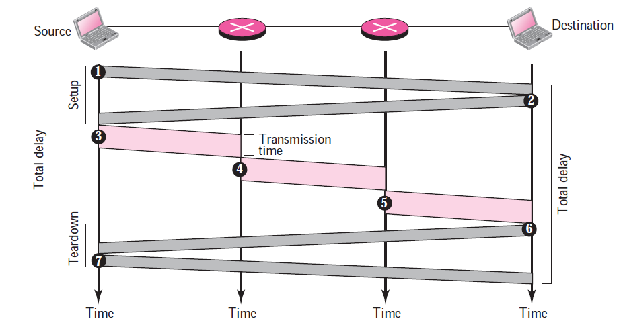
Packet Switching-Connection Oriented Service
Delay in Connection Oriented Network
Notes:
Permanent (Permanent Virtual Circuit (PVC)) ,﻿ i.e., circuits permanently built by the network administrator.
Switched (Switched Virtual Circuit (SVC)), i.e., virtual circuits that are created dynamically as the need arises. An SVC is created with the help of signalizing protocols that can be used for communicating between the user and the network itself. The network signalizes to the user various events that can be used for network monitoring and administration. SVC communication consists of two steps: creating the virtual circuit and using it for communication.

Slide 93
END OF CHAPTER
Notes:
END OF CHAPTER

