Slide 1

SRI INDU COLLEGE OF ENGINEERING & TECHNOLOGY
UGC AUTONOMOUS INSTITUTION
PERMENENTLY AFFILIATED TO JNTU
DEPARTMENT OF INTERNET OF THINGS
ONLINE FOOD ORDERING SYSTEM
SUBMITTED BY
G.PRABHAS-22D41A6925
G.SAICHARAN-22D41A6919
P.HAREESH-22D41A6948
K.VIGNESHWAR REDDY-23D45A6903
PRESENTED TO
R.RACHEL
M.RAJ KUMAR

Slide 2
ABSTRACT
The Online Food Ordering System is a project designed to streamline the process of ordering food online. Using ReactJS for the frontend, JavaScript for scripting functionalities, and Node.js for server-side operations, this system ensures a user-friendly experience for customers. The interfaces are designed to be simple and easy to navigate, making it accessible to anyone looking to order food over the internet and with this system, users can easily browse through menus, select their desired items, and place orders seamlessly. The integration of a reliable database allows the system to keep track of user details, previous orders, and restaurant information. This not only enhances convenience but also enables users to track the status of their orders and estimated delivery times.By leveraging frontend technologies like ReactJS and backend support from Node.js, this project aims to revolutionize the online food ordering experience, making it hassle-free and enjoyable for everyone involved.

Slide 3
INTODUCTION TO THE PROJECT
In today's digital age, the convenience of online services has become paramount, and the food industry is no exception. This project presents an Online Food Ordering System with a strong emphasis on front-end web development. Designed to provide an engaging and user-friendly experience, this system allows users to browse, customize, and order food from their ease. The system leverages modern web technologies such as HTML5, CSS3, and JavaScript, with frameworks like React and Bootstrap, to create a visually appealing and responsive interface. Users can explore a diverse menu, customize their orders, and manage their selections through an interactive shopping cart that updates in real-time. The design ensures that the platform is accessible and functional across various devices, from desktops to smartphones. While the focus is primarily on the front end, the backend is kept minimal to streamline the process. Essential functionalities such as order submission and basic data storage are implemented to support the core operations. This approach simplifies the system while ensuring reliability and efficiency in handling user orders. In summary, this Online Food Ordering System highlights the capabilities of front-end web development in creating a seamless and enjoyable user experience. By integrating modern design principles and technologies, the project aims to meet the growing demand for convenient online food services, making it an ideal solution for both users and restaurant owners

Slide 4
MOTIVATION
The motivation behind creating an online food ordering system is driven by the increasing demand for convenience in the food industry. As digital platforms become essential in daily life, customers seek efficient ways to order and pay for meals from anywhere, leading to the development of streamlined ordering processes. JavaScript, HTML, CSS, and databases are foundational technologies used in building these systems. JavaScript adds interactivity to the user interface, while HTML and CSS ensure visually appealing and responsive designs. Databases manage vast amounts of data, including menus, customer profiles, orders, and payments, enabling efficient information retrieval and processing. These technologies enable the system to offer features like real-time menu updates, personalized recommendations, secure payment processing, order tracking, and feedback mechanisms. This enhances the overall user experience by providing convenience, choice, and transparency throughout the ordering journey. Moreover, the system provides valuable insights into customer behavior and preferences, empowering restaurants to optimize their offerings and marketing strategies. By embracing digital solutions, businesses can better cater to modern consumer needs, driving customer satisfaction and business growth in an increasingly digital landscape

Slide 5
EXISTING WORK
The literature on online food ordering systems is extensive and multifaceted, reflecting the rapid evolution of technology in the food industry. Numerous studies have explored various aspects of these systems, including user experience, technological frameworks, business models, and the impact on traditional food service establishments. Reviews typically highlight the benefits of convenience and accessibility for consumers, the potential for increased revenue and efficiency for restaurants, and the challenges related to logistics, customer satisfaction, and market competition. Existing work often emphasizes the importance of user interfaces, mobile app functionality, payment security, and data analytics in optimizing the online food ordering experience. Additionally, academic research often delves into the role of emerging technology such as AI in enhancing system capabilities and addressing industry challenges. Overall, the literature underscores the significant influence of online food ordering systems on reshaping the food service landscape and driving digital transformation within the industry.

Slide 6
IMPLEMENTATION
The implementation of the METMS involves the development of both frontend and backend components, as well as their integration with the database. The following steps outline the implementation process:
Backend Development: o Node.js ▪ Set up the Node.js environment and initialize the project. ▪ Create Express.js routes for handling API requests. ▪ Implement controllers for business logic and data manipulation. ▪ Set up MongoDB using Mongoose for database interaction. ▪ Implement authentication and authorization mechanisms.
. Frontend Development: o React.js: ▪ Set up the React environment using Create React App. ▪ Design and implement components for the user interface. ▪ Integrate Redux for state management. ▪ Implement forms for user input and data display components. ▪ Use Axios for making API requests to the backend.
Database Integration: o MongoDB: ▪ Design the database schema using Mongoose models. ▪ Implement CRUD operations for managing expenses and user data

Slide 7
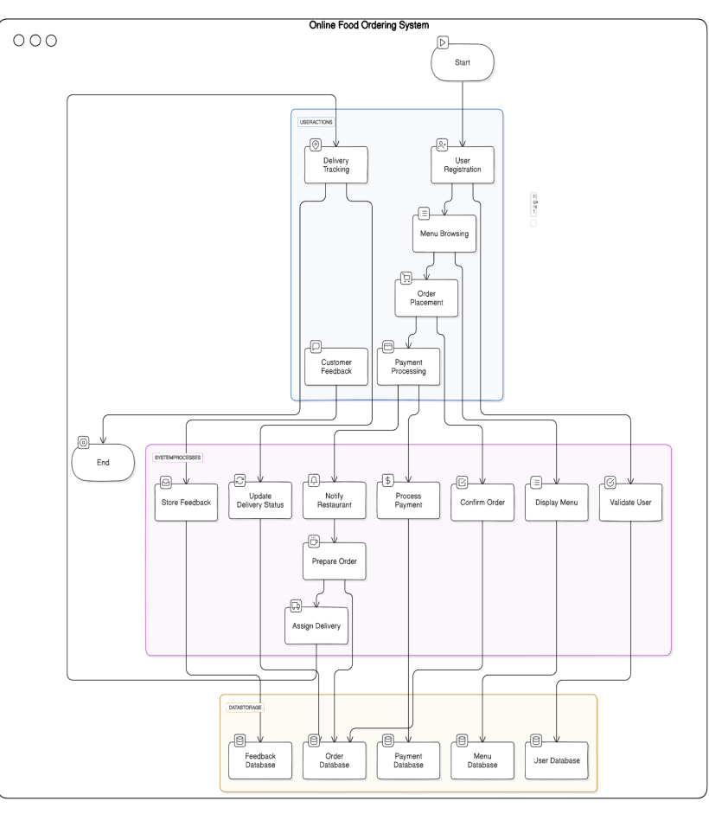
DATA FLOW DIAGRAM

Slide 8
TECHNOLOGY DESCRIPTION
The technology stack used for developing this project is MERN stack which is the best full stack technology to develop a website now a days. It contains the following
1. MongoDB: - Description: A NoSQL database that stores data in JSON-like documents. - Use in Project: Storing user expenses, budget data, and historical records. - Advantages: Scalability, flexibility in data modeling, and ease of use.
2. Express.js: - Description: A web application framework for Node.js. - Use in Project: Creating RESTful APIs to handle HTTP requests and responses. - Advantages: Simplifies routing, middleware integration, and server-side logic.
3. React.js: - Description: A JavaScript library for building user interfaces. - Use in Project: Developing the frontend for an interactive and dynamic user experience. - Advantages: Component-based architecture, fast rendering with Virtual DOM, and rich ecosystem.
4. Node.js: - Description: A JavaScript runtime built on Chrome's V8 engine. - Use in Project: Running the backend server and executing JavaScript on the server-side. - Advantages: Non- blocking I/O, event-driven architecture, and large community support. The Integrated development environment we used for developing our project is
5. Visual Studio Code: - Description: A free, open-source code editor with support for various programming languages and tools. - Use in Project: Writing, debugging, and maintaining the codebase. - Advantages: Intuitive interface, powerful extensions, and integrated Git support

Slide 9
REQUIREMENTS
Software Requirements:
Languages:Html,CSS,React.js,Javascript,Node.js
Database: MongoDB
Tools/IDE: Visual Studio Code
Hardware Requirements:
System Specifications: (RAM & Hard disk): 4GB RAM
Operating System: Windows
Processor: Intel i5

Slide 10
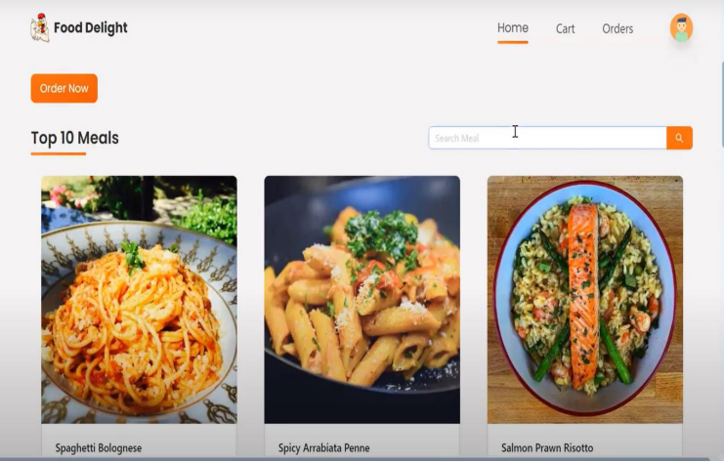
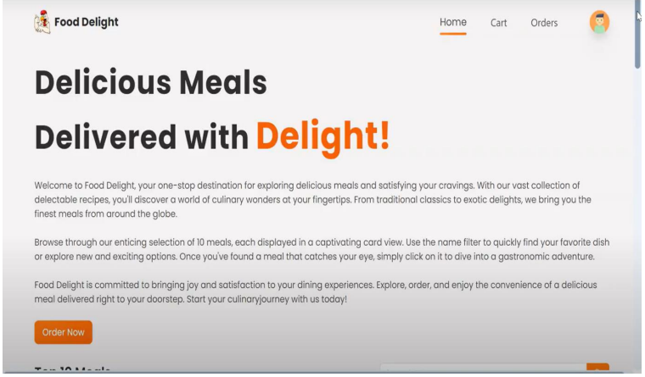
HOME PAGE

Slide 11
CONCLUSION
In conclusion, the online food ordering system represents a comprehensive solution designed to revolutionize the way people discover, order, and enjoy food. Through meticulous planning, innovative design, and robust implementation, the project has successfully addressed key challenges in the food industry, offering users a seamless and convenient platform to satisfy their culinary cravings.
The project's user-friendly interface, intuitive navigation, and personalized features have elevated the online food ordering experience, making it accessible to a wide range of users. From browsing menus to placing orders and tracking deliveries, every step of the process has been optimized to ensure efficiency, transparency, and satisfaction.
Moreover, the project's focus on reliability, security, and scalability has laid a solid foundation for future growth and expansion. By leveraging cutting-edge technologies and best practices, the platform is well-equipped to handle increasing user demand, adapt to evolving trends, and deliver exceptional service on a global scale.

Slide 12
REFERENCES
Websites and Platforms
Stack Overflow
• A valuable resource for troubleshooting coding issues and finding community support.
2. GitHub
• Platform for hosting and sharing code repositories, useful for version control and collaboration

Slide 13

QUERIES

Slide 14
THANKING YOU

