Slide 1

Lending Club Case Study Through Exploratory Data Analysis
-Submitted By,
Vishnu Vardhan Gudla

Slide 2
Lending Club:
Lending Club is the largest online loan marketplace, facilitating personal loans, business loans, and financing of medical procedures.
Borrowers can easily access lower interest rate loans through a fast online Interface.
Problem Statement:
Use Exploratory Data Analysis to understand how consumer attributes and loan attributes influence the tendency of default.
Business Objectives:
Identify Risky loan applicants to reduce credit loss using EDA
Understand the driving factors behind loan default, i.e., the variables which are strong indicators of default. The company can utilize this knowledge for its portfolio and risk assessment.

Slide 3
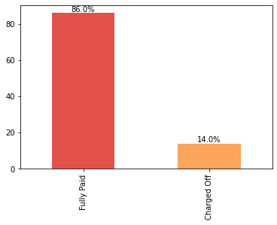
Analyzing Target feature Loan_Status
Observation:
14% of the Lending Club loans are defaulted
lending club recovered 86% of loans successfully from year 2007 to 2011

Slide 4
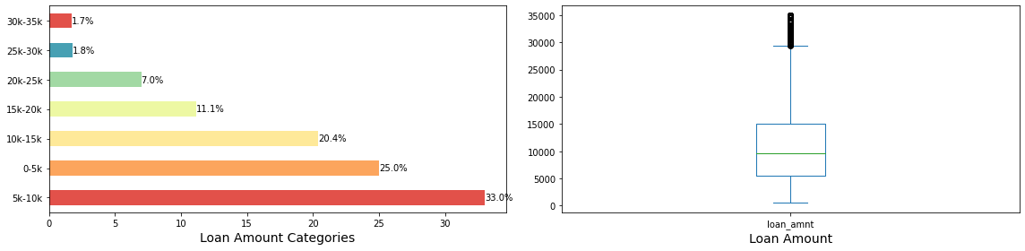
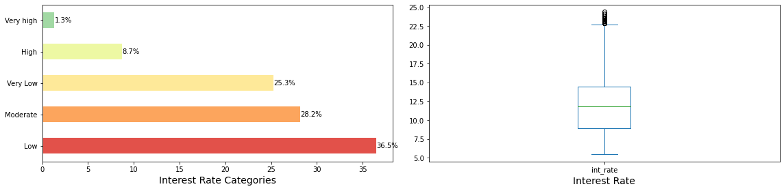
Univariate Analysis
Observation:
33 % of the total loans fall under 0-5K loan amount category Interest rates of the most lending club loans are low.

Slide 5
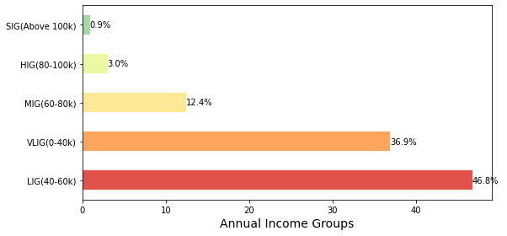
Univariate Analysis
Observation:
People under Low Income Group (LIG) applied for maximum (47%) of loans

Slide 6
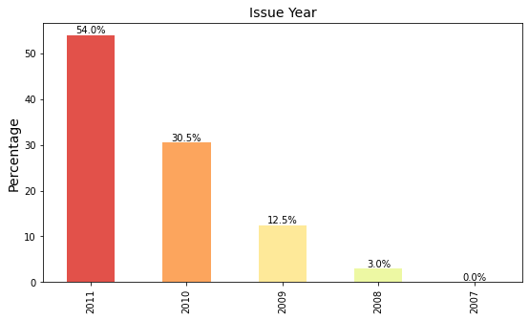
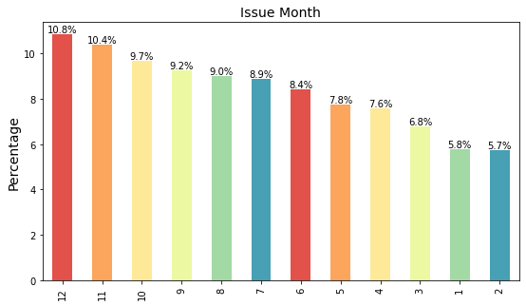
Univariate Analysis
Observation:
Maximum number ( 54% ) of the loans are issued in the year 2011.
Observation:
Maximum number ( 11% ) of the loans are issued in the month of December.

Slide 7
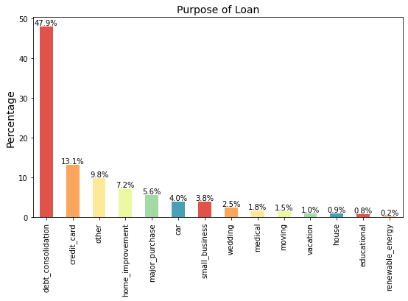
Univariate Analysis
Observation:
Maximum number ( 54% ) of the lending club loans are applied for the purpose of debt consolidation.

Slide 8
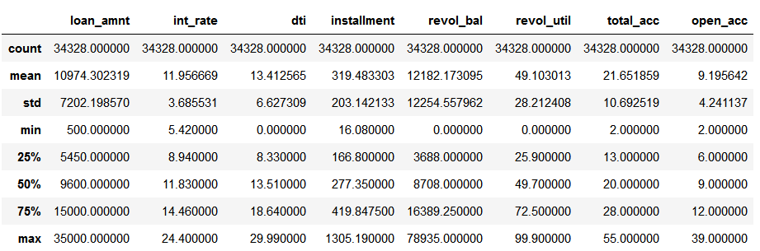
Univariate Analysis for Numerical Variables
Observation:
Loan Amount:
75% of the loans have an loan amount below 15000 dollars.
mean is less the median, which indicates that the loan amount data is negatively skewed.
Interest Rate:
Majority of the loans have an interest rate between 9-12%
Mean and Median are almost similar, which indicates zero skew and data following perfect normal distribution
Debt-to-Income Ratio: ranges between 0 and 30 with inter quartile range of 10
Installment: The IQR is 253 and mean greater than median, indicating the data is positively skewed.

Slide 9
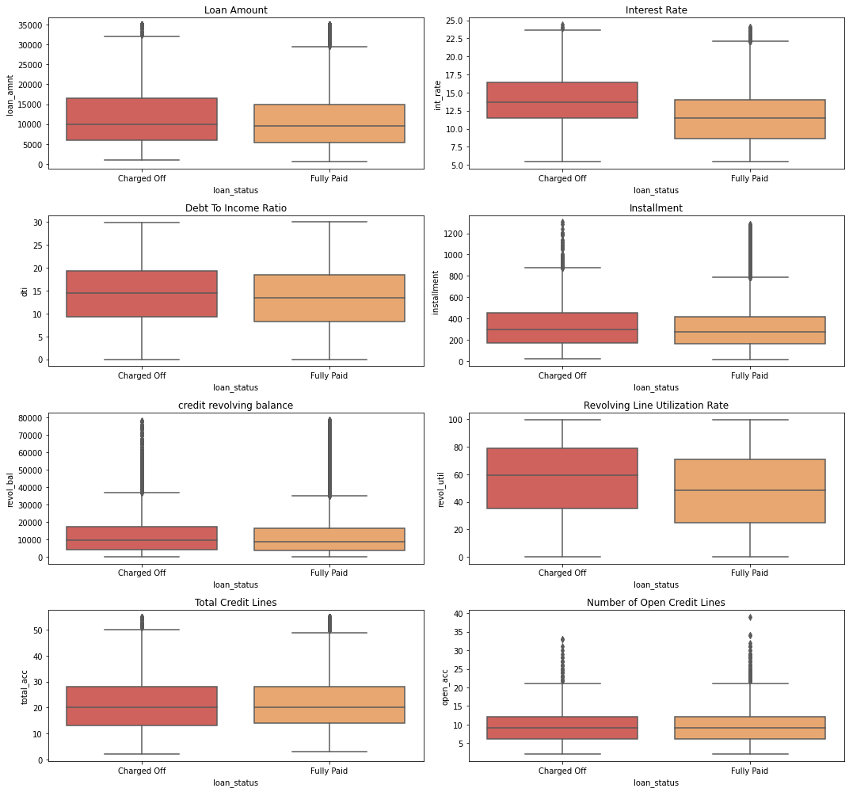
Bivariate Analysis for Numerical Variables

Slide 10
Bivariate Analysis for Numerical Variables

Slide 11
Univariate Analysis for Numerical Variables
Observation:
After analyzing the above numerical columns with loan status, the major reasons for loan Charged Off/default are:
Higher Loan amount
Interest Rate
Higher Debt-to-Income Ratio
Higher Revolving line Utilization rate

Slide 12
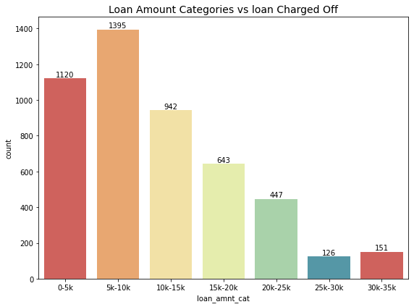
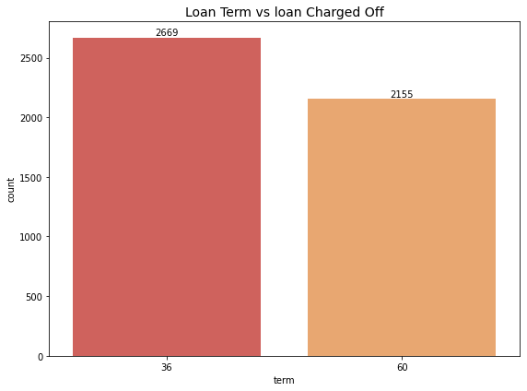
Bivariate Analysis
Observation:
The loan Charged Off/default happens when:
loan amount in range 5-10K
loan term is less (3 years)

Slide 13
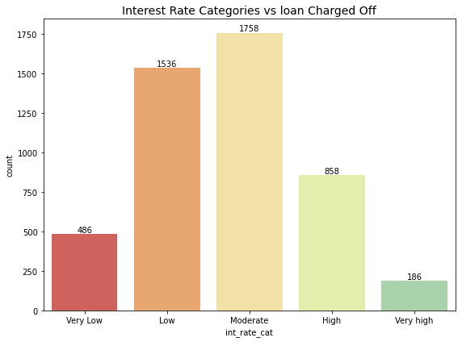
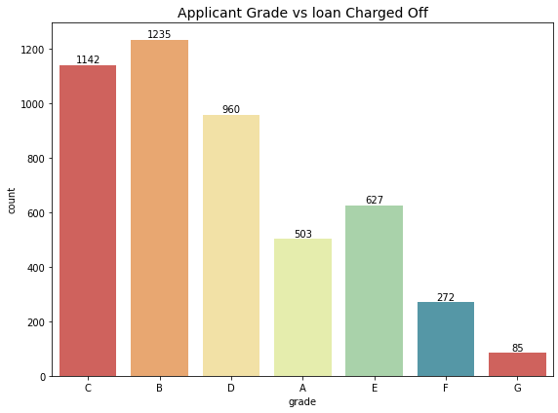
Bivariate Analysis

Slide 14
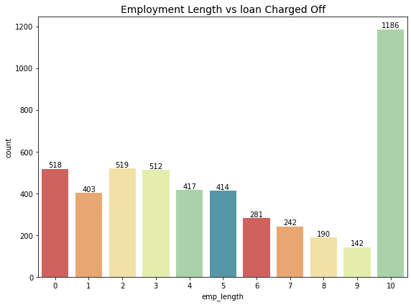
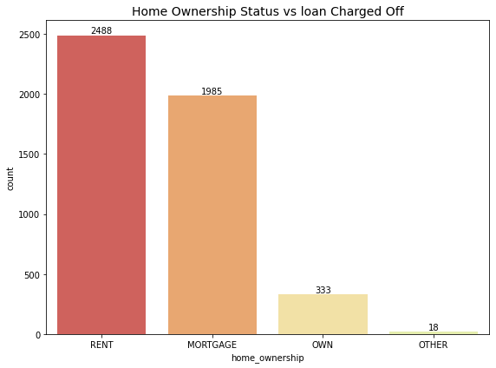
Bivariate Analysis

Slide 15
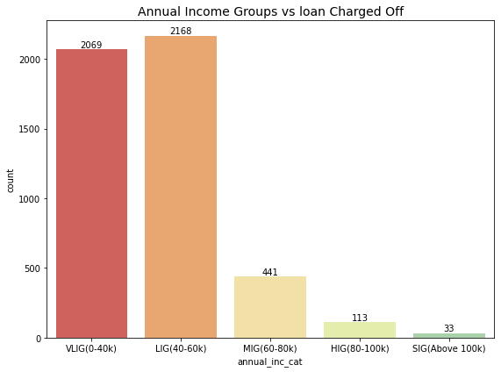
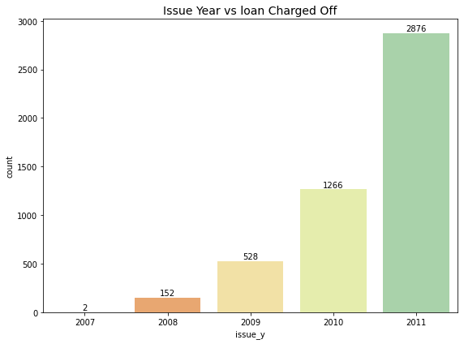
Bivariate Analysis

Slide 16
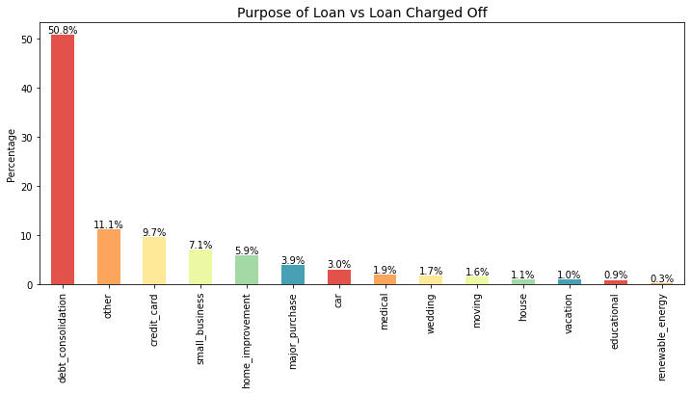
Bivariate Analysis

Slide 17
Bivariate Analysis
Observations: After analyzing the above categorical columns with loan status, the loan Charged Off/default happens when:
loan amount in range 5-10K
loan term is less (3 years)
Interest Rate is Moderate/low (More loans are aprroved with low/moderate interest rates)
Applicants belong to Grades B and C
Applicants have more than 10 years of employment experience (More loans are approved for higher cadre employee).
Applicants living in rented houses and have house/property mortgage.
Applicants belong to Low and very Low income groups.
Loans which are not properly verified are defaulted more.
Most of the loans are defaulted in the year 2011 and in the month of december.
loans of the applicants who have done 1 or 2 inquiries in the last 6 months.
loans applied by employess from US Army are defaulted more when compared to other organizations (More loans are approved for US Army employees).
Loans applied for debt consolidation purpose defaulted more.

Slide 18
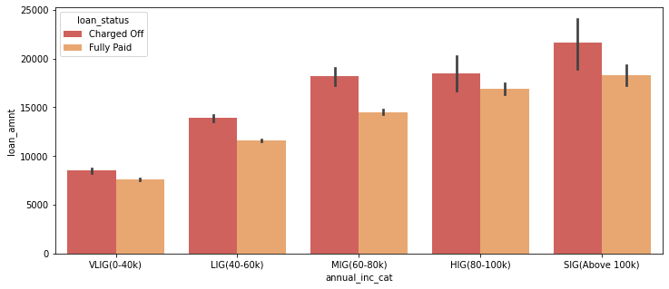
Bivariate Analysis

Slide 19
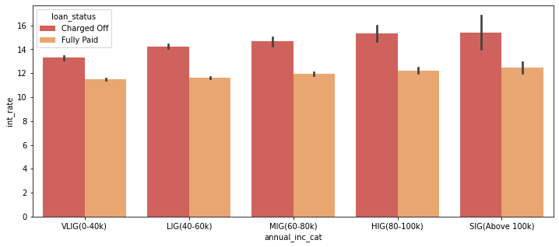
Bivariate Analysis

Slide 20
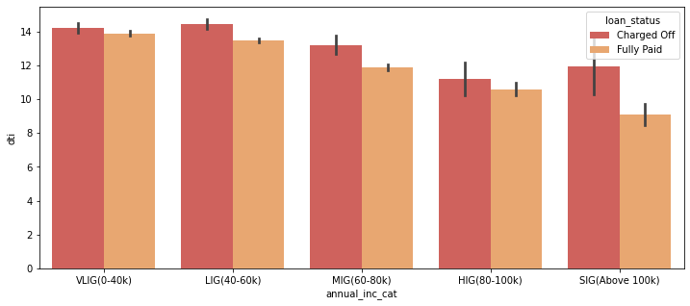
Bivariate Analysis

Slide 21
Bivariate Analysis
Observations: After analyzing the above categorical columns with loan status, the loan Charged Off/default happens when:
Applicants belonging to higher income groups (MIG-SIG) taking large amounts of loans.
As Applicants belonging to Superior Income geoups take large amounts of loans, their monthly installment is also high.
As Loans corresponding to VLIG and LIG have higher DTI ratio.
Applicants belonging to higher income groups with more lines of credit defaulted more.
Applicants belonging to MIG having more than 10 open lines of credit defaulted more.

Slide 22
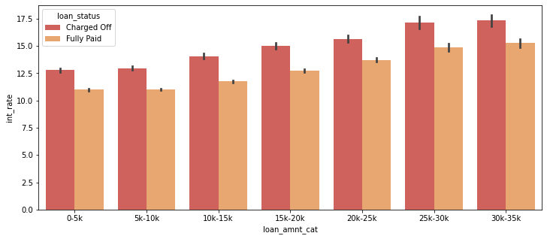
Bivariate Analysis

Slide 23
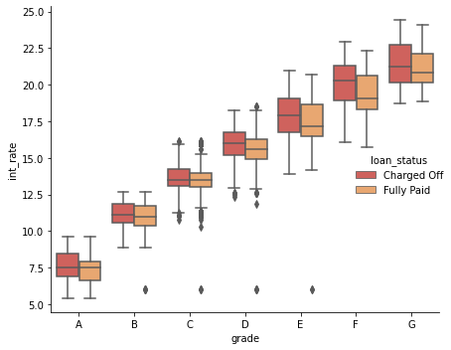
Bivariate Analysis
Observation:
The loan Charged Off/default happens when:
Applicants belonging to lower grade (F and G) with higher loan amount.
Interest Rates are higher for applicants belonging to lower grade (F and G)

Slide 24
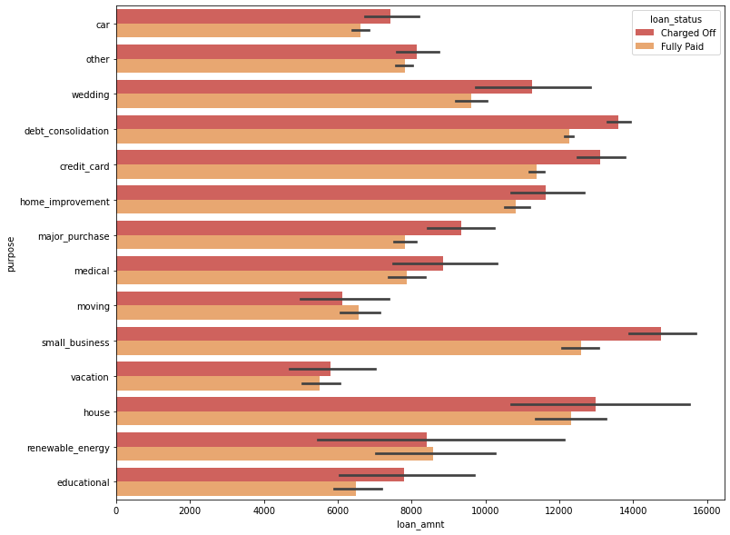
Bivariate Analysis
Observation:
The loan Charged Off/default happens when:
Small Business and Debt Consolidation with higher average loan amount

Slide 25
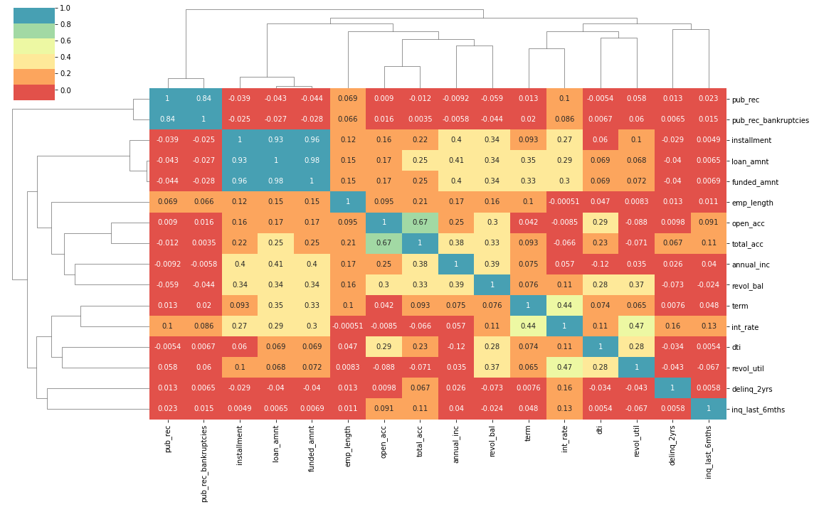
Correlation Analysis

Slide 26
Correlation Analysis
Observation:
Correlation between Interest rate and revolving line utilization rate is 0.47, which indicates that Lending club is charging higher interest rates for riskier loan applicant
Correlation between loan amount and credit Revolving Balance is 0.35, which indicates that lending club is approving higher amount loans for applicants with higher credit revolving balance (Risk)

Slide 27
Recommendations
Recommendations:
Stop – approving loans where Loan amount/income is higher
Reduce – number of approvals where purpose is Debt Consolidation and small business or increase interest rates
Stop – approving loans approving higher amount loans for applicants with higher credit revolving balance (Risk)
Reduce-approving loans to people with employment experience greater than 10 years
Reduce-approving loans to US government based organizations
Stop- approving loans to people with higher number of inquires (low credit score) for higher loan amounts

