Slide 1
Contract Obligation
High level technical objectives (my understanding)
Dataset - Atticus project and CUAD dataset
Attention based model frameworks
Demo - Fine-tuning with pre trained models
Extending on current work and alternatives
Challenges
Resources

Slide 2
High level technical objectives
Required to pick out certain clauses from a document (multiple pages), potentially reducing amount of human review
Understand model metrics based on type of clauses
Automate workflows/ manual review process

Slide 3
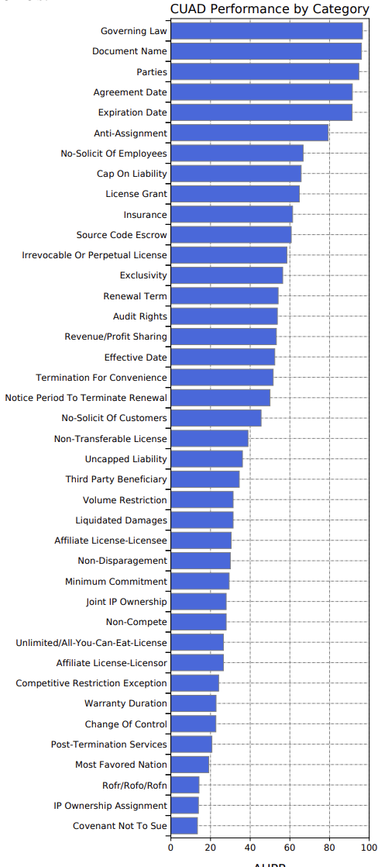
Dataset - Atticus project and CUAD dataset
Atticus Project released the Contract Understanding Atticus Dataset (CUAD) - https://www.atticusprojectai.org/
Consists of over 500 contracts
Carefully labelled by legal experts
41 different types of important clauses
More than 13,000 annotations
Published several state-of-the-art Transformer models that have been trained on the dataset
Datasets and pre trained models available in Github and Zenodo

Slide 4
Attention based model frameworks - Encoders
Context understanding from long sequences
For legal contracts, attention based models can be used for understanding clauses from a piece of text
For example – Can identify specific parts of a long text referring to a clause
BERT based Q&A encoder models are a perfect match for needle within haystack tasks
The only skill as a practitioner we need is to understand if we are asking the right questions to a document (can be standardised)
Evaluation metrics can be based on specific clauses with the type of questions we ask
The outputs can be compared across standard embeddings for a second automated review process

Slide 5
Demo

Slide 6
Extending on current work and alternatives
The pre trained models could be used as a classifier directly
Fine-tuning for better adaptation (refer to resources for Q&A fine-tuning code examples)
Multiple variants of BERT exists (with latency considerations)
A UI for easy validation as modelling and checking results contextually would be challenging for a practitioner
Model metrics can be further refined
OCR for extracting text data from scanned documents. If digital extracting accuracy would not be an issue. Have a development instance of containerised PaddleOCR solution, other OCRs could be tested
Alternatives – multi label classification, sentence tokenization and cosine match, combining multi label classification and Q&A, ensemble modelling

Slide 7
Challenges
Q&A Tasks – metrics could be challenging as tokens could be nearby context presenting tokens, specially when models are not trained very well
Multi label classification – Still need to review the entire text (in case human review is involved)
Data extraction from scanned images/digital files.
Accurate text extraction
Not enough data

Slide 8
Resources
CUAD Paper -https://arxiv.org/abs/2103.06268
CUAD Dataset - https://github.com/TheAtticusProject/cuad/
Models published on Zenodo - https://zenodo.org/record/4599830#.Yq_5j-zMKWA
Summary of transformer models - https://medium.com/data-science-in-your-pocket/attention-is-all-you-need-understanding-with-example-c8d074c37767
Transformers Paper - https://arxiv.org/abs/1706.03762
Code for fine-tuning a Q&A dataset – Will update post repo push

