Slide 1
Functional programming and Type-Driven development
Vrasidas Oikonomakos

Slide 2
Functional Programming What???
Separation of data and behavior ?
Functions the core element ?
No variables ?
No Interfaces ?
Monads ??????
What about OO principles like Encapsulation and Polymorphism.
What about S.O.L.I.D and design patterns.

Slide 3






Functional Programming concepts
Partial Application
Catamorphism
Anamorphism
Currying
Algebraic Types
Monoid

Slide 4

The dreadful Monad
Can someone please explain me what exactly is a Monad without having to complete a PhD in Mathematics and Physics?
It’s simple. A monad is just a monoid in the category of the endofuctors.
Ok... I got it now!

Slide 5
Monad
In functional programming, a monad is a structure that represents computations defined as sequences of steps: a type with a monad structure defines what it means to chain operations, or nest functions of that type together. This allows the programmer to build pipelines that process data in a series of steps in which each action is decorated with additional processing rules provided by the monad.
Monads allow a programming style where programs are written by putting together highly composable parts. [From Wikipedia]

Slide 6
Things have changed…
Prevalence of multicore systems
Data explosion
Data from a great variety of devices
Your car
Your refrigerator
Your watch
Your home security system

Slide 7
New functional languages
Scala
F#
Elixir
Functional features in mainstream constructs in OO languages
C#
Java 8

Slide 8
Core Principles of Functional Programming
Functions as First Class Citizens
Ability to store a function as a variable and pass that function as a parameter.
High Order Functions
Functions can accept and return functions
Composition
Lazy execution
Composition is everywhere
Types are not classes

Slide 9
Expressions instead of Statements
Think of LINQ
Pure Functions
Pure Functions always return the same result for a given set of parameter values
No side effects caused by Class or Instance state
No side effects caused by I/O device
No time related side effects
Immutability
Thanks to the immutability, we can’t introduce race conditions and we can write lock-free code

Slide 10
An Immutable class in C#
public class Movie
{
private readonly string title;
private readonly string director;
private readonly MovieGenre genre;
private readonly int releasedYear;
public Movie(string title, string director, MovieGenre genre, int releasedYear)
{
this.title = title;
this.director = director;
this.genre = genre;
this.releasedYear = releasedYear;
}
public string Title { get {return title;} }
public string Director { get {return director;} }
public MovieGenre Genre { get {return genre;} }
public int ReleasedYear { get { return releasedYear;} }

Slide 11
protected bool Equals(Movie other)
{
return string.Equals(title, other.title) && string.Equals(director, other.director) &&
releasedYear == other.releasedYear;
}
public override bool Equals(object obj)
{
if (ReferenceEquals(null, obj)) return false;
if (ReferenceEquals(this, obj)) return true;
if (obj.GetType() != this.GetType()) return false;
return Equals((Movie) obj);
}
public override int GetHashCode()
{
unchecked
{
var hashCode = (title != null ? title.GetHashCode() : 0);
hashCode = (hashCode*397) ^ (director != null ? director.GetHashCode() : 0);
hashCode = (hashCode*397) ^ releasedYear;
return hashCode;
}
}

Slide 12
An immutable type in F#
type Movie = {Title: string; Director: string; Genre: MovieGenre; ReleasedYear: int }

Slide 13
The Problem: Find the day with the greatest variance between the opening and closing price in stock data
//"Date,Open,High,Low,Close,Volume,Adj Close"
let stockData =
[
"2012-03-30,32.40,32.41,32.04,32.26,31749400,32.26";
"2012-03-29,32.06,32.19,31.81,32.12,37038500,32.12";
"2012-03-28,32.52,32.70,32.04,32.19,41344800,32.19";
"2012-03-27,32.65,32.70,32.40,32.52,36274900,32.52";
"2012-03-26,32.19,32.61,32.15,32.59,36758300,32.59";
"2012-03-23,32.10,32.11,31.72,32.01,35912200,32.01";
"2012-03-22,31.81,32.09,31.79,32.00,31749500,32.00";
"2012-03-21,31.96,32.15,31.82,31.91,37928600,31.91";
"2012-03-20,32.10,32.15,31.74,31.99,41566800,31.99";
"2012-03-19,32.54,32.61,32.15,32.20,44789200,32.20";
"2012-03-16,32.91,32.95,32.50,32.60,65626400,32.60";
"2012-03-09,32.10,32.16,31.92,31.99,34628400,31.99";
"2012-03-08,32.04,32.21,31.90,32.01,36747400,32.01";
]

Slide 14
The solution
let splitCommas (x:string) =
x.Split([|','|])
stockData
|> List.map splitCommas
|> List.maxBy (fun x -> abs(float x.[1] - float x.[4]))
|> (fun x -> x.[0])

Slide 15
Crash course in F#
// The "let" keyword defines an (immutable) value
let year = 2000
let title = "Mars"
// ======== Lists ============
let numbers = [2;3;4;5]
let firstHundredNumbers = [1..100];
// ======== Functions ========
// The "let" keyword also defines a named function.
let multiply x y= x * y
//Pipe Operator
[1..100] |> List.map (fun x->x*x) |> List.sum
// Record types have named fields. Semicolons are separators.
type Movie = {Title:string; Year:int}
let movie = {Title = "Predator"; Year= 1987}
let validValue = Some(movie)
let invalidValue = None
// ======== Pattern Matching ========
let matchMovie movie =
match movie with
| Some m -> printfn "Movie found %s" m.Title
| _ -> printfn "Movie does not exist" // underscore matches anything

Slide 16
OO Pattern/Principle
Single Responsibility Principle
Open/Closed principle
Dependency Inversion Principle
Interface Segregation Principle
Factory Pattern
Strategy Pattern
Command Pattern
Decorator Pattern
Functional Programming design patterns, Scott Wlaschin, NDC London 2014
FP equivalent
Functions
Functions
Functions
Functions
Functions again
Eeeh.., Functions
Functions
Yes, the F word

Slide 17
Command and Decorator pattern the OO way.
interface ISendMessageCommand
{
Task Execute();
}
class SendMessageWithTimeStatsCommand : ISendMessageCommand
{
private readonly ISendMessageCommand sendMessageCommand;
public SendMessageWithTimeStatsCommand(ISendMessageCommand sendMessageCommand)
{
this.sendMessageCommand = sendMessageCommand;
}
public Task Execute()
{
Stopwatch stopwatch = Stopwatch.StartNew();
Task result = sendMessageCommand.Execute();
stopwatch.Stop();
// record time elapsed
return result;
}
}

Slide 18
class SendMessageWithDelayCommand : ISendMessageCommand
{
private readonly ISendMessageCommand sendMessageCommand;
private readonly int delay;
public SendMessageWithDelayCommand(ISendMessageCommand sendMessageCommand, int delay)
{
this.sendMessageCommand = sendMessageCommand;
this.delay = delay;
}
public async Task Execute()
{
await Task.Delay(delay);
return sendMessageCommand.Execute();
}
}
public ISendMessageCommand CreateDelayedCommand(ISendMessageCommand command, TimeSpan delay)
{
return new SendMessageWithDelayCommand(command, delay);
}
public ISendMessageCommand CreateDelayedCommand(ISendMessageCommand command)
{
return new SendMessageWithTimeStatsCommand(command);
}

Slide 19
But now we want to delay sending a message as well as record time stats.
public ISendMessageCommand CreateDelayedWithStatsCommand(ISendMessageCommand command, TimeSpan delay)
{
return new SendMessageWithDelayCommand(new SendMessageWithTimeStatsCommand (command, delay));
}

Slide 20

Command and Decorator pattern
The FP way

Slide 21
let execute createMessage sendMessage data =
let msg = createMessage data
sendMessage msg
let createSmsMessage data = printfn "Creating message"; data
let sendSmsMessage msg = printfn "Sending message"; msg
type SmsData = {Data: string}
let executeSmsCommand = execute createSmsMessage sendSmsMessage
let sms = {Data = "sms"}
executeSmsCommand sms

Slide 22
let executeWithDelay execute data delay =
printfn "Delaying execution for %i" delay
execute data
executeWithDelay executeSmsCommand sms 100
let executeWithTimeStats execute data =
printfn "Start"
let result = execute data
printfn "Stop"
result
executeWithTimeStats executeSmsCommand sms
let executeSmsCommandWithTimeStats =
executeWithTimeStats executeSmsCommand
let executeWithTimeStatsAndDelay execute data delay =
executeWithDelay executeSmsCommandWithTimeStats data delay
executeWithTimeStatsAndDelay executeSmsCommand sms 240

Slide 23
Using the Type System
class SendMessageWithDelayCommand : ISendMessageCommand
{
private readonly ISendMessageCommand sendMessageCommand;
private readonly int delay;
public SendMessageWithDelayCommand(ISendMessageCommand sendMessageCommand, int delay)
{
this.sendMessageCommand = sendMessageCommand;
this.delay = delay;
}
}
class SendMessageWithDelayCommand : ISendMessageCommand
{
private readonly ISendMessageCommand sendMessageCommand;
private readonly int delayInMilliseconds;
public SendMessageWithDelayCommand(ISendMessageCommand sendMessageCommand, int delayInMilliseconds)
{
this.sendMessageCommand = sendMessageCommand;
this.delayInMilliseconds = delayInMilliseconds;
}
}
class SendMessageWithDelayCommand : ISendMessageCommand
{
private readonly ISendMessageCommand sendMessageCommand;
private readonly TimeSpan delay;
public SendMessageWithDelayCommand(ISendMessageCommand sendMessageCommand, TimeSpan delay)
{
this.sendMessageCommand = sendMessageCommand;
this.delay = delay;
}

Slide 24
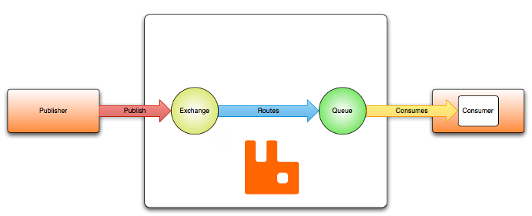
RabbitMQ: Exchanges, Queues & Routing
Publishers publish messages to Exchanges
Consumers consume messages from queues
Exchanges route messages to queues
Queues bind to exchanges with a routing key

Slide 25
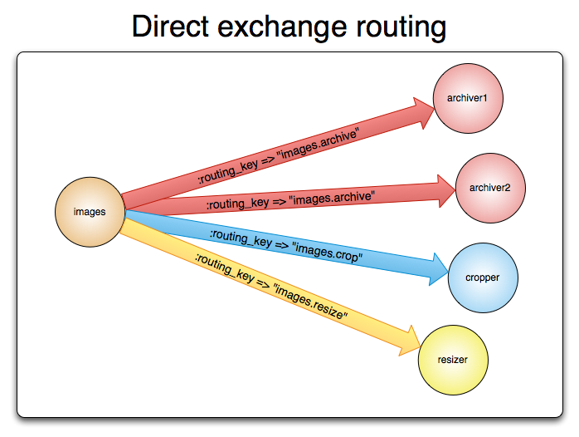

Slide 26
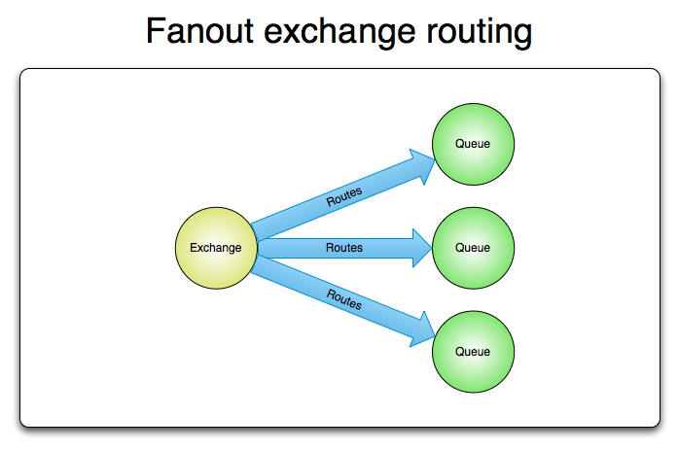

Slide 27
Publishing a message
var factory = new ConnectionFactory() { HostName = "localhost" };
using(var connection = factory.CreateConnection())
using(var channel = connection.CreateModel())
{
channel.ExchangeDeclare(exchange: "direct_logs",
type: "direct");
string severity = "info";
string message = "some message";
var body = Encoding.UTF8.GetBytes(message);
channel.BasicPublish(exchange: "direct_logs",
routingKey: severity,
basicProperties: null,
body: body);
}

Slide 28
Exchange : string
Exchange Type : string
Routing Key: string
Use empty string to define Default Exchange
Use empty string to define no routing key
Exchange == Routing Key

Slide 29
internal class Exchange
{
public string Name {get; private set;}
private static Exchange Create(string name)
{
return new Exchange(name);
}
private static Exchange Default()
{
return new Exchange(string.Empty);
}
private Exchange(string name)
{
Name = name;
}
}
public enum ExchangeType
{
Direct,
Topic,
Fanout
}

Slide 30
class RoutingKey
{
public string Value {get; private set;}
public static RoutingKey CreateForTopic(string value)
{
return new RoutingKey(value);
}
public static RoutingKey None()
{
return new RoutingKey(string.Empty);
}
private RoutingKey(string value)
{
Value = value;
}
}
void ExchangeDeclare(Exchange exchange, ExchangeType exchangeType);
void BasicPublich (Exchange exchange, RoutingKey routingKey, BasicProperties basicProperties, byte[] body);

Slide 31

Nulls are Evil

Slide 32

The Maybe Monad

Slide 33
The Maybe type is the simplest instance of a Monad. It represents a computation that might not produce a result.
type Option<'a> = // Generic definition
| Some of 'a // Valid value
| None
let validNumber = Some 10
let invalidNumber = None
match validNumber with
| Some x -> printfn "the valid value is %A" x
| None -> printfn "the value is None"

Slide 34
CallMeMaybe C# Library
public Maybe<string> HowLuckyIs(int number)
{
return number == 13 ? "So lucky." : null;
}
// ‘Is’ will tell you whether the value matches another value or criteria.
bool isLucky1 = HowLuckyIs(number).Is("So lucky.");
bool isLucky2 = HowLuckyIs(number).Is(s => s.Contains("lucky"));
// ‘Else’ will return the given value if the ‘Maybe’ has no value.
bool isLucky3 = HowLuckyIs(number).Else("").Contains("lucky");
// ‘Select’ will return a Maybe<>, running the lambda only if there's a value.
bool isLucky4 = HowLuckyIs(number).Select(n => n.Contains("lucky")).Else(false);
// ‘Single’ will throw an exception if there is no value.
bool isLucky5 = HowLuckyIs(number).Single().Contains("lucky");
// ‘HasValue’ will simply tell you whether there is a value in the ‘Maybe’
bool isLucky6 = HowLuckyIs(number).HasValue;

Slide 35
// ‘Do’ will only do something if the ‘Maybe’ has a value.
HowLuckyIs(number).Do(n => Console.WriteLine(n.Contains("lucky")));
var luckyNumbers =
from n in Enumerable.Range(1, 20)
from s in HowLuckyIs(n)
where s.Contains("lucky")
select new {number = n, howLucky = s};
var validInput = Maybe.From(input).ParseInt32().Where(i => i > 0);
https://bitbucket.org/j2jensen/callmemaybe

Slide 36
Resources
Real-World Functional Programming: With Examples in F# and C# 1st Edition by Tomas Petricek, Jon Skeet
Seven Concurrency Models in Seven Weeks: When Threads Unravel (The Pragmatic Programmers) by Paul Butcher
Mark Seemann's blog, http://blog.ploeh.dk/
Tomas Petricek's blog, http://tomasp.net/
F# for fun and profit, http://fsharpforfunandprofit.com/
Eric Lippert’s blog, Monads, http://ericlippert.com/2013/02/21/monads-part-one/
Type-Driven Development - Mark Seemann, https://vimeo.com/131631483
Transforming your C# code to functional style - Venkat Subramaniam , https://vimeo.com/97519532
Learning from Haskell - Venkat Subramaniam, https://vimeo.com/131409651
Functional programming design patterns - Scott Wlaschin, https://vimeo.com/113588389
Idioms for building distributed fault-tolerant applications w/ Elixir - José Valim, https://vimeo.com/131631884
The Power and Practicalities of Immutability - Venkat Subramaniam, https://vimeo.com/131635253

Slide 37
Thank you

