Slide 1

Introduction to Reactive Extensions
Vrasidas Oikonomakos

Slide 2
Reactive Programming
Reactive programming is a programming paradigm oriented around data flows and the propagation of change (https://en.wikipedia.org/wiki/Reactive_programming)
Reactive programming concentrates on the propagation of changes and their effects. The focus is on reacting to changes, such as data values or events. It can and often is done imperatively (callbacks, events)
Reactive programming is best applicable for cases like
Processing user events such as mouse movement and clicks, keyboard typing, GPS signals
Responding to and processing any and all latency-bound IO events from disk or network, given that IO operations are inherently asynchronous
Handling events or data pushed at an application by a producer it cannot control (system events from a server, the aforementioned user events, signals from hardware)

Slide 3
Reactive Programming using events
Declare
event Action<int> E;
Publish
E(42);
Subscribe
E += x => Console.WriteLine(x)

Slide 4
Reactive Extensions
Reactive Extensions is a library for composing asynchronous and event-based programs by using observable sequences.
It extends the observer deesign pattern to support sequences of data and/or events and adds operators that allow you to compose sequences together declaratively while abstracting away concerns about things like low-level threading, synchronization, thread-safety, concurrent data structures, and non-blocking I/O.

Slide 5
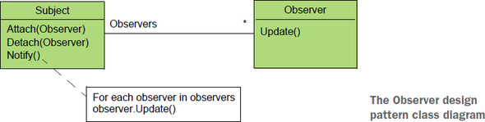
Observer design pattern
The Observer pattern was introduced by the Gang of Four (GoF) in Design Patterns: Elements of Reusable Object-Oriented Software The pattern defines two components: subject and observer (not to be confused with IObserver of Rx). The observer is the participant that’s interested in an event and subscribes itself to the subject that raises the events.

Slide 6
Reactive Programming using Rx
Declare
ISubject subject = new Subject<int>()
Publish
subject.OnNext(42);
Subscribe
subject.Subscribe(x => Console.WriteLine(x));

Slide 7
Pull vs Push model
Central to Rx is the Observable type that represents a stream of data or events.
Sequences are a list of things in a particular order that may or may not end
In C# on very common sequence is IEnumerable<T>
When using enumerables, we pull values out of the collection, usually with a loop.
Rx observables behave differently: instead of pulling, the values are pushed to the observer.
Push model and pull model data types
 | Single value | Multiple values
Pull/Synchronous/Interactive | T | IEnumerable<T>
Push/Asynchronous/Reactive | Task<T> | IObservable<T>

Slide 8
The duality principle
How IEnumerator and IObserver correspond to each other
How IEnumerable and IObservable correspond to each other
IEnumerator | IObserver
MoveNext — when false | OnCompleted
MoveNext — when exception | OnError(Exception exception)
Current | OnNext(T)
IEnumerable | IObservable
IEnumerator GetEnumerator() | IDisposable Subscribe(IObserver)

Slide 9
Observable: First-Class structure
It can be stored in variables and data structures
Can be passed as a parameter to a method
Can returned as a result of a method
Can be constructed at runtime
IObservable <string> textChanged = …;
void Process(IObservable<string> stream) {…}
IObservable<string> Query(){…}

Slide 10
Reactive Extensions
Rx is
A set of types representing asynchronous data streams
A set of operators to query asynchronous data streams
A set of types to parameterize concurrency
Rx = Observables + LINQ + Schedulers

Slide 11
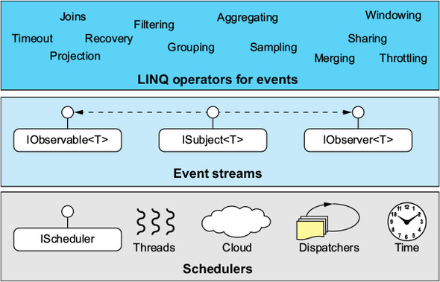
The Rx layers

Slide 12
Rx Interfaces
IObservable<T>
Subscribe(IObserver<T> observer)
IObserver<T>
- OnCompleted() : void
- OnError(Exception ex) : void
- OnNext(T value) : void
ISubject<T>
- IObserver<T>
- IObservable<T>

Slide 13
Observable creation
Create — create an Observable from scratch by calling observer methods programmatically
Defer — do not create the Observable until the observer subscribes, and create a fresh Observable for each observer
From — convert some other object or data structure into an Observable
Interval — create an Observable that emits a sequence of integers spaced by a particular time interval
Just — convert an object or a set of objects into an Observable that emits that or those objects
Range — create an Observable that emits a range of sequential integers
Repeat — create an Observable that emits a particular item or sequence of items repeatedly
Timer — create an Observable that emits a single item after a given delay

Slide 14
Reactive Extensions
Rx is
A set of types representing asynchronous data streams
A set of operators to query asynchronous data streams
A set of types to parameterize concurrency
Rx = Observables + LINQ + Schedulers

Slide 15
Rx Operators
Reactive Extensions also brings a rich set of operators.
Part of a domain-specific language (DSL) that describes event processing in a declarative way.
Create pipelines of querying, transformation, projections
Operators for transforming, filtering and combining observables

Slide 16
Transforming Observables
Select — transform the items emitted by an Observable by applying a function to each item
Buffer — periodically gather items from an Observable into bundles and emit these bundles rather than emitting the items one at a time
SelectMany — transform the items emitted by an Observable into Observables, then flatten the emissions from those into a single Observable
GroupBy — divide an Observable into a set of Observables that each emit a different group of items from the original Observable, organized by key
Scan — apply a function to each item emitted by an Observable, sequentially, and emit each successive value
Window — periodically subdivide items from an Observable into Observable windows and emit these windows rather than emitting the items one at a time

Slide 17
Filtering Observables
Throttle — only emit an item from an Observable if a particular timespan has passed without it emitting another item
Distinct — suppress duplicate items emitted by an Observable
— emit only item n emitted by an Observable
Where — emit only those items from an Observable that pass a predicate test
— emit only the last item emitted by an Observable
Sample — emit the most recent item emitted by an Observable within periodic time intervals
Skip — suppress the first n items emitted by an Observable
Take — emit only the first n items emitted by an Observable

Slide 18
Combining Observables
CombineLatest — when an item is emitted by either of two Observables, combine the latest item emitted by each Observable via a specified function and emit items based on the results of this function
Join — combine items emitted by two Observables whenever an item from one Observable is emitted during a time window defined according to an item emitted by the other Observable
Merge — combine multiple Observables into one by merging their emissions
StartWith — emit a specified sequence of items before beginning to emit the items from the source Observable
Switch — convert an Observable that emits Observables into a single Observable that emits the items emitted by the most-recently-emitted of those Observables
Zip — combine the emissions of multiple Observables together via a specified function and emit single items for each combination based on the results of this function

Slide 19
Reactive Extensions
Rx is
A set of types representing asynchronous data streams
A set of operators to query asynchronous data streams
A set of types to parameterize concurrency
Rx = Observables + LINQ + Schedulers

Slide 20
Schedulers
In Rx everything that introduces concurrency must do so by using a Scheduler type, which is the abstraction layer Rx uses for concurrency and time.
A scheduler is a unit that represents a clock and an execution context. The clock maintains the current time and allows for scheduling work at a specific time (such as a timer). The execution context determines where to process the work (for example, in the current thread or in the current SynchronizationContext object)
Scheduler Types
NewThreadScheduler
ThreadPoolScheduler
TaskPoolScheduler
CurrentThreadScheduler
ImmediateScheduler
EventLoopScheduler
Scheduling on the SynchronizationContext

Slide 21
Contract
Grammar: OnNext*[OnCompleted | OnError]
Serialized execution of observer’s methods

Slide 22
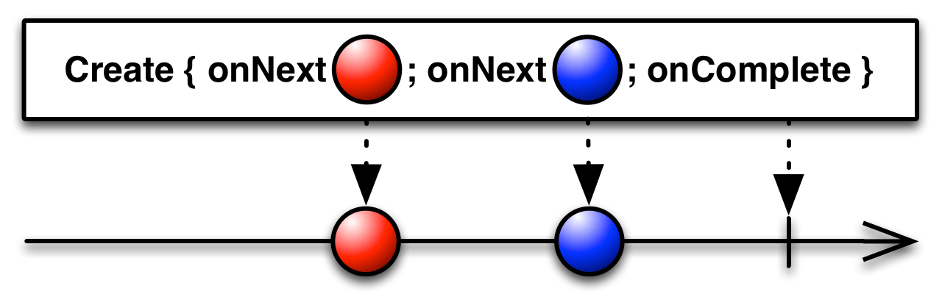
Marble diagrams
Marble diagrams use a horizontal axis to represent the observable sequence.

Slide 23
Web request enhanced with timeout and retry capabilities
public async Task<List<Movie>> GetMoviesInternal(string url)
{
var client = HttpClient();
HttpResponseMessage response = await HttpClient().GetAsync(url);
var content = await response.Content.ReadAsStringAsync();
return JsonConvert.DeserializeObject<List<Movie>>(content);
}
public async Task<List<Movie>> GetMovies(string url)
{
return await Observable.Defer(() => GetMoviesInternal(url).ToObservable)
.Timeout(TimeSpan.FromSeconds(5))
.Retry(3)
.Catch(Observable.Return(new List<Movie>()));
}

Slide 24
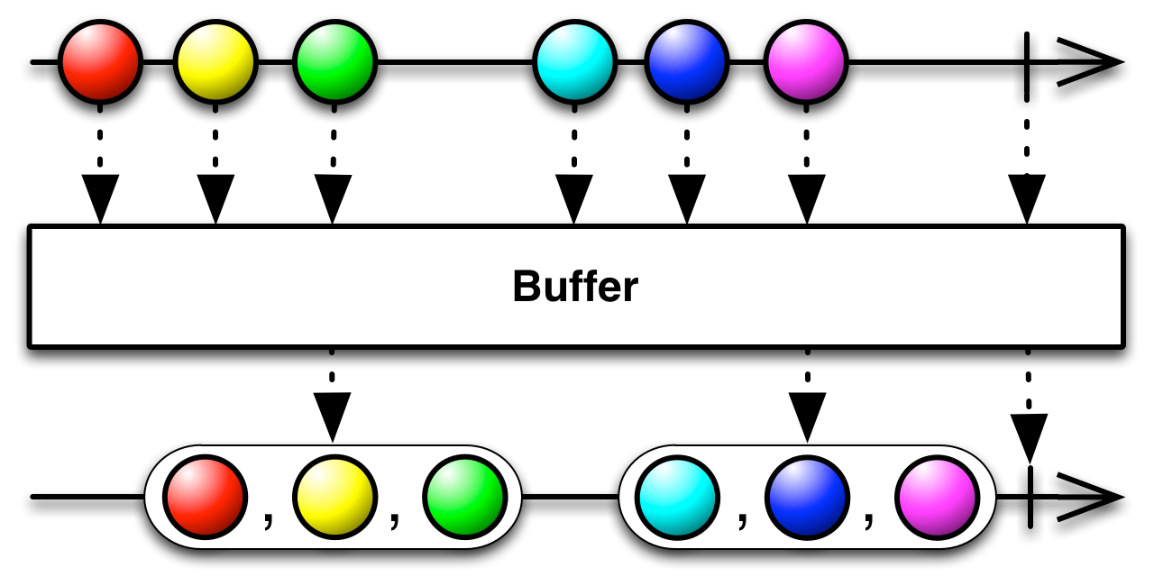

Slide 25
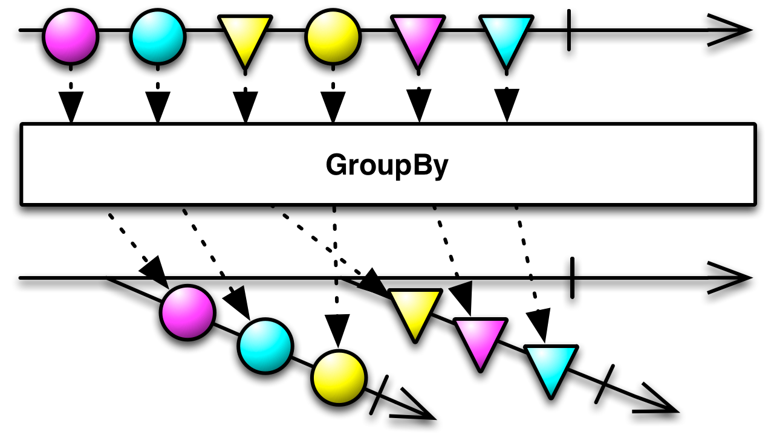

Slide 26
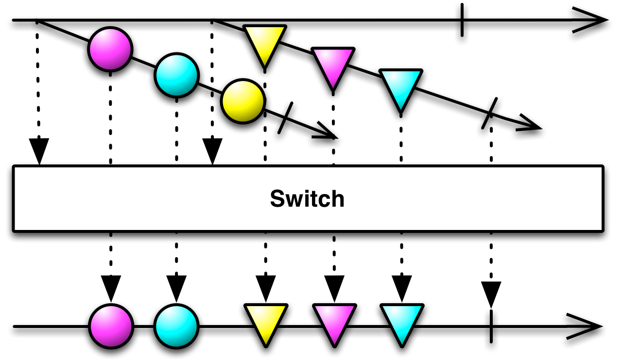

Slide 27
Resources
ReactiveX, http://reactivex.io/
Introduction to Rx, http://www.introtorx.com/
Rx.NET in Action: With examples in C# 1st Edition, by Tamir Dresher, Manning Publications
Reactive Programming with RxJava: Creating Asynchronous, Event-Based Applications by Tomasz Nurkiewicz , Ben Christensen, O'Reily Publications
RxJS in Action by Paul P. Daniels, Luis Atencio, Manning Publications
ReactiveUI, https://reactiveui.net/
Dynamic Data, https://dynamic-data.org/

Slide 28
Thank you

