Slide 1
Summer Intern
Final Project

Slide 2
Problem Statement
01.
Learnings
04.
Flow of the gateway
02.
Problems faced
03.

Slide 3
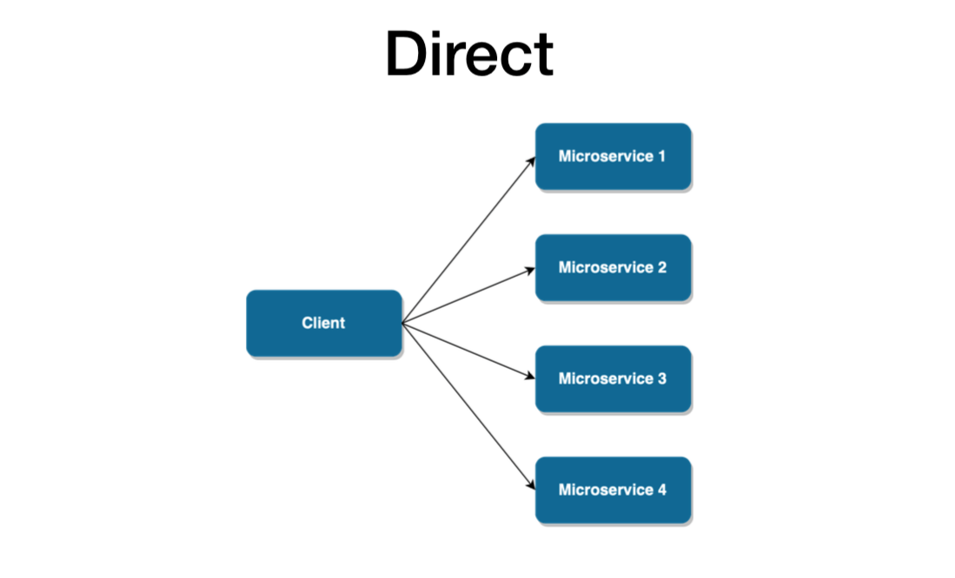
Problem Statement
Direct Client-microservice
architecture

Slide 4
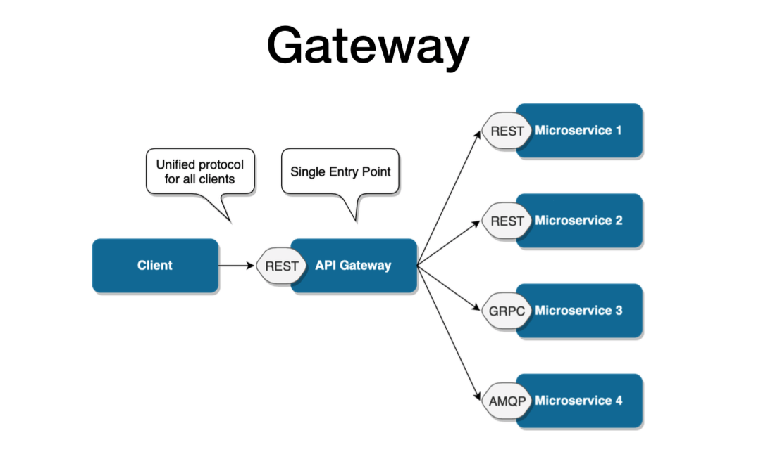
Problem Statement
Api-gateway pattern

Slide 5
Flow of Gateway
Designed for post and Get request
To add a new Microservice just insert it in the application.yaml file with required parameters
Deletion of the service can also be done without changing any code part

Slide 6
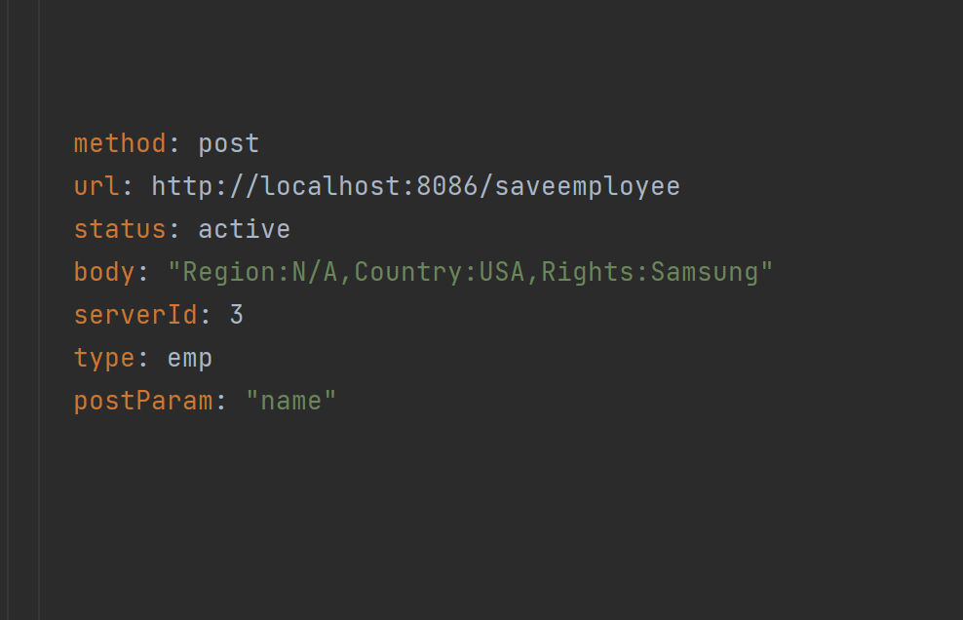
Flow of Gateway
Parameters required while adding a microservice

Slide 7
Flow of Gateway
Now calls every server one by one and store their response in a list and returns it
Get request
Comes to gateway
Scans all servers having the method get
And saves them in a list
Post request
Comes to gateway
Gets the server suitable to server that request
Makes the call to the selected server and returns the status

Slide 8
Problems faced
How to make the post request in the gateway generalized
How to store all the responses of the get request made to different servers
Configuring the Yaml file

Slide 9
Learnings
Microservices,Rest Api
Spring boot , yaml files
Gateways architecture

Slide 10
Thanks!

